Slide 1
Online Job Portal
In partial fulfillment of the requirement for the award of the degree
Of
Master of Computer Applications
By Gauri N. Raut.
(Roll No. 1405000198)

Slide 2
Introduction
Online Job Portal is developed for creating an interactive job vacancy for candidates.
This web application is to be conceived in its current form as a dynamic site-requiring constant updates both from the seekers as well as the companies.
On the whole the objective of the project is to enable jobseekers to place their resumes and companies to publish their vacancies.
It enables jobseekers to post their resume, search for jobs, view personal job listings.

Slide 3
Proposed System And Its Advantages
Users of the system:
The users of this system are administrator, clients, job provider and jobseekers.
Module Description:
The proposed system is developed by using four modules:
1. Job Seeker.
2. Job Provider.
3. Administrator.

Slide 4
Technical Feasibility
Hardware Requirements:
Software Requirements:
Content | Description
HDD | 10 GB Min
 | 40 GB Recommended
RAM | 512 GB Min
 | 1 GB Recommended
Content | Description
OS | Windows XP with SP2 or Windows Vista or higher
Database | MYSQL Server
Technologies | C#
IDE | Visual Studio

Slide 5
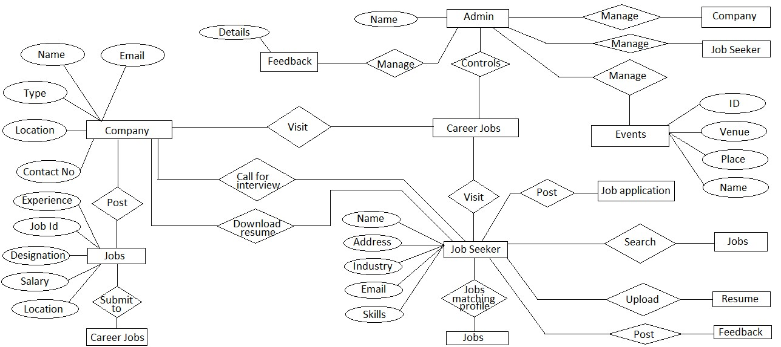
ER Diagram

Slide 6
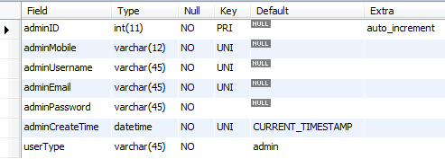
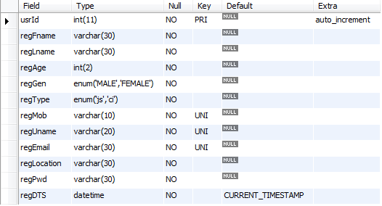
Table Structure
Admin :
Registration:

Slide 7
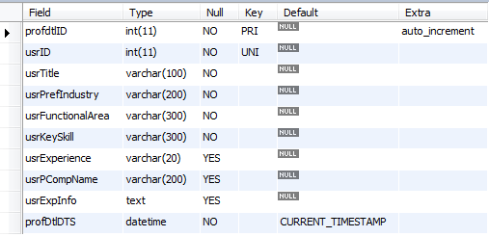
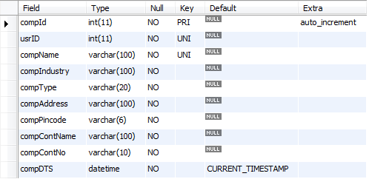
Table Structure
Job Seeker:
Companies:

Slide 8
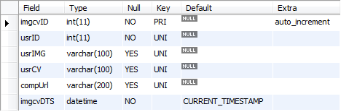
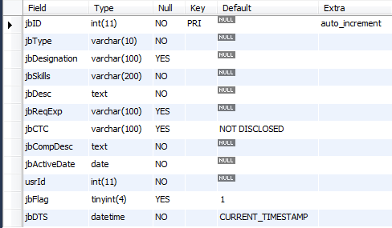
Table Structure
Profile:
Job Posting

Slide 9
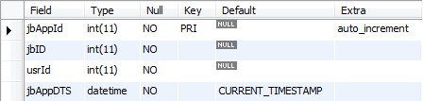
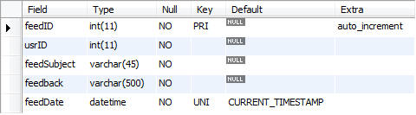
Table Structure
Job Application:
Feedback:

Slide 10
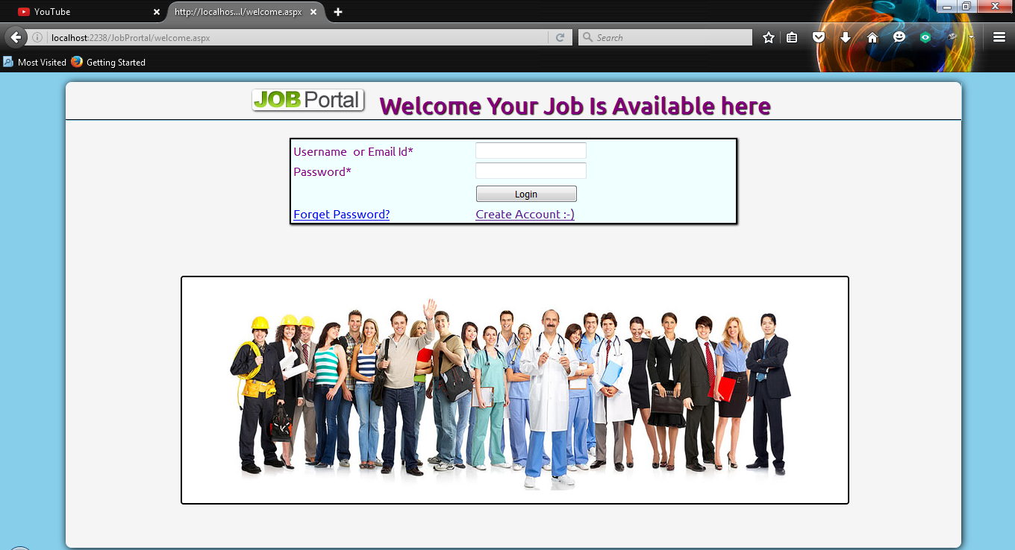
Screen Layout
Login Screen:

Slide 11
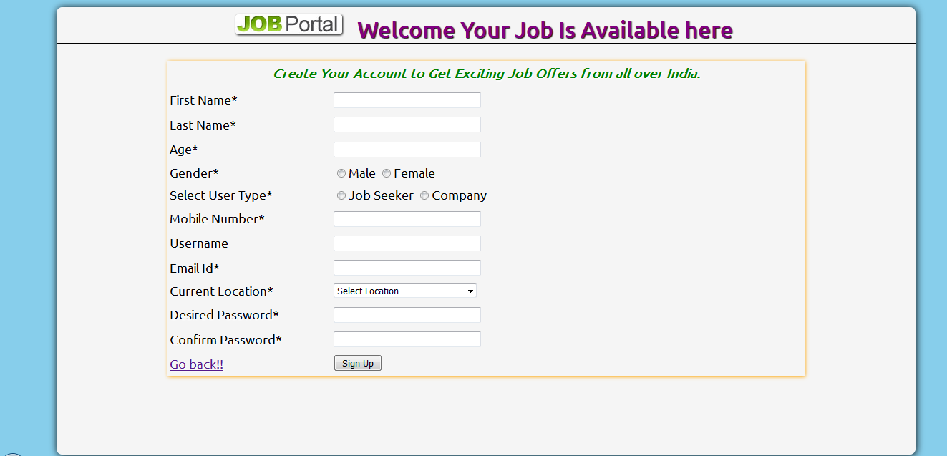
Screen Layout
User Details:

Slide 12
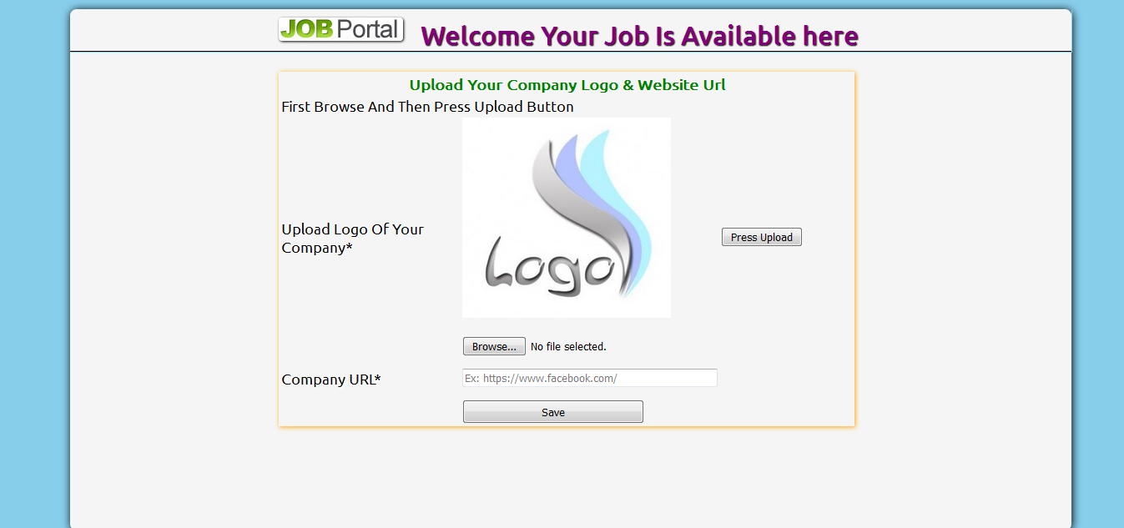
Screen Layout
Organization Details:

Slide 13
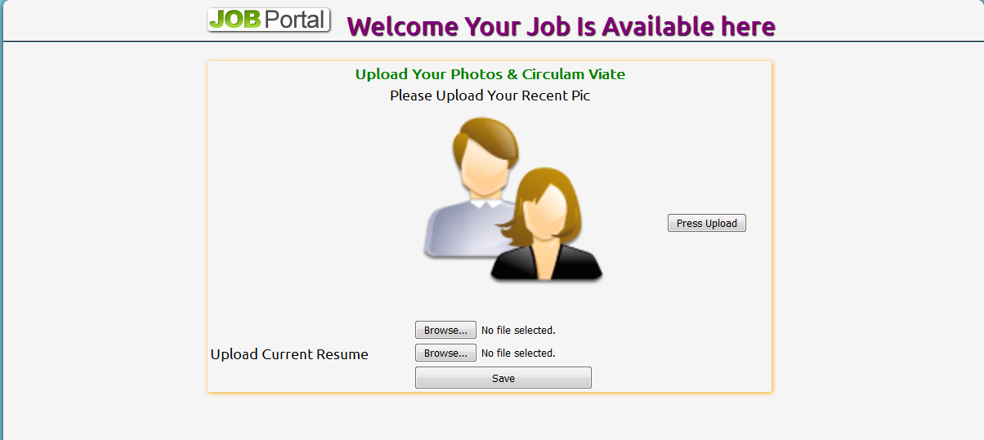
Screen Layout
Job Seeker Details:

Slide 14
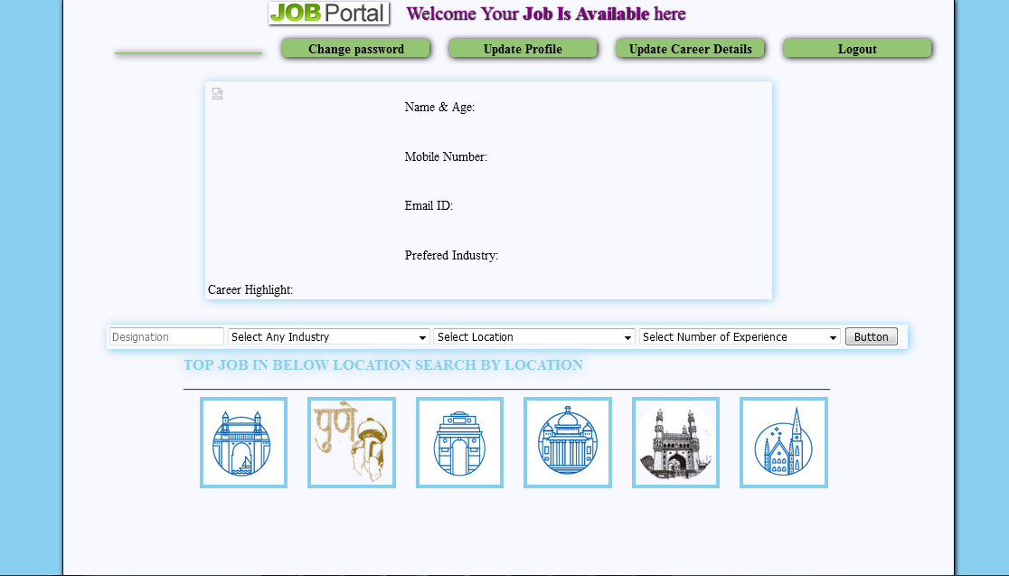
Screen Layout
User Home Page:

Slide 15
Limitations and Future Enhancements
To ensure portability and compatibility of system.
We will integrate our web-application with net banking.
We will include condition of candidate in our application through LinkedIn profile.
The system can be integrated along with QR code reader technology.
In future we will look forward for these changes. These enhancements will definitely help in developing an efficient system.

Slide 16
Conclusion

Slide 17
Bibliography
MySQL DBA by- John Sanson
ASP .NET with C# by Sangeela Sagar and Pallavi Tawde.
ASP .NET The Complete Reference 1st Edition- by Matthew Macdonald.
Object Modeling language by Martin Fowler.
MySQL open source 2008 by Paul Nielson
www. msdn.microsoft.com
www.w3schools.com
www.codeproject.com
www.aspdotnetfunda.com
www.asp.net.com
Introduction to Object-Oriented Analysis and Design and Unified Process by Craig Larman.

Slide 18
Thank You

