Slide 1
PCMH: Patient Centered Medical Home

Slide 2
Agenda
Introduction
Characteristics of the PCMH
Eligible Applicants
Quality Standards and Measures
Benefits of PCMH

Slide 3
Introduction
The patient-centered medical home (PCMH) is a model of care that aims to transform the delivery of comprehensive primary care
Through the medical home model, practices seek to improve the quality, effectiveness, and efficiency of the care they deliver while responding to each patient’s unique needs and preferences
NCQA Patient-Centered Medical Home (PCMH) Recognition is the most widely-used way to transform primary care practices into medical homes
The Patient Centered Medical Home (PCMH) program is for practices that provide first contact, continuous, comprehensive, whole person care for patients across the practice

Slide 4
Characteristics of the PCMH
Personal physician
Physician directed medical practice
Whole person orientation
Coordinated and integrated care
Enhanced access to care
Quality and safety

Slide 5
Eligible Applicants
Outpatient primary care practices.
Practice is defined as a clinician or clinicians practicing together at a single geographic location
Recognitions are conferred at geographic site level one Recognition per address, one address per survey
Physicians in training (residents) should not be listed.
Practice may add or remove clinicians during the
Recognition period

Slide 6
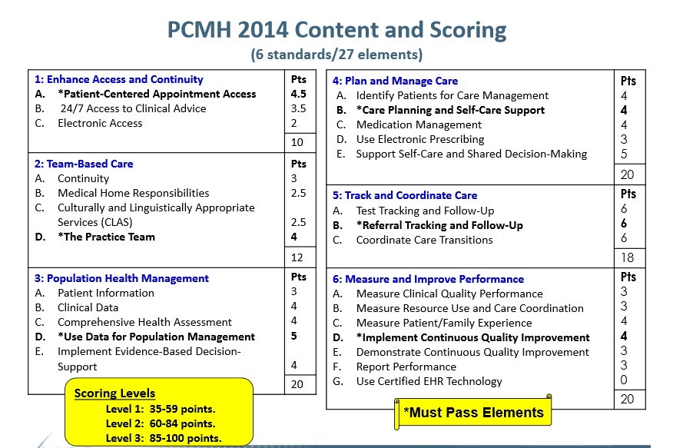
Quality Standards (1/2)

Slide 7
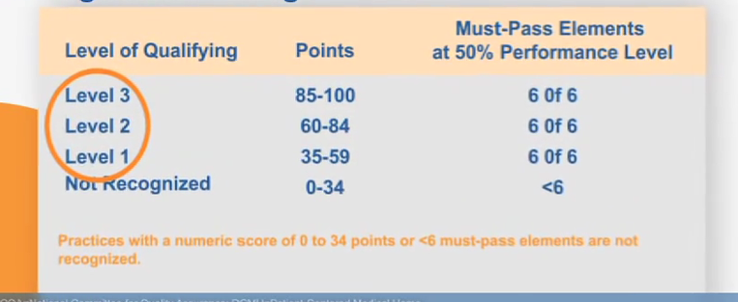
Quality Standards (1/2)

Slide 8
Scoring and Documentation Example(1/5)
The practice provides access to team-based care for both routine and urgent needs of patients /families /care-givers at all times
10 Points Elements :
PCMH 1A: Patient-Centered Appointment Access --MUST PASS (4.5 points)
PCMH 1B: 24/7 Access to Clinical Advice (3.5 points)
PCMH 1C: Electronic Access (2 points)

Slide 9
Scoring and Documentation Example(2/5)
The practice has a written process and defined standards for providing access to appointments, and regularly assesses its performance on below factors:
F1.Providing routine and urgent same-day appointments – CRITICAL FACTOR
F2.Providing routine and urgent-care appointments outside regular business hours
F3.Providing alternative types of clinical encounters
F4.Availability of appointments
F5.Monitoring no-show rates
F6.Acting on identified opportunities to improve access

Slide 10
PCMH 1: Patient-Centered Access(3/5)
Scoring:-
5-6 factors (including Factor 1)= 100%
3-4 factors (including Factor 1) = 75%
2 factors (including Factor 1) = 50%
1 factor (including Factor 1) = 25%
0 factors = 0%
Must meet 2 factors (including factor 1) to pass this Must-Pass Element

Slide 11
Scoring and Documentation Example(4/5)
Documentation :-
F1: Report(s) with at least 5 days of data showing availability/use of same-day appointments for both routine and urgent care
F2:Materials communicating extended hours or report showing after-hours availability, process to arrange after-hours access not required if practice has regular extended hours.
F3:Report with frequency of scheduled alternative encounter types in recent 30-calendar-day period.
F4:Report showing appointment wait times compared to practice defined standards including policy for how practice monitors appointment availability with at least 5 days of data.

Slide 12
Scoring and Documentation Example(4/5)
F5:Report showing rate of no shows from a recent-30-calendar day period. (Patients seen/Scheduled visits).
F6:Documented process indicating the method a practices uses to select, analyze and update its approach to creating greater access to appointments and a report showing practice has evaluated access data and implemented QI Plan to create greater access.
https://www.ncqa.org/Portals/0/Programs/Recognition/RPtraining/PCMH%202014%20Training%20Slides%20Standards%201-3.pdf
https://www.ncqa.org/Portals/0/Programs/Recognition/RPtraining/PCMH%202014%20Intro.%20Training%20Slides%20Part%202%20-%20Standards%204-6%20-%2011.26.pdf

Slide 13
Benefits of PCMH (1/2)
Benefit to Patients
Engaged, happier, and more satisfied patients
Better coordinated, more comprehensive and personalized care
Improved access to medical care and services
Improved health outcomes, especially for patients who have chronic conditions
Benefits to Providers
Increased physician and staff member satisfaction
Physicians and staff members who practice at the top of their licenses
Improved safety and quality of care

Slide 14
Benefits of PCMH (2/2)
Benefits to Payers
A solid return on investment (ROI) can be realized by creating a total cost picture that is a function of an employee’s inpatient and outpatient treatments, pharmacy, disability, absenteeism, and workers’ compensation.
Allows physicians to share in savings from reduced hospitalizations
Allows for additional payments for achieving measurable and continuous quality improvements
Countries with a greater proportion of physicians practicing primary care medicine tend to have lower per-capita health expenditures than those with a greater proportion of specialists

Slide 15
Thank You

