Slide 1
Blood Cell Detection with YOLO26n
Real-time detection and counting of RBCs, WBCs and Platelets from microscopic blood-smear images
Problem
Manual inspection is slow and cell-dense images are difficult to count consistently.
Goal: localize, classify and count each visible cell—not just classify the whole image.
Training Dataset
BCCD public object-detection dataset hosted by Roboflow.
364 raw images • 4,888 labels • 3 classes: RBC, WBC, Platelets.
Bounding-box annotations support supervised object detection.
Why YOLO26n?
Object detection returns a bounding box, class and confidence for every cell.
YOLO26n is lightweight, supports 640px detection, and is designed for efficient real-time inference.
Design Goal
Build a model that is quantitatively accurate AND visually verifiable in an interactive Streamlit app.
Evaluation: mAP on unseen test images + visual confirmation of detected cells.
Sources: Roboflow BCCD public dataset; Ultralytics YOLO26 documentation

Slide 2
Iteration & Learning: The Dataset Was Part of the Model
Error analysis changed the project from “train longer” to “improve the supervision signal.”
1
2
3
4
5
6
Baseline training
Evaluate unseen test
Inspect failures
Audit & correct annotations
Fine-tune on corrected subset
Retrain on full dataset
Baseline mAP@50
81.81%
Baseline Precision
71.74%
RBC mAP@50
83.40%
Platelet mAP@50
65.10%
What the audit exposed
Duplicate/noisy annotations were found during dataset auditing.
Visual review also revealed missing/inconsistent bounding boxes, including small cells such as platelets.
Key learning
High aggregate accuracy can hide label-quality problems.
A carefully corrected subset was used to fine-tune the detector before returning to full-dataset training.

Slide 3
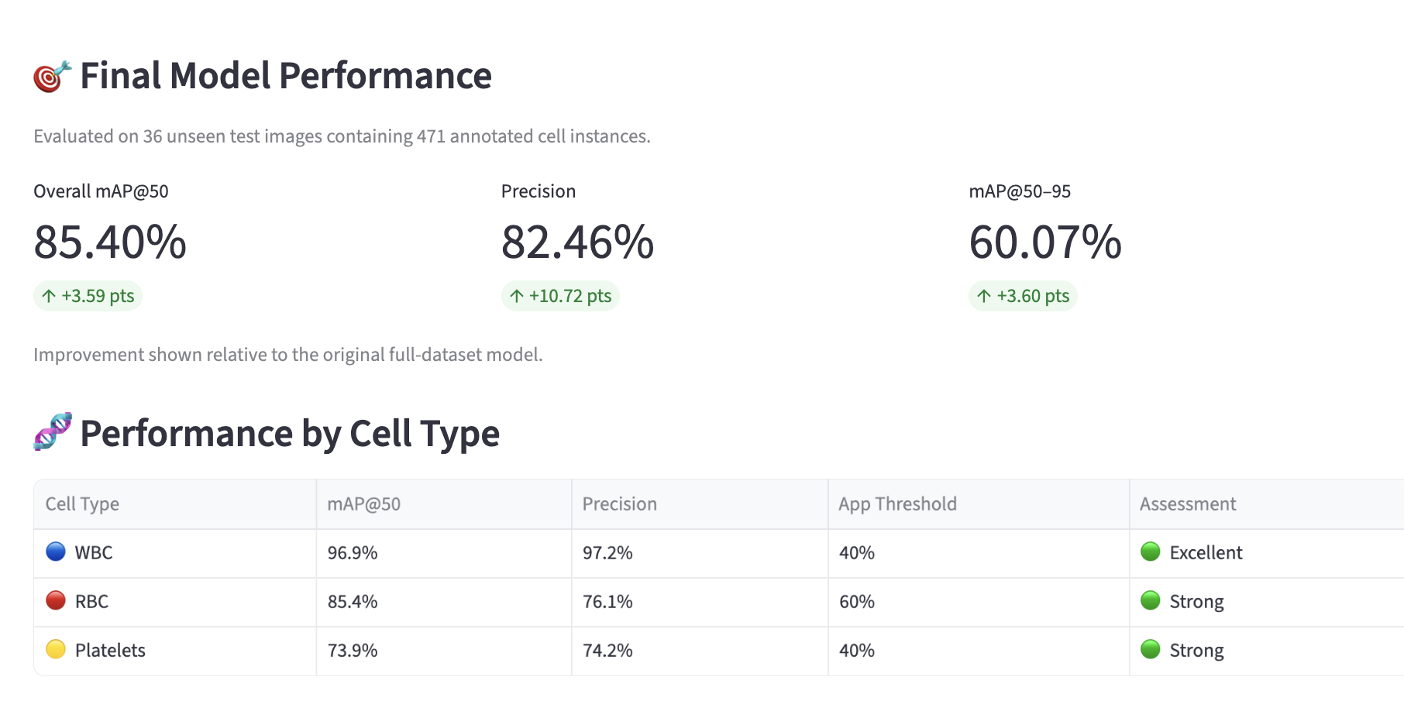
Retraining Strategy → Measurable Improvement
Final evaluation used the same 36 unseen test images containing 471 annotated cell instances.
Overall mAP@50
85.40%
+3.59 pts
Precision
82.46%
+10.72 pts
mAP@50–95
60.07%
+3.60 pts
WBC mAP@50
96.90%
Maintained
Metric | Original | Final | Change
Overall mAP@50 | 81.81% | 85.40% | +3.59
Overall Precision | 71.74% | 82.46% | +10.72
RBC mAP@50 | 83.40% | 85.40% | +2.00
RBC Precision | 61.00% | 76.10% | +15.10
Platelet mAP@50 | 65.10% | 73.90% | +8.80
Platelet Precision | 59.20% | 74.20% | +15.00
WBC Precision | 95.00% | 97.20% | +2.20
Result: better precision and mAP, with strongest gains in RBC/Platelet precision.

Slide 4
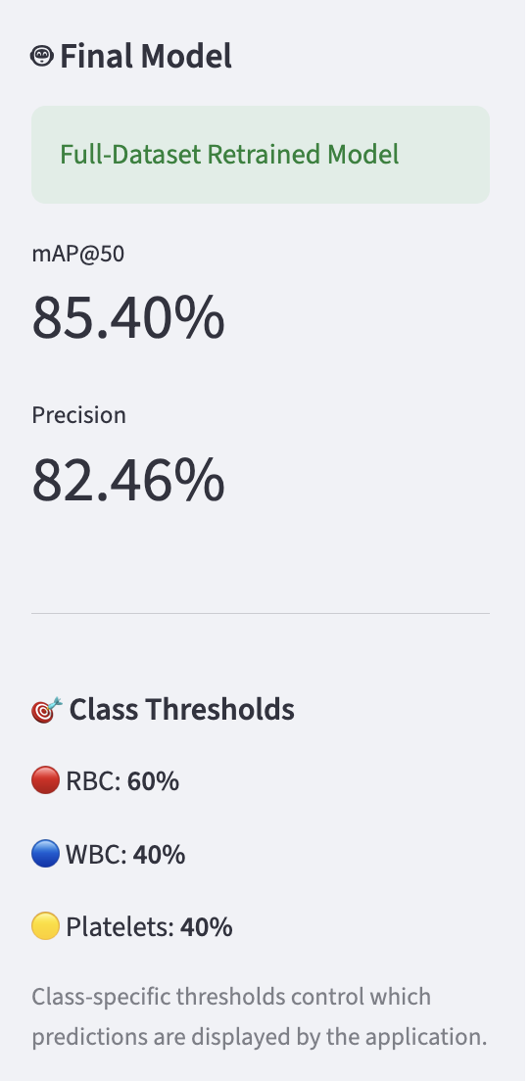
Deployment Calibration: Different Classes Need Different Operating Thresholds
A confidence threshold is an application decision rule; it does not change the trained model or its mAP.
Why a single threshold struggled
RBCs dominate the images, while WBCs and Platelets are much less represented.
At a high global threshold, valid lower-confidence WBC/Platelet predictions could be hidden.
RBC threshold
60%
WBC threshold
40%
Platelet threshold
40%
Important distinction
mAP@50 = 85.4% measures final detector performance on the unseen test set.
60/40/40 are deployment thresholds controlling which predictions the Streamlit app displays.
Final application approach
Request candidate detections, then apply a class-specific acceptance threshold.
This lets the app be conservative for abundant RBCs while preserving sensitivity to rarer cell types.
Engineering takeaway
Confidence calibration turns a strong detector into a more dependable application by matching the decision rule to each class’s prediction behavior.

Slide 5
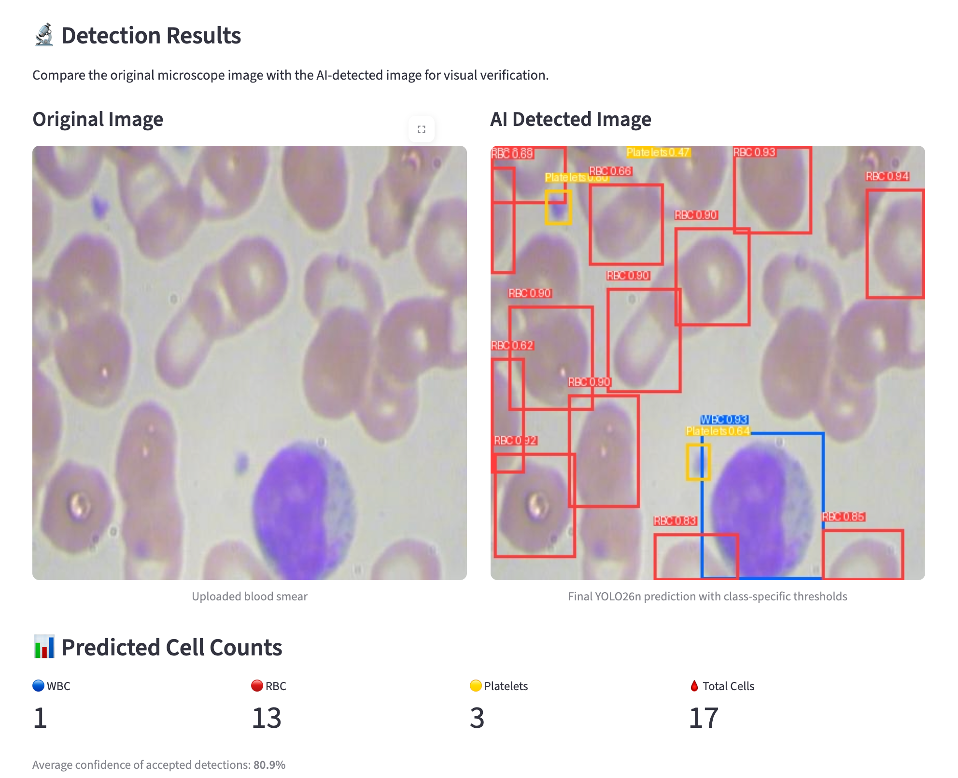
Final System: Quantitative Accuracy + Visual Verification
The final app makes every prediction inspectable: box, class, confidence and count.
Final mAP@50
85.40%
+3.59 pts
Final Precision
82.46%
+10.72 pts
Representative visual check
1 WBC • 13 RBCs • 3 Platelets
17 total detected cells
80.9% average confidence of accepted detections
Final learning: reliable ML came from the full loop—model choice → data audit → annotation correction → retraining → unbiased evaluation → deployment calibration.

