Slide 1
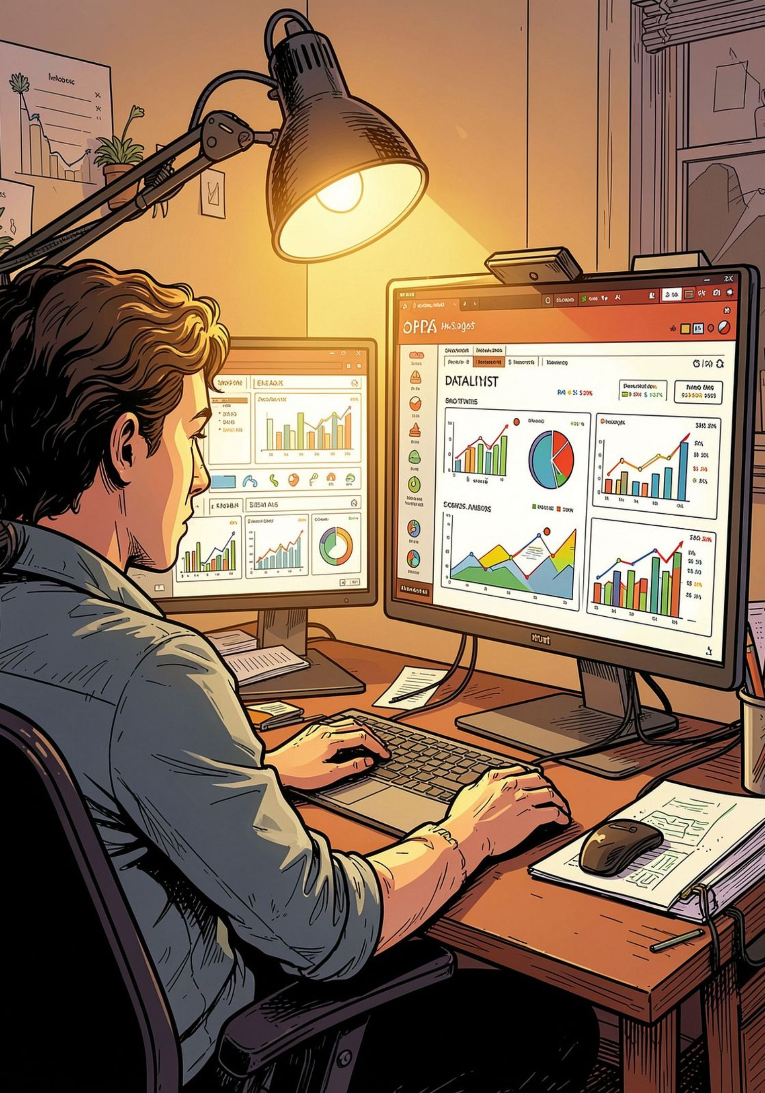
Customer Shopping Behavior Analysis
End-to-end analytics project: data preparation → MySQL → SQL analysis → Power BI → DAX → interactive dashboard → business insights.

Slide 2
Project Objectives
Understand Purchasing
Product Performance
Loyalty & Subscriptions
Overall customer purchasing behavior across segments.
Identify high-performing products and categories.
Examine repeat purchases and subscription behavior.
Discounts & Preferences
Deliverable
Evaluate discount usage, shipping, and payment patterns.
Interactive Power BI dashboard with actionable recommendations.

Slide 3
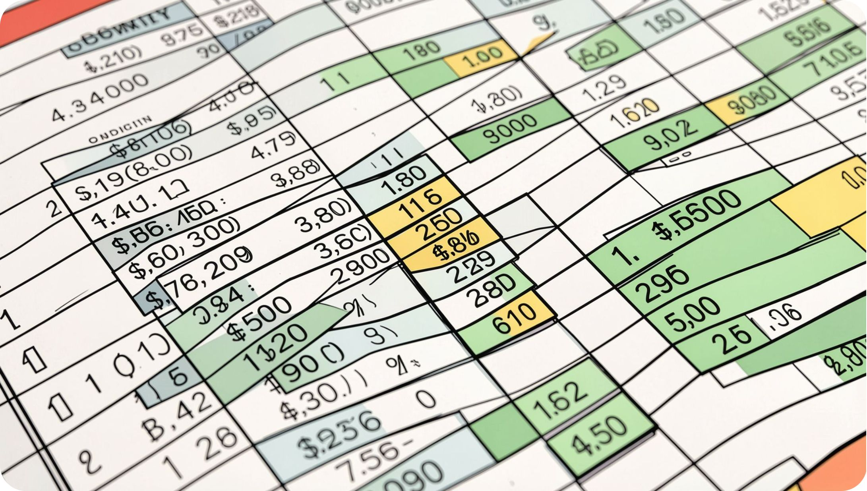
Dataset Overview
Key facts
3,900 purchase records • 18 columns covering customer info, purchase details, and behavior. Initially 37 missing values in Review Rating.
Customer: id, age, gender, location, subscription
Purchase: item, category, amount, season, size, color
Behavior: discount, promo, prev purchases, frequency, rating, shipping, payment

Slide 4


Data Preparation (Python)
Feature Engineering
Consistency Check
Exploration and cleaning using pandas: head(), info(), describe(), isnull().sum().
Missing ratings filled by median review rating within each product category to preserve category patterns.
Columns standardized to lowercase snake_case for compatibility with SQL and Power BI.
Added Age Group (quartiles) and Purchase Frequency Days (e.g., Weekly→7, Monthly→30).
promo_code_used found redundant with discount_applied and removed from cleaned dataset.

Slide 5
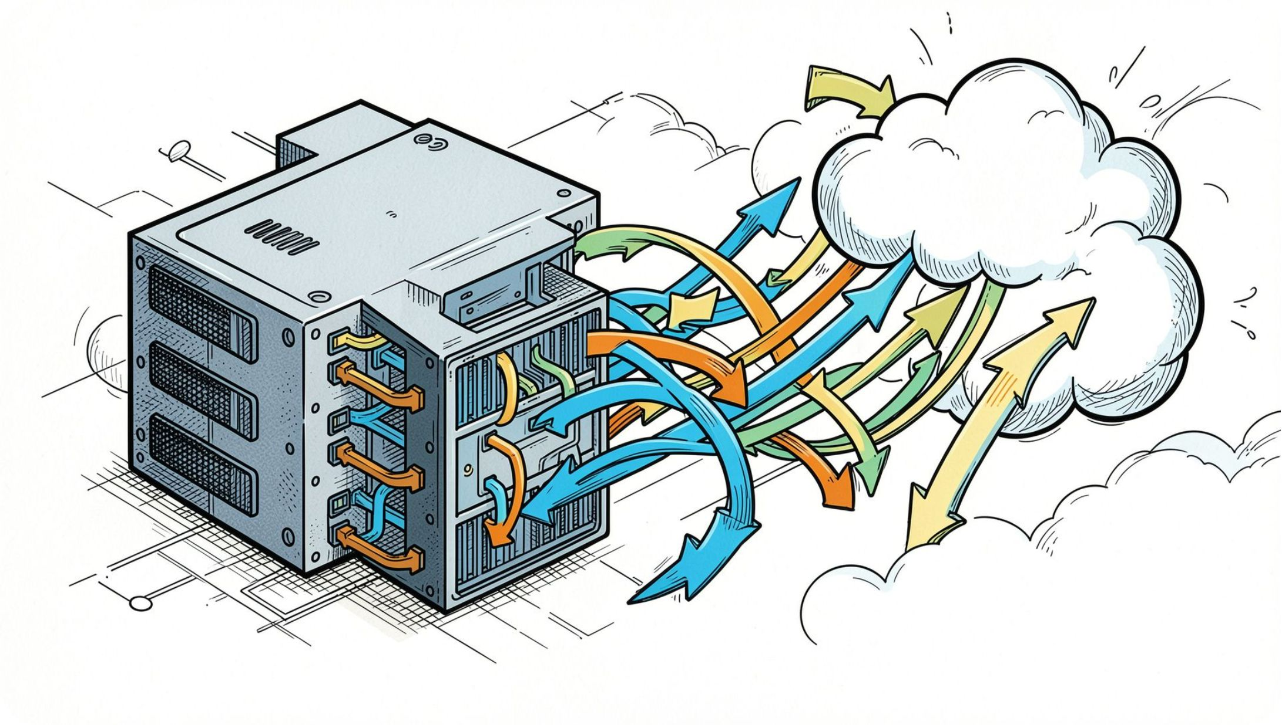
Database Integration
Cleaned DataFrame loaded into MySQL schema customerBehaviour into table customer.
Python connectors: PyMySQL, SQLAlchemy
Creates a reliable database layer for SQL analysis
Workflow: CSV → Python/pandas → Cleaning & features → MySQL (customerBehaviour.customer)

Slide 6





SQL Analysis Highlights
High-Spending with Discounts
Top Products by Rating
Shipping & Revenue
Subscriber Analysis
Average purchase amount: Standard vs Express shipping.
By subscription: count, avg purchase amount, total revenue.
Customers using discounts whose purchase >= overall average.
Average rating per item; top 5 products.
Segments & Rankings
Customer segments and top-3 products per category via ROW_NUMBER().

Slide 7
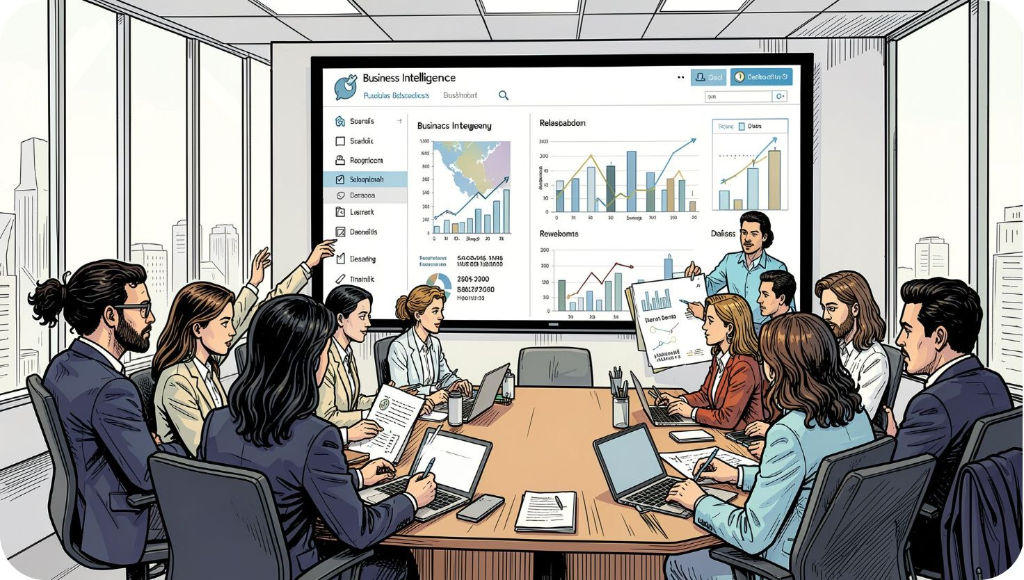
Power BI & DAX
Integration
Imported MySQL table into Power BI to build a four-page interactive report.
Core DAX Measures
No. of customers = COUNT('customerBehaviour customer'[customer_id])
Avg purchase amount = AVERAGE('customerBehaviour customer'[purchase_amount])
Avg review rating = AVERAGE('customerBehaviour customer'[review_rating])
Additional measures support revenue, discounts, subscriptions, and frequency KPIs.

Slide 8
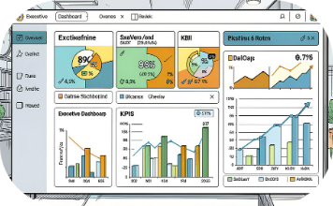

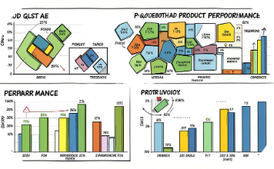
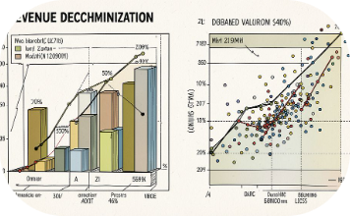
Dashboard Pages & Visuals
Page 1: Executive Overview
Page 2: Customer & Loyalty
Page 3: Product & Category
Page 4: Purchase Behavior & Revenue
Number of customers, total revenue, avg purchase, avg rating, subscription rate; high-level comparisons by demographics.
Segments, subscription behavior, demographics, new vs returning vs loyal analysis.
Top products (Top5/Top10 toggle), treemap for category revenue, discount rate and rating comparisons.
Scatter of prev purchases vs amount, decomposition tree, revenue by payment method, frequency KPIs.

Slide 9
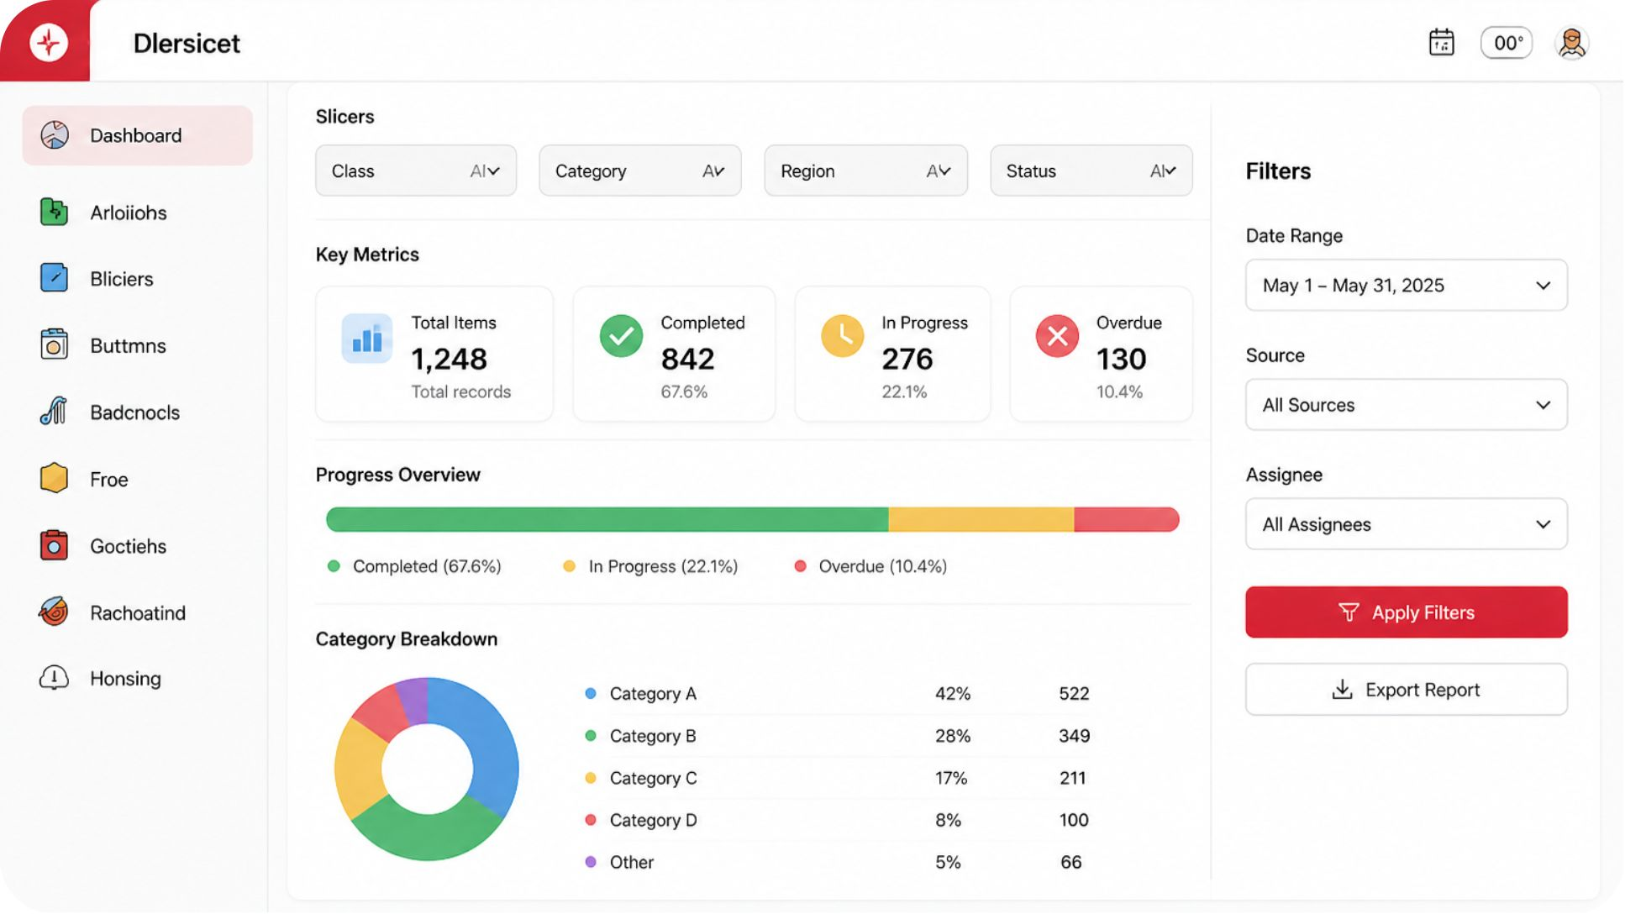

Interactivity & UX
Interactive Features
Slicers for Age Group, Gender, Category, Subscription
Page navigation buttons for seamless flow
Bookmark-based Top 5 / Top 10 toggle implemented with overlapping visuals
Decomposition Tree for ad-hoc revenue exploration
Design emphasizes clean interaction and focused visuals to answer business questions quickly.

Slide 10
Key Takeaways & Recommendations
Strengthen Loyalty
Optimize Subscriptions
Conclusion
Target returning customers with loyalty initiatives to convert them into long-term loyal customers.
Analyze subscriber vs non-subscriber spend to improve adoption strategies.
This project demonstrates an end-to-end analytics workflow and delivers a four-page Power BI dashboard that empowers business users to explore customer behavior, product performance, revenue drivers, and discount/subscription dynamics using Python, SQL, MySQL, Power BI, and DAX.
Review Discount Strategy
Promote Top Products
Investigate high-discount products to ensure discounts drive meaningful revenue.
Feature high-revenue, highly rated items in campaigns to maximize ROI.
Target High-Value Groups
Use demographic and purchase patterns to focus marketing on revenue-driving segments.

