Slide 1
CREDITZ (Prototype v2)
An Intelligent Co-Curricular Activity Credit Management & Verification System
Automating AICTE 200 Activity Points Lifecycle with Multimodal AI Vision & Deterministic Rules
PROJECT TEAM (Department of Computer Science & Engineering)
• Sharan P Shetty (NNM23CS176)
• Sampath Kumar (NNM23CS167)
• Ronak Shetty (NNM23CS157)
• Gaurish Bangera (NNM23CS078)
NMAM Institute of Technology, Nitte (Deemed to be University) • Academic Year 2025-2026

Slide 2
CREDITZ PROTOTYPE V2
The Challenge: Manual Verification vs. Creditz Automation
THE PROBLEM (Current Legacy Process)
• Manual Verification Overhead: Faculty mentors spend weeks manually checking paper certificates and spreadsheets.
• Certificate Fraud & Tampering: Zero automated validation for forged certificates, fake issuers, or borrowed credentials.
• Final-Year Credit Dumping: Students submit all 200 points in semester 7/8, defeating the goal of continuous development.
• No Institutional Visibility: HODs have no real-time metrics on degree clearance risks until final graduation audits.
• Evaluation Latency: Students wait months to know if their activity claims were accepted or rejected.
THE CREDITZ SOLUTION
✓ Automated Multimodal OCR: Google Gemini 1.5 Flash Vision automatically extracts certificate details in seconds.
✓ AI Discrepancy & Fraud Check: Real-time validation flags name mismatches, altered dates, and suspicious templates.
✓ Strict 30 Pts/Semester Ceilings: Computational enforcement ensures continuous participation across all 8 semesters.
✓ Executive Governance Console: Live HOD analytics monitor clearance rates, domain caps, and faculty workloads.
✓ 1-Click Verification Workflows: Mentors review side-by-side certificate proofs and AI audit badges instantly.

Slide 3
CREDITZ PROTOTYPE V2
Project Objectives & Scope
1. Multi-Role Institutional Architecture
Implement strict Role-Based Access Control (RBAC) connecting Students, Faculty Mentors, and HODs in a unified single-page platform.
2. Automated Certificate Fraud Detection
Integrate Google Gemini 1.5 Flash Vision to inspect student certificate proofs (PDF, PNG, JPG), extracting metadata and computing authenticity confidence scores.
3. Deterministic Credit Ceiling Enforcement
Compute raw vs. effective points using an arithmetic rules engine enforcing a 30-point semester ceiling and university category domain caps.
4. Transparent Side-by-Side Evaluation Queue
Provide faculty mentors with an interactive inspection console showing original certificate proofs alongside automated AI discrepancy flags.
5. Institutional Governance & Compliance Reporting
Deliver aggregate department-wide clearance metrics, student-mentor allocations, and one-click accreditation CSV audit rosters.

Slide 4
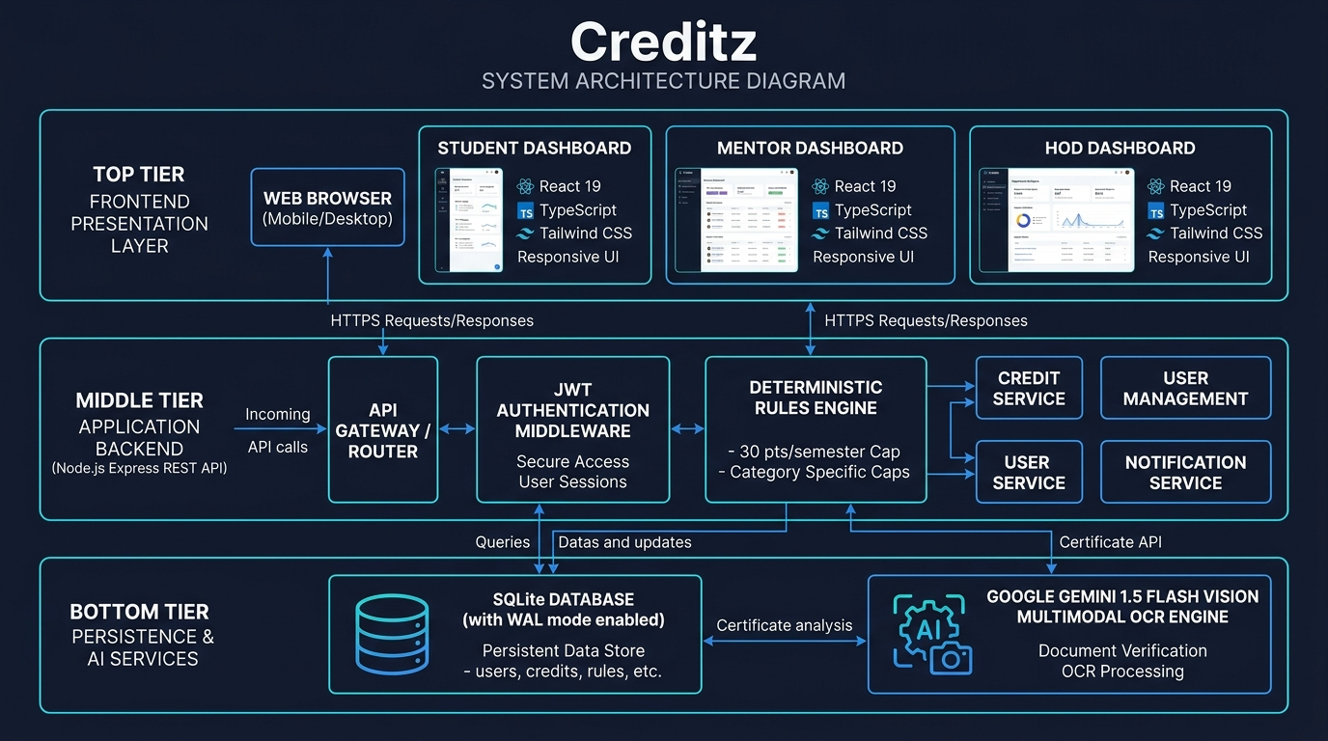
CREDITZ PROTOTYPE V2
System Architecture: 3-Tier Layered Design
ARCHITECTURE HIGHLIGHTS
• Presentation Layer: React 19 SPA with TypeScript, Tailwind CSS v4, and Lucide icons.
• Application Backend: Node.js Express REST API server coordinating authentication, file storage, and points rules.
• Deterministic Engine: Independent mathematical module enforcing 30 pts/sem and category limits.
• AI Vision Engine: Google Gemini 1.5 Flash Vision Multimodal OCR with offline smart heuristic fallback.
• Persistence: SQLite database running in high-performance Write-Ahead Logging (WAL) mode.

Slide 5
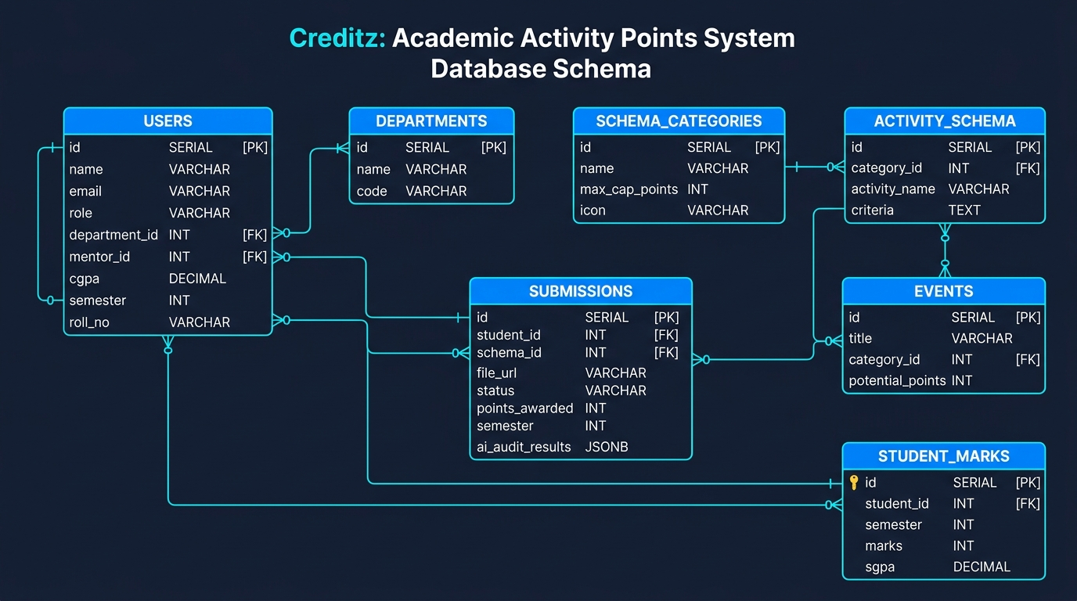
CREDITZ PROTOTYPE V2
Database Schema & Entity-Relationship (ER) Model
KEY RELATIONAL ENTITIES
• Users: Central entity managing Student, Mentor, and HOD roles with department foreign keys.
• Submissions: Holds student proof uploads, claimed points, status (pending/approved/rejected), and AI audit JSON.
• Activity_Schema: Institutional catalog of activities, base points, criteria, and version tracking.
• Schema_Categories: Governs domain credit caps (max 50 pts online, max 60 pts hackathons).
• Student_Marks: Semester-wise CIE exam marks, lab scores, and SGPA calculations.

Slide 6
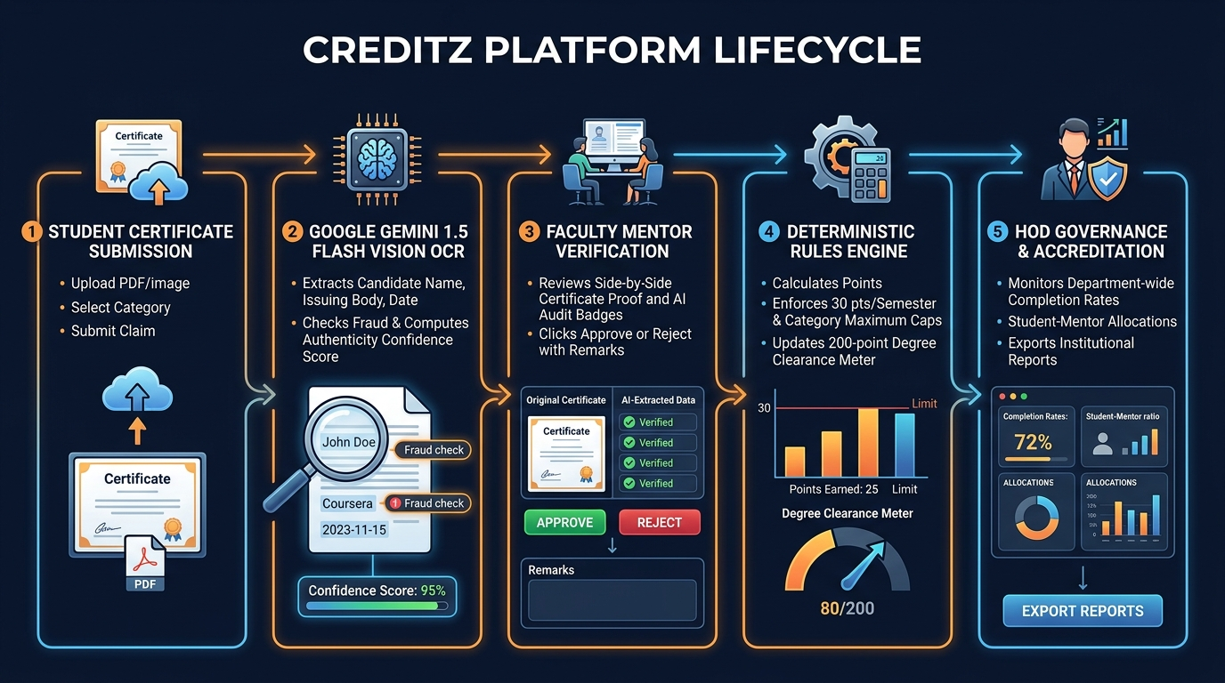
CREDITZ PROTOTYPE V2
End-to-End Operational Lifecycle & Verification Flow

Slide 7
CREDITZ PROTOTYPE V2
Deterministic Rules Engine & Verification Mechanics
Semester Credit Ceiling
Enforces a max 30 points per semester cap. Even if a student earns 60 points in semester 4, exactly 30 effective points count toward degree clearance, while the excess is recorded as capped.
Category Domain Caps
Guarantees a well-rounded student portfolio by capping specific categories (e.g. Max 50 pts in Online Certifications, Max 60 pts in Hackathons). Eliminates single-category credit farming.
AI Multi-Modal OCR
Google Gemini 1.5 Flash Vision reads binary document buffers (PDF, PNG, JPG), extracting student name, course title, issuing organization, and completion date automatically.
Discrepancy Detection
Compares Gemini's extracted text against the student's database profile. Flags mismatches in recipient names, out-of-bounds dates, and computes an Authenticity Score (0-100%).
Deterministic Fallback
If internet is offline or API keys are unavailable, Creditz automatically falls back to an internal smart vision heuristic, guaranteeing 100% platform availability during evaluations.

Slide 8
CREDITZ PROTOTYPE V2
Academic Literature Survey Summary (Clean Baseline)
Mishra et al. (2026, IEEE) — AI-Enhanced Blockchain-Based Certificate Verification
Hybrid CNN-BiLSTM for visual and semantic certificate forgery detection with 98.3% accuracy.
Nguyen et al. (2025, IEEE) — Knowledge Graph Framework for Course Recommendations
Semantic representation of prerequisites, degree pathways, and institutional constraint enforcement.
Chen et al. (2018, IEEE) — DRLGENCERT: Automated Testing of Certificate Verification
Reinforcement learning for certificate feature extraction and discrepancy detection.
Zhang et al. (2024, IEEE) — Temporal Point Process Model for Course Recommendations
Captures learning motivation factors and temporal cycles across academic progression.
Edge et al. (2024, Microsoft) — From Local to Global: Graph RAG Summarization
Foundational study demonstrating how graph-grounded evidence eliminates LLM hallucinations.

Slide 9
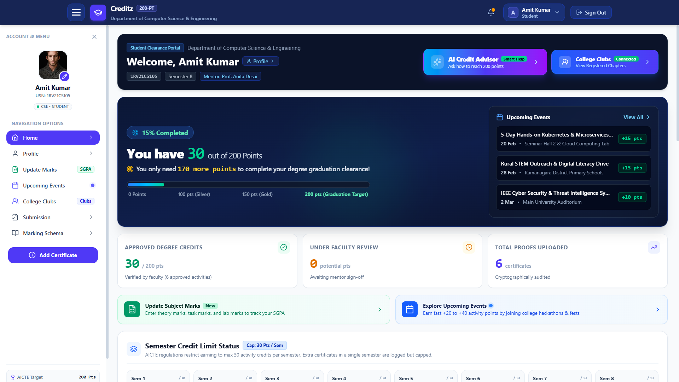
CREDITZ PROTOTYPE V2
Role 1: Student Dashboard & Clearance Progress
STUDENT CAPABILITIES
• 200-Point Clearance Meter: Live visualization of completed vs remaining points required to graduate.
• Semester Credit Status: 8-semester interactive grid checking adherence to the 30 pts/sem ceiling.
• Easy Certificate Submission: Drag-and-drop modal with live delivery status tracking.
• Campus Clubs: Browse and register for college technical and cultural chapters (IEEE, NSS, etc.).
• Academic SGPA: Track CIE exam marks and semester SGPA alongside activity points.

Slide 10
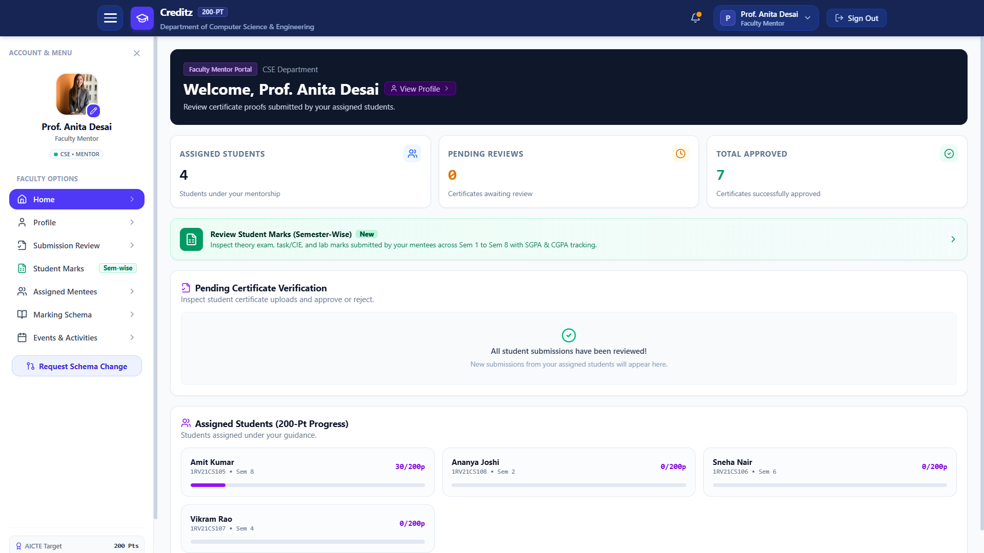
CREDITZ PROTOTYPE V2
Role 2: Faculty Mentor Verification Console
MENTOR CAPABILITIES
• Assigned Mentee List: Monitor student degree clearance progress (Cleared, Near Completion, At Risk).
• Submission Review Queue: Direct inbox of pending certificate submissions awaiting faculty signature.
• Side-by-Side Proof Viewer: Inspect original document proof alongside AI Authenticity Badges.
• 1-Click Approvals: Instantly award verified credit points or return submissions with mentor feedback.
• Mentee Academic Marks: Review mentee semester marks and internal scores for holistic mentoring.

Slide 11
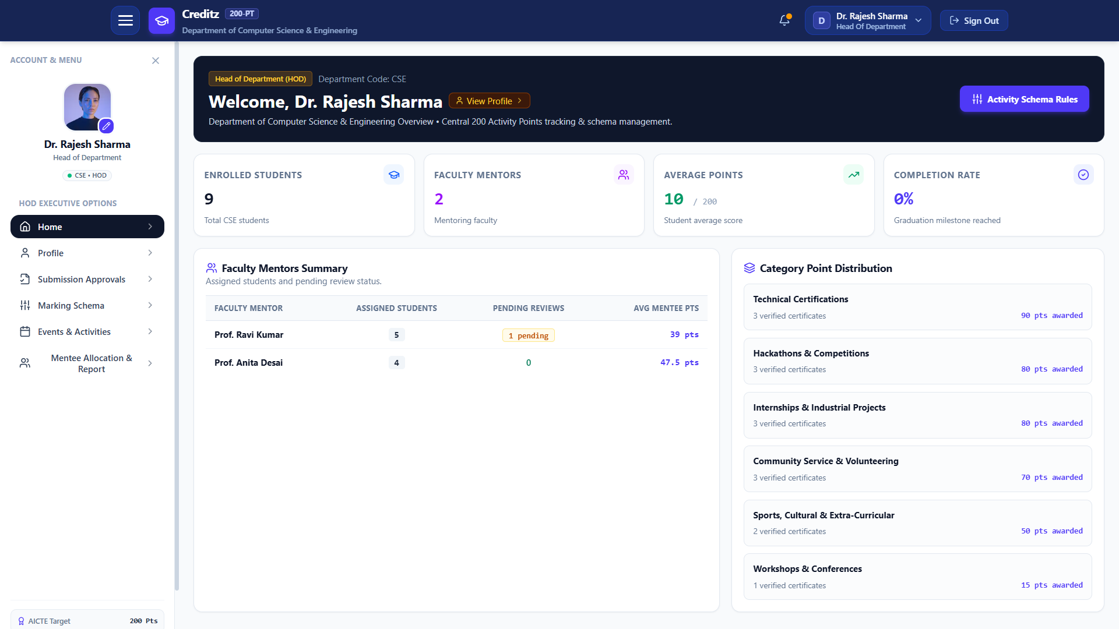
CREDITZ PROTOTYPE V2
Role 3: Head of Department (HOD) Governance
HOD CAPABILITIES
• Clearance Analytics: Live department overview of total students, average points, and completion rate.
• Faculty Mentors Summary: Monitor advisory workloads and pending review queues across faculty.
• Category Point Distribution: Visualize aggregate points awarded across technical, cultural, and sports domains.
• Schema Cap Manager: Adjust category domain caps dynamically in response to institutional policies.
• Accreditation Export: One-click CSV roster download for NAAC/NBA compliance audits.

Slide 12
CREDITZ PROTOTYPE V2
Technology Stack & Engineering Highlights
Frontend (Single Page App)
Stack: React 19, TypeScript, Tailwind CSS v4, Lucide Icons, Framer Motion
Delivers responsive single-page dashboards, interactive modals, and high-contrast dark/light presentation.
Backend & Server Runtime
Stack: Node.js 20/22, Express REST API, JWT Authentication, Multer
Coordinates role-based routing, binary file uploads, and deterministic credit calculation rules.
AI & Multimodal OCR
Stack: Google Gemini 1.5 Flash Vision via official @google/genai SDK
High-speed document understanding model performing automated certificate OCR and fraud checks.
Persistence & Storage
Stack: SQLite (better-sqlite3) with Write-Ahead Logging (WAL) Mode
ACID-compliant relational persistence ensuring zero transactional corruption with 1-command startup.

Slide 13
CREDITZ PROTOTYPE V2
Conclusion & Future Roadmap
Key Achievements of Creditz Prototype v2
✓ Successfully replaced manual paper logbooks with an automated, role-based digital activity portal.
✓ Eliminated certificate fraud using Google Gemini 1.5 Flash Vision OCR.
✓ Enforced university continuous development policies (30 pts/sem cap) deterministically.
✓ Empowered faculty and HODs with real-time clearance visibility and 1-click approvals.
✓ Zero-friction deployment with single-command local execution and offline fallback resilience.
Future Scope & Enhancements
• Blockchain Credential Anchoring for tamper-proof post-graduation degree verification.
• Mobile Native Progressive Web App (PWA) with push notifications for event registrations.
• Cross-Institutional Activity Points Portability across universities.

Slide 14
Thank You!
Creditz (Prototype v2)
Open for Questions & Discussion

