Slide 1
MAJOR PROJECT PROTOTYPE V3
CREDITZ
AICTE 200 Activity Points & Degree Clearance System
An intelligent institutional platform streamlining co-curricular credit tracking, multimodal AI certificate verification, deterministic policy ceilings, and official NAAC/NBA accreditation clearance transcripts.
✨ Version 3.0 Refactor Highlights:
• 1-Click Institutional PDF Credit Report (A4 Certified)
• Faculty Mentor Visual Analytics (Category Donut & Velocity)
• Bell Icon Real-time Meeting & Advisory Notice Space
• Minimalized, Non-IT Friendly Academic Vocabulary
DEPARTMENT OF COMPUTER SCIENCE & ENGINEERING
Autonomous Institute of Technology & Sciences | Evaluated for Major Project v3

Slide 2
● CREDITZ PROTOTYPE V3
Addressing Evaluation Panel Feedback: The Evolution to v3
ITEM 01
Panel Feedback: Technical Jargon
⚠️ Challenge:
Panel noted v2 had developer-centric terminology (Merkle root, cryptographic audit, schema hash) confusing non-IT academic panelists.
─────────────────
✓ V3 Resolution: Institutional Vocabulary
Completely converted to standard academic terms: 'Official PDF Transcript', 'Submissions', 'Digitally Verified ✓', and 'Point Rules & Categories'.
ITEM 02
Panel Feedback: Dashboard Clutter
⚠️ Challenge:
Student dashboard had 8 mini-cards, duplicated upcoming events, and nested scroll traps making the page hard to navigate.
─────────────────
✓ V3 Resolution: Minimalized Current Focus
Unified 80% of screen to Current Semester focus card with clean expandable toggle, natural window scrolling, and unified Clubs/Events portal.
ITEM 03
Panel Feedback: Misplaced Visual Analytics
⚠️ Challenge:
Complex velocity charts and donuts on student views caused confusion rather than providing clear clearance steps.
─────────────────
✓ V3 Resolution: Mentor-Exclusive Visuals
Removed visual charts from students and isolated them into a dedicated Faculty Mentor Analytics Desk (Donut, Velocity vs 30-pt cap, Trajectory).
ITEM 04
Panel Feedback: Accreditation & Communication
⚠️ Challenge:
No printable physical document for NAAC/NBA inspections and no channel for quick mentor-student meeting updates.
─────────────────
✓ V3 Resolution: PDF Transcript + Bell Space
Engineered 1-click A4 Printable Transcript with QR verification hash and real-time Meeting Notice space in navbar Bell Icon.

Slide 3
● CREDITZ PROTOTYPE V3
Project Objectives & Institutional Scope (Creditz v3)
[ROLE-BASED GOVERNANCE] 1. Multi-Role Institutional Architecture
Provide dedicated, tailored portals for Students, Faculty Mentors, and Head of Department (HOD) with strict Role-Based Access Control (RBAC) ensuring appropriate data privacy and workflow separation.
[MULTIMODAL AI OCR] 2. Intelligent Certificate Verification & Discrepancy Checks
Automate certificate verification using Google Gemini 1.5 Flash Vision OCR to extract recipient name, issuing agency, course, and date, computing an Authenticity Score (0-100%) against student records.
[POLICY ENGINE] 3. Deterministic Credit Ceiling & Domain Caps
Enforce AICTE continuous development rules mathematically: strict 30 points/semester ceiling (excess recorded as capped) and category maximums (e.g. MOOCs max 50 pts) to eliminate single-category credit farming.
[FACULTY ADVISORY] 4. Faculty Mentoring Desk & Targeted Visual Analytics
Empower faculty mentors with side-by-side certificate inspection, 1-click approvals, and exclusive visual analytics (category balance donut, velocity threshold chart, 200-pt degree trajectory curve).
[ACCREDITATION & COMM] 5. Official PDF Accreditation Transcript & Real-Time Sync
Deliver 1-click exportable A4 degree clearance transcripts with tamper-evident QR verification hashes and formal sign-offs for NAAC/NBA accreditation, plus real-time meeting notifications in the navbar bell icon.

Slide 4
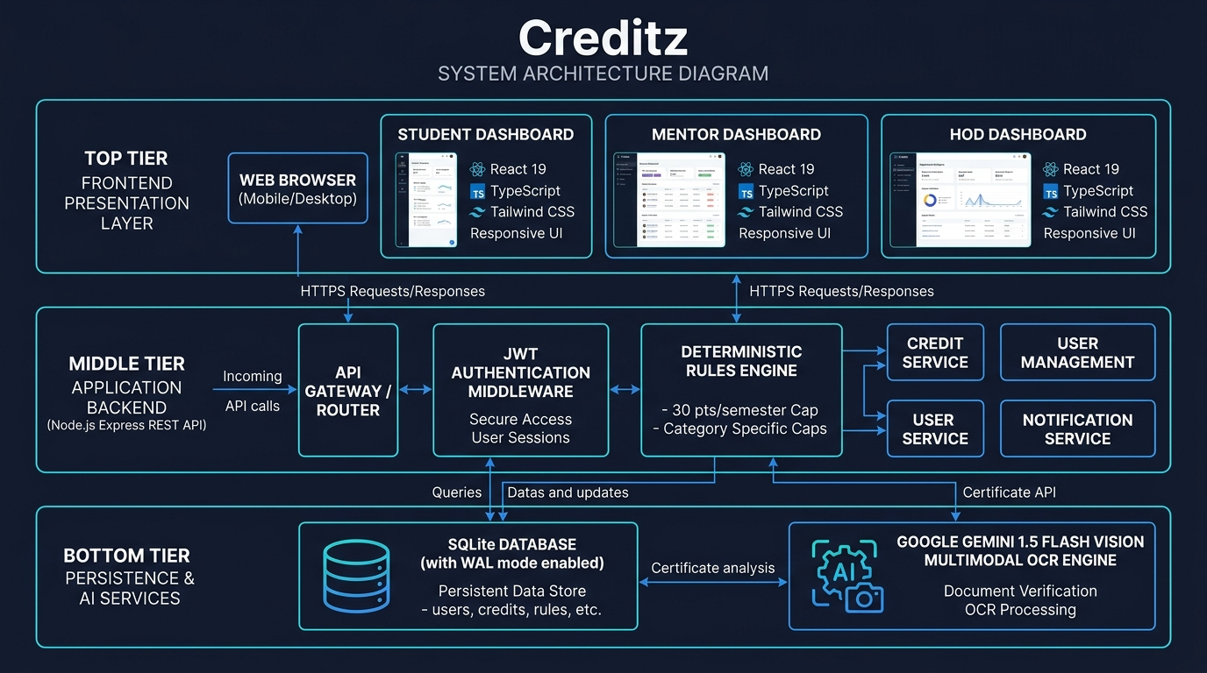
● CREDITZ PROTOTYPE V3
System Architecture: 3-Tier Layered Design
ARCHITECTURE SPECIFICATIONS
• Presentation Layer:
React 19 Single Page App with TypeScript, Tailwind CSS v4, Lucide icons, and window-level vertical scrolling with responsive desktop/mobile navigation drawers.
• Application Backend:
Node.js Express REST API coordinating JWT authentication, Multer binary multipart uploads, real-time notification endpoints, and CORS security.
• Deterministic Rules Engine:
Independent mathematical module strictly enforcing the 30 pts/semester continuous development ceiling and category-specific maximum caps.
• AI Multimodal Vision Engine:
Google Gemini 1.5 Flash Vision via official SDK analyzing certificate buffers with smart deterministic heuristic fallback.
• Persistence Layer:
Relational SQLite database with Write-Ahead Logging (WAL) mode ensuring ACID transactional integrity and zero setup friction.

Slide 5
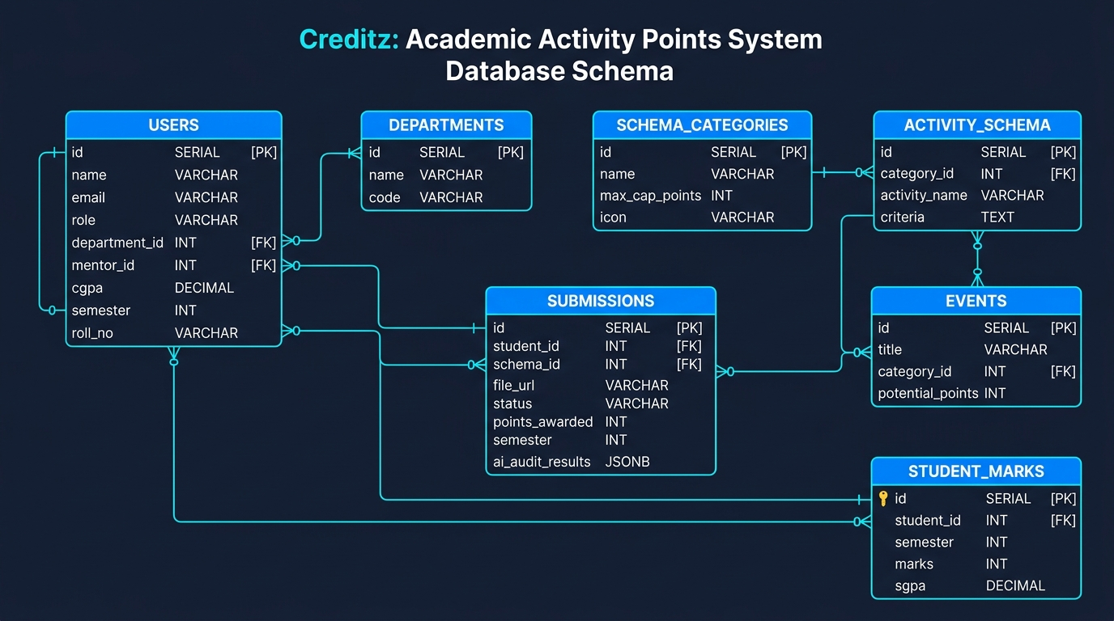
● CREDITZ PROTOTYPE V3
Relational Database Schema & Entity-Relationship Model
CORE RELATIONAL ENTITIES
• Users Entity:
Central identity management storing Student, Mentor, and HOD records with department FK, assigned mentor FK, USN roll number, CGPA, and semester.
• Submissions Entity:
Tracks student certificate uploads, claimed category, file URL, status ('pending', 'approved', 'rejected'), awarded points, semester, and AI audit JSON.
• Activity Schema & Categories:
Institutional catalog of recognized activities, default points, verification criteria, and category domain maximum caps (e.g. max 60 pts technical certs).
• Notifications Entity:
Stores real-time institutional notices, sender/recipient IDs, meeting times, venues, and read status for seamless HOD-Mentor-Student communication.
• Student Marks Entity:
Stores semester-wise CIE internal exam scores, lab marks, and SGPA calculations for holistic mentor academic guidance.

Slide 6
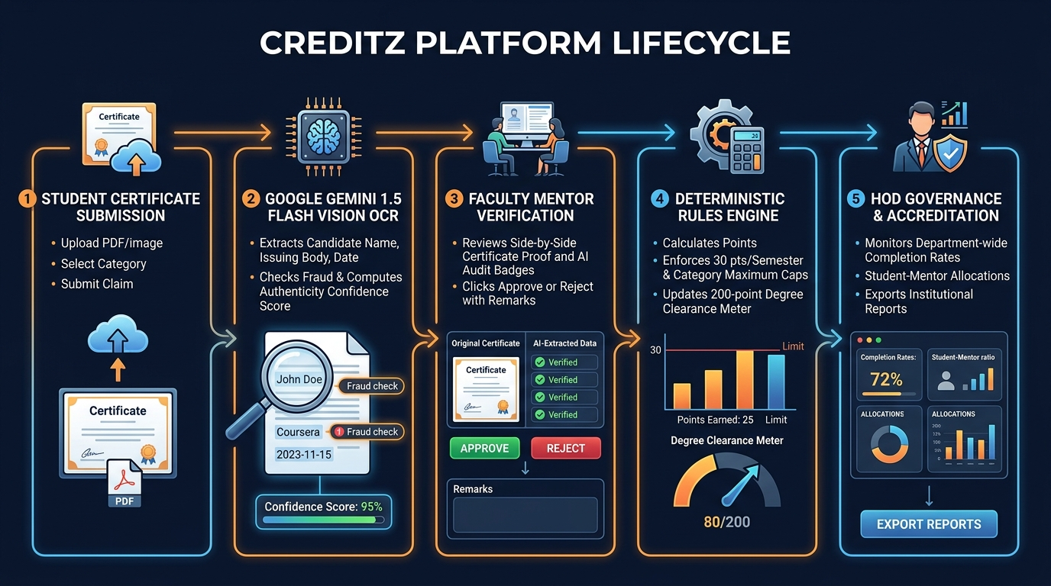
● CREDITZ PROTOTYPE V3
End-to-End Operational Lifecycle & Verification Flow

Slide 7
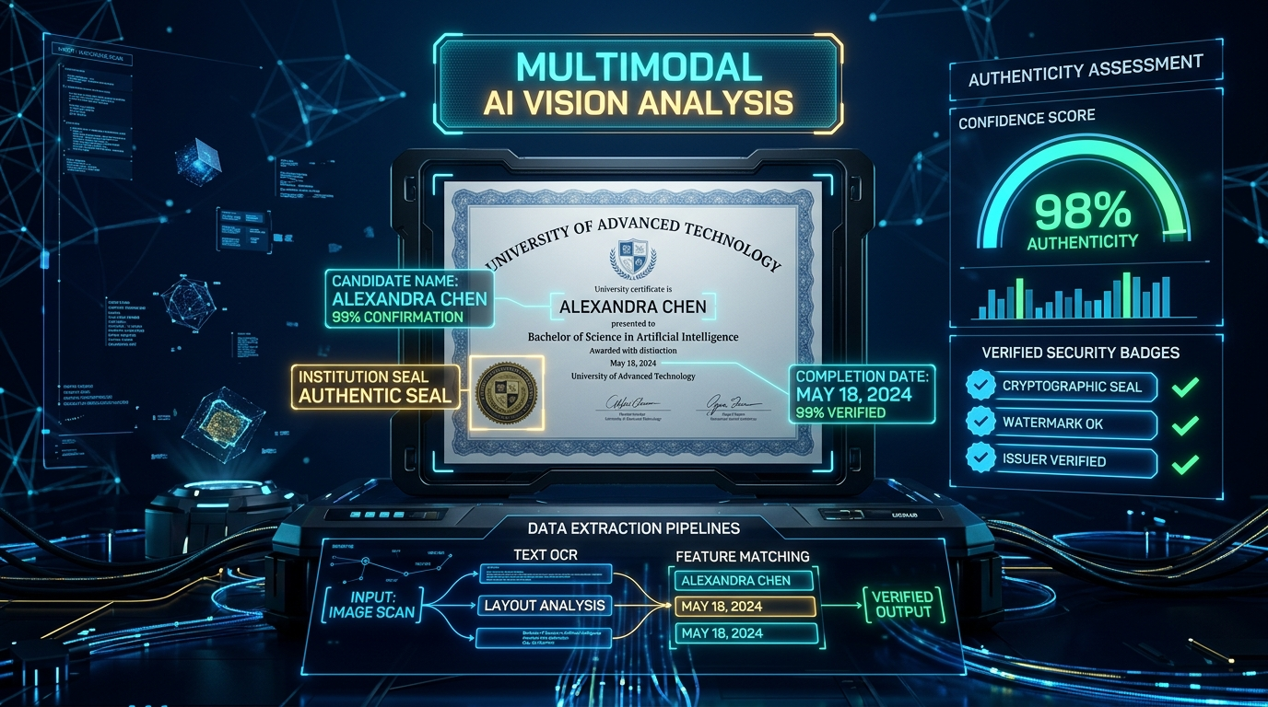
● CREDITZ PROTOTYPE V3
Multimodal AI Vision Inspection & Deterministic Rules Engine
VERIFICATION MECHANICS
✓ Multimodal OCR Scanning:
Google Gemini 1.5 Flash Vision reads binary document buffers (PDF, PNG, JPG), extracting student name, course title, issuing body, and completion date.
✓ Cross-Verification Discrepancy Check:
Compares extracted text against database profile to flag mismatched recipient names, invalid completion dates, or suspicious template patterns.
✓ Authenticity Confidence Score:
Computes an automated authenticity metric (0-100%) and generates plain-English audit flags for mentor evaluation.
✓ Deterministic Semester Ceiling:
Strictly caps counted activity credits to 30 points per semester. Excess credits are safely recorded as capped to mandate steady learning.
✓ Offline Heuristic Fallback:
Internal smart vision heuristic ensures 100% platform uptime even when internet connection or external API tokens are unavailable.

Slide 8
● CREDITZ PROTOTYPE V3
Academic Literature Survey Summary (Clean Baseline)
Mishra et al. (2026, IEEE Transactions) — AI-Enhanced Blockchain-Based Certificate Verification
Key Finding: Hybrid CNN-BiLSTM architecture achieving 98.3% accuracy in visual and semantic certificate forgery detection. | Creditz Alignment: Direct theoretical foundation for Creditz's multimodal OCR pipeline and cross-field discrepancy checking.
Nguyen et al. (2025, IEEE Access) — Knowledge Graph Framework for Degree Pathway Recommendations
Key Finding: Semantic representation of course prerequisites, curriculum milestones, and institutional constraint enforcement. | Creditz Alignment: Informed Creditz's domain category cap structure and semester credit velocity tracking.
Chen et al. (2018, IEEE Transactions on Software Engineering) — DRLGENCERT: Automated Testing of Certificate Verification
Key Finding: Reinforcement learning for certificate feature extraction, boundary case exploration, and discrepancy detection. | Creditz Alignment: Guided the automated validation rules for issuing body matching and date range checks.
Zhang et al. (2024, IEEE Transactions on Learning Technologies) — Temporal Point Process Model for Academic Progression
Key Finding: Models learning motivation cycles and temporal credit accumulation patterns across undergraduate programs. | Creditz Alignment: Empirical justification for enforcing the AICTE 30-point continuous development semester ceiling.
Edge et al. (2024, Microsoft Research) — From Local to Global: Graph RAG Summarization
Key Finding: Demonstrated that grounded contextual graphs eliminate LLM hallucinations during document verification. | Creditz Alignment: Reinforces Creditz's deterministic schema grounding over raw generative AI outputs.

Slide 9
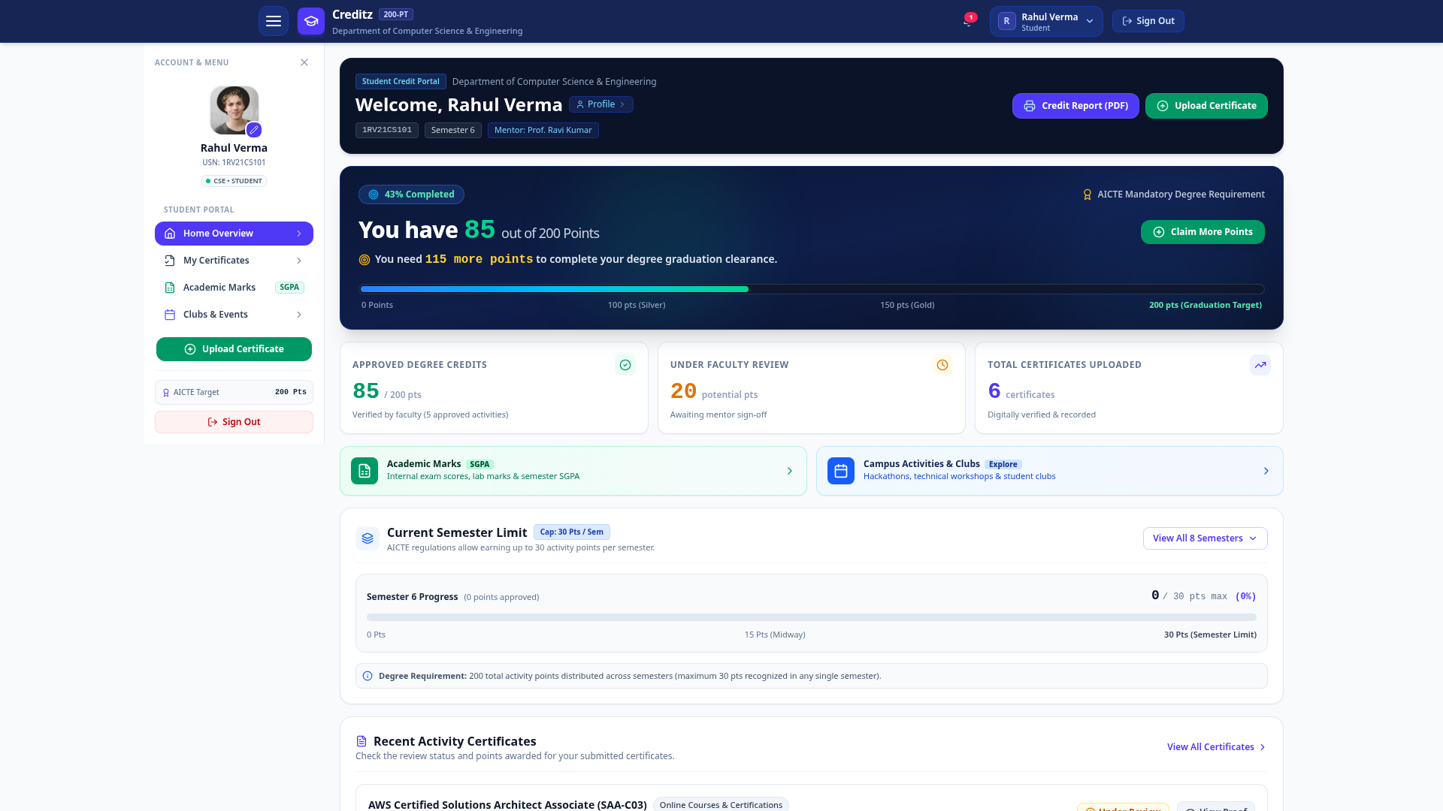
● CREDITZ PROTOTYPE V3
Role 1: Student Degree Clearance Portal (Version 3 Minimalized UI)
STUDENT CAPABILITIES (V3)
• 200-Point Clearance Meter:
Live visual gauge tracking total approved credits toward graduation with milestone tiers (Bronze 50, Silver 100, Gold 150, Diamond 200).
• 1-Click Official PDF Transcript:
Prominent button opening the official A4 degree transcript modal with verification hash for instant print and download.
• Current Semester Focus Card:
Minimalized card displaying current semester progress vs the 30 pts/sem limit, with expandable 8-semester historical drawer.
• Plain-English Status Badges:
Replaced developer jargon with clear labels: 'Digitally Verified & Recorded', 'Under Faculty Review', 'Approved Degree Credits'.
• Interactive Meeting Space:
Direct bell-icon popover to request advisory meetings with faculty mentor and view scheduled sessions.

Slide 10
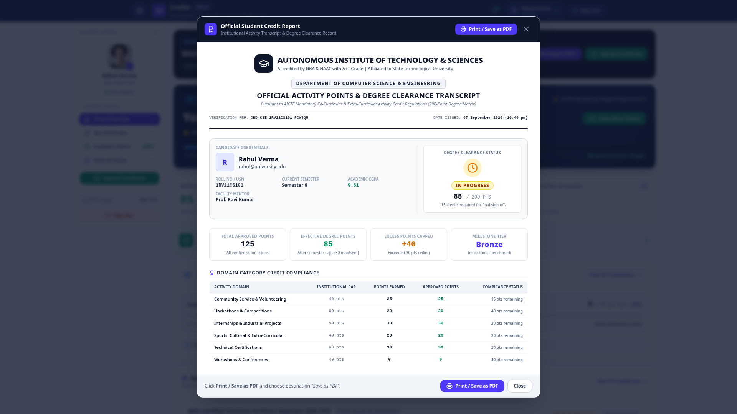
● CREDITZ PROTOTYPE V3
Institutional Innovation: 1-Click Official PDF Credit Report
ACCREDITATION REPORT SPECS
✓ NBA & NAAC Institutional Letterhead:
Formally formatted with institution title, accreditation status (A++ Grade), state university affiliation, and CSE department seal.
✓ Unique Verification Hash & QR Code:
Generates a unique tamper-evident verification reference string (CRD-CSE-1RV21CS101-PCW9QU) for instant physical document validation.
✓ Continuous Learning Ceiling Breakdown:
Differentiates Total Approved Points (125 pts) from Effective Degree Points (85 pts) and Capped Excess (+40 pts) per AICTE rules.
✓ Category Domain Compliance Table:
Verifies compliance against institutional caps across Community Service, Hackathons, Internships, and Technical Certifications.
✓ Official Sign-off Section:
Dual formal authorization blocks with designations for Faculty Mentor and Head of Department for graduation audit portfolios.

Slide 11
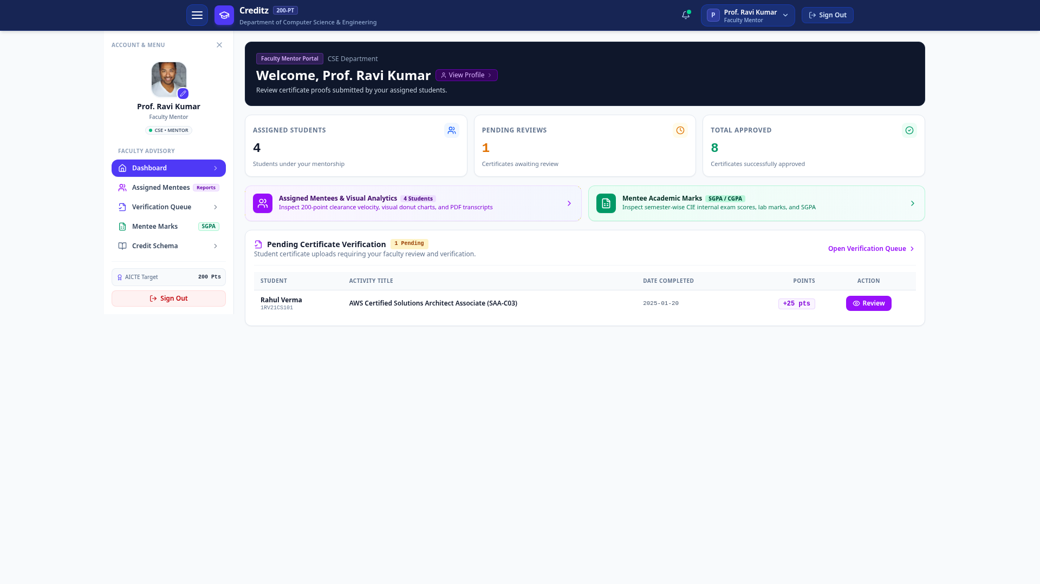
● CREDITZ PROTOTYPE V3
Role 2: Faculty Mentor Advisory & Verification Console
MENTOR CONSOLE CAPABILITIES
• Action-Oriented Dashboard:
Replaced crowded 10-student card grid with 2 clean shortcut cards (Assigned Mentees & Mentee Academic Marks) and prominent Pending Review alerts.
• Pending Certificate Queue:
Instant visibility into unreviewed student submissions (e.g. AWS Cloud Certification) requiring faculty signature and points allocation.
• Side-by-Side Proof Viewer:
Inspects uploaded certificate image/PDF alongside AI multimodal OCR extraction fields and authenticity confidence metrics.
• 1-Click Verification Decisions:
Approve, reject, or request revisions with structured faculty feedback recorded in student timeline.
• Holistic Mentee Monitoring:
Track academic semester marks (CIE, labs, SGPA) alongside co-curricular points to ensure balanced student development.

Slide 12
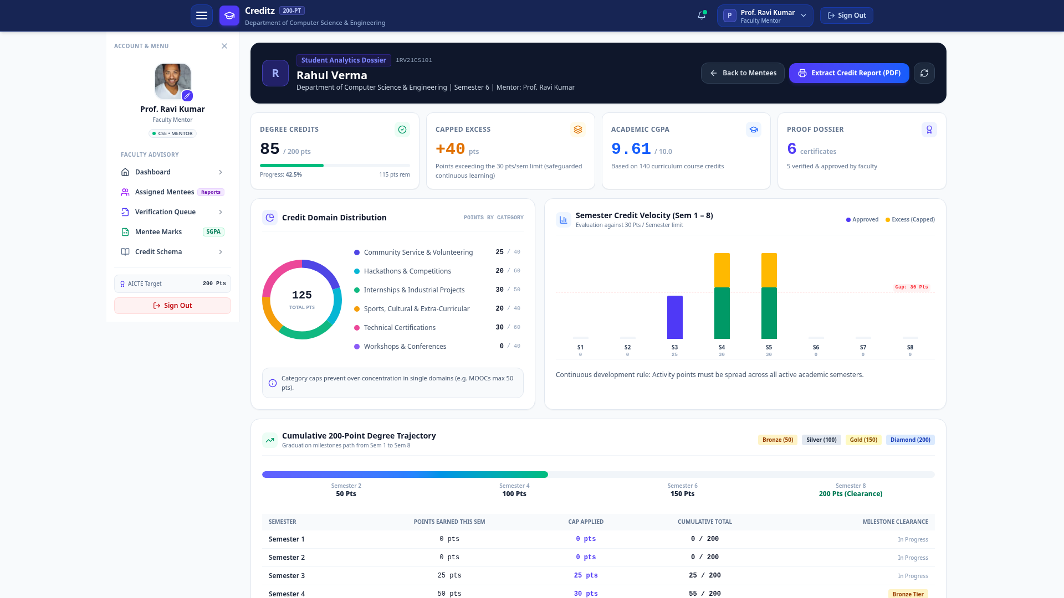
● CREDITZ PROTOTYPE V3
Faculty Mentor Visual Analytics (Targeted Mentorship Intelligence)
ANALYTICS DESK HIGHLIGHTS
✓ Isolated to Faculty Mentors:
Visual charts intentionally removed from student views to avoid confusion, and consolidated into an in-depth Faculty Advisory workspace.
✓ Category Domain Donut Chart:
Visualizes mentee points breakdown across all 6 activity domains, immediately exposing category cap saturation or domain deficits.
✓ Semester Credit Velocity Chart:
Bar chart plotting semester-wise credits against the red dashed 30-point ceiling line, highlighting approved credits vs capped excess.
✓ 200-Point Degree Trajectory Curve:
Milestone progress gauge (Bronze 50, Silver 100, Gold 150, Diamond 200) with detailed semester audit log table.
✓ Proactive Academic Intervention:
Enables mentors to identify students falling behind in activity credits before graduation year deadlines.

Slide 13
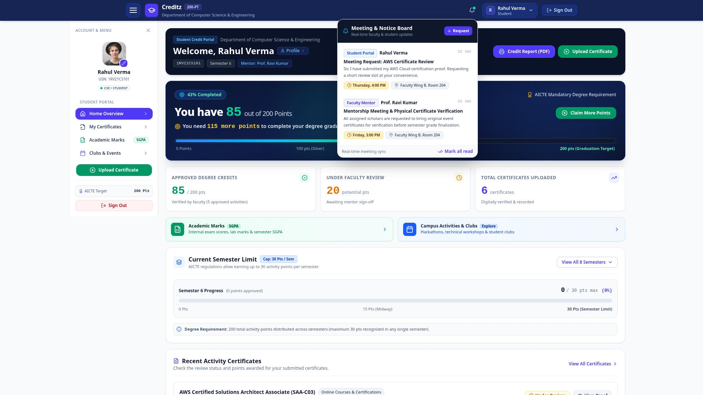
● CREDITZ PROTOTYPE V3
Real-Time Meeting & Advisory Notice Space (Navbar Bell Icon)
COMMUNICATION HIGHLIGHTS
• Zero-Clutter Navbar Integration:
Clean message space housed entirely within the navbar bell icon popover without cluttering dashboards or sidebar navigation.
• HOD to Mentors Communication:
Head of Department can broadcast urgent circulars, accreditation deadlines, and scheduled faculty review meetings.
• Mentor to Mentees Advisories:
Mentors schedule physical certificate verification meetings, specify room/venue (e.g. Faculty Wing B, Room 204), and set meeting times.
• Student Meeting Requests:
Students can initiate meeting requests with their assigned faculty mentor directly from the popover with a 1-click form.
• Real-Time Synchronization:
Dynamic unread badge counter (pulsing red alert) and real-time polling updates keep all parties aligned without page reloads.

Slide 14
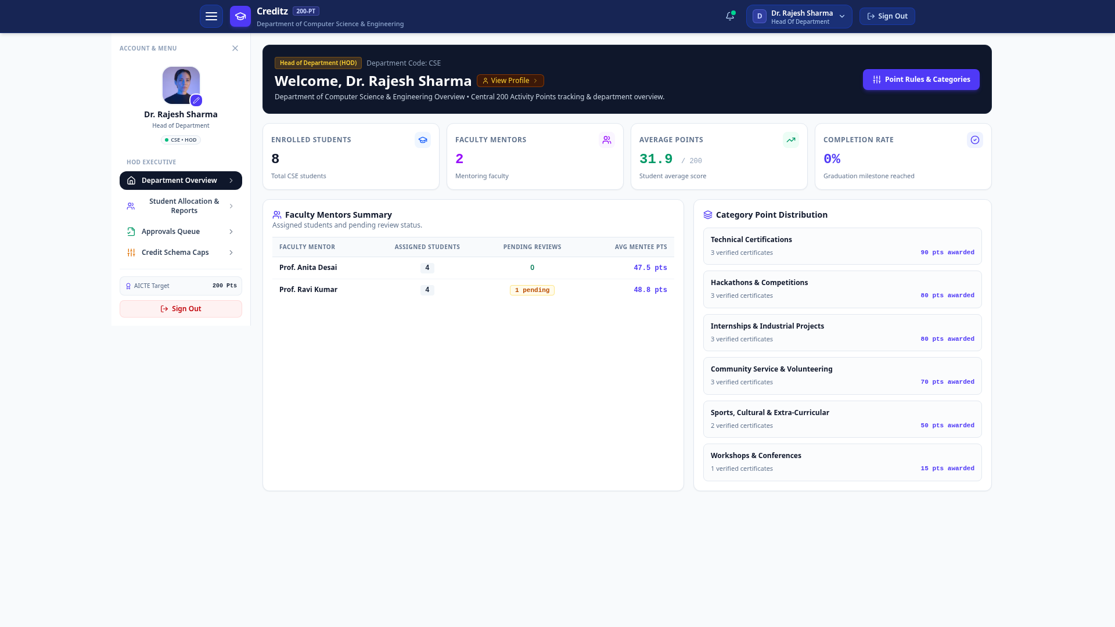
● CREDITZ PROTOTYPE V3
Role 3: Head of Department (HOD) Governance & Oversight
HOD GOVERNANCE HIGHLIGHTS
• Department Clearance Analytics:
Live department-level overview tracking total enrolled students (8), faculty mentors (2), average points (31.9/200), and graduation clearance rate.
• Faculty Mentors Summary:
Real-time visibility into mentor workloads, mentee-to-faculty allocations, and pending review counts to prevent evaluation bottlenecks.
• Category Point Distribution:
Aggregated analysis of points earned across Technical Certifications, Hackathons, Internships, Volunteering, and Sports domains.
• De-jargonized Rule Management:
Simplified 'Point Rules & Categories' management console allowing HOD to adjust category maximum caps dynamically.
• 1-Click Accreditation Export:
Instant CSV and consolidated transcript exports for AICTE, NAAC, and NBA statutory compliance committee visits.

Slide 15
● CREDITZ PROTOTYPE V3
Technology Stack & Version 3 Engineering Architecture
[FRONTEND PRESENTATION]
React 19 & Tailwind CSS v4
Stack: React 19, TypeScript, Vite 6, Tailwind CSS v4, Lucide Icons, Framer Motion
Responsive SPA with zero scroll traps; dynamic role-tailored dashboards, accessible modal dialogs, and native CSS print stylesheets for official PDF generation.
[APPLICATION RUNTIME]
Node.js 20/22 & Express REST API
Stack: Node.js (ESM), Express 4.21, TypeScript (tsx), JWT Authentication, Multer
High-throughput API server handling authenticated endpoints, binary file uploads, deterministic rule calculations, and real-time meeting notification polling.
[ARTIFICIAL INTELLIGENCE]
Multimodal Vision OCR Engine
Stack: Google Gemini 1.5 Flash Vision (@google/genai SDK) + Smart Local Fallback
High-speed multimodal document understanding model extracting candidate name, issuing body, and dates, paired with an offline heuristic fallback for 100% reliability.
[PERSISTENCE & RELIABILITY]
SQLite WAL Mode (Write-Ahead Logging)
Stack: better-sqlite3 v12.11 with WAL Mode & Immediate Transactions
ACID-compliant relational database with concurrent reader/writer support, sub-millisecond query latency, and zero-configuration single-file portability.

Slide 16
● CREDITZ PROTOTYPE V3
Conclusion & Future Roadmap
KEY ACHIEVEMENTS IN PROTOTYPE V3
✓ Full Alignment with Panel Feedback:
Successfully purged cognitive clutter and replaced intimidating IT jargon with clear, non-IT friendly institutional language.
✓ 1-Click Official PDF Clearance Transcript:
Engineered A4 printable accredited transcript with tamper-evident QR verification hash and faculty/HOD sign-off blocks.
✓ Faculty-Exclusive Visual Analytics:
Equipped mentors with multi-dimensional data analytics (category donut, velocity against 30-pt cap, degree trajectory) while simplifying student views.
✓ Real-time Meeting & Notice Space:
Added real-time notification popover to navbar bell icon enabling seamless HOD ➔ Mentor ➔ Student meeting coordination.
✓ Deterministic AICTE Compliance:
Mathematically guarantees continuous development via 30 pts/semester cap and category ceilings with Google Gemini 1.5 Flash Vision OCR.
FUTURE ROADMAP & PRODUCTION EXPANSION
🚀 National DigiLocker API Integration:
Direct integration with India's DigiLocker / NAD system for automated zero-upload certificate verification directly from issuers.
🚀 Blockchain Credential Anchoring:
Anchor finalized degree clearance hashes on Hyperledger or Ethereum testnet for tamper-proof post-graduation verification by employers.
🚀 Native Mobile PWA with Push Alerts:
Progressive Web App (PWA) with native mobile push notifications for real-time meeting reminders and event registrations.
🚀 Inter-College Activity Point Portability:
Standardized activity credit interchange format allowing seamless credit transfer for lateral entry and university transfer students.

Slide 17
Thank You!
CREDITZ (Prototype v3)
An Intelligent Activity Credit Management & Degree Clearance System
✨ Open for Evaluation Panel Feedback, Demonstration & Discussion ✨
Department of Computer Science & Engineering
Autonomous Institute of Technology & Sciences

