Slide 2
Employee Management System
Introduction
User Interfaces
Class Diagram

Slide 3
Introduction
In this project, the employee management system has been made for an organization using Python 3.7.4 (32 bit) in PyCharm 2019.3.3 (Community Edition).
Functions
Direct access button to register page from sign in page and vice-versa without going back to home page,
Email format will be checked while registering,
Password length will be checked,
registration won’t work using the same email twice,
Direct access button to employee details page from department details page and vice-versa without going back to administrator page,
Details of only related employee will be shown in the login page even if two employees have same name
same department and employee having same contact no., email cannot be added twice,
error messages will popup according to the mistakes and incorrect behaviors made while registering, logging in, adding departments and employees like registering without filling up the form completely,
Successful messages will appear after successful login and registering, successfully adding employees and departments.
Limitations
same employee can register and login using different email,
the added departments and the employees cannot be deleted,
no full details of the administrator like the employees,
space cannot be given while registering the employee details otherwise the system will not work properly,
more than one department cannot be chosen for an employee etc.

Slide 4
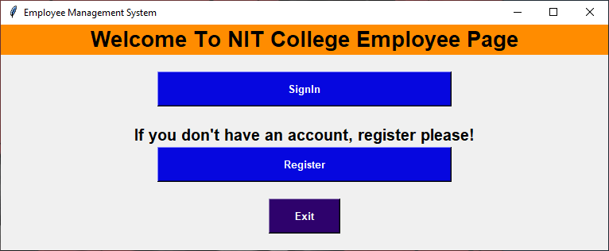
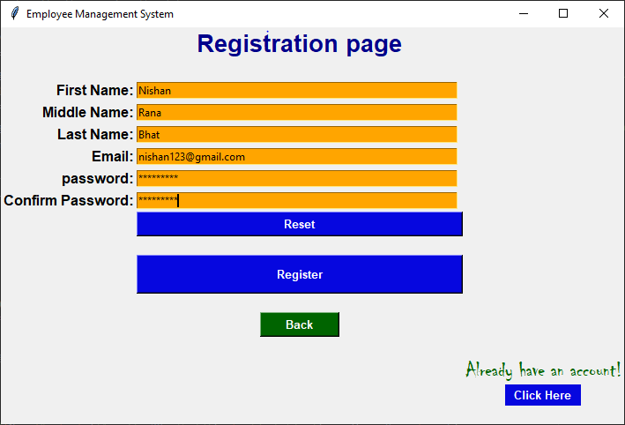
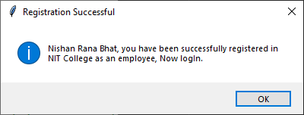
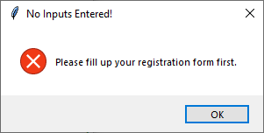
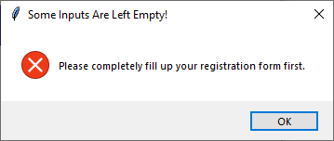
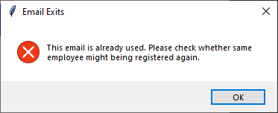
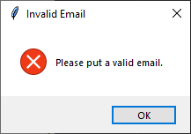
User Interfaces

Slide 5
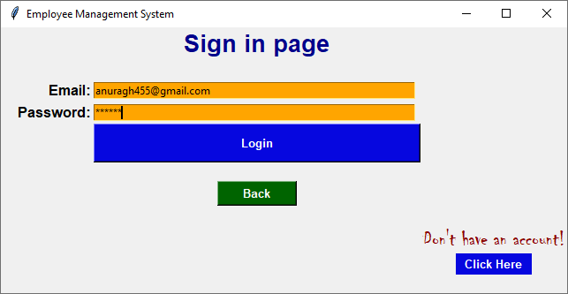
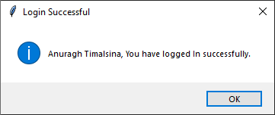
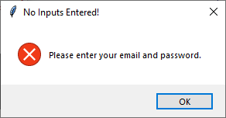
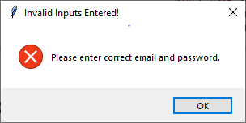
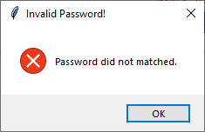
User Interfaces

Slide 6
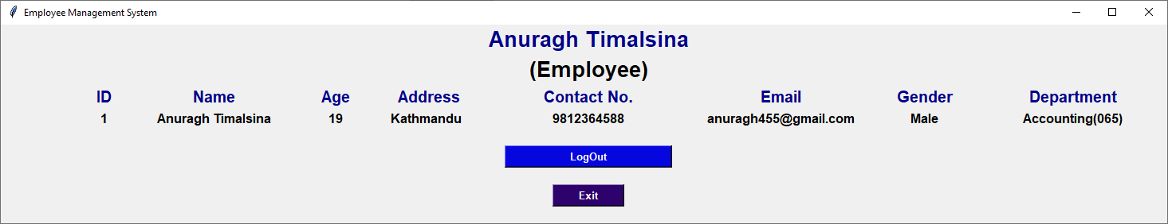
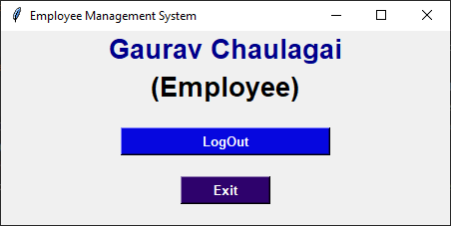
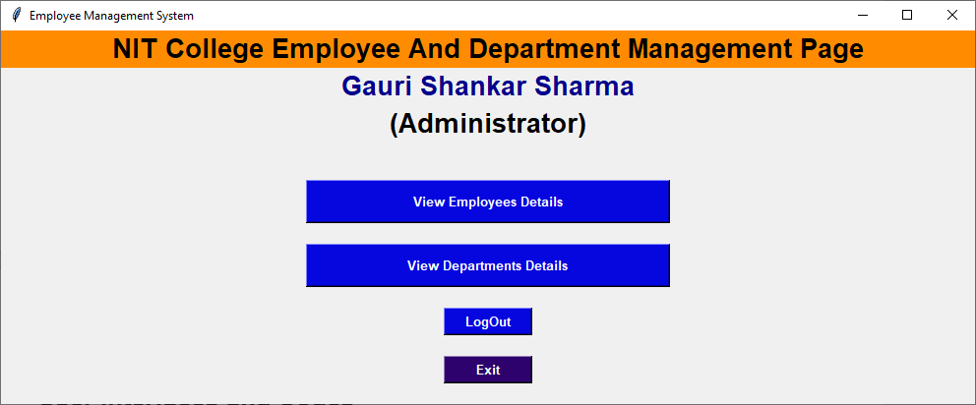
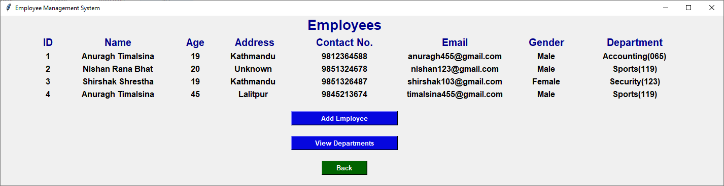
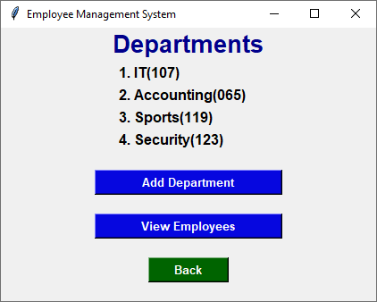
User Interfaces

Slide 7
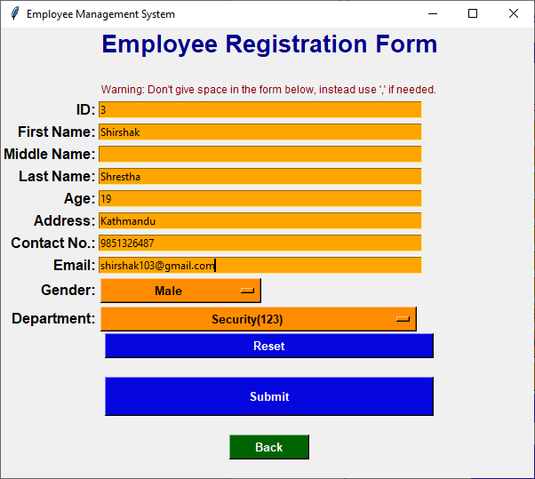
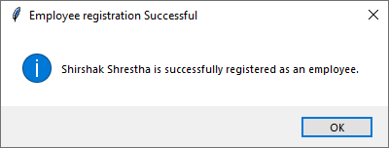
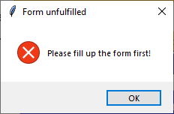
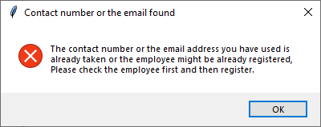
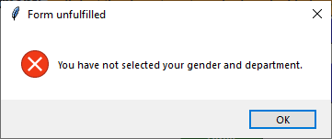
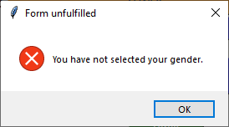
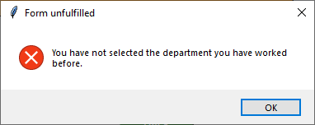
User Interfaces

Slide 8
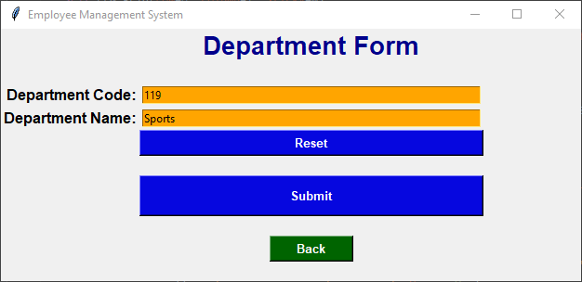
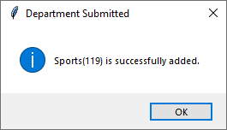
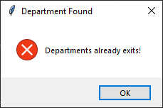
User Interfaces
Thank You

Slide 9
Class Diagram

Slide 10
Thank You!

