Slide 1
STW120CT Final Assignment
Task 1
Task 2
Findings And Recommendation

Slide 2
Task 1
Introduction
Objectives
Design
Description
CPI
Comparison
Conclusion

Slide 3
Task 1
Design
Resources
Lenovo
Lenovo
Dell
Dell
HDD
HDD/SSD
SSD
HDD/SSD
HDD
HDD/SSD
SSD
HDD/SSD
HDD/SSD
HDD/SSD

Slide 4
Task 1
Comparison
Attributes | WD HDD |  | WD SSD
 | Read | Write | Read | Write
Seq. | 114.96 MB/s | 104.56 MB/s | 2221.19 MB/s | 1844.39 MB/s
4K | 0.30 MB/s | 0.43 MB/s | 32.95 MB/s | 119.10 MB/s
4K-64Thrd | 0.50 MB/s | 0.46 MB/s | 1160.42 MB/s | 905.16 MB/s
Access Time | 4.899 ms | 23.153 ms | 0.114 ms | 0.073 ms
Capacity | 1 TB |  | 1 TB
Power Draw | 1.5 W |  | 3.5 W
Cost | NPR 3,950 |  | NPR 11,300
Attributes | Seagate HDD |  | Seagate SSD
 | Read | Write | Read | Write
Seq. | 50.11 MB/s | 51.81 MB/s | 3017.50 MB/s | 2823.90 MB/s
4K | 0.09 MB/s | 0.11 MB/s | 62.29 MB/s | 151.46 MB/s
4K-64Thrd | 0.76 MB/s | 0.22 MB/s | 1802.68 MB/s | 1778.16 MB/s
Access Time | 19.675 ms | 16.820 ms | 0.027 ms | 0.022 ms
Capacity | 1 TB |  | 1 TB
Power Draw | 2.7 W |  | 5.3 W
Cost | NPR 7,900 |  | NPR 18,150

Slide 5
Task 1
Comparison of SSD
Attributes | Western Digital |  | Seagate
 | Read | Write | Read | Write
Seq. | 2221.19 MB/s | 1844.39 MB/s | 3017.50 MB/s | 2823.90 MB/s
4K | 32.95 MB/s | 119.10 MB/s | 62.29 MB/s | 151.46 MB/s
4K-64Thrd | 1160.42 MB/s | 905.16 MB/s | 1802.68 MB/s | 1778.16 MB/s
Access Time | 0.114 ms | 0.073 ms | 0.027 ms | 0.022 ms
Capacity | 1 TB |  | 1 TB
Power Draw | 3.5 W |  | 5.3 W
Cost | NPR 11,300 |  | NPR 18,150

Slide 6
Task 2
Introduction
Objectives
Subnetting
Design
Analysis
Conclusion

Slide 7
Task 2
Subnetting And Assigning IP Addresses
Attributes |  | No. of hosts | Network Blocks | Network Address | Broadcast Address | Total Usable Addresses | First Usable Address | Last Usable Address
Students |  | 1200 | 172.23.0.0/21 | 172.23.0.0 | 172.23.7.255 | 2,046 | 172.23.0.1 | 172.23.7.254
Staffs | Exam | 41 | 172.23.8.0/26 | 172.23.8.0 | 172.23.8.63 | 62 | 172.23.8.1 | 172.23.8.62
 | Operation | 28 | 172.23.8.64/27 | 172.23.8.64 | 172.23.8.95 | 30 | 172.23.8.65 | 172.23.8.94
 | IT | 13 | 172.23.8.128/28 | 172.23.8.128 | 172.23.8.143 | 14 | 172.23.8.129 | 172.23.8.142
 | Faculty | 11 | 172.23.8.144/28 | 172.23.8.144 | 172.23.8.159 | 14 | 172.23.8.145 | 172.23.8.158
 | Admin | 7 | 172.23.8.160/28 | 172.23.8.160 | 172.23.8.175 | 14 | 172.23.8.161 | 172.23.8.174

Slide 8
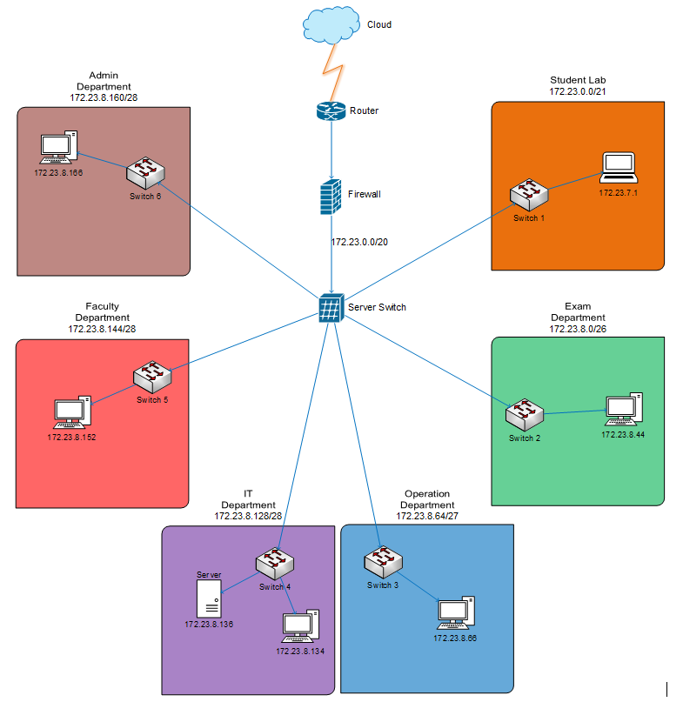
Task 2
Network Topology

Slide 9
Task 2
Price Analysis
Device Name | Device Module | No. of Devices | Price of Each Device | Total price
Router | Cisco ISR 4431 | 1 | NPR 3,76,244.20 | NPR 3,76,244.20
Firewall | Cisco ASA5508-K9 | 1 | NPR 1,25,704.02 | NPR 1,25,704.02
Server witch | Cisco SG550X-24 | 1 | NPR 1,08,901.83 | NPR 1,08,901.83
LAN Switch | WS-C2960+24TC-L | 6 | NPR 42,159.40 | NPR 2,52,956.4
LAN Cable | Cat RJ45 Ethernet Network Internet Patch cable | Length | Price per meter | NPR 30,000
 |  | 1,500 meters | NPR 20 per meter
Total cost of the project = NPR 8,93,806.45

Slide 10
Task1 AND Task 2
Findings
Recommendation
Thank You

