Slide 1
Module:
STW106CR-Designing for Usability-I-M20
Assignment Title:
Coursework- Group Project
Intake:
September/November 2019
Group Members:
Gauri Shankar Sharma
Anuragh Timalsina
Nishan Bhat
Gaurav Chaulagain
Prabesh Pathak
Anish Khadka

Slide 2

Gesture Recognition
Introduction
Types
Input Devices
Benefits
Applications
Advantages
Disadvantages

Slide 3
Introduction
It is perceptual computing user interface that allows computers to capture, understand and interpret human gestures and execute commands based on those gestures. In a simple word, it can be define as the mathematical interpretation of a human motion by a computing device.
In order to understand how it works, the definition of the word “Gesture” should be cleared. Gesture refers to any non-verbal communication that is intended to communicate a specific message. In the world of gesture recognition, a gesture is defined as any physical movement, larger or small, that can be interpreted by a motion sensor. It may include anything from the pointing of a finger to a roundhouse kick or a nod of the head to a pinch or wave of the hand.

Slide 4
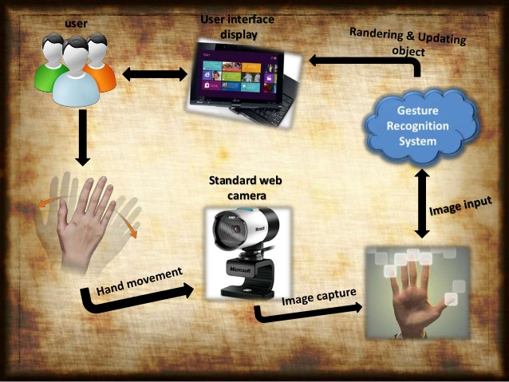

Slide 5
Types
In Computer interfaces, two types of gesture recognition are distinguished.
Offline Gestures: Those gestures which are processed after the user interaction with the object is finished are offline gestures. An example is the gesture to activate a menu.
Online Gestures: These are direct manipulation gestures. These are used to scale or rotate a tangible object.

Slide 6
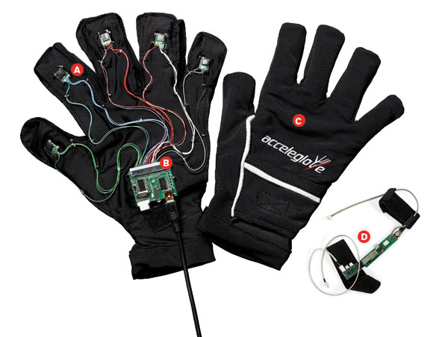
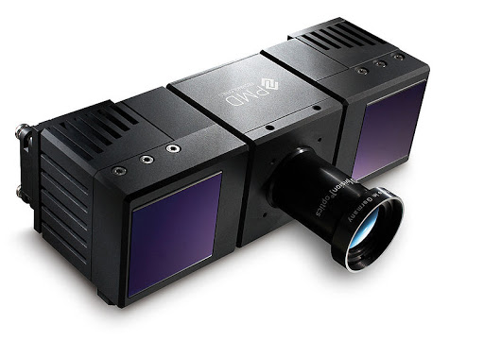
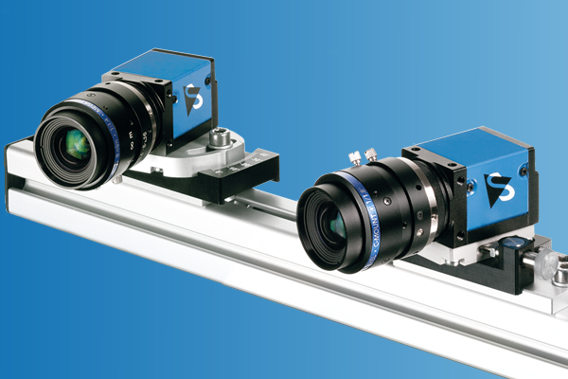
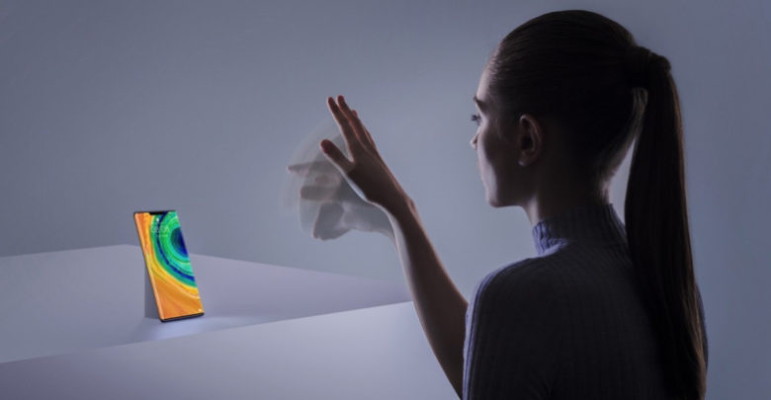
Input Devices
Wired Glove
Depth Aware Camera
Streo Camera
Controlled Gestures

Slide 7
Benefits
No physical contact with computers
Replace mouse and keyboard
Pointing gestures
Communicate at a distance
Interact with the 3D world
Navigate in a virtual environment
Pick up and manipulate virtual objects

Slide 8
Applications
Supermarkets, Post Offices, Banks
Sign language recognition
Control facial recognition
Immersive game technology
Controlling robots
Communicating in video conferencing
Enabling very young children to interact with computers
Navigating or manipulating in virtual enviroment

Slide 9
Advantages
No training is required
Simple fast, and easy to implement. Can be applied on real system and play games
Low computational workload
It is portable and can be placed anywhere
No need of lengthy wires
Power consumption is low
Low cost of manufacturing
Speed and sufficient reliable for recognition system

Slide 10
Disadvantages
Irrelevant object might overlap with the hand. Wrong Object extraction appeared if the objects larger than the hand.
Performance recognition algorithm decreases when the distance is greater than 1.5 meters between the user and the camera.
System limitations restrict the applications such as the arm must be vertical, the palm is facing the camera and the finger color must be basic color such as either red or green or blue.
Ambient light affects the color detection threshold.

Slide 11
Thank You

