Slide 1

Topic 5 & 6
The Relational Model
Notes:
Best Example Link for ER Modelling: http://www.tutorialspoint.com/dbms/er_model_basic_concepts.htm

Slide 2
Do not confuse relations with relationships in ER models

Slide 3
Terminology
Relation
A relation is a table with columns and rows.
Attribute
The columns in a relation are known as attributes.
Tuple
A tuple is a row of a relation. They are also called the records.
Domain
A domain or attribute domain is the set of allowable values for one or more attributes.

Slide 4
Terminology
Degree
The degree of a relation is the number of attributes it has. Example, the department table has 3 attributes. So, is has degree three.
Cardinality
The cardinality of a relation is the number of tuples it contains.
Relational Database
A collection of normalized relations with distinct or unique relation names. It consists of relations that are appropriately structured having no repeating groups. This is known as Normalization.
So normalized database called relation database.

Slide 5
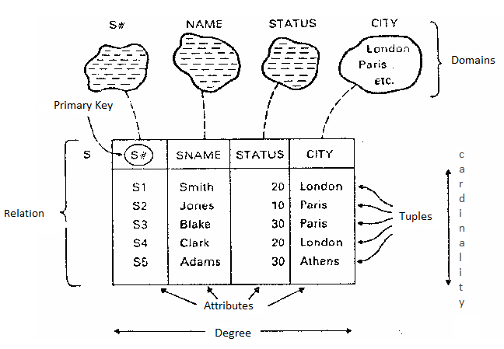
Student Table

Slide 6
Alternative Terminology
Formal Term | Alternative 1 | Alternative 2
Relation | Table | File
Tuple | Row | Record
Attribute | Column | Field

Slide 7
Relational Keys
Super Key (All Possible Combination of Keys)
An attribute, or set of attributes, that uniquely identifies a tuple within a relation.
For example, for the entity Student = {Roll No, Name, Address, Age, Mobile No}, the possible super keys are <Roll No>, < Mobile No, Name>, <Roll No, Name>.
Roll No | Name | Address | Age | Mobile No
1 | ABC | KTM | 20 | 9089
2 | PQR | KTM | 20 | 9190
3 | XYZ | PKR | 29 | 9999
4 | ABC | BKT | 20 | 9199

Slide 8
Relational Keys
2. Candidate Key (All highly likely keys)
It is such an attribute or attributes of a table that can uniquely identify a row in a table.
Generally they contain unique values and can never contain NULL values. There can be more than one candidate key in a table.
There can be one or more candidate key(s) in the table, if there is only one candidate key, it can be chosen as primary key.
e.g. within a STUDENT table Roll No and Mobile No. can both serve to uniquely identify a student.
Roll No | Name | Address | Age | Mobile No
1 | ABC | KTM | 20 | 9089
2 | PQR | KTM | 20 | 9190
3 | XYZ | PKR | 29 | 9999
4 | ABC | BKT | 20 | 9199
Notes:
e.g Facebook : username and emailId

Slide 9
Relational Keys
3. Primary Key (Chosen one Key)
It is one of the candidate keys that are chosen to be the identifying key for the entire table.
There can only be one primary key in the table.
E.g. although there are two candidate keys in the STUDENT table, the college would obviously use Roll as the primary key of the table.
4. Alternate Key:
This is the candidate key which is not chosen as the primary key of the table. They are named so because although not the primary key, they can still identify a row.
Notes:
Alternate key : There can be a key apart from primary key in a table that can also be a key. This key may or may not be a unique key. For example, in an employee table, empno is a primary key, empname is a alternate key that may not be unique but still helps in identifying a row of the table.

Slide 10
Relational Keys
5. Composite Key:
Sometimes one key is not enough to uniquely identify a row. E.g. in a single class Roll No is enough to find a student, but in the entire school, merely searching by the Roll No is not enough, because there could be 10 classes in the school and each one of them may contain a certain roll no 5.
To uniquely identify the student we have to say something like “class VII, roll no 5”. So, a combination of two or more attributes is combined to create a unique combination of values, such as Class + Roll.
Roll No | Name | Address | Age | Mobile No
1 | ABC | KTM | 20 | 9089
2 | PQR | KTM | 20 | 9190
3 | XYZ | PKR | 29 | 9999
4 | ABC | BKT | 20 | 9199

Slide 11
Primary key(rollno, name)
1 utsav shrestha
2 ustsav shrestha

Slide 12
Relational Keys
6. Foreign Key:
A foreign key is a field (or collection of fields) in one table that uniquely identifies a row of another table. In simpler words, the foreign key is defined in a second table, but it refers to the primary key in the first table.
Sometimes we may have to work with an attribute that does not have a primary key of its own.
To identify its rows, we have to use the primary attribute of a related table. Such a copy of another related table’s primary key is called foreign key.

Slide 13
RDBMS
A relational database management system (RDBMS) is a database management system (DBMS) that is based on the relational model as introduced by E.F. Codd.
Dominates the market in databases
Many popular databases currently in use are based on the relational database model. e.g. Oracle, MySQL, Microsoft SQL Server, etc.
Second generation of DBMSs
The first generation of database technology started in the 60's and continued into the 70's.
Notes:
https://www.ibm.com/developerworks/community/blogs/fredho66/entry/the_3rd_generation_of_database_technology_part_i52?lang=en

Slide 14
Relational Model
In the relational model, all data must be stored in relations (tables)
Each relation consists of rows and columns.
Each relation must have a header and body.
The header is simply the list of columns in the relation.
The body is the set of data that actually populates the relation, organized into rows.
You can extrapolate that the junction of one column and one row will result in a unique value - this value is called a tuple.
Notes:
http://www.techopedia.com/definition/24559/relational-model-database
Extrapolate : estimate the value of

Slide 15
Relational Model
The another major characteristic of the relational model is the usage of keys.
These are specially designated columns within a relation, used to order data or relate data to other relations.
One of the most important keys is the primary key, which is used to uniquely identify each row of data.
To make querying for data easier, most relational databases go further and physically order the data by the primary key.
Foreign keys relate data in one relation to the primary key of another relation.
Notes:
http://www.techopedia.com/definition/24559/relational-model-database

Slide 16
Properties of a Relation
It has a name which is unique within the relational schema. e.g. department_name column should not contain values other than department's name.
Each cell of a relation contains exactly one value.
Each attribute has a name.
Each tuple is unique.
The order of attributes is insignificant.
The order of tuples is insignificant.

Slide 17
Class Record (Is This a Relation? )
Class Code | Instrument Taught | Teachers | No of Instruments Rented
2 | Saxophone | Marcus Smith | 10
6 | Trumpet | Ajay Singh Sonny Muller | 20
7 | Guitar | Farhad Khan | 10
9 | Guitar | Farhad Khan Tommy Jones | 23
1 | Drums | Tommy Jones | 5

Slide 18
Activity - Is This a Relation?
It has a name which is unique within the relational schema -
Each cell of a relation contains exactly one value -
Each attribute has a name –
Each tuple is unique -
The order of attributes is insignificant –
The order of tuples is insignificant -
Yes
No
Yes
Yes
Yes
Yes

Slide 19
Class Record – A Relation
Class Code | Instrument Taught | Teachers | No of Instruments Rented
2 | Saxophone | Marcus Smith | 10
6 | Trumpet | Ajay Singh | 20
6 | Trumpet | Sonny Muller | 20
7 | Guitar | Farhad Khan | 10
9 | Guitar | Farhad Khan | 23
9 | Guitar | Tommy Jones | 23
1 | Drums | Tommy Jones | 5

Slide 20
Activity - Is This a Relation?
Student Name | Modules | Course
Guy Smith | Med1 Medieval History 1 Med2 Medieval History 2 TCE Twentieth Century | History
Sarah Anusiem 12 New Street, Lagos | OS Operating Systems NET Networks | Computing

Slide 21
Activity - Is This a Relation?
It has a name which is unique within the relational schema
Each cell of a relation contains exactly one value
Each attribute has a name
Each tuple is unique
The order of attributes is insignificant
The order of tuples is insignificant
No
No
Yes
Yes
Yes
Yes

Slide 22
Now a Relation
Student Name | Address | Modules | Course
Guy Smith |  | Med1 Medieval History 1 | History
Guy Smith |  | Med2 Medieval History 2 | History
Guy Smith |  | TCE Twentieth Century | History
Sarah Anusiem | 12 New Street, Lagos | OS Operating Systems | Computing
Sarah Anusiem | 12 New Street, Lagos | NET Networks | Computing

Slide 23
Problem in Previous Solution
There are a lot of repetition for example the name, address and course.
In order to overcome the problem of repetition, the relation is split. This should result in reducing repletion to a minimum.
Only certain attributes are repeated and these are foreign keys that are linking the data in one relation with the data in another.

Slide 24
Normalization
This process of moving from data that is not in a relational form, to a relation is known as normalization.
It is the process of organizing data to minimize redundancy.
In normalization, we divide the database table in two or more tables and create a relationship between them.
Notes:
Redundancy: Unnecessary duplication of data in database.

Slide 25
Relational Integrity Constraints
Relational integrity constraints are used to ensure accuracy and consistency of data in a relational database.
It refers to the different rules that exist within the model to make sure that it is made of relations.
Types
Null integrity
Entity integrity
Referential integrity
General constraints

Slide 26
1. Null Integrity
A Null rule is a rule defined on a column that allows or disallows a null (the absence of a value) in that column.
Nulls represent values of an attribute that are unknown. Note that this does NOT mean blank or zero.
Since null means unknown, it is NOT possible to say that an attribute with a value of null is equal to another attribute with a value of null.

Slide 27
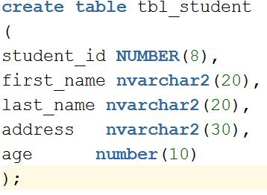
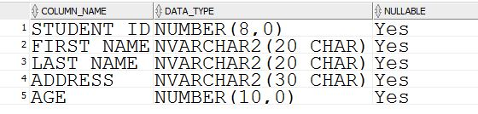
1. Null Integrity

Slide 28


1. Null Integrity
This query will produce error because there are already NULL in student_id.
So, delete the row having student_id NULL. Try the query again.

Slide 29
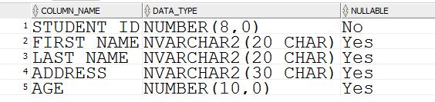
1. Null Integrity

Slide 30
2. Entity Integrity
This rule is about making sure that each tuple (or row) in a relation is unique.
Entity integrity is an integrity rule which states that every table must have a primary key and that the column or columns chosen to be the primary key should be unique and not null.
Why an attribute that is a primary key cannot not be null? Why would this potentially violate uniqueness?
Answer: A null value, being unknown, might be the same as the value in the primary key of another tuple.

Slide 31
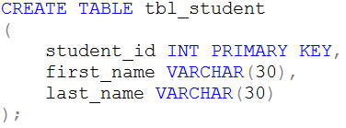
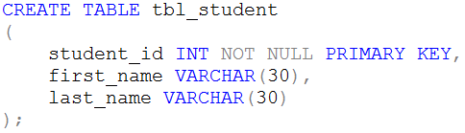
Creating Primary Key

Slide 32

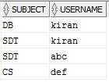
3. Referential Integrity
The referential integrity constraint is specified between two relations and is used to maintain the consistency among tuples in the two relations.
Referential integrity means if a foreign key is pointing to a record in another table, then that record must exist.
Primary Key
Foreign Key
If the foreign key points to a record that doesn't exist, referential integrity is broken.
It also includes the techniques known as cascading update and cascading delete, which ensure that changes made to the linked table are reflected in the primary table.

Slide 33
4. General Constraints (Business Rules )
Customized rules specified by the users or database administrators.
It is also called as a business rule which is a statement that defines or constrains some aspect of the business. It is intended to control the behavior of the business.
E.g.: age>=18 && age<=60
It is implemented using CHECK Constraint.

Slide 34
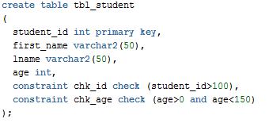
CHECK Constraint
Ensures that the value in a column meets a specific condition.
Enforce domain integrity by limiting the values that are accepted by column(s).
Multiple CHECK constraints can apply to a single column.

Slide 35
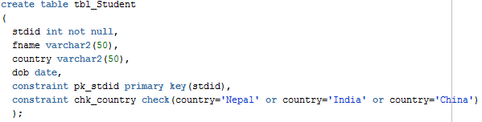
CHECK Constraint

Slide 36
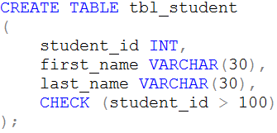
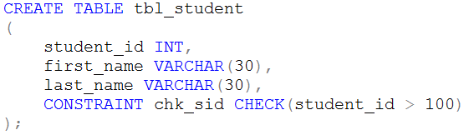
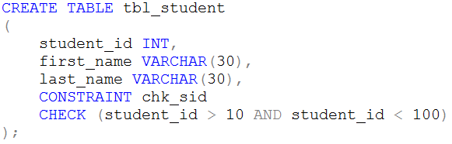
CHECK Constraint

Slide 37
Functional Dependency
Student ID | First Name | Surname
9901 | John | Dacus
9902 | Satpal | Singh
9922 | Jagpal | Singh
9911 | John | Smith
Students
For any Student ID, there is one first name and one surname, So, First Name and Surname are functionally dependent on Student ID. We can also say Student ID functionally determines First Name and Surname.
Student ID -> First Name, but not the reverse
Student ID -> Surname

Slide 38
Functional Dependency
A functional dependency is a constraint that describes the relationship between attributes in a relation.
If A and B are attributes of relation R, B is said to be functionally dependent on A (denoted A → B), if each value of A is associated with exactly one value of B.
A → B means B is functionally dependent on A or A functionally determines B.

Slide 39
Partial Dependency
When an non-key attribute is determined by a part, but not the whole, of a composite primary key. This kind of functional dependency is known as partial dependency.
There are two non-key fields : marks and subject_name.
If you know just student_id, can you determine marks?
If you know just subject_id, can you determine marks?
Both student_id and Subject Id is needed to determine Marks
But Subject _name can be identified by subject_id independently
This is called Partial Dependency
student_id | subject_id | marks | subject_name
1 | 1 | 80 | Database
2 | 1 | 70 | Database
1 | 2 | 90 | Java

Slide 40
Normalization :
1NF : single value attributes , Remove dublicate data
2NF : 1NF , Remove Partial Dependency
3NF : 2NF , Remove Transitive Dependency

Slide 41
Transitive Dependency
Three attributes A, B, and C connected in such a way that A→B and B→C. In other words A→C. If we know the value of A, we can determine B, which we can use in turn to determine C. This kind of functional dependency is known as transitive dependency.
e.g. The functional dependency {Book} → {Author Nationality} applies; that is, if we know the book, we know the author's nationality. Furthermore:
{Book} → {Author} {Author} does not → {Book} {Author} → {Author Nationality}
Therefore {Book} → {Author Nationality} is a transitive dependency.
Notes:
A → B means A functionally determines B.

Slide 42
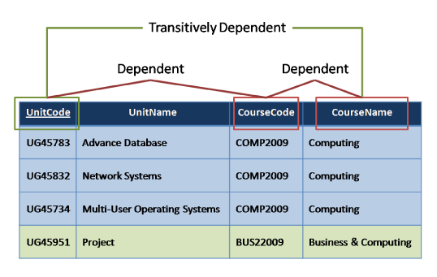
Transitive Dependency
Notes:
A → B means A functionally determines B.

Slide 43
Anomalies
Anomalies are inconvenient or error-prone situation arising when we process the tables. There are three types of anomalies:
Insert Anomalies
Update Anomalies
Delete Anomalies
Notes:
Anomalies: Deviation or departure from the normal or common order, form, or rule. One that is peculiar, irregular, abnormal, or difficult to classify.

Slide 44
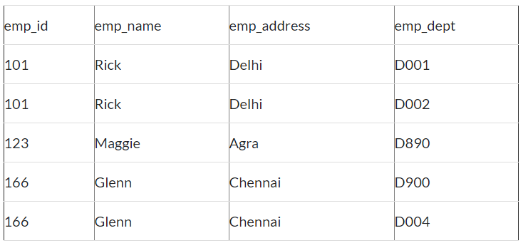
Activity: Insert Anomaly
An Insert Anomaly occurs when certain attributes cannot be inserted into the database without the presence of other attributes.
Suppose a new employee joins the company, who is under training and currently not assigned to any department then we would not be able to insert the data into the table if emp_dept field doesn’t allow nulls.

Slide 45
Update Anomaly
An Update Anomaly exists when one or more instances of duplicated data is updated, but not all.
We have two rows for employee Rick as he belongs to two departments of the company. If we want to update the address of Rick then we have to update the same in two rows or the data will become inconsistent. If somehow, the correct address gets updated in one department but not in other then as per the database, Rick would be having two different addresses, which is not correct and would lead to inconsistent data.

Slide 46
Delete Anomaly
Delete Anomaly exists when certain attributes are lost because of the deletion of other attributes.
Suppose, if at a point of time the company closes the department D890 then deleting the rows that are having emp_dept as D890 would also delete the information of employee Maggie since she is assigned only to this department.

Slide 47
WHAT IS NORMALIZATION
Inconsistency
or
abnormal
Break down
It is the process of decomposing relation with anomalies into small relations
Why?
Ensuring Data Integrity
Remove Data Redundancy
Satisfies all integrity constraint
Prevent insert , update , delete anomaly. Since,
the data is only available in one table in the
Database.
Domain integrity , entity integrity ,
Referential integrity constraints.

Slide 48
Normal Forms:
Un-normalized – There are multivalued attributes or repeating groups
1 NF – No multivalued attributes or repeating groups.
2 NF – 1 NF plus no partial dependencies
3 NF – 2 NF plus remove non-Key dependencies or transitive dependencies

Slide 49
Billing System
Bill No.: 1078
Date: 2013-12-20
Customer Code: C100
Customer Name: Ram Shrestha
ItemCode | ItemName | Rate | Qty
1 | Copy | 20 | 10
2 | Book | 200 | 8
3 | Pen | 10 | 3

Slide 50
UNF (Un-Normalized Form)
The first step is to identify which attributes belong to the repeating group.
Those attributes where there is one occurrence are marked with a ‘1’.
Those attributes where there is a repeating group are marked with a ‘2’.
The tentative primary key is also underlined. In this case it is BillNo.
UNF | UNF Level
BillNo | 1
Date | 1
CustomerCode | 1
CustomerName | 1
ItemCode | 2
ItemName | 2
Rate | 2
Qty | 2

Slide 51
First Normal Form(1NF)
Remove Repeating Group Information
BillNo
Date
CustomerCode
CustomerName
BillNo
ItemCode
ItemName
Rate
Qty

Slide 52
Second Normal Form (2NF)
Remove Partial Key Dependencies
Identify the attributes that are dependent on only one part of the primary key (composite key) and separate them.
BillNo
Date
CustomerName
ItemCode
ItemName
Rate
BillNo
ItemCode
Qty

Slide 53
Third Normal Form (3NF)
Remove Non-Key Dependencies or Transitive Dependencies
Identify the attributes that are functionally dependent on non-key attributes or identify the attributes that are not functionally dependent on primary key.
Here CustomerName is dependent of CustomerCode not BillNo.
BillNo
Date
CustomerCode
CustomerCode
CustomerName
BillNo
ItemCode
Qty
ItemCode
ItemName
Rate

Slide 54
The Document - Example

Slide 55
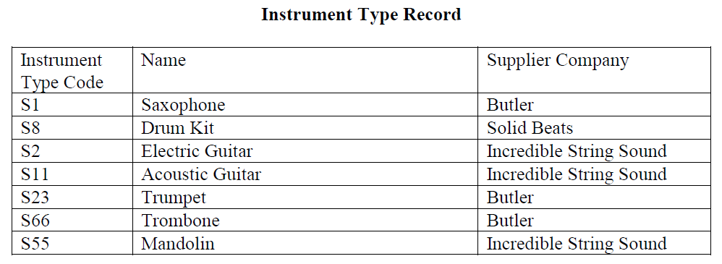
Activity 1

Slide 56
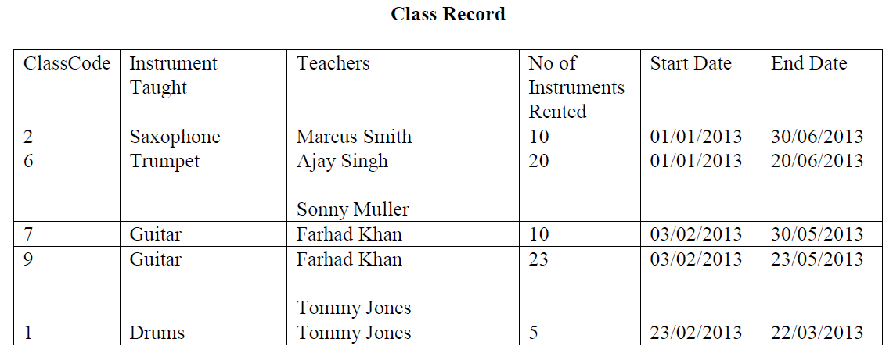
Activity 2

Slide 57
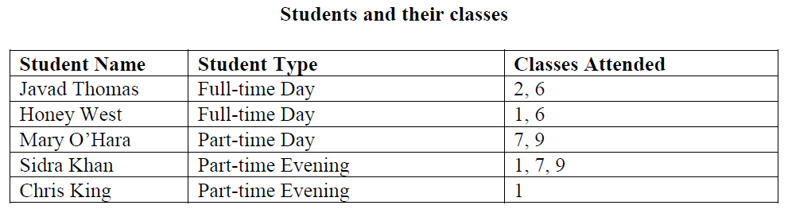
Activity 3

Slide 58
Any questions?

Slide 59
References
http://rdbms.opengrass.net/2_Database%20Design/2.2_Normalisation/2.2.4_1NF%20Repeating%20Attributes.html
http://rdbms.opengrass.net/2_Database%20Design/2.2_Normalisation/2.2.5_2NF-Partial%20Dependancy.html
http://rdbms.opengrass.net/2_Database%20Design/2.2_Normalisation/2.2.6_3NF-Transitive%20Dependency.html
http://en.wikipedia.org/wiki/Integrity_constraints
http://www.jkinfoline.com/functional-dependency.html
http://jcsites.juniata.edu/faculty/rhodes/dbms/funcdep.htm

