Slide 1
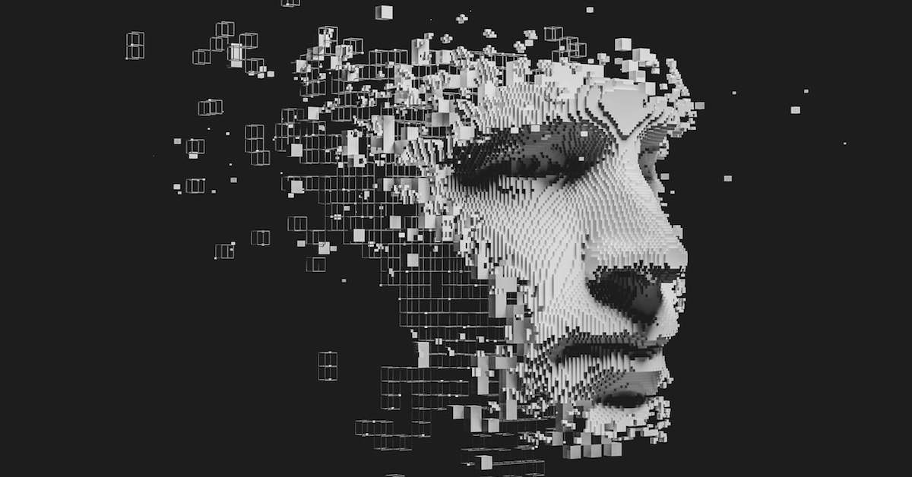

Module:
SWT290COM – Technology and its Social, Legal and Ethical context
Presentation Title:
Deepfake
Intake:
SEPTMEBER/NOVEMBER 2019
Submitted By:
CU ID: 10173183
College ID: 190199
Name: Gauri Shankar Sharma

Slide 2
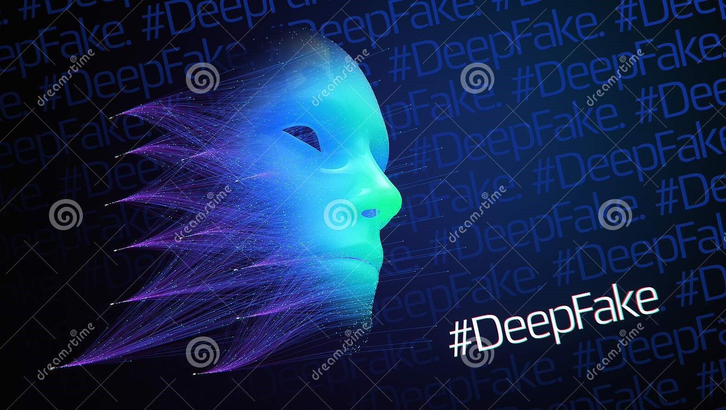
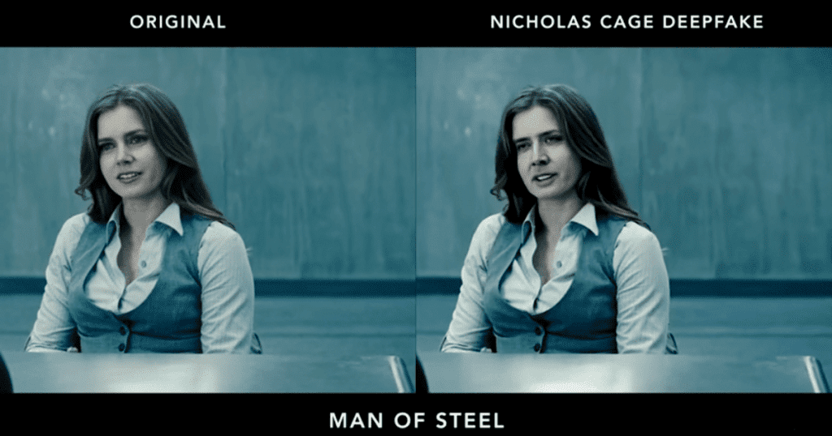
Deepfake
Introductions
Deepfake term refers to deep machine learning technology which can be used to steal someone else identity or to replace someone else identity by own likeness with the help of AI as shown in the figure. It is used to swap not only face and hole body but also to steal voices.
The term deepfakes originated around the end of 2017 from a Reddit user named “deepfakes’. He had shared deepfakes videos involved celebrities’ faces swapped onto the bodies of actresses in pornographic videos. While non-pornographic content included many videos with actor Nicolas Cage’s face swapped into various movies.

Slide 3
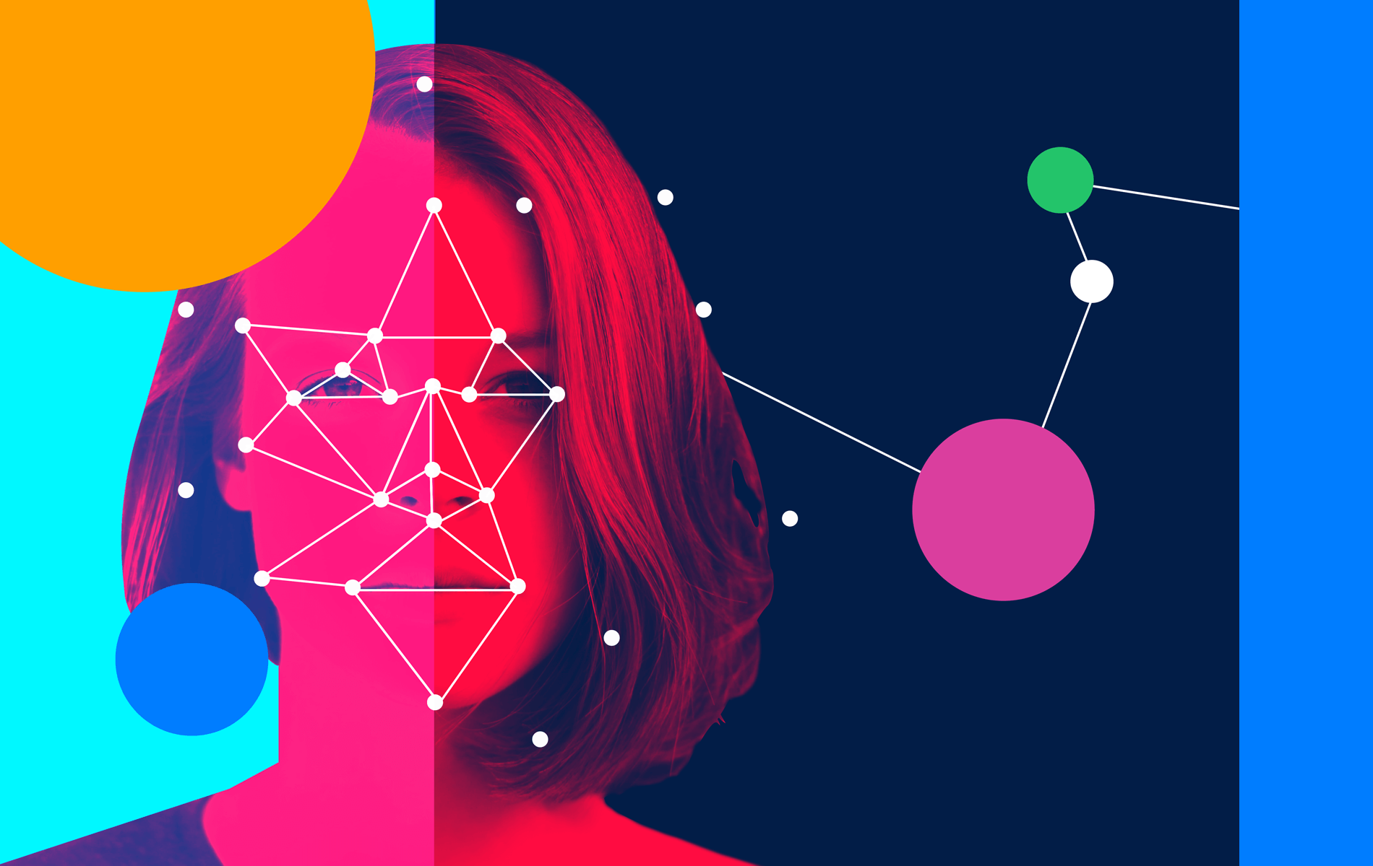
Deepfake
Applications
Blackmails
Pornography
Art
Politics
Acting
Movies
Social Media
Sock puppet
Fraud

Slide 4
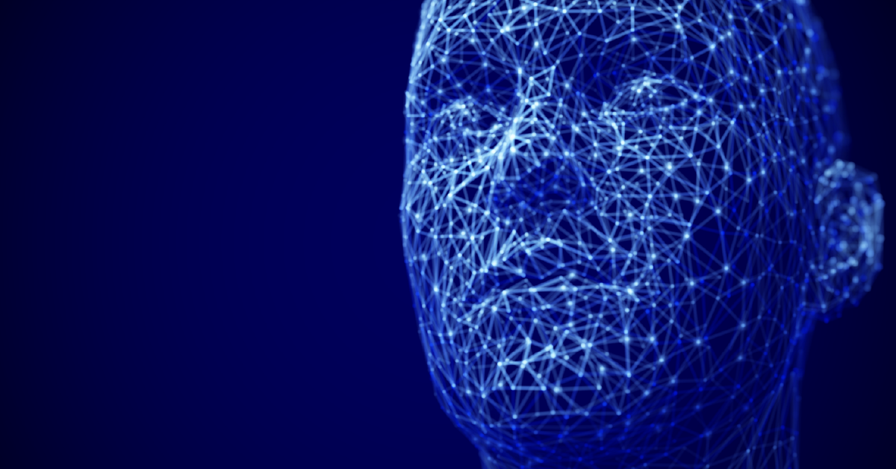
Deepfake
Ethical Implications
Deepfake has an enormous number of ethical implications
It lacks laws and policies and it can be misused by anyone, anytime, anywhere targeting anyone.
It does not have a fixed boundary. It can be weaponized for any purpose which can have a very large impact to the victim.
it can damage individuals, society, democracy, businesses, and even can make an untrusted truth fake news.
For Example, What if a video of a politician is released a few days before the election showing the politician using hate speech that undercut their image? It can make the politician lose the election or even can destroy the political career.
The CEO of a UK-based energy firm was scammed by the AI-generated voice of the chief executive of the firm’s parent German company in 2019. He was ordered to transfer €220, 000 into a Hungarian bank account (Damiani, 2019).
Credibility and authenticity

Slide 5
Deepfake
Solutions
Development of Deepfake detecting technology
Improving media literacy by filtering content from social platform.
Social media apps like YouTube, Facebook, Twitter, Instagram, Tik-Tok, and others should upgrade their policies regarding deepfake.
Laws, policies, rules and regulations should be made all around the world. For Example, deepfake technology should be developed and implemented under the control and vision of the government. Deepfake content creators should be punished as badly as its impact. Deepfake technology should be only used by professionals and authorized ones.
Strict implementations of the laws and policies.
A global awareness of deepfake to the world by educating people about it.

Slide 6
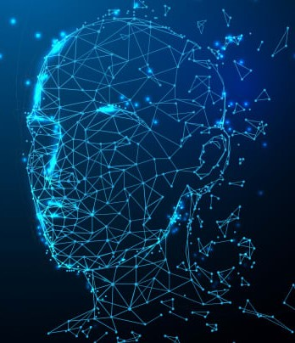
Deepfake
Laws And Policies
There is not a perfect and clear legislation on deepfakes signed into laws all around the world because it is newly generated technology and its misuse has been increasing steadily.
On December 20, 2019, President Trump signed the nation’s first federal law related to “deepfakes.” The deepfake legislation is part of the National Defense Authorization Act for Fiscal Year 2020 (NDAA). the NDAA was the first bill to become law that contains sections related to deepfakes.
In case of Nepal, The Cybercrime Act, xx (2018) can prevent the creating and spreading of deepfake content. This is the current legal framework on electronic evidence and cybercrime in Nepal through its Banking Offence and Punishment Act 2064 and Electronic Transactions Act, 2063. Illegal Devices (s10), Electronic Fraud (s12), Pornography (s14), Identity-Related Crime (s15) are the laws specified in The Cybercrime Act which can help the victim of deepfake content (Government, 2021).

Slide 7
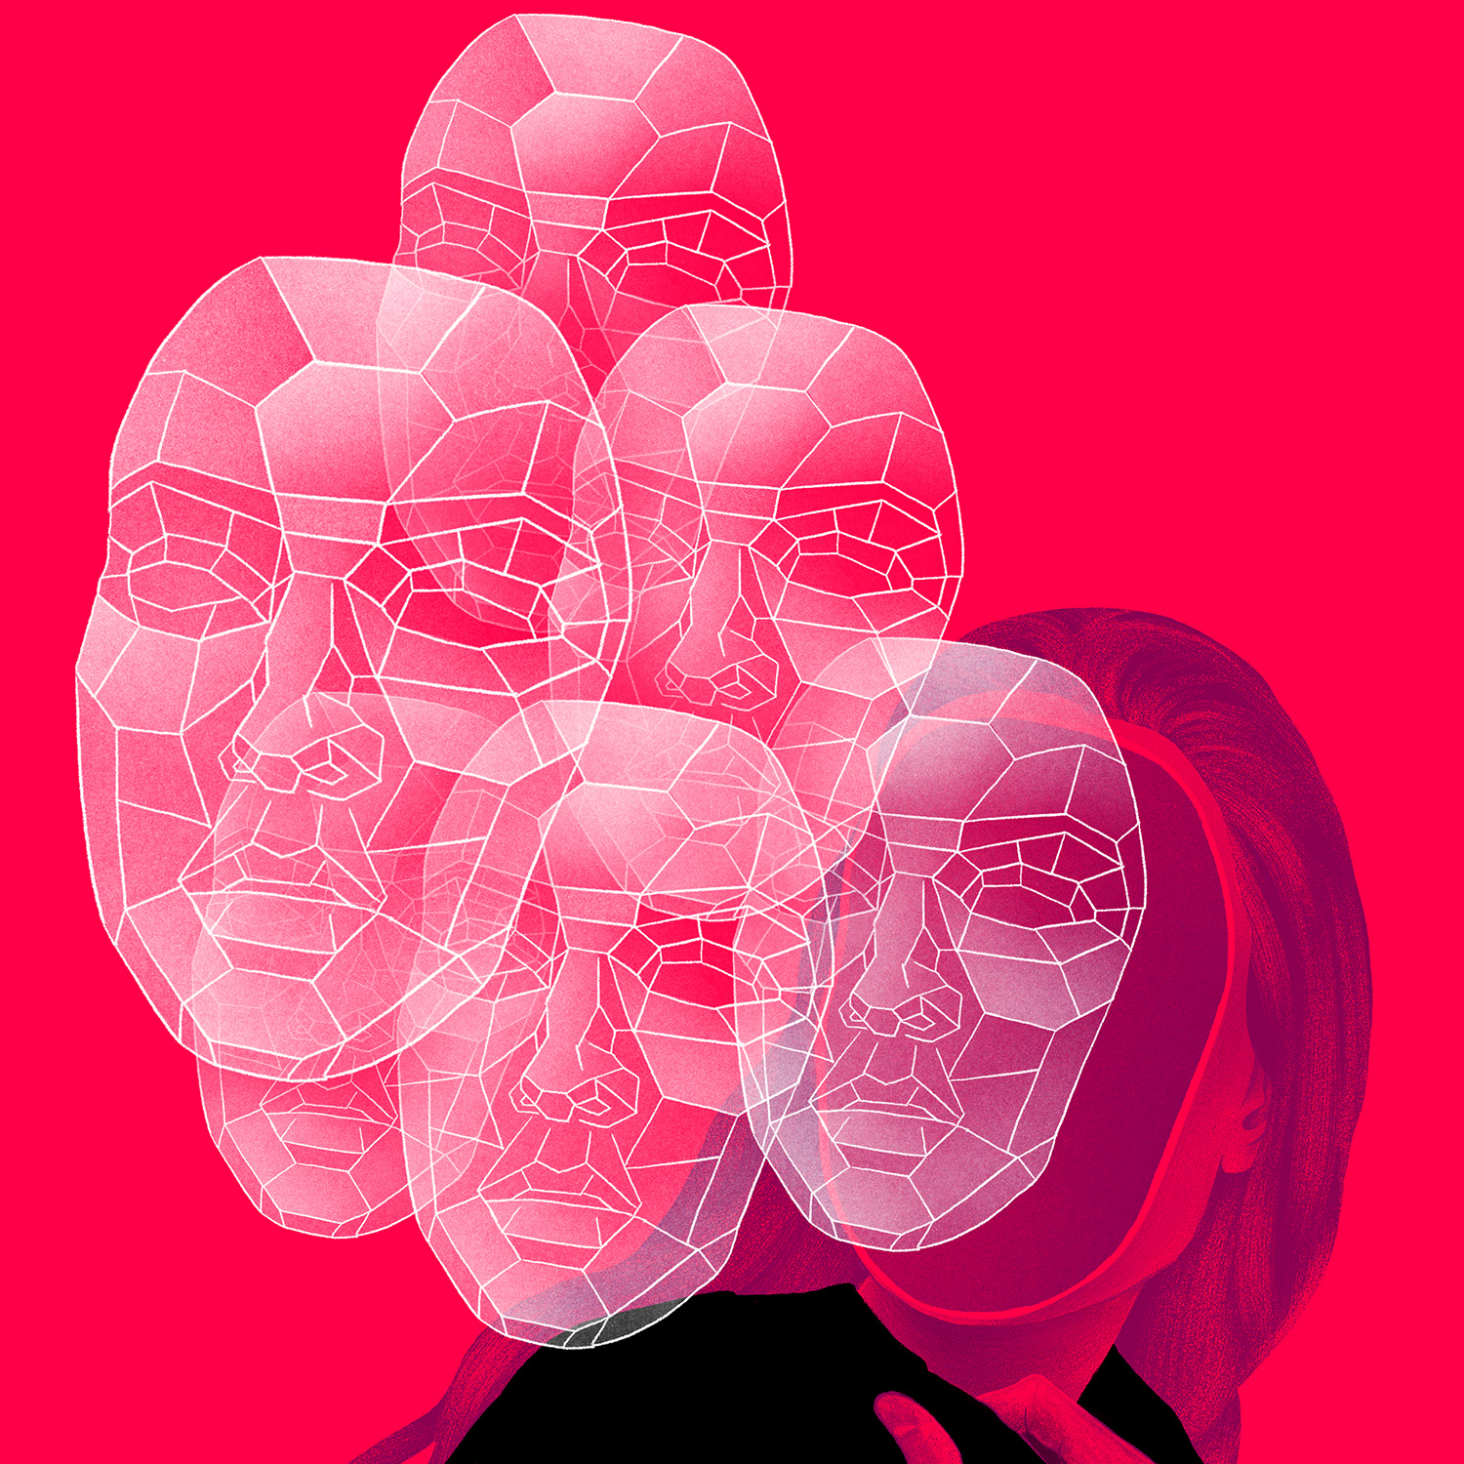
Deepfake
Conclusion
Deepfake has made it easy to falsify media, frequently without letting know about it.
It has caused psychological harm, disruption in business, and instability in politics. Deepfake weaponization provides an enormous impact on personal freedom, national security, and the economy.
But deepfake has been also used positively. Still, its malicious uses are more and increasing.
The world should be notified and made aware of deepfake and its impact that the future can face.
Perfect laws, policies, rules, and regulations regarding deepfake should be made and strictly implemented all around the world.

