Slide 1
Accessibility

Slide 2
Introduction
Accessibility: addresses discriminatory aspects related to equivalent user experience for people with disabilities.
Accessibility primarily focuses on people with disabilities.

Slide 3
Web accessibility also benefits people without disabilities, for example:
people using mobile phones, smart watches, smart TVs, and other devices with small screens, different input modes, etc.
older people with changing abilities due to ageing
people with “temporary disabilities” such as a broken arm or lost glasses
people with “situational limitations” such as in bright sunlight or in an environment where they cannot listen to audio
people using a slow Internet connection, or who have limited or expensive bandwidth

Slide 4
Check out the video
https://www.youtube.com/watch?v=3f31oufqFSM

Slide 5
WHY??
Disabled users make up a significant proportion of web users.
Accessible sites assist older web users.
Many countries have legal requirements to support disabled users.
Web accessibility also benefits people without disabilities

Slide 6
SO?
Accessibility is about designing websites that people with disabilities can use.

Slide 7
Different types of disabilities:
Visual
People that are blind or have limited vision.
They may not be able to see contents clearly.
Motor
People that have limited or no use of hands.
They could struggle to use conventional input devices that require fine motor control.

Slide 8
Different types of disabilities
Auditory
People that are deaf or hard of hearing.
They could struggle to understand audio and video content on the web/app.
Cognitive
People with cognitive disabilities may struggle to use websites/app with complex language, navigation, or interaction processes.

Slide 9
Assistive Technologies
Auditory
People that are deaf or hard of hearing.
They could struggle to understand audio and video content on the web.
Cognitive
People with cognitive disabilities may struggle to use websites with complex language, navigation, or interaction processes.

Slide 10
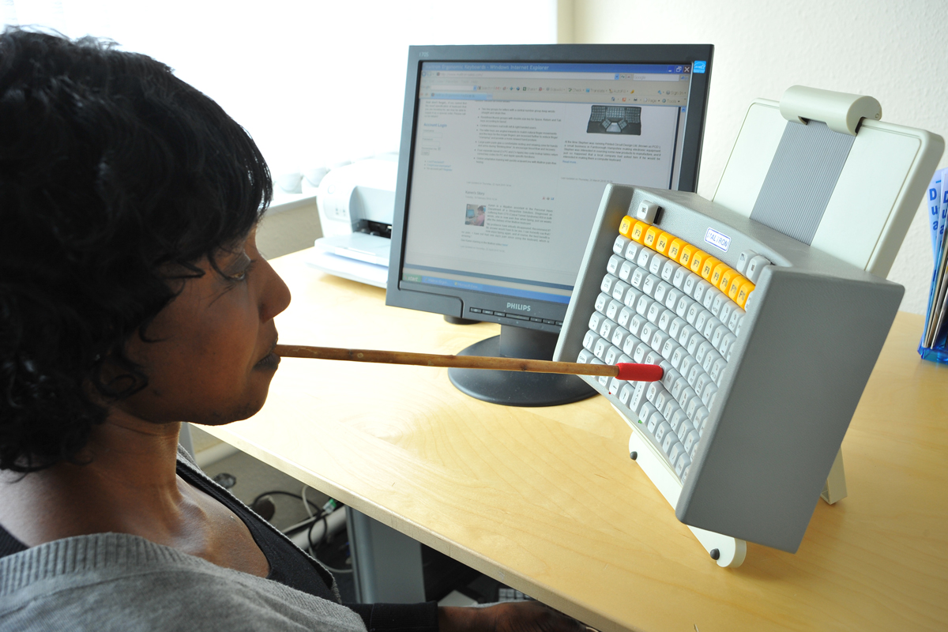
Keyboard

Slide 11
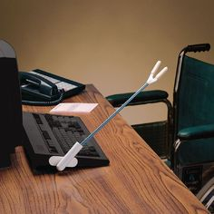
Mouth wands

Slide 12
Assistive Technologies
Visually impaired
Blind users will often use a ‘screen reader’ to surf the web
A screen reader reads out the contents of a page
Motor impaired users
May use specially designed keyboards, mouth wands, eye tracking, voice recognition

