Slide 1
106CR Pre-Week4 Lecture slides Recap Week3: Affordance Week4 Topic: Prototyping
Most of these slides are from previous years created by Peter Every - where updates made they are signalled in the right hand column

Slide 2
What is Task Analysis?
Task analysis is the process of learning about ordinary users by observing them in action to understand in detail how they perform their tasks and achieve their intended goals.
Tasks analysis helps identify the tasks that your website and applications must support and can also help you refine or re-define your site’s navigation

Slide 3
What is Task Analysis?
A methods to analyse human actions:
what people do
what things they work with
what they must know

Slide 4
Purpose of Task Analysis
What your users’ goals are; what they are trying to achieve
What users actually do to achieve those goals
How users are influenced by their physical environment
How users’ previous knowledge and experience influence:

Slide 5
When to Perform a Task Analysis
It’s important to perform a task analysis early in your process, in particular prior to design work. Task analysis helps support several other aspects of the user-centered design process, including:
Website requirements gathering
Developing your content strategy and site structure
Wireframing and Prototyping
Performing usability testing

Slide 6
An Example
In order to clean the house
get the vacuum cleaner out
fix the appropriate attachments
clean the rooms
when the dust bag gets full, empty it
put the vacuum cleaner and tools away
A person must know about:
vacuum cleaners, their attachments, dust bags, cupboards, rooms etc.

Slide 7
Approaches to Task Analysis
Task decomposition
splitting task into (ordered) subtasks

Slide 8
How to Conduct a Task Analysis
Breaks down the process for decomposing a high-level task into the following steps:
Identify the task to be analyzed.
Break this high-level task down into 4 to 8 subtasks. The subtask should be specified in terms of objectives and, between them, should cover the whole area of interest.
Draw a layered task diagram of each subtasks ensuring that it is complete
Produce a written account as well as the decomposition diagram.
Present the analysis to someone else who has not been involved in the decomposition but who knows the tasks well enough to check for consistency

Slide 9
Hierarchical Task Analysis
Please read Shepherd (1998) journal article:
Shepherd, A. (1998) HTA as a framework for task analysis. Ergonomics, VOL. 41 (11), pages 1537-1552
Please also see slides here: https://www8.cs.umu.se/kurser/5DV048/VT10/utdelat/F5-HTA.pdf

Slide 10
HTA
A hierarchical task analysis provides an understanding of the tasks users need to perform to achieve certain goals.
When designing a new system, hierarchical task analysis lets you explore various possible approaches to completing the same task. When analyzing an existing system, it can help you to optimize particular interactions.
Once you’ve created a hierarchical task analysis, it can serve as an effective form of system documentation, enabling developers to rapidly understand how users interact with a system.

Slide 11
HTA description consists of 2 parts:
1) Hierarchy description ...
0. in order to clean the house
1. get the vacuum cleaner out
2. get the appropriate attachment
3. clean the rooms
3.1. clean the hall
3.2. clean the living rooms
3.3. clean the bedrooms
4. empty the dust bag
4.1 some task
4.2 some other task
5. put vacuum cleaner and attachments away
2) plans
Plan 0: do 1 - 2 - 3 - 5 in that order. when the dust bag gets full do 4
Plan 3: do any of 3.1, 3.2 or 3.3 in any order depending on which rooms need cleaning
Plan 4 : do 4.1 or 4.2 in any order
Note: only the plans denote order

Slide 12
Types of plan
fixed sequence - do 1 then 2 then 3
optional tasks - if hall needs cleaning but other rooms do not, then do 3.1
wait for events - when dust bag is full do 4
cycles - do 3 while there are still dirty rooms
time-sharing - do 0; at the same time …(listen to music)
discretionary - do any of 3.1, 3.2 or 3.3 in any order
mixtures - most plans involve several of the above

Slide 13
Hierarchical Task Analysis
Problem: Stopping rules
How do we know when to stop?
Is “empty the dust bag” simple enough?
we need to expand only the relevant tasks
Motor actions: lowest sensible level

Slide 14
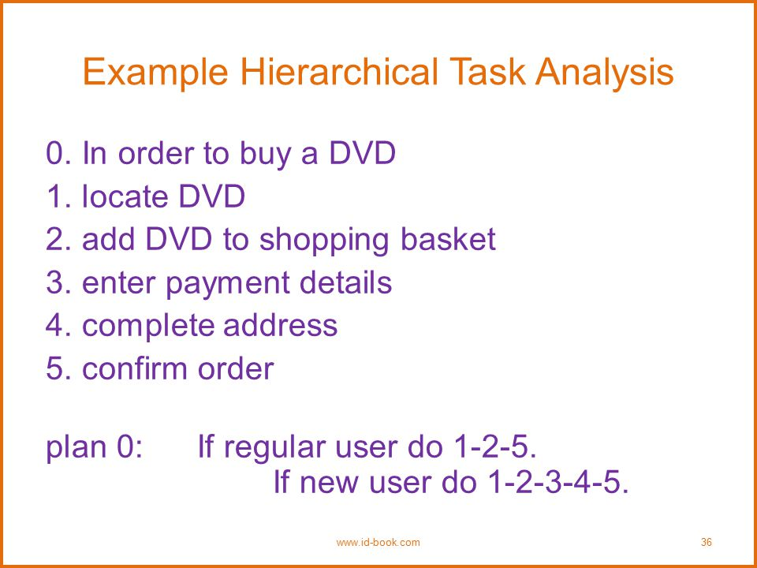
Hierarchical Task Analysis: Buying a DVD-1
From: http://slideplayer.com/slide/5261158/

Slide 15
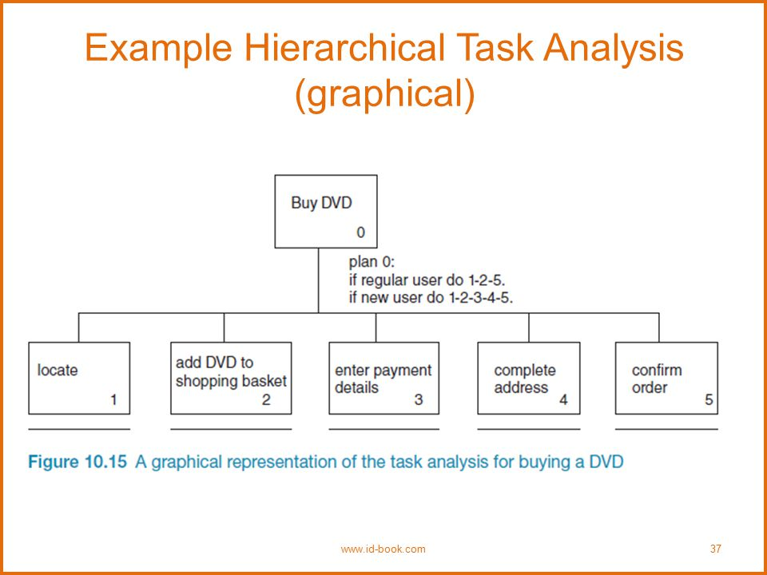
Hierarchical Task Analysis: Buying a DVD-2
From: http://slideplayer.com/slide/5261158/

Slide 16
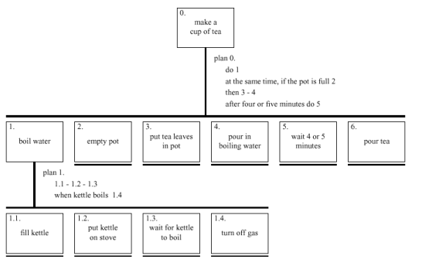
HTA for making a cup of tea
HTA image from the web

Slide 17
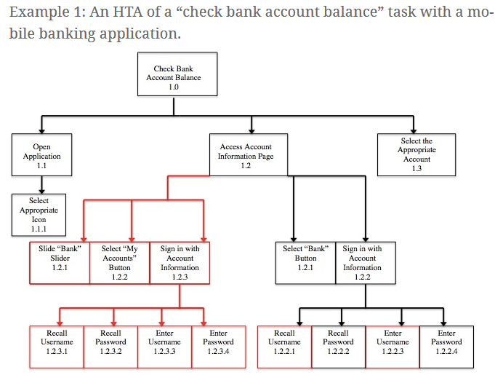

Slide 18
From tasks to screen interactions
A key task in developing interactive systems is taking our analysis of real tasks and mapping them on to an interaction sequence in the interface.
We need to know about actions (commands), objects to be controlled, information to be input - all of which can be captured in the task analysis

Slide 19
Example: buying a book in town
You enter a book shop
You use the categories / labels on the shelves to select a type of book, for example, “science fiction”
The books are presented alphabetically – you could choose the author: “William Gibson” or “Neal Stephenson”
Select a book “Neuromancer” or “Cryptonomicon”
Browse for more books or you decide to leave and pay.
Visit the till, present the book and your mobile ‘phone or your bank card
The book is scanned.
Payment type is validated.
The book is wrapped and given to you.
You leave the shop.

Slide 20
Example: Buying a book online
Enter the URL of the online retailer:
Amazon; Waterstones; Cambridge University Press
Follow a link to browse by genre – selecting “science fiction”
OR use the search facility to find books by “William Gibson”
Select the book “Neuromancer”
Given the choice: “add to shopping cart and continue browsing” or “check out now” – you choose to check out.
You are presented with a form to enter your email address, delivery address and payment type. You do this and click “buy”
The site shows you a “confirm” page – with all the details you entered – it allows you to correct any mistakes in your data. Click “confirm”.
An email is sent to confirming all the details given, promising delivery within [X number] of hours/days.

Slide 21
Example: Buying a book online
In that example the interaction design for the online book shop maps closely onto an experience of buying books in a physical book shop – it matches the ‘mental model’ of the task.
There would be a problem if the online shop asked for payment before allowing the selection of a book (that would not happen in a ‘real’ shop)
There would also be a problem if you were asked to give unnecessary information about yourself when paying (e.g. income, where you heard about the shop, persuading you to sign up to their mailing list) – does this happen in a ‘real’ shop?

Slide 22
So now we know that:
Task analysis can be used to guide our decisions about the ‘flow’ or order of interaction in interface design – to bring it close to users’ mental models of the task – and to eliminate unnecessary elements from the interaction.

