Slide 1
Usability

Slide 2
Introduction
Usability : the extent to which a product can be used by specified users to achieve specified goals with effectiveness, efficiency and satisfaction in a specified context of use.
According to the ISO 9241-11

Slide 3
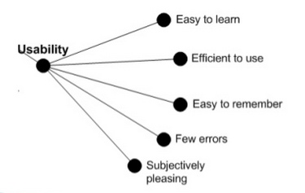
Usability
Usability is quality attribute that assesses how easy user interfaces are to use.
Usability also refers to methods for improving ease-of-use during the design process.

Slide 4
Components of Usability
Learnability
Efficiency
Memorability
Error Tolerance
Satisfaction

Slide 5
Learnability
A usable product is easy to learn. In this busy and competitive world, no one has time to use a product which is difficult to understand.
Ease of use is the first important thing that a user feels in a product, so it needs to be a priority while making design decisions.
Basically, ease of learning means that a user must be able to learn how to use a system as quickly and as easily as possible.
However, different learning times are acceptable, depending on the type of system.
Solution??

Slide 6
Efficiency
Efficiency means how fast a user can perform tasks once she has learned to use a system.
An efficient product is the one that makes it easier for a user to perform his tasks quickly and effectively.
If this factor is missing in design, a beautifully designed product will also lose the trust of its users.
Solution?
One way to improve efficiency is by adding hidden shortcuts for frequently used functions

Slide 7
Memorability
Memorability measures how well users can remember different functions after they have learned the functions.
A good product is the one that do not require user to memorize it. Instead, user should be able to go through the layout and flow easily whenever he comes to use the product.
Solution?

Slide 8
Error Tolerance
A product’s usability can easily be measured by the way its response to human errors. A usable product tries to resolve errors seamlessly.

Slide 9
Satisfaction
Satisfaction with a system means basically how pleasing it is to use. It affects the user’s motivation and thus the effectiveness of use
This usability component requires to provide a pleasant and satisfactory user experience. If a user comes to use a product, he should be able to accomplish his goals in a way that he wants to come back again to the same product.
Solution?

