Slide 1
Personas
The purpose of personas is to create reliable and realistic representations of your key audience segments for reference.
It is based on the research carried out into users:

Slide 2
Personas
The purpose of personas is to create reliable and realistic representations of your key audience segments for reference. These representations should be based on qualitative and some quantitative user research and web analytics. Remember, your personas are only as good as the research behind them.

Slide 3
Effective Personas
Represent a major user group for your website
Express and focus on the major needs and expectations of the most important user groups
Give a clear picture of the user's expectations and how they're likely to use the site
Aid in uncovering universal features and functionality
Describe real people with backgrounds, goals, and values

Slide 4
Elements of Personas
Persona Group (i.e. web manager)
Fictional name
Job titles and major responsibilities
Demographics such as age, education, ethnicity, and family status
The goals and tasks they are trying to complete using the site
Their physical, social, and technological environment

Slide 5
Questions to be asked (Personal)
What is the age of your person?
What is the gender of your person?
What is the highest level of education this person has received?

Slide 6
Question to be asked(Technical)
What technological devices does your person use on a regular basis?
What software and/or applications does your person use on a regular basis?
Through what technological device does your user primarily access the web for information?
How much time does your person spend browsing the web every day?

Slide 7
Name: Anne Foster
Age: 49
Occupation: Part-time Accountant
Browser: Internet Explorer
Screen Resolution: 1024x800
Web experience: Regularly uses the web to check her email, keep in touch with friends and shop online.
Details: Anne is married with two teenage children. She cares about the way she looks and likes to think she has a distinctive style, not just following the latest fashions and trends.

Slide 8
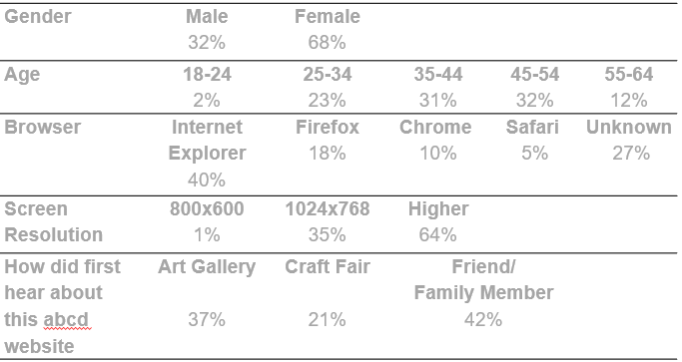

Slide 9
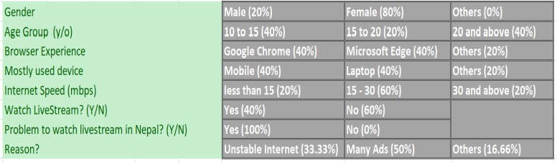
Example

