Slide 1
Prototype

Slide 2
What is Prototype?
A prototype is a draft version of a product that allows you to explore your ideas and show the intention behind a feature or the overall design concept to users before investing time and money into development.
A prototype can be anything from paper drawings (low-fidelity) to something that allows click-through of a few pieces of content to a fully functioning site (high-fidelity).

Slide 3
Benefits of prototype
Early discovery of design problems.
Estimate production costs, manufacturing time, and requirements for materials.
Determine machinery necessary for production.
Testing to determine fit and durability.
Receive feedback from client and end-users/identify improvements.
It is much cheaper to change a product early in the development process than to make change after you develop the site.

Slide 4
Some of the problems of Prototype
Excessive development time - When the end user is asked to evaluate a prototype and provide feedback there is a risk that they will be forever wanting to tweak the product, thus leading to delays in development.
User confusion - Sometimes features appear in a prototype which are then removed from the final system. Users can become confused or disappointed with the final product if it differs greatly from the prototype.
Prototyping expense - Building a prototype costs money in terms of development time and possibly hardware.
Excessive focus on one part of the product - When a lot of time is spent on one specific part of the prototype, other parts of the product might end up being neglected.
Increased development time - The end user might start to ask for features to be included which were never in the original user requirements specification. This can lead to increased development time and costs.

Slide 5
Types of prototype
Low Fidelity Prototype
High Fidelity Prototype

Slide 6
Low-fidelity prototype
Low-fidelity (lo-fi) prototyping is a quick and easy way to translate high-level design concepts into tangible and testable artifacts.
The first and most important role of lo-fi prototypes is to check and test functionality rather than the visual appearance of the product.

Slide 7
Characteristics of low-fidelity prototype
Visual design: Only some of the visual attributes of the final product are presented (such as shapes of elements, basic visual hierarchy, etc.).
Content: Only key elements of the content are included.
Interactivity: The prototype can be simulated by a real human.

Slide 8
PROS
Inexpensive: The clear advantage of low-fidelity prototyping is its extremely low cost.
Fast: It’s possible to create a lo-fi paper prototype in just five to ten minutes. This allows product teams to explore different ideas without too much effort.
Collaborative: This type of prototyping stimulates group work. Since lo-fi prototyping doesn’t require special skills, more people can be involved in the design process. Even non-designers can play an active part in the idea-formulation process.
Clarifying: Both team members and stakeholders will have a much clearer expectation about an upcoming project

Slide 9
CONS
Uncertainty during testing: With a lo-fi prototype, it might be unclear to test participants what is supposed to work and what isn’t. A low-fidelity prototype requires a lot of imagination from the user, limiting the outcome of user testing.
Limited interactivity: It’s impossible to convey complex animations or transitions using this type of prototype.

Slide 10
Popular techniques for creating Low-fidelity Prototypes:
Paper Prototype
Wireframe

Slide 11
Paper Prototype
Paper prototyping allows you to prototype a digital product interface without using digital software. The technique is based on creating hand drawings of different screens that represent user interfaces of a product.
While this is a relatively simple technique, it can be useful when a product team needs to explore different ideas and refine designs quickly.
This is especially true in the early stages of design when the team is trying different approaches.

Slide 12
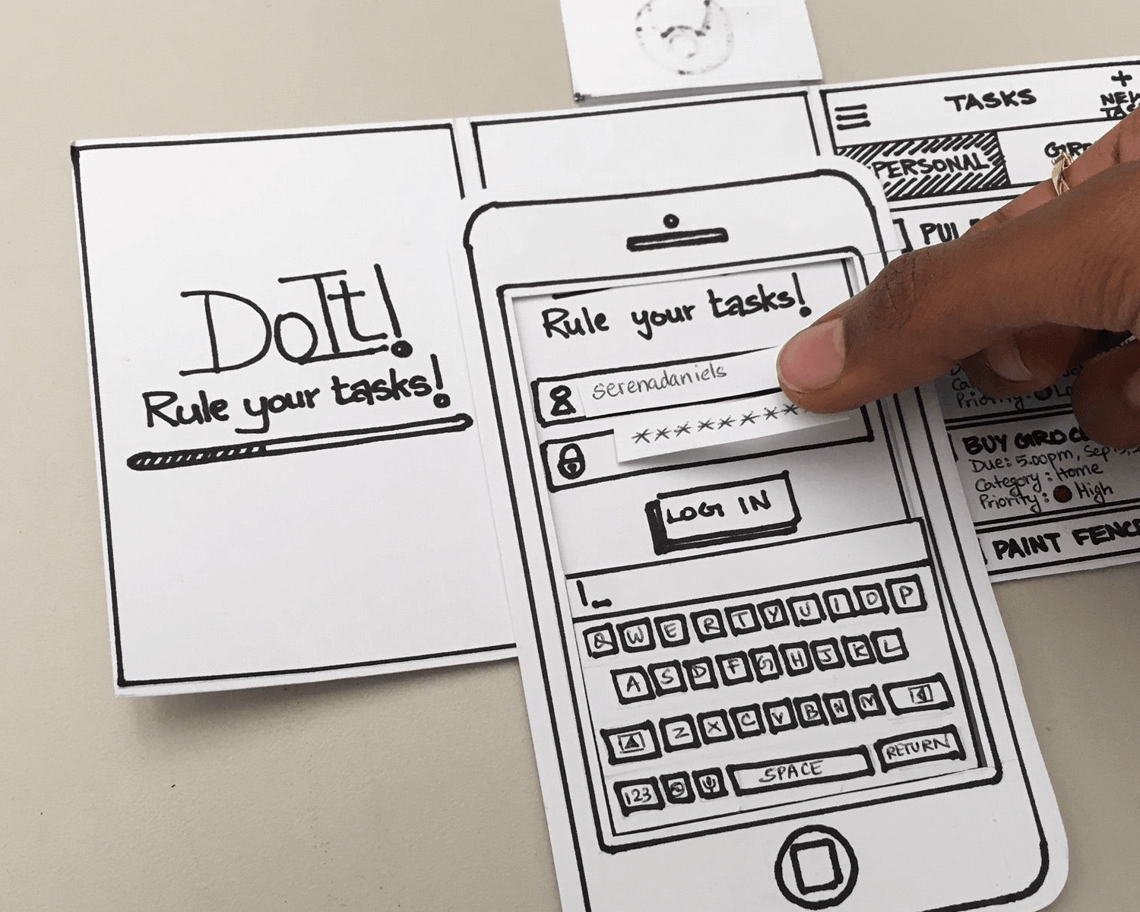
Example

Slide 13
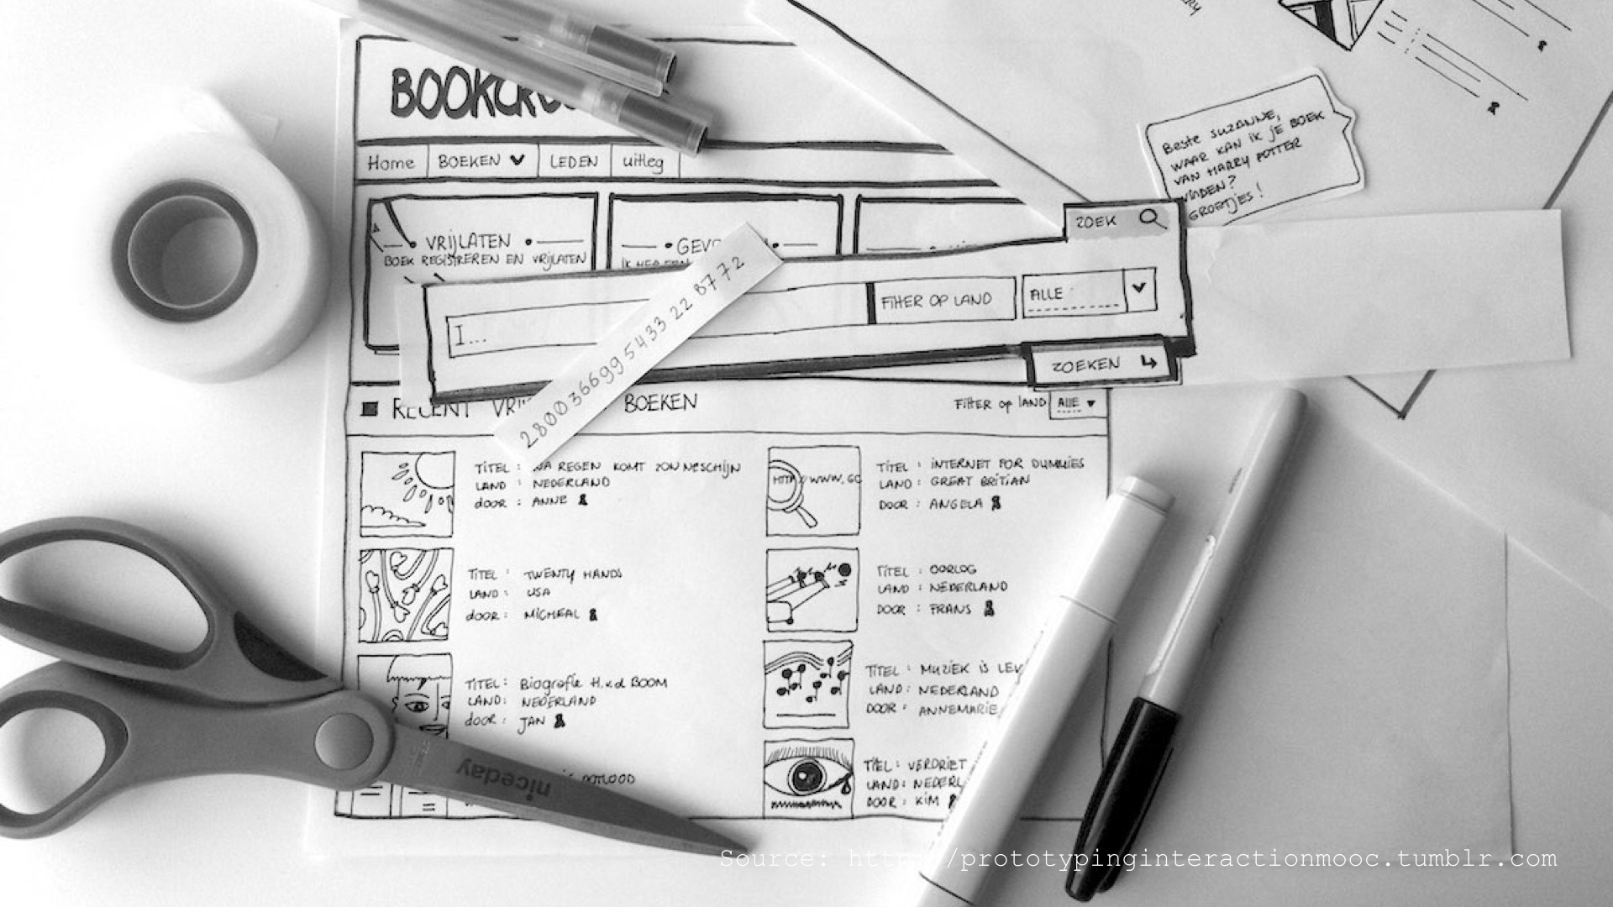
Example

Slide 14
Example

Slide 15
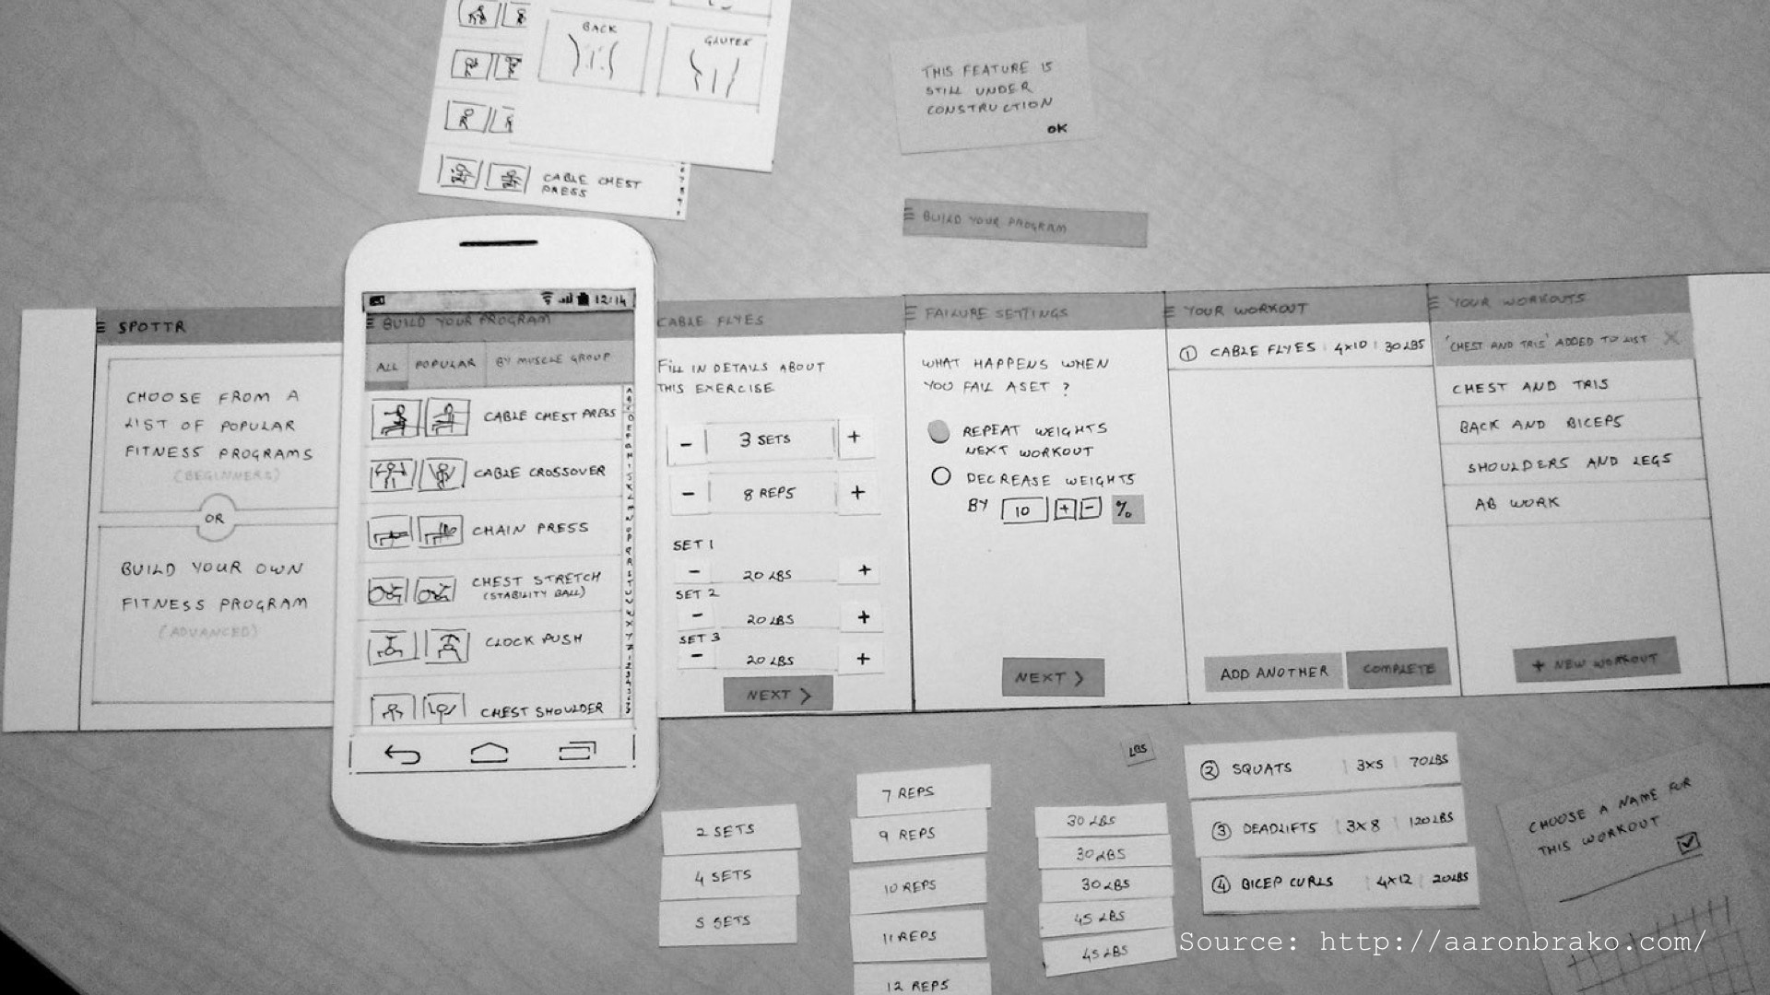
Example

Slide 16
Benefits of paper prototype
Leverage common design skills: Everyone can sketch (even those who say they can’t) and this means that everyone can build paper prototypes.
Allow early testing: Testing prototypes early lets product teams find big-picture problems — such as unclear information architecture — before they become too difficult to handle.
Support rapid experimentation: Different user interface elements can be drawn, cut out, copied to make extras, and then assembled on a new piece of paper. With paper prototypes, it’s also possible to mimic complex interactions, such as scrolling.

Slide 17
Cont..
Serve as documentation. Unlike digital prototypes, paper prototypes can be used as a reference for future iterations. Notes and revisions can be written either directly on the prototype or on sticky notes attached to the pages.
Facilitate adjustments. Using paper prototypes, it’s possible to make changes during the testing session. If designers need to add a change to the prototype they can quickly sketch a response or erase part of the design.

Slide 18
Some of the drawbacks of Paper prototype
An additional person is required to conduct the test session. You’ll need at least two people to conduct the test. One person will be the facilitator (‘computer’) that’s helping the test participant walk through the design and the other person will be actually testing the app.
It’s hard to convey complicated operations. Paper prototypes are less suitable for visually-complex or highly-interactive interfaces.

Slide 19
Wireframe
A wireframe is a visual representation of a product page that the designer can use to arrange page elements. Wireframes can be used as a foundation for lo-fi prototypes

Slide 20
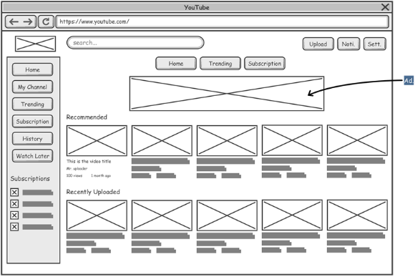
Example

Slide 21
Benifits
Existing design deliverables can be reused. During a particular phase of the design process you’ll have wireframes or sketches that represent your product’s UI design. In most cases, it’s possible to use them to create a clickable flow.
Layouts can be easily changed. Designers can easily adapt wireframes based on user feedback and repeat the testing process. With the right tool, it’s easy to create or modify click-through prototypes without spending a lot of extra time.

