Slide 1
Storyboard
Definition: A storyboard communicates a story through images displayed in a sequence of panels that chronologically maps the story’s main events.
In the world of UX, we use storyboards to provide additional context to our teams and stakeholders. Using images makes the story quick to understand at first glance and easy to remember.

Slide 2
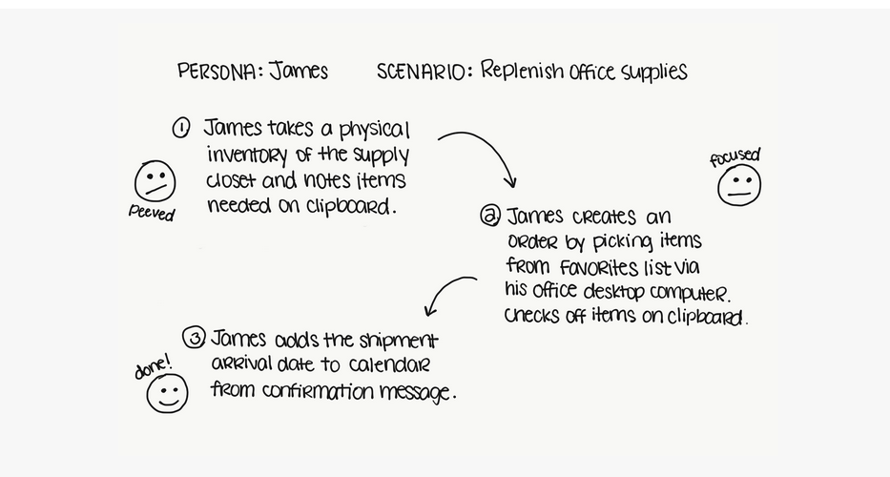
Detailing

Slide 3
Contd…

Slide 4
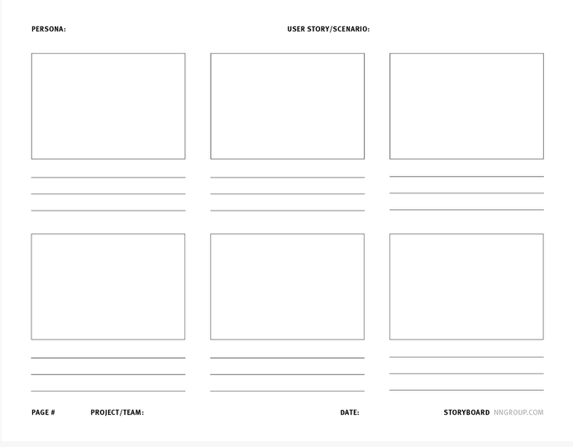
template

Slide 5
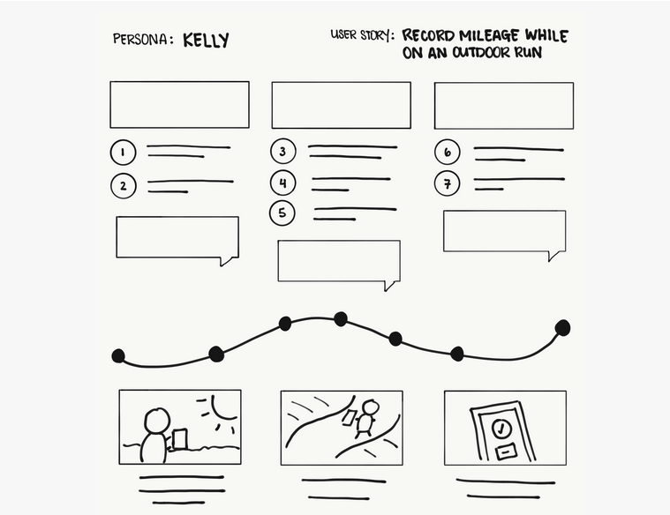
Ex 1

Slide 6
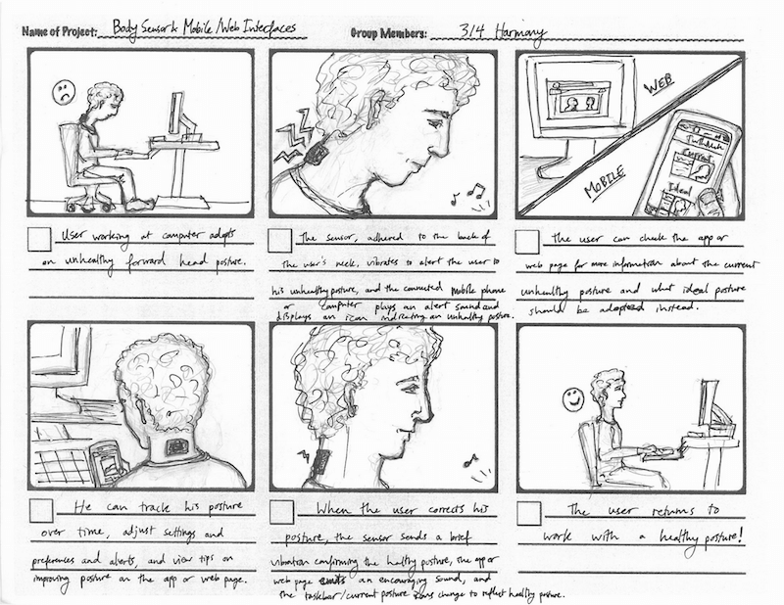
Real example

