Slide 1
Pervasive Computing
Parts of the slides are extracted from those of Profs. Mark Weiser, Deborah Estrin, Akbar Sayeed, Jack Stankovic, Mani Srivastava, Esa Tuulari, Qiong Luo, Chung-Ta King, and so on.

Slide 2
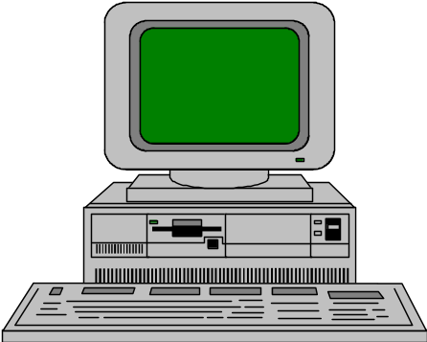



The Trends in Computing Technology
1970s
1990s
Late 1990s
Now and Tomorrow ?

Slide 3

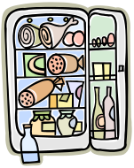

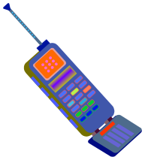


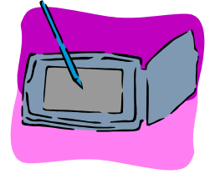




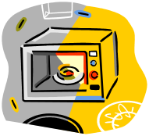



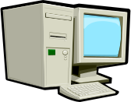


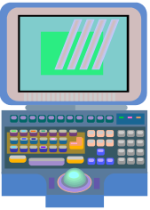


Pervasive Computing Era

Slide 4
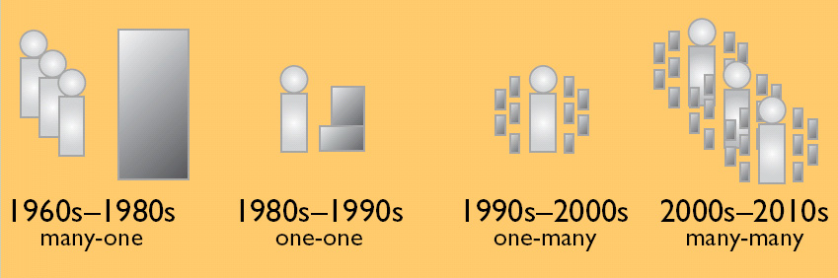
Computing Evolution

Slide 5
Ubiquitous Computing
Mark Weiser, Xerox PARC 1988
“Ubiquitous computing enhances computer use by making many computers available throughout the physical environment, but making them effectively invisible to the user.”
Source: Weiser, 1993a

Slide 6
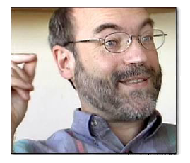

Pervasive (Ubiquitous)
Computing Vision
“In the 21st century the technology revolution will move into the everyday, the small and the invisible…”
“The most profound technologies are those that disappear. They weave themselves into the fabrics of everyday life until they are indistinguishable from it.”
Mark Weiser (1952 –1999), XEROX PARC
Small, cheap, mobile processors and sensors
  in almost all everyday objects
  on your body (“wearable computing”)
  embedded in environment (“ambient intelligence”)

Slide 7
Related Topics
Several terms that share a common vision
  Pervasive Computing
  Sentient computing
  Ubiquitous Computing
  Ambient Intelligence
  Wearable Computing
  Context Awareness
  ...

Slide 8
What is Ubiquitous Computing?
Ubiquitous computing (ubicomp) integrates computation into the environment, rather than having computers which are distinct objects.
The idea of ubicomp enable people to interact with information-processing devices more naturally and casually, and in ways that suit whatever location or context they find themselves in.
~from Wiki

Slide 9
Goals of Pervasive (Ubiquitous) Computing
Ultimate goal:
  Invisible technology
  Integration of virtual and physical worlds
  Throughout desks, rooms, buildings, and life
  Take the data out of environment, leaving behind just an enhanced ability to act

Slide 10
Pervasive Computing Phase I
Phase I
  Smart, ubiquitous I/O devices: tabs, pads, and boards
  Hundreds of computers per person, but casual, low-intensity use
  Many, many “displays”: audio, visual, environmental
  Wireless networks
  Location-based, context-aware services
Using a computer should be as refreshing as a walk in the woods

Slide 11
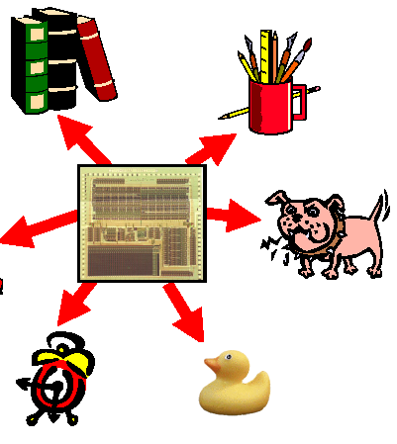
Smart Objects
Real world objects are enriched with information processing capabilities
Embedded processors
  in everyday objects
  small, cheap, lightweight
Communication capability
  wired or wireless
  spontaneous networking and interaction
Sensors and actuators

Slide 12
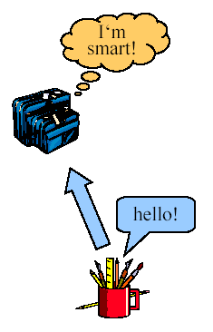
Smart Objects (cont.)
Can remember pertinent events
  They have a memory
Show context-sensitive behavior
  They may have sensors
  Location/situation/context
  awareness
Are responsive/proactive
  Communicate with environment
  Networked with other smart objects

Slide 13
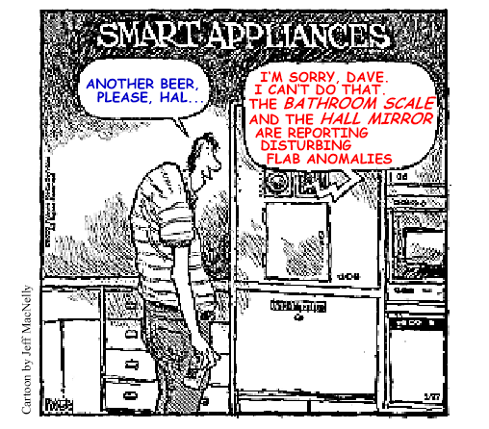
Smart Objects (cont.)

Slide 14
Pervasive Computing Enablers
Moore’s Law of IC Technologies
Communication Technologies
Material Technologies
Sensors/Actuators

Slide 15
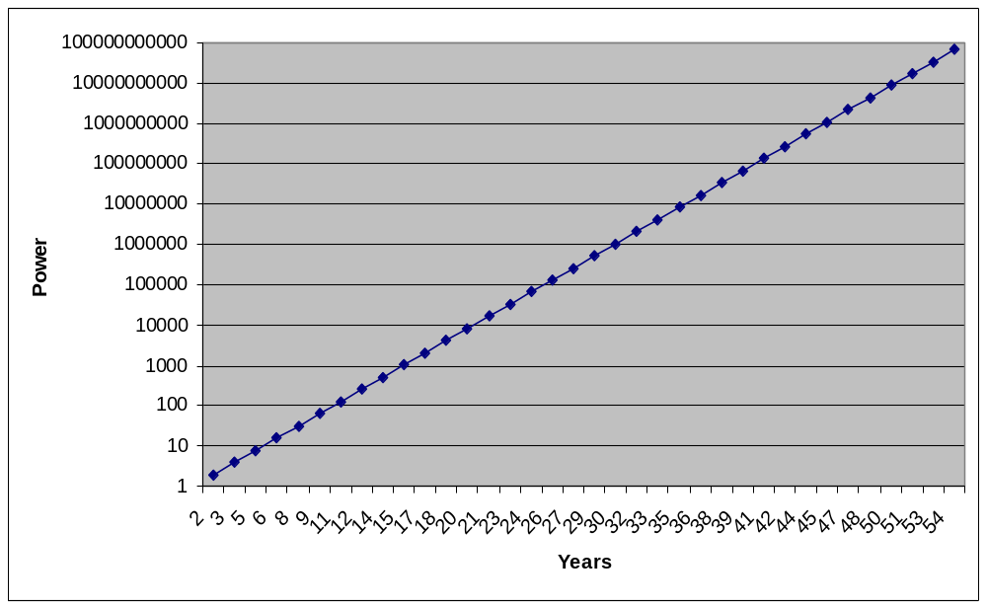
Moore’s Law
Computing power (or number of transistors in an integrated circuit) doubles every 18 months

Slide 16
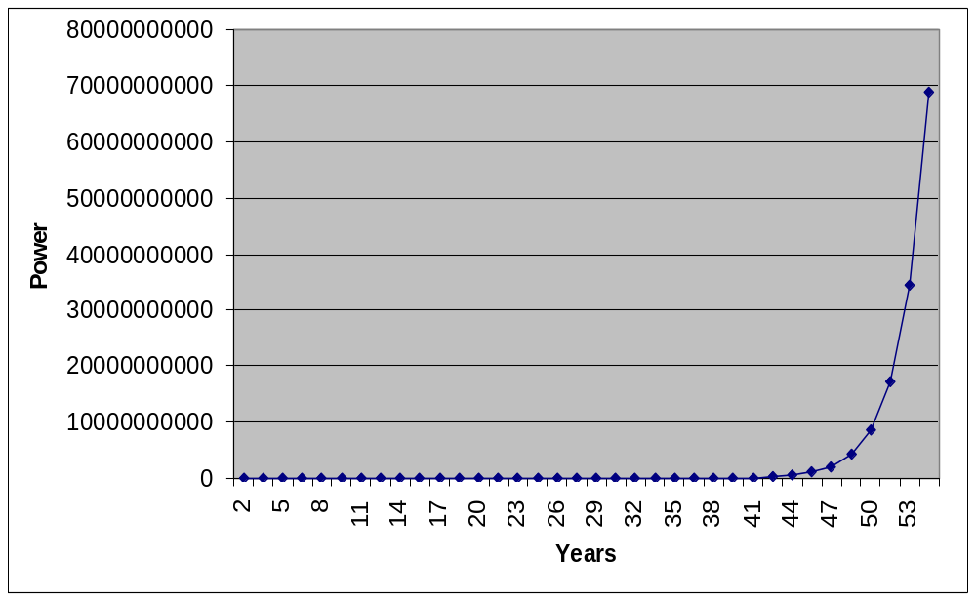
Moore’s Law
1965
Computing power (or number of transistors in an integrated circuit) doubles every 18 months

Slide 17
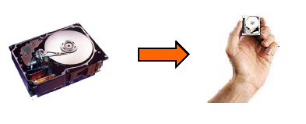
Generalized Moore’s Law
Most important technology parameters double every 1–3 years:
  computation cycles
  memory, magnetic disks
  bandwidth 
Consequence:
  scaling down
Problems:
• increasing cost
• energy

Slide 18
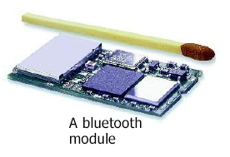
2nd Enabler: Communication
Bandwidth of single fibers ~10 Gb/s
  2002: ~20 Tb/s with wavelength multiplex
  Powerline
  coffee maker “automatically” connected to the Internet
Wireless
  mobile phone: GSM, GPRS, 3G
  wireless LAN (> 10 Mb/s)
  PAN (Bluetooth), BAN

Slide 19
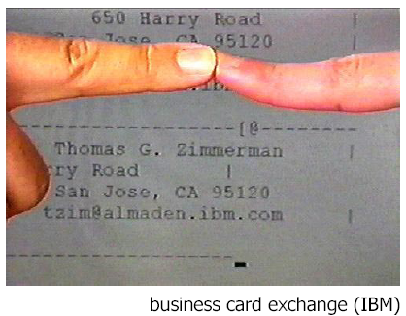
Body Area Networks
Very low current (some nA), some kb/s through the human body
Possible applications:
  Car recognize driver
  Pay when touching
  the door of a bus
  Phone configures itself
  when it is touched

Slide 20
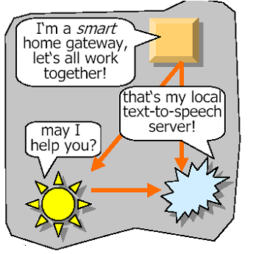
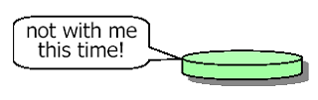
Spontaneous Networking
Objects in an open, distributed, dynamic world find each other and form a transitory community
  Devices recognize that
  they “belong together”

Slide 21
3rd Enabler: New Materials
Important: whole eras named after materials
  e.g., “Stone Age”, “Iron Age”, “Pottery Age”, etc.
Recent: semiconductors, fibers
  information and communication technologies
Organic semiconductors
  change the external appearance of computers
“Plastic” laser
  Flexible displays,…

Slide 22
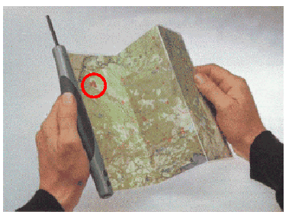
Interactive Map
Foldable and rollable
You are here!

Slide 23
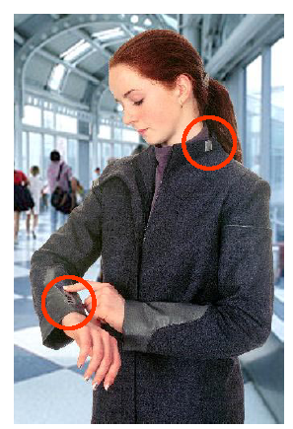
Smart Clothing
Conductive textiles and inks
  print electrically active patterns directly onto fabrics
Sensors based on fabric
  e.g., monitor pulse, blood pressure, body temperature
Invisible collar microphones
Kidswear
  game console on the sleeve?
  integrated GPS-driven locators?
  integrated small cameras (to keep the parents calm)?

Slide 24
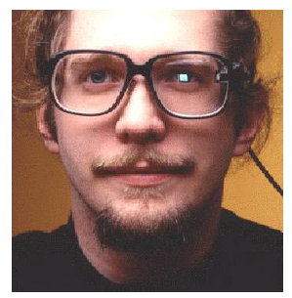
Smart Glasses
By 2009, computers will disappear. Visual information will be written directly onto our
retinas by devices in
our eyeglasses and
contact lenses
-- Raymond Kurzweil

Slide 25
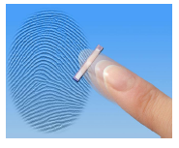
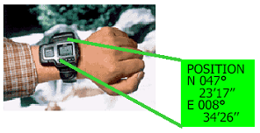
4th Enabler: Sensors/Actuators
Miniaturized cameras, microphones,...
Fingerprint sensor
Radio sensors
RFID
Infrared
Location sensors
  e.g., GPS
...

Slide 26
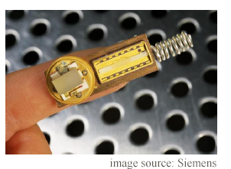
Example: Radio Sensors
No external power supply
  energy from the
  actuation process
  piezoelectric and
  pyroelectric materials
  transform changes in
  pressure or temperature
  into energy
RF signal is transmitted via an antenna (20 m distance)
Applications: temperature surveillance, remote control (e.g., wireless light switch),...

Slide 27
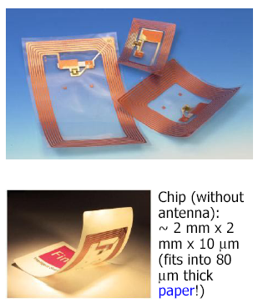
RFIDs (“Smart Labels”)
Identify objects from distance
  small IC with RF-transponder
Wireless energy supply
  ~1m
  magnetic field (induction)
ROM or EEPROM (writeable)
  ~100 Byte
Cost ~$0.1 ... $1
  consumable and disposable
Flexible tags
  laminated with paper

Slide 28
Outline of the Course (1)
Introduction to Pervasive Computing
Wireless Communications
Mobile Ad Hoc Networks (MANETs)
Wireless Sensor Networks (WSNs)
Media Access Control (MAC) Protocols
Wireless Sensor Network Deployment
Data-Centric Routing for WSNs

Slide 29
Outline of the Course (2)
Congestion Control and Avoidance for WSNs
WSN Data Aggregation
Localization
Geographical Routing
Location Service
Event Detection
Target Tracking
RFID
RFID anti-collision algorithms
Ubiquitous Guiding System

Slide 30
Q&A

