Slide 1

MICROCONTROLLER

Slide 2
What is a MICROCONTROLLER?
A microcontroller is an integrated circuit (IC) that can be programmed to perform a set of functions to control a collection of electronic devices.
A self-contained system in which a processor, support, memory, and input/output (I/O) are all contained in a single package.
Being programmable is what makes the microcontroller unique.

Slide 3
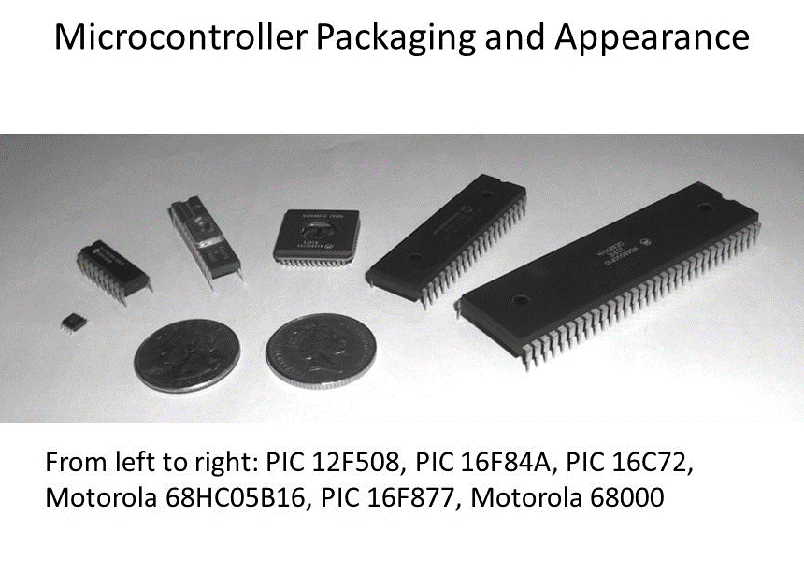

Slide 4
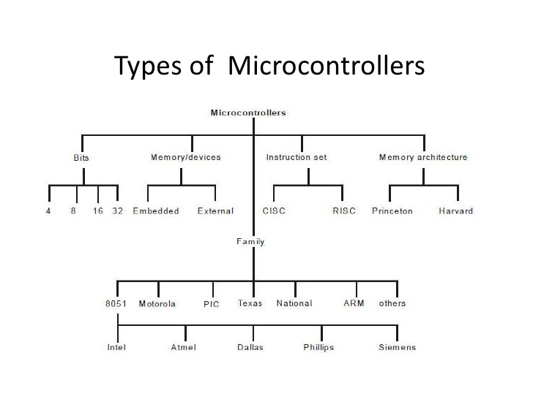

Slide 5
According to Bits : 4 bit microcontroller
ALU performs arithmetic and logical operations on a nibble (4-bits) at an instruction.
Internal bus width of 4-bit.
Small size, minimum pin count and low cost controllers.
Low power consumption and used for low end applications like LED & LCD display drivers, portable battery chargers.
Examples: Renasa M34501 256 and ATAM862 series from ATMEL.

Slide 6
8 bit microcontroller
ALU performs arithmetic and logical operations on a byte (8-bits) at an instruction.
Internal bus width of 8-bit.
Examples: Intel 8051 family and Motorola MC68HC11 family

Slide 7
16 bit microcontroller
ALU performs arithmetic and logical operations on a word (16-bits) at an instruction.
Internal bus width of 16-bit microcontroller is of 16-bit.
Enhanced performance, computing capability and greater precision as compared to the 8-bit microcontrollers.
Examples: Intel 8096 family, Motorola MC68HC12 and MC68332 families.

Slide 8
32 bit microcontroller
ALU performs arithmetic and logical operations on a double word (32-bits) at an instruction.
Internal bus width of 32-bit.
Much more enhanced performance, computing capability with greater precision as compared to 16-bit microcontrollers.
Examples: Intel 80960 family, Motorola M683xx and Intel/Atmel 251 family.

Slide 9
According to Memory/Devices : EMBEDDED MICROCONTROLLERS
An embedded system has a microcontroller unit that has all the functional blocks (including program as well as data memory) available on a the same chip.
Example: 8051 having Program & Data Memory, I/O Ports, Serial Communication, Counters and Timers and Interrupt Control logic on the chip.

Slide 10
EXTERNAL MEMORY MICROCONTROLLERS
An external system has a microcontroller unit that does not have all the functional blocks available on a chip.
All or part of the memory units are externally interfaced using an interfacing circuit called the glue circuit.
Example: 8031 has no program memory on the chip.

Slide 11
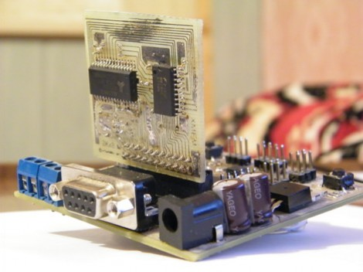

Slide 12
According to Instruction Set : CISC (COMPLEX INSTRUCTION SET COMPUTER) ARCHITECTURE MICROCONTROLLERS
Has an instruction set that supports many addressing modes for the arithmetic and logical instructions, data transfer and memory accesses instructions.
Many of the instructions are macro like.
Allows the programmer to use one instruction in place of many simpler instructions.  Example: Intel 8096 family.

Slide 13
RISC (REDUCED INSTRUCTION SET COMPUTER) ARCHITECTURE MICROCONTROLLERS
Contains an instruction set that supports fewer addressing modes for the arithmetic and logical instructions and for data transfer instructions.
Allows simultaneous access of program and data.
Instruction pipelining increases execution speed
Allow each instruction to operate on any register or use any addressing mode.
Smaller chip and pin count.
Very low power consumption

Slide 14
According to MEMORY ARCHITECTURE
The architectures of microcontrollers differ in the way data and programs are stored and accessed.
Von-Neuman/Princeton Architecture
Harvard Architecture

Slide 15
1. Von-Neuman/Princeton Architecture
Single data bus that is used to fetch both instructions and data. Program instructions and data are stored in a common main memory.
When such a controller addresses main memory, it first fetches an instruction, and then it fetches the data to support the instruction.
Simplifies the microcontroller design because only one memory is accessed.
The weakness is that two separate fetches can slow up the controller’s operation.
Example: Motorola 68HC11.

Slide 16
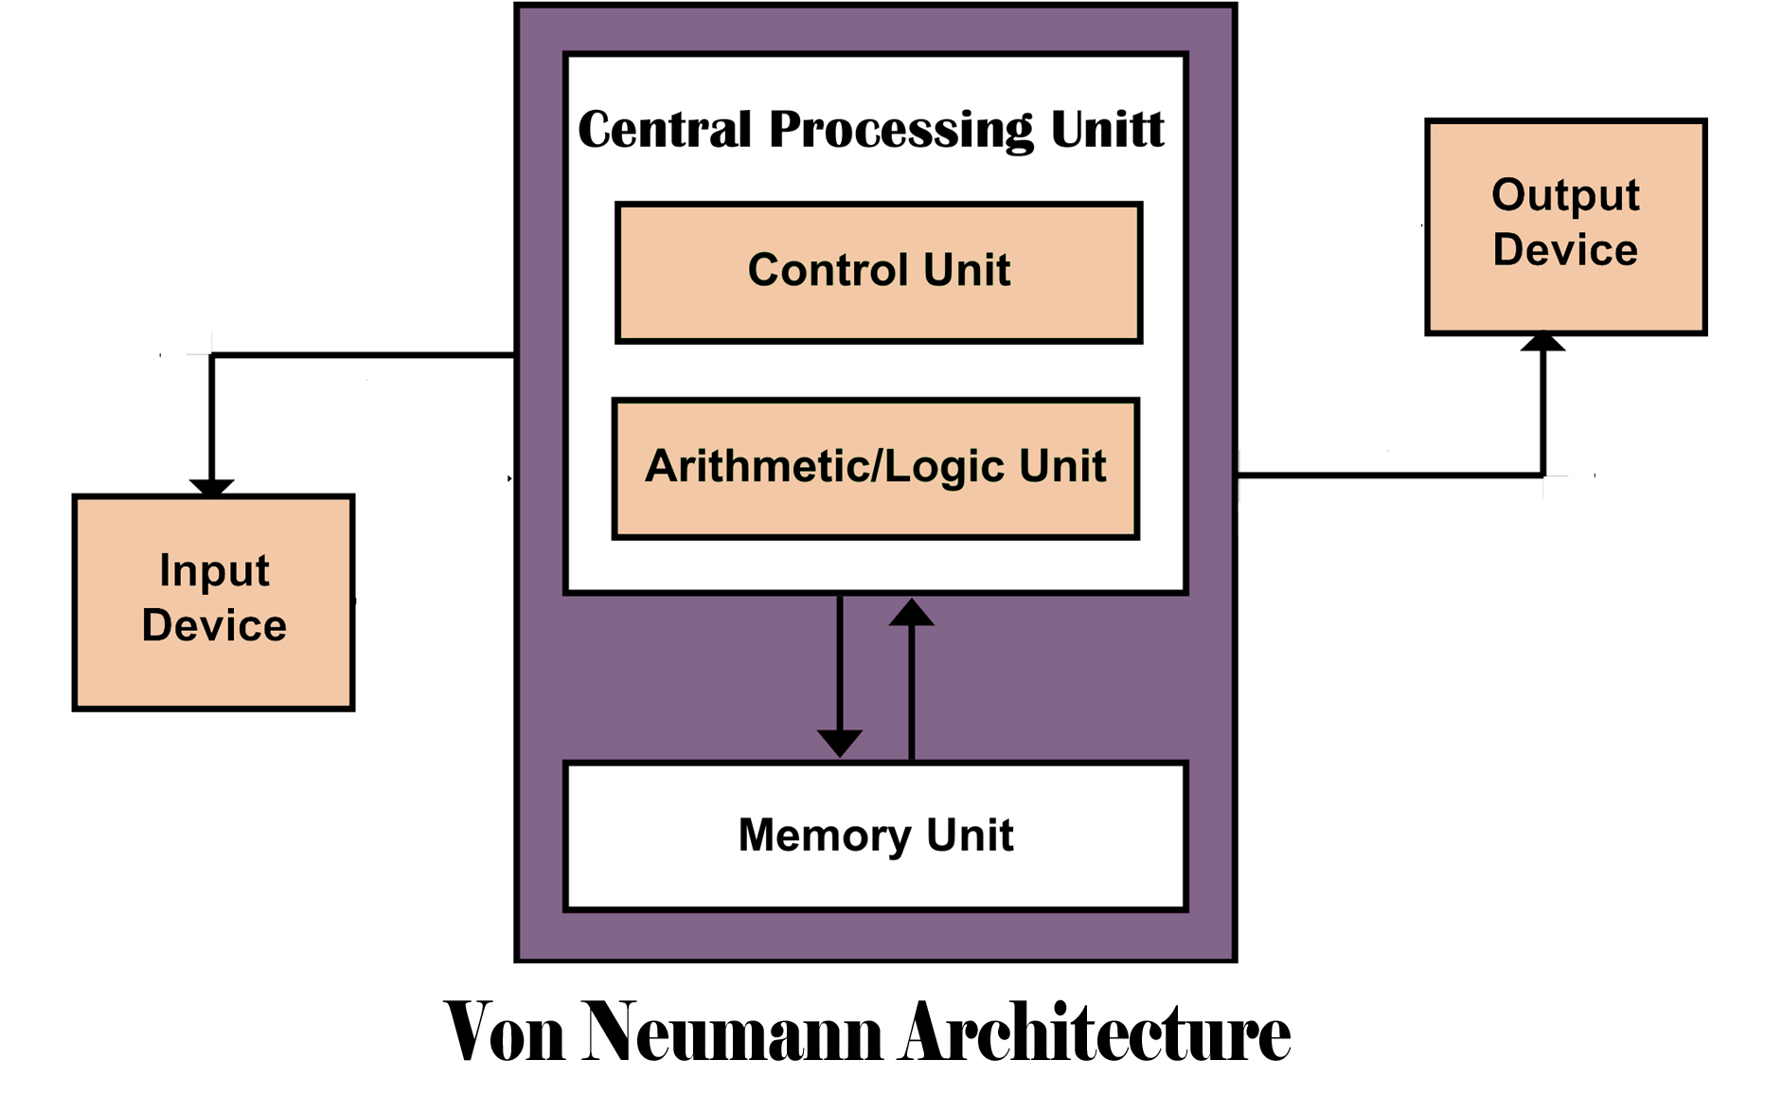
Von-Neuman/Princeton Architecture

Slide 17
2. HARVARD ARCHITECTURE
Separate data bus and an instruction bus.
Execution occur in parallel.
Much faster execution than Von-Neuman architecture.
Design complexity.
Example: intel MCS-51 family and PIC microcontrollers

Slide 18
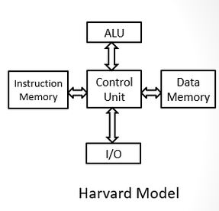
HARVARD ARCHITECTURE

Slide 19
MICROCONTROLLER OPERATION
When a microcontroller is mounted on a circuit board with other components function as a single unit, is referred as a module or a microcontroller board.
A microcontroller module typically consists of microcontroller, a power source, an interface for connecting to a programming device, I/O ports, and additional memory

Slide 20
MICROCONTROLLER OPERATION
A power source: powers the microcontroller and any accompanying components located on the printed circuit board.
An interface: communicate with the controller.
A set of input/output (I/O) ports: send and receive signals from the devices the microcontroller is designed to control.
I/O ports when programmed as an output pin, each pin can output digital signals. When programmed as an input pin, each pin can receive digital signals.
Digital-to-analog and analog-to-digital converters change the digital pulses into analog signals.

Slide 21
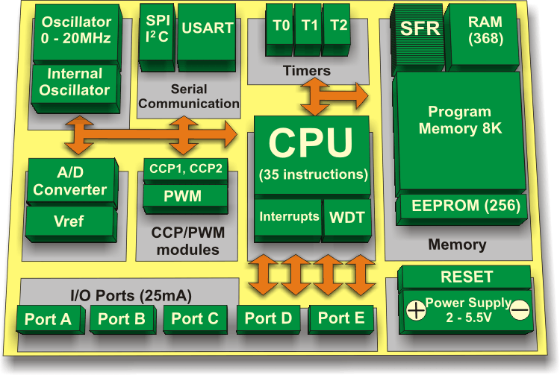
MICROCONTROLLER OPERATION

Slide 22
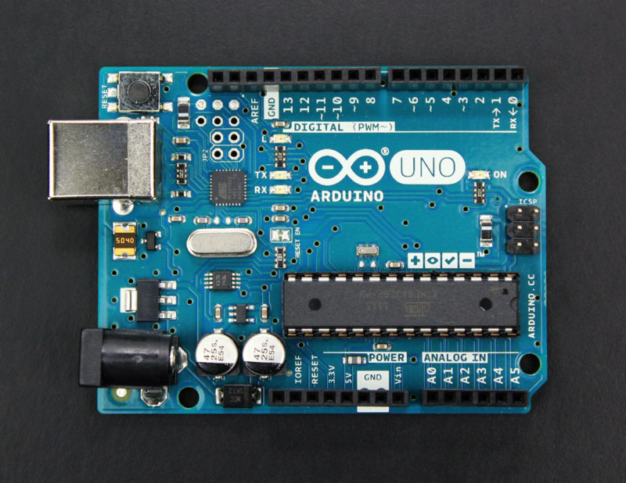

Slide 23
Internal Operation
The microcontroller consists of thousands of digital circuits that are combined into areas to provide specific functions.
The parts of the microcontroller are used to save data and programs, perform math and logic functions, and generate timing signals.
The different areas are connected by a bus system. The bus system contains tiny parallel circuits that carry the digital pulse patterns from section to section.
The ROM stores the program required for the microcontroller to function and controls how the chip components operate and how data and instructions flow through the chip.
RAM stores programs and data temporarily.
Ports and registers are special memory locations dedicated to a specific function such as a hardware location or a place to manipulate data.

Slide 24
AREAS OF MICROCONTROLLER APPLICATION
Home monitoring system.
Automotive applications such as robotics.
Appliances such as microwave oven, refrigerators, television and VCRs, stereos.
Automobiles in engine control, diagnostics, climate control. Environmental control in greenhouse, temperature, humidity, factory, home.
Instrumentation.
Aerospace.

Slide 25
Thank You

