Slide 1
Vivekananda College, Kolhapur (Autonomous)
Department of Computer Science
B.Sc. III (Computer Science)
2022-23
“Online Central Assessment System”
Submitted by
Sayali S. Patil
Gauri B. Tanugade
Shruti S. Patil
Akshata A. Patil

Slide 2
Introduction
1.Autonomous college
2.System Work >collect papers >give to checker>collect them in fixed date>generate the bills
3.Benefits of System.>reduce paperwork>reduce physical storage requirements >accuracy

Slide 3
Objectives
Paper Accept
Teacher Notification
Paper Issue
Paper Submit
Billing

Slide 4
Forms And Databases

Slide 5
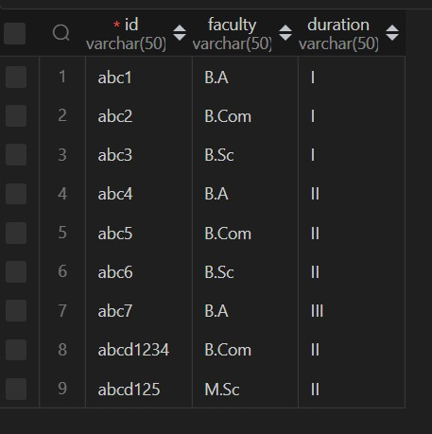
Add_Faculty
Table

Slide 6
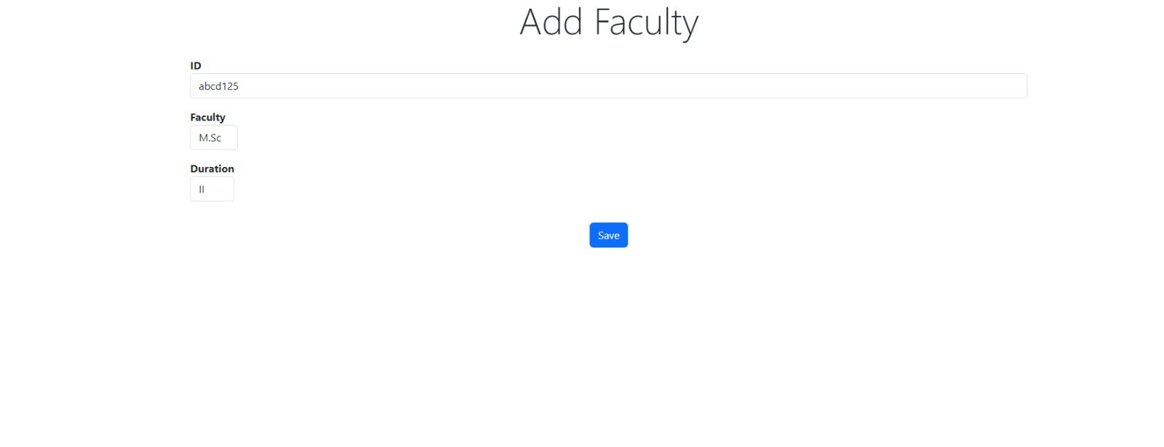

Slide 7
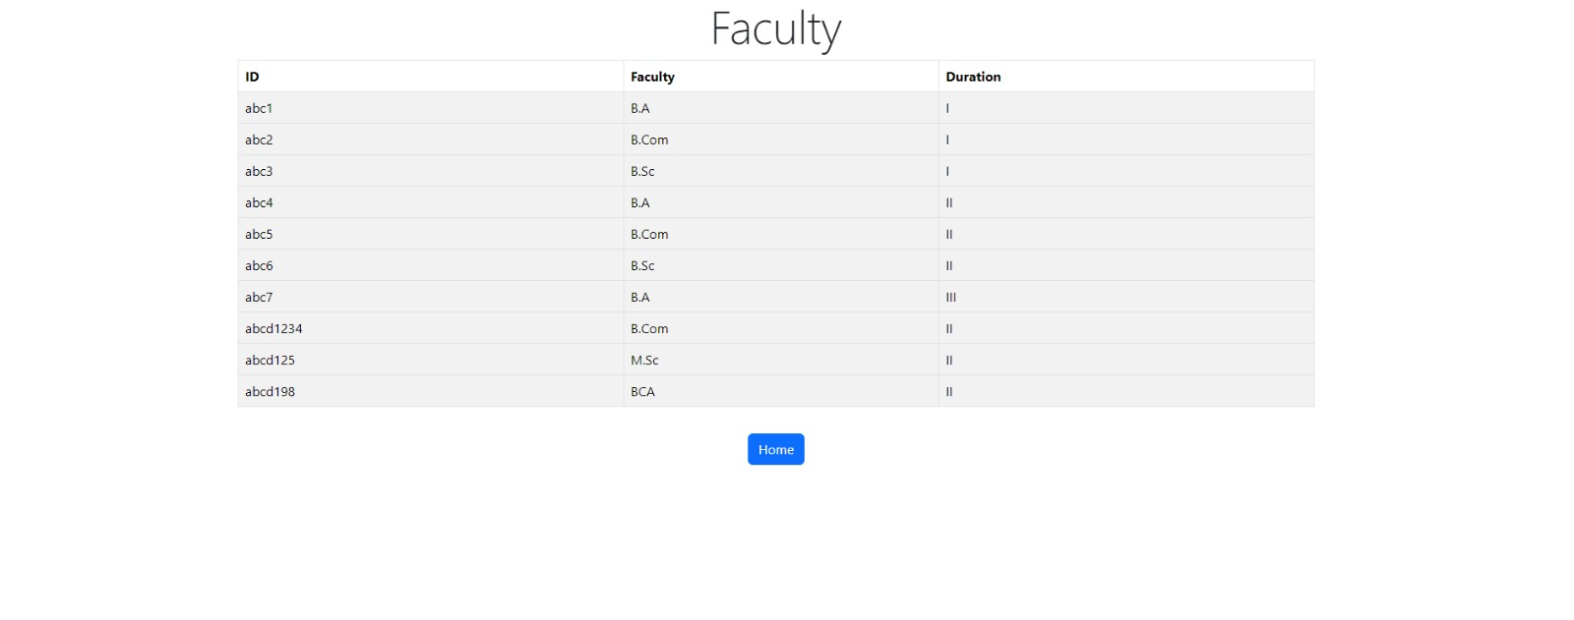

Slide 8
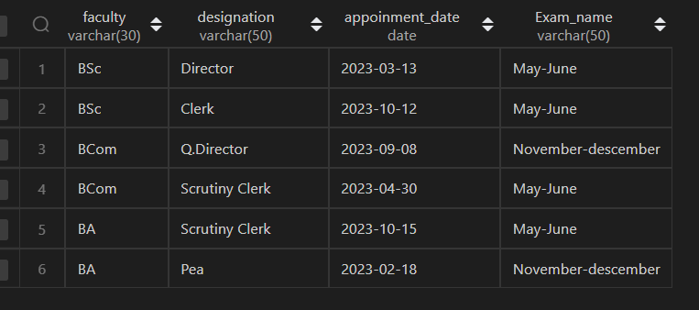
2.Cap_Faculty

Slide 9
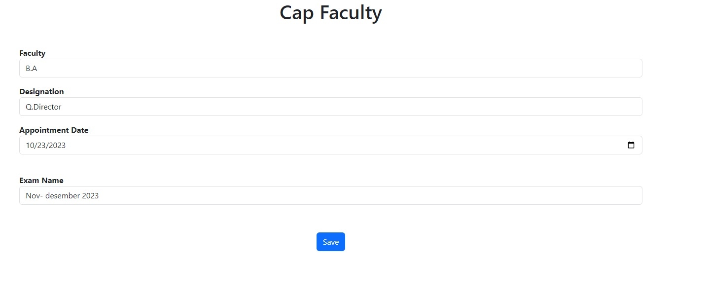

Slide 10
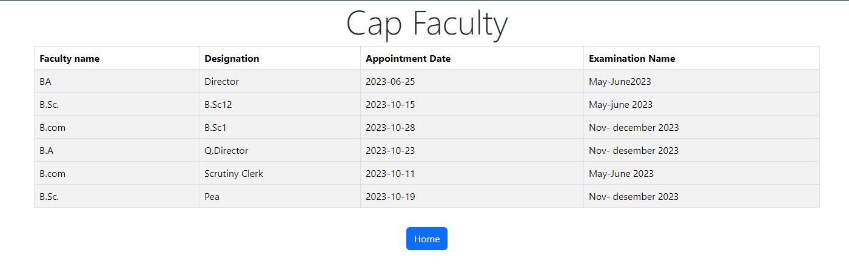

Slide 11
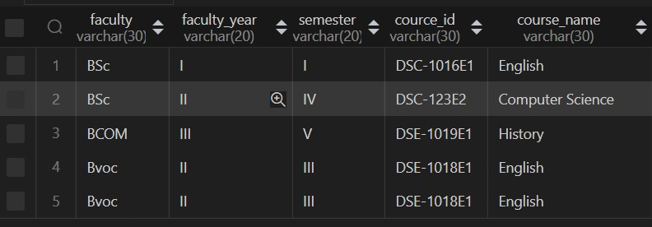
3.Add_Course
table

Slide 12
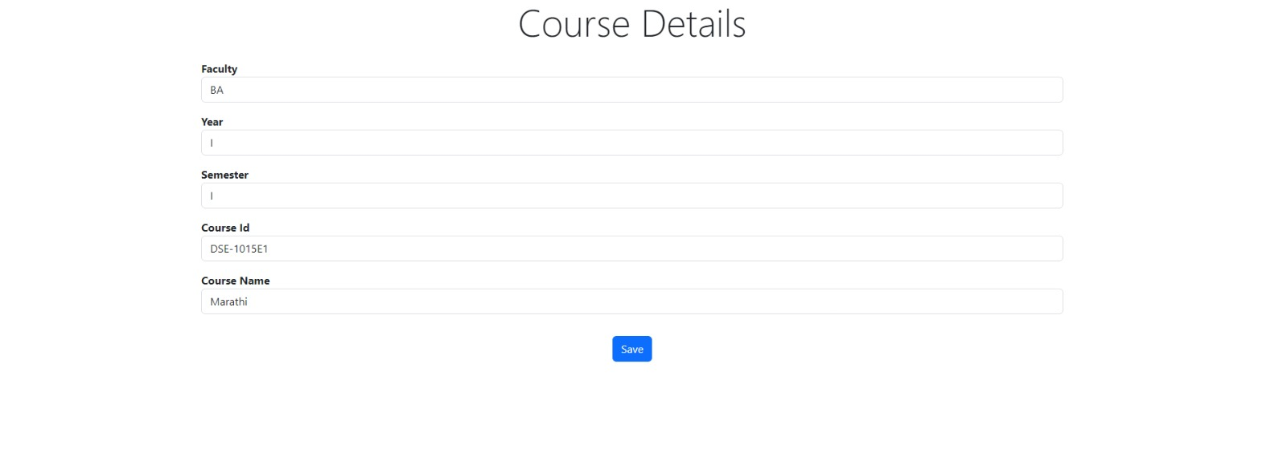

Slide 13
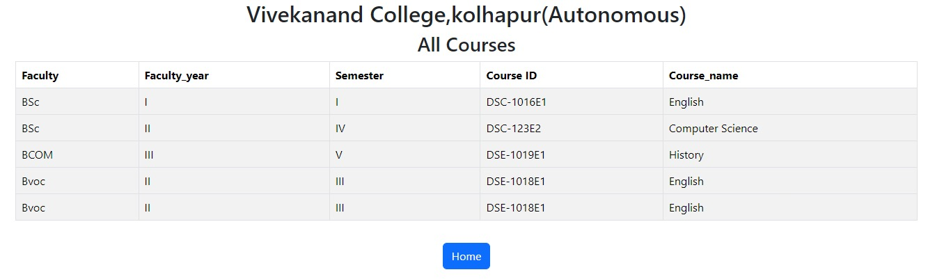
Add course

Slide 14
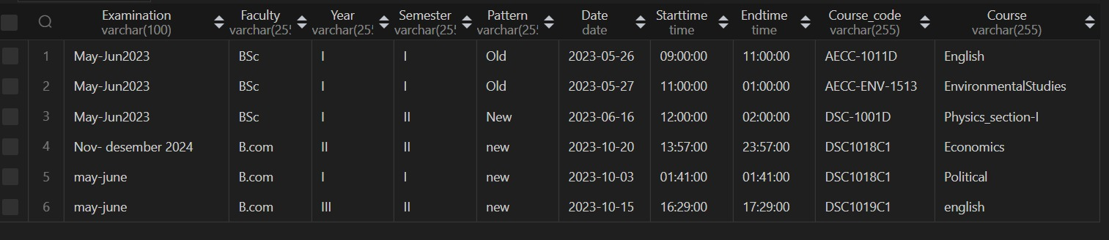
4.Create Timetable

Slide 15
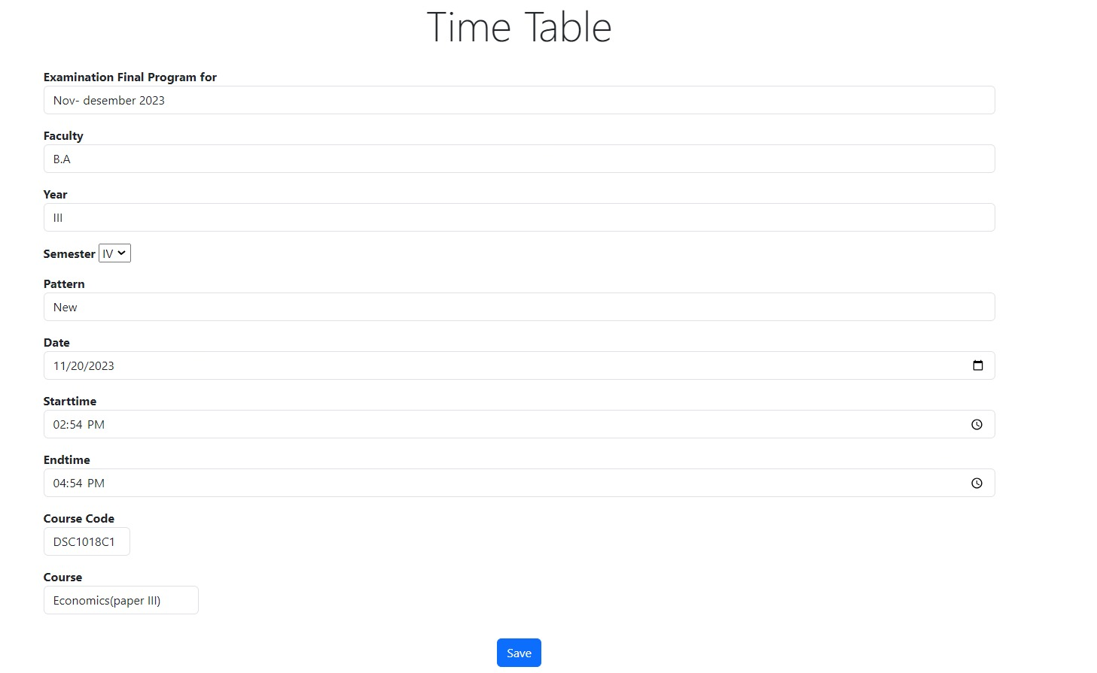
Time_table

Slide 16
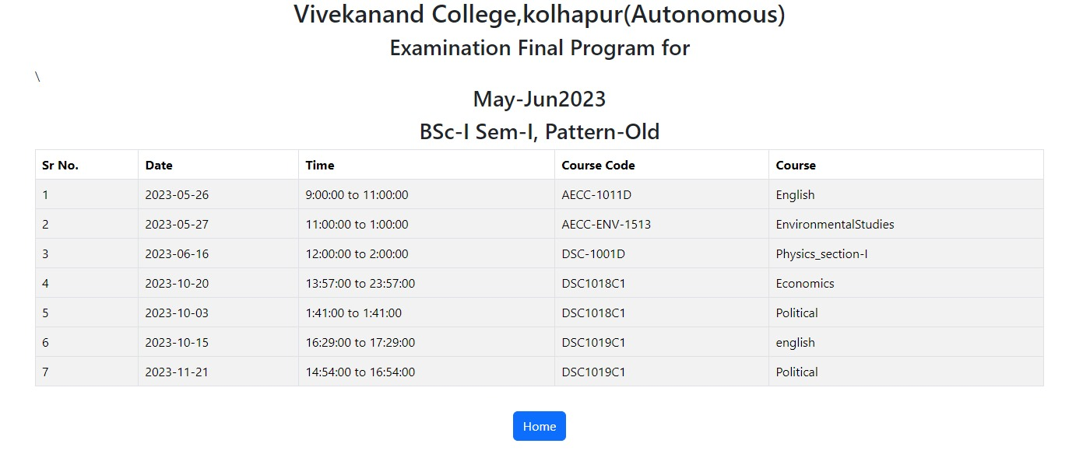
Time_table

Slide 17
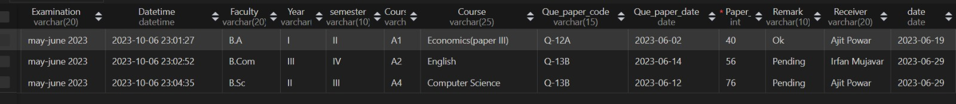
5.Register Details

Slide 18
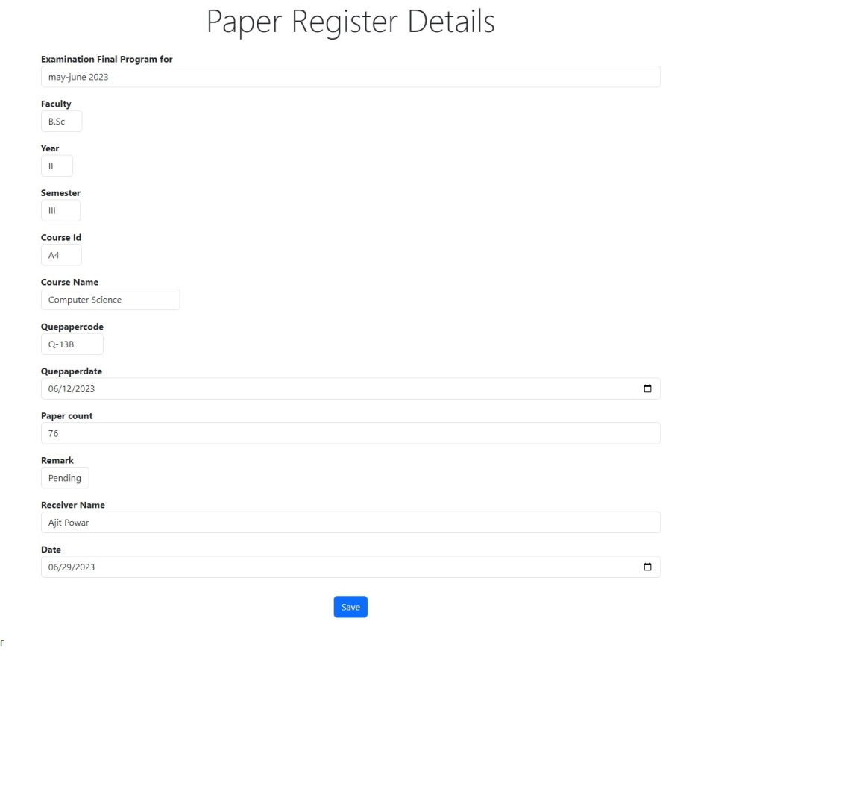
register

Slide 19
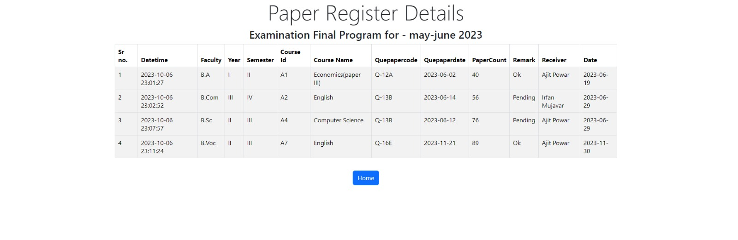

Slide 20
Thank You…!!!

