Slide 1
Neura: AI-Powered Intelligent Voice Assistant
Mid-Term Evaluation
Prisha Prafull Tated 219301743 Manipal University Jaipur

Slide 2
What is Neura?
Neura is an AI-powered voice assistant designed to interact with users via voice commands.
It integrates speech recognition, text-to-speech conversion, and AI-driven decision-making for enhanced user experience.
Objective:
To create a voice-controlled assistant that can perform tasks like playing music, opening apps, searching the web, and more.
Novelty:
Customizable and open-source.
Integration of multiple features.
Future scope: Emotional intelligence.

Slide 3
Technologies Used
Programming Language: Python
Frontend: HTML, CSS, JavaScript, Bootstrap
Backend: Python (Eel for integration)
Database: SQLite
AI/ML Models:
Speech Recognition: Google Speech Recognition API
Text-to-Speech: SAPI5 (Windows) or pyttsx3
Chatbot: Hugging Face Transformers (for ChatGPT-like functionality)
Libraries:
pywhatkit (for YouTube and web searches)
pyautogui (for automation)
sqlite3 (for database management)
pvporcupine (for hotword detection)
hugchat (for chatbot functionality)

Slide 4
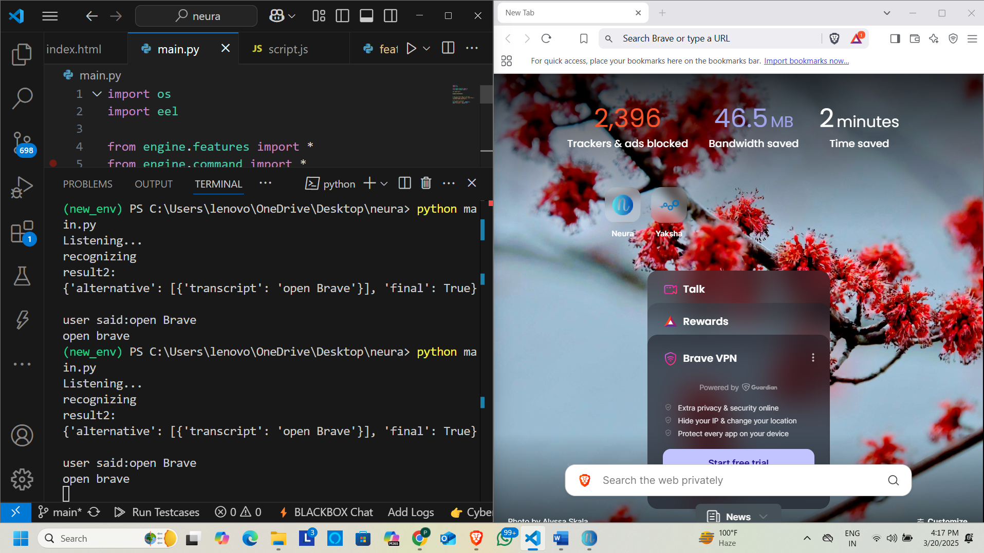
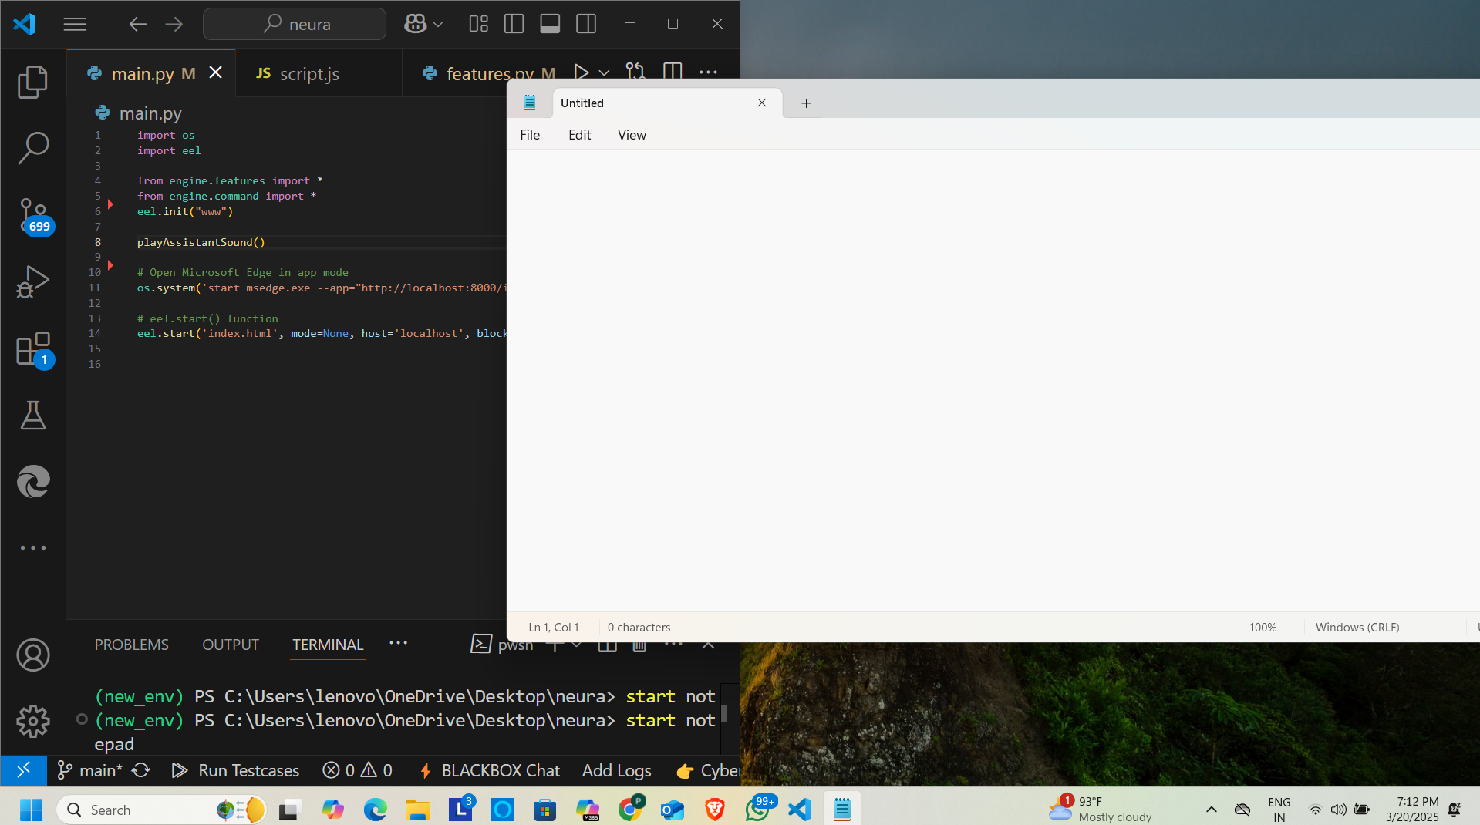
Features Implemented: Voice Commands
Play music on YouTube.
Open apps and websites.
Perform web searches.

Slide 5
Frontend-Backend Integration
Frontend
HTML/CSS/JS
Eel
Bridge
Backend
Python

Slide 6
Speech Recognition Workflow
Microphone Input (PyAudio)
Speech Recognition (Google API)
Command Processing

Slide 7
Text-to-Speech Workflow
Text Input (Backend)
Text-to-Speech Conversion (SAPI5/pyttsx3)
Audio Output (Speakers)

Slide 8
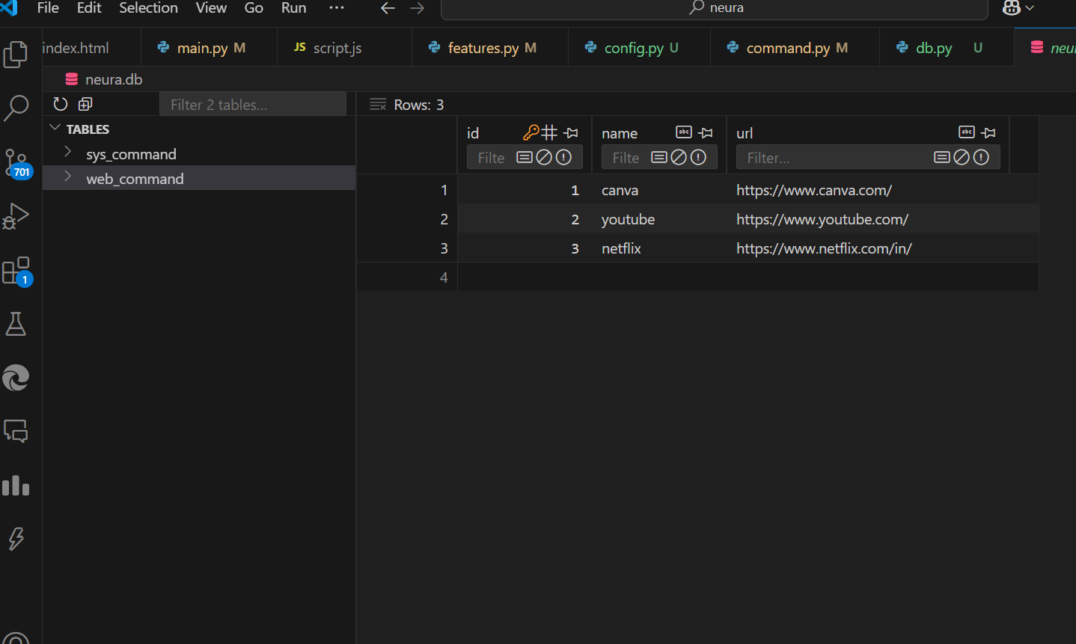
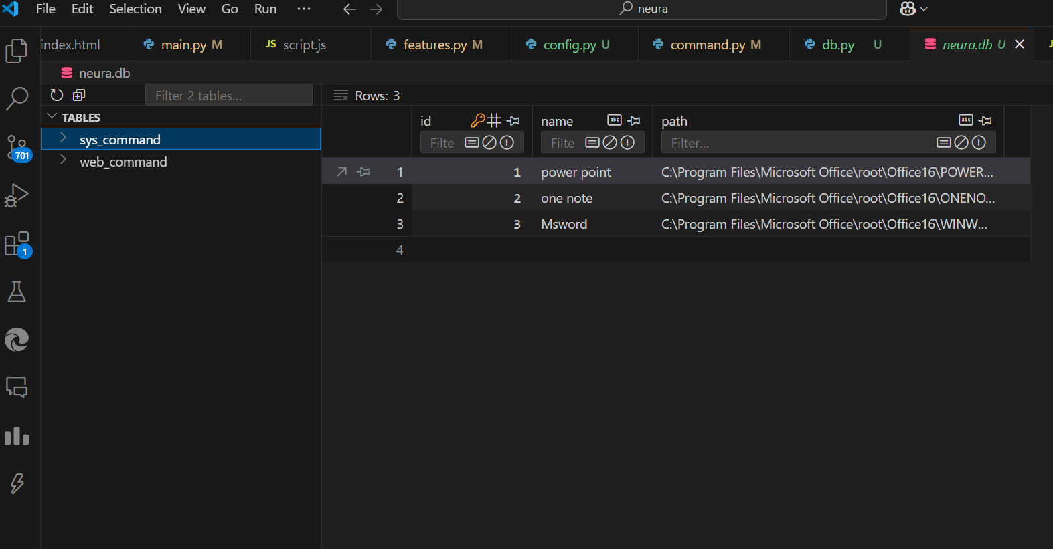
SQLite Database:
Stores app and website paths for quick access.

Slide 9
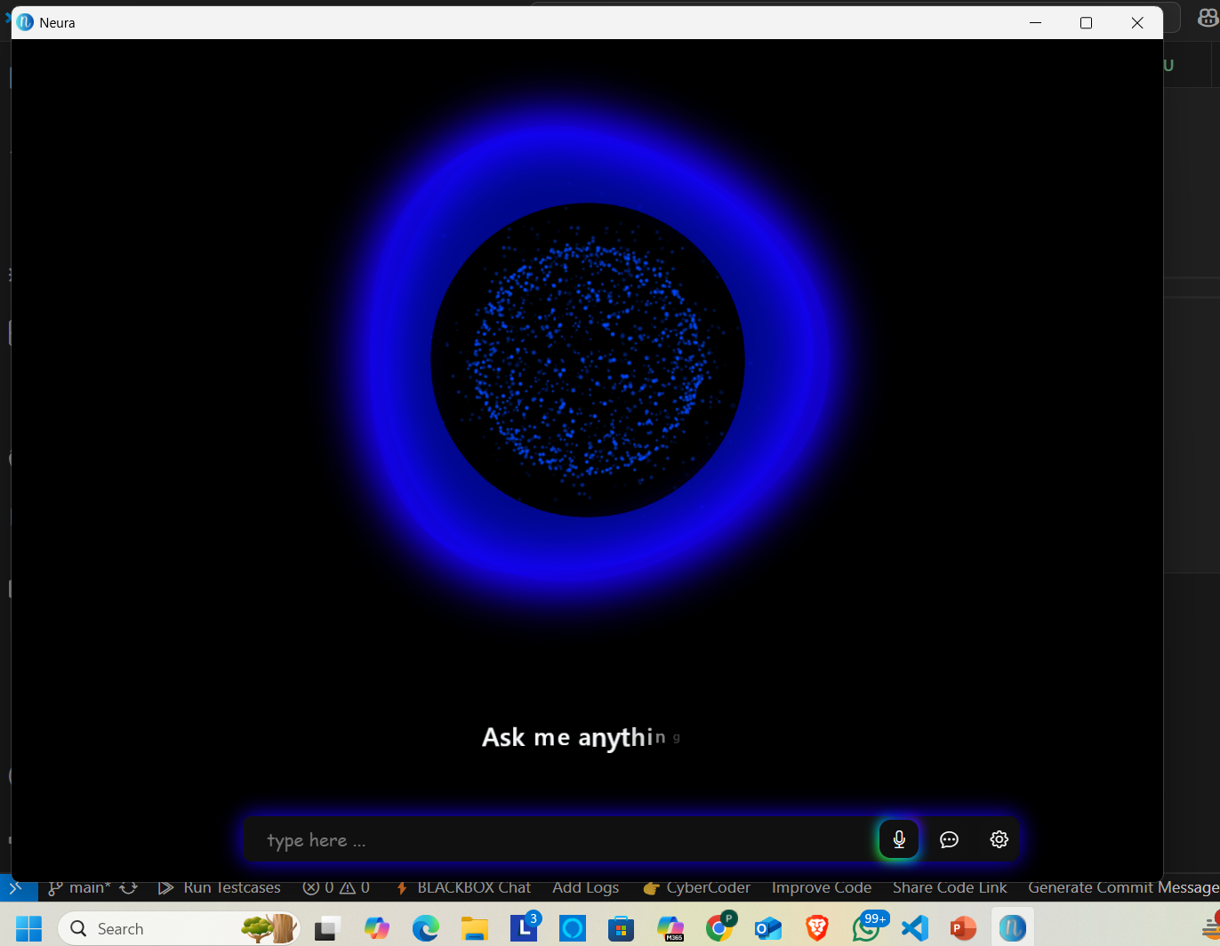
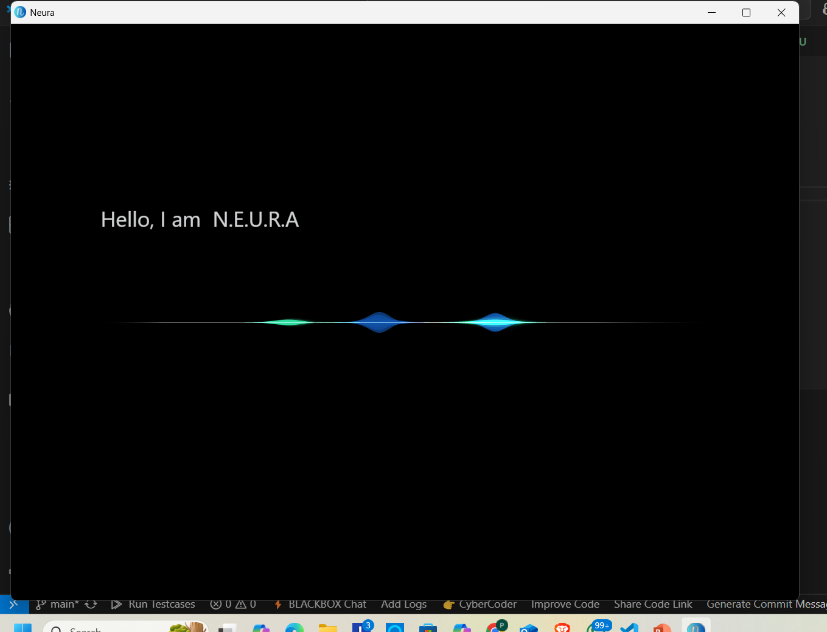
Customizable UI:
Siri-like wave animation, mic button animation, and text animations.

Slide 10
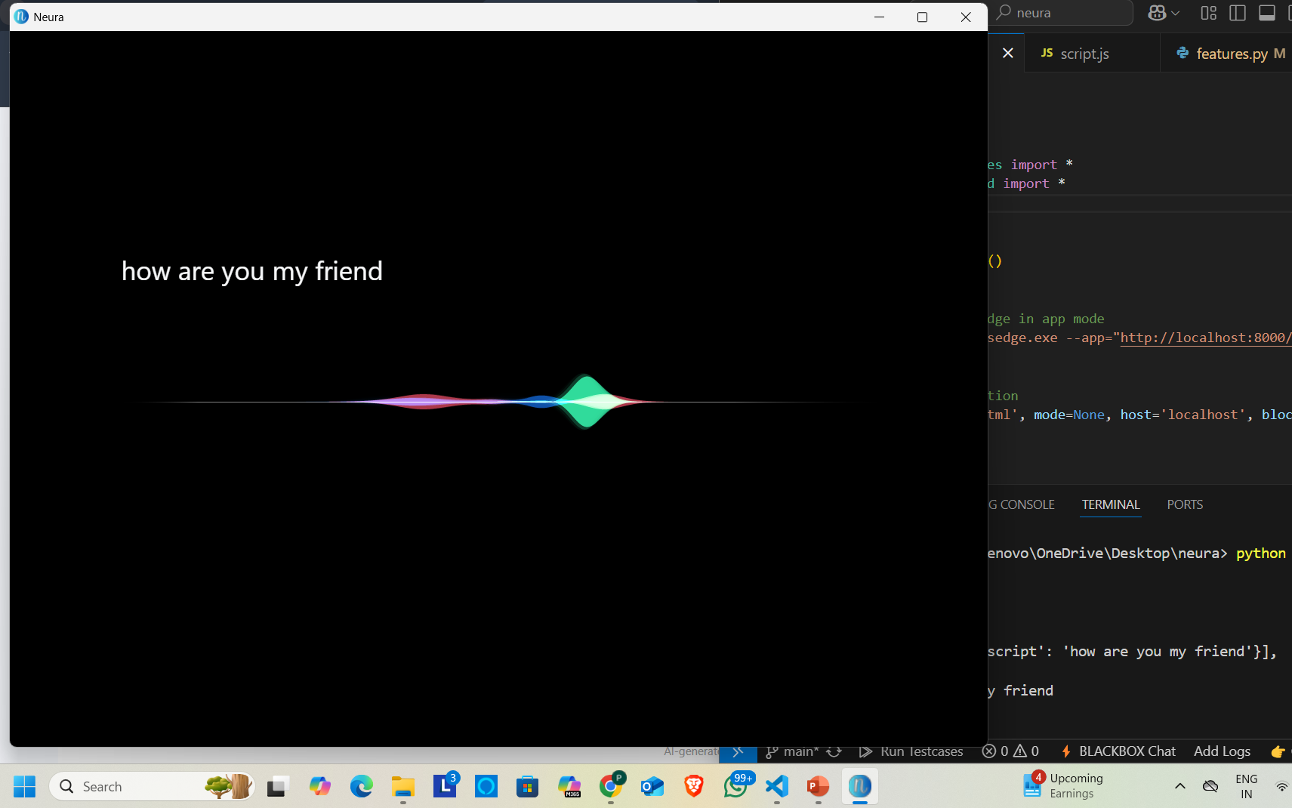
Audio Handling with PyAudio:
Captures microphone input for speech recognition.

Slide 11
Future Enhancements
Hotword Detection:
Add wake word detection (e.g., "Hey Neura") to activate the assistant.
WhatsApp Automation:
Send messages, make calls, and start video calls via WhatsApp.
Chatting Feature:
Integrate a conversational AI for natural language interactions.
Chat History:
Store and retrieve chat history for better user experience.
Free ChatGPT API Alternative:
Use open-source models like Hugging Face for chatbot functionality.
Mobile Automation:
Control mobile devices via voice commands (e.g., make calls, send SMS).
Face Authentication:
Add face recognition for secure access to the assistant.
Emotional Intelligence:
Detect user emotions (e.g., happy, sad, angry) and respond empathetically.

Slide 12
Hotword Detection Workflow
Audio Input (PyAudio)
Hotword Detection (Porcupine)
Activate Neura

Slide 13
Emotion Detection Workflow
Voice Tone Analysis (Librosa)
Facial Emotion Recognition(FER)
Empathetic Response

Slide 14
Learning Outcomes
Technical Skills:
Gained more expertise in Python, frontend-backend integration, and AI/ML models.
Problem-Solving:
Learned to debug and resolve issues in speech recognition, UI design, and audio handling.
Project Management:
Improved time management and task prioritization skills.

Slide 15
Conclusion
Summary:
Neura is a powerful voice assistant that simplifies tasks through voice commands.
Future Scope:
Enhancements like emotional intelligence, WhatsApp automation, Mobile Automation and face authentication will make Neura more versatile and user-friendly.

