Slide 1
NYC AIRBNB PRICE PREDICTION
Using the Concepts of Machine Learning to build a model to predict the prices of Airbnb in New York City given the listing activity and metrics from 2019

Slide 2
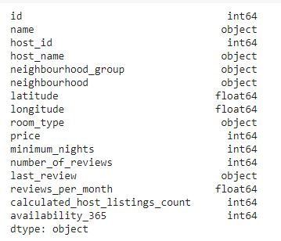
ABOUT THE DATA
The data describes the listing activity and metrics in NYC, NY for 2019
It consists of 50k Airbnb listings
The data has 16 columns
The data types include int46,
object, and float64.

Slide 3
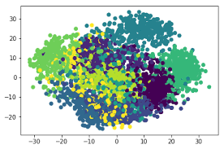
ALL ABOUT EDA!
Exploratory Data Analysis is understanding the data sets by summarizing their main characteristics often plotting them visually. This step is very important especially when we arrive at modeling the data in order to apply Machine learning
Steps involved in EDA include:
Handling missing data
Understanding data types
Visualizing distribution of various columns
Checking for correlations and collinearity
Encoding categorical features and much more…

Slide 4
Handling missing data
If the columns that are not of use have a lot of missing data – drop those columns. Like ‘host_name’ and ‘name’ features have 21 and 16 missing values respectively, we drop these columns.
We fill the NaN values in ‘reviews per month’ with 0’s.
All other data is checked to be clean.

Slide 5
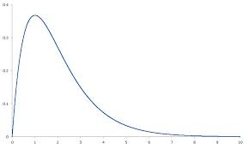
Skewed Distributions
We notice from our data that the ‘price’ and ‘minimum number of nights’ is highly skewed. Skewness means that the data is not symmetrically distributed. Skewed data can mess up the power of the predictive model if not addressed correctly
“Linear Models love normally distributed data”, hence log transformation is performed on these features to make it easy for machine learning algorithms to be implemented

Slide 6
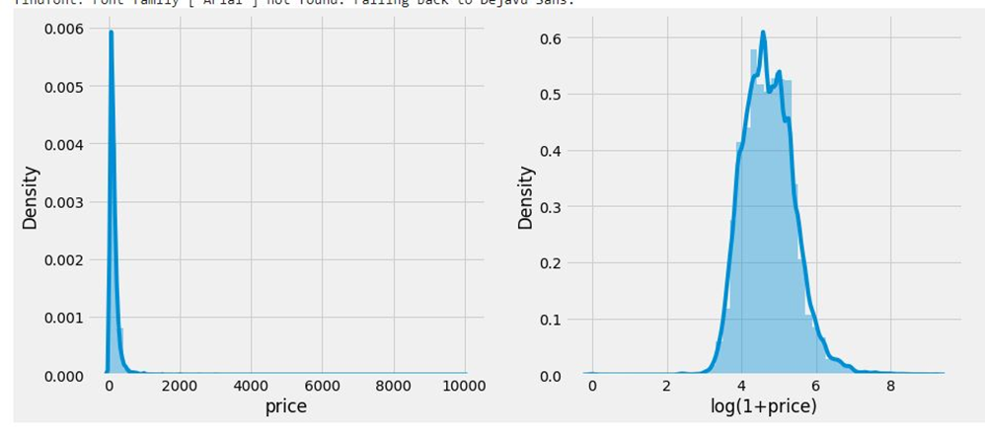
Skewness and log transformation

Slide 7
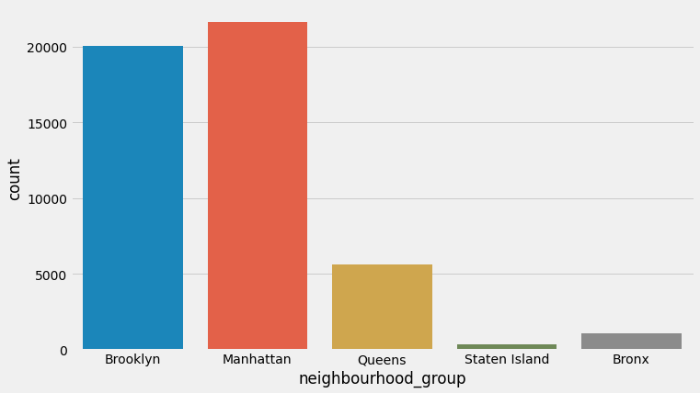
Neighborhood Analysis
Building a categorical plot, we can see the count of Airbnb properties in various neighborhoods of NYC.

Slide 8
Conclusion from the plot
I notice that Statten Island and the Bronx are highly underrepresented in this dataset. For Statten Island, the reason is that the population of the island is small. However, this cannot be the case for Bronx which has a population comparable (~ 1.4mln) to Manhattan (~ 1.6mln) or for Brooklyn /Queens with their populations of ~2.5mln and ~2.4mln, respectively.
This makes sense: Queens, Bronx and, to a fair extent Brooklyn, are residential neighborhoods unlike Manhattan which is a business center as well as a tourist destination.

Slide 9
Other Conclusions
Room Type: Maximum Airbnbs are of apartment type, followed by private rooms and shared rooms with least count.
The ‘minimum nights’ feature is also skewed, hence performed log transformation.
The density plots of latitude and longitude were visualized to understand the density distribution of Airbnb properties
The distribution of the number of reviews per month is highly skewed however way we cut it. This is because there is a large weight on smaller number of reviews: there are a lot of properties which only get a few reviews and a rather fat tail of properties which get a lot of reviews.

Slide 10
Feature Engineering & Correlation
The number of reviews per month is fairly (40%) correlated with the total number of reviews and the the total number of reviews is correlated (at 30%) with the availability of the property. Both of these correlations make sense.
It's also interesting that the longitude is anticorrelated (at 20%) with the price. This makes sense as property in Bronx and Queens is cheaper than in Manhattan and Brooklyn.

Slide 11
Encoding Categorical Features
Categorical data is a common type of non-numerical data that contains label values and not numbers.
The features with data type ‘object’ are categorical in nature and we perform one hot encoding on them.
Machine learning algorithms require that input and output variables are numbers. This means that categorical data must be encoded to numbers before we can use it to fit and evaluate a model.
A one hot encoding is appropriate for categorical data where no relationship exists between categories.
It involves representing each categorical variable with a binary vector that has one element for each unique label and marking the class label with a 1 and all other elements 0.

Slide 12
Modelling
Linear Regression
Ridge Regression
Linear SVR
Random Forest Regressor
KNN

Slide 13
LINEAR REGRESSION
Since the target variable, rental price, is a continuous variable, we consider this problem as a supervised regression problem instead of classification. Thus, the baseline model is the default linear regression.
Simple linear regression is a type of regression analysis where the number of independent variables is one and there is a linear relationship between the independent(x) and dependent(y) variable.
y = a_0 + a_1 * x ## Linear Equation. The motive of the linear regression algorithm is to find the best values for a_0 and a_1.

Slide 14
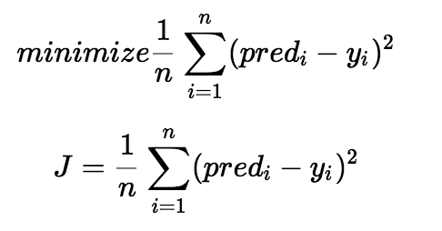
The cost function helps us to figure out the best possible values for a_0 and a_1 which would provide the best fit line for the data points. Since we want the best values for a_0 and a_1, we convert this search problem into a minimization problem where we would like to minimize the error between the predicted value and the actual value.
However, linear regression is always too oversimplified for reality problem because it assumes the covariates and response variables to have linear relationship which may not suit out problem. To improve this, we also use another linear model , the Ridge Regression Model

Slide 15
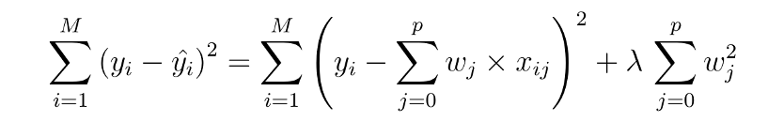
RIDGE LINEAR REGRESSION
Linear regression is always too oversimplified for reality because it assumes the covariates and response variables to have linear relationship which may not suit our problem. So we use the Ridge Model.
The cost function is altered by adding a penalty equivalent to square of magnitude of the coefficients.
To find the optimal parameters and avoid overfitting, we also compare the performance of model with alphas=[0.001,0.01,0.1,1] as well as cross validation by RidgeCV.

Slide 16

RANDOM FOREST REGRESSOR
Random forests are able to capture non-linear interaction between the features and the target.
It runs decision trees in parallel which means there is no interaction between these trees while building the trees.
I used RandomizedSearchCV which uses random combinations of hyperparameters to find the best solution for the built model.

Slide 17
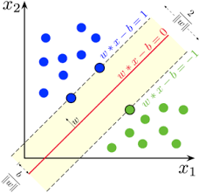
LINEAR SVR
Support Vector Regressor uses the same basic idea as Support Vector Machine (SVM), a classification algorithm, but applies it to predict real values rather than a class.
SVR acknowledges the presence of non-linearity in the data and provides a proficient prediction model.
We use GridSearchCV to do model tuning to find the optimal C value that gives best prediction and cross validation with fold 5 to avoid overfitting.

Slide 18
KNN REGRESSOR
The last way to approach is by the k-nearest neighbors' algorithm. It is a form of memory-based learning wherein we don’t learn a function of features to estimate the target variable.
It searches the training data for the k nearest neighbors, as calculated by Euclidean distance function, then does the regression process based on the value of these k neighbors.
To find the optimal value of k, we compared the performance of knn models with k in the range of (5,25).

Slide 19


EVALUATION METRICS
RMSE: It is a quadratic scoring rule that measures the average magnitude of the error. It is the square root of the squared differences between prediction and actual variable
MAE: It measures the average magnitude of the errors without considering their direction. It is the average over the test sample of the absolute differences between prediction and actual observations

Slide 20
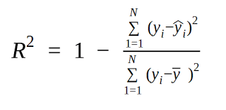
R^2: R-squared is a statistical measure of how close the data are to the fitted regression line.
R-squared = Explained variation / Total variation
R-squared is always between 0 and 100%:
0% indicates that the model explains none of the variability of the response data around its mean.
100% indicates that the model explains all the variability of the response data around its mean.

Slide 21
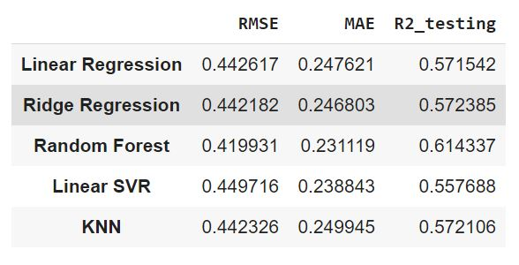
CONCLUSION
This project uses different models including Linear Regression, Ridge Regression, Linear SVR, Random Forest and KNN to predict prices for Airbnb in NYC.
Through comparing RMSE, MAE, and R2-score on the test data, we conclude that Random Forest outperforms the other models.

Slide 22
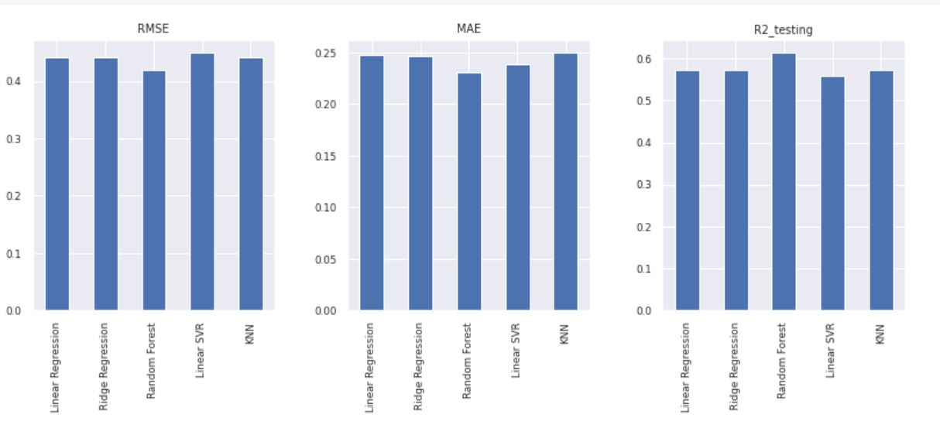
From the above histograms, we can see that after implementation, the test data accuracy of Linear Regression turns out to be really low, so clearly linear regression is too oversimplified for our problem. Also, the Ridge Regression perform similarly to Linear Regression with a little bit differences in RMSE and MAE which means it also does not improve the result a lot. Because we have a relatively large amount of data, the probability of over-fitting seem to be low. We also do the R2-score in training set and confirm that each R2-score is always between 40% and 70% which means these models do not have a too high R2 as not true.

Slide 23
THANK YOU!

