Slide 1
Name: Gauri Yadav
Roll No. : 202510101150174
Course : Digital Electronics
Course Code : UEC3001
Submitted to: Prabhat Srivastava
Github link :https://github.com/gauriyadav5692576-design/Water-Level-Alarm-Simulator/blob/main/Water-Alarm-A-Digital-Electronics-Project.pptx

Slide 2
UNDERGRADUATE DIGITAL ELECTRONICS
Water Alarm:
A Digital Electronics Project
Design a simple sensing-and-alert circuit that warns when a tank reaches a critical water level.

Slide 3



WHY IT MATTERS
Why a water alarm matters
Prevent overflow
Warn before overflow
One complete circuit
Water overflow wastes water and can damage surrounding spaces.
The project demonstrates sensing, switching, indication, and sound output in one circuit.
An alarm gives an immediate indication before the tank overflows.

Slide 4
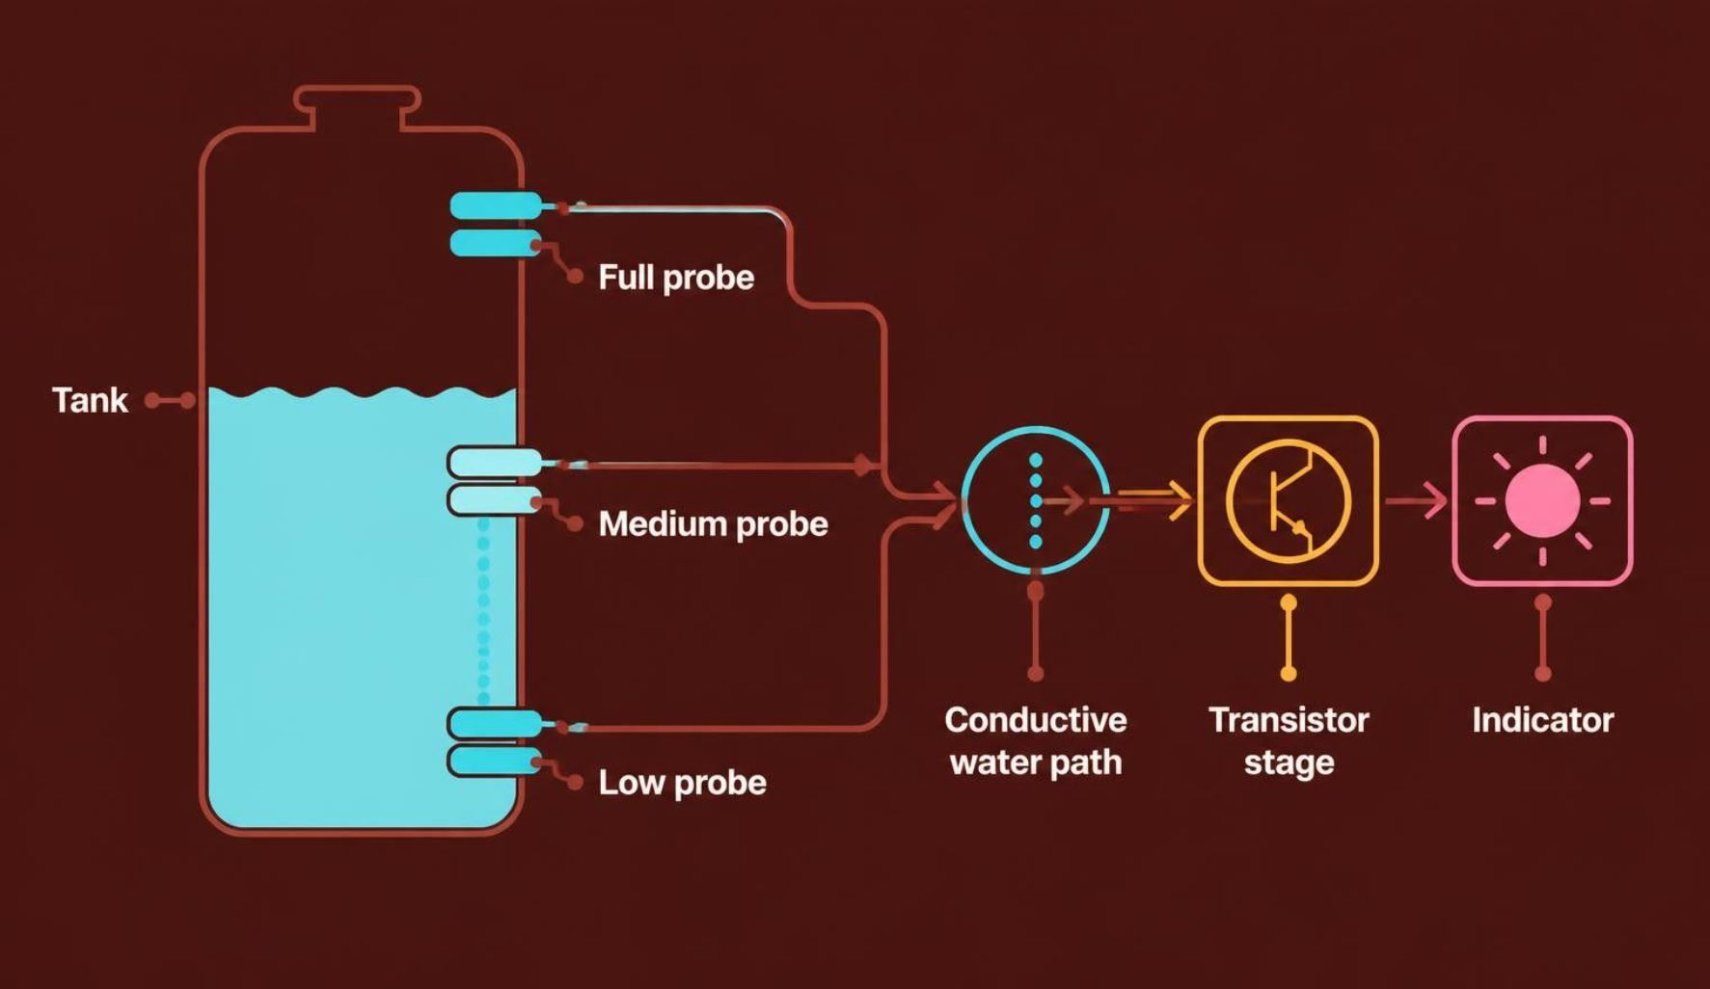
SENSING PRINCIPLE
The water itself closes the sensing path
Metal probes are placed at selected heights inside the tank. When water touches two probes, it provides a conductive path between them.
That small signal drives a transistor stage and activates an indicator.

Slide 5




Each part has one clear job
Metal probes
BC548 NPN transistors
Resistors
Detects water level.
Limit current; bias transistor bases.
Electronic switches.
LEDs + buzzer
Optional NE555 timer stage
LEDs show level; buzzer warns at full level.
Generates or controls the alarm signal.

Slide 6
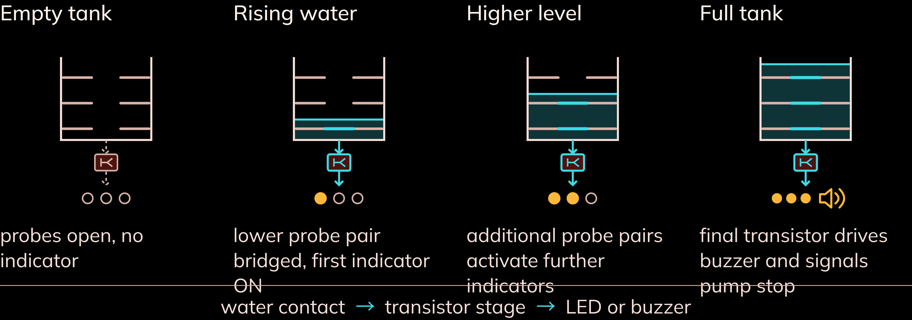
LEVEL-BY-LEVEL OPERATION
As water rises, the signal moves upward

Slide 7
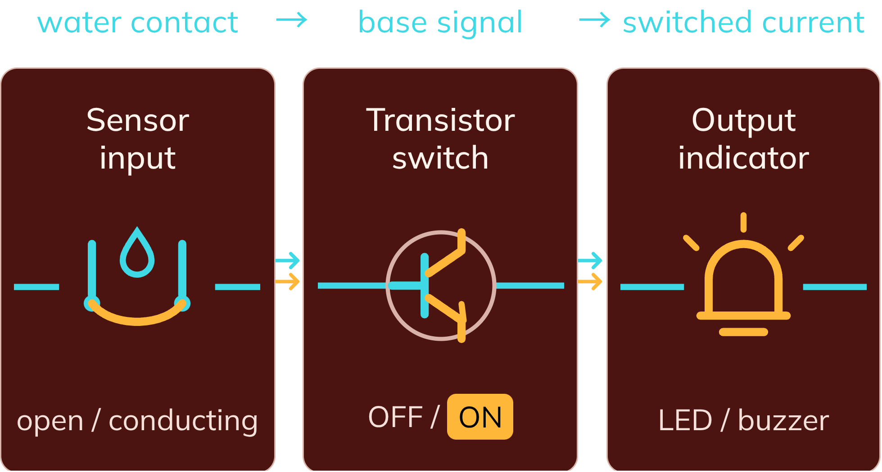
DIGITAL ELECTRONICS IDEA
Transistor switching turns a small signal into a decisive output
Water contact changes the input from open to conducting. The transistor interprets that probe signal as an ON/OFF control.
Sensing followed by digital-style switching.

Slide 8



Verify the circuit before trusting the alarm
Maintain the probes
Test each level
Keep sensing electrodes clean and firmly fixed.
Test each probe level separately before placing on a tank.
Protect the electronics
Expect variation
Use a low-voltage isolated supply; protect the circuit from splashes.
Water conductivity varies; probe spacing and resistor values may need adjustment.

Slide 9
CONCLUSION
A small circuit
with a useful result
The water alarm converts water presence into a visible and audible warning.
08
08
1
2
3
Conductive sensing
Transistor switching
Output indication
The same idea can extend to multiple levels, pump control, or a microcontroller interface.

