Slide 1
A DIGITAL ELECTRONICS
Water Alarm: A Digital Electroproject
Design a simple sensing-and-alert circuit that warns when a tank reaches a critical water level
A Team-Based Electronics Project
Submitted By:
Team Members: Nakul Chaudhry(202510101150140)
Gauri Yadav(202510101150174)
Ashutosh Singh(202510101150121)
Subh Yadav(202510101150148)
Vinay Singh(202510101150132)
Anubhav Kashyap(202510101150173)
Department : Btech CSE(DS+AI)
College: Shri Ram Swaroop Memorial University

Slide 2
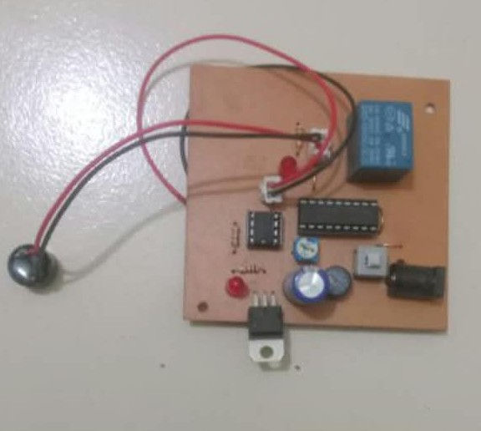
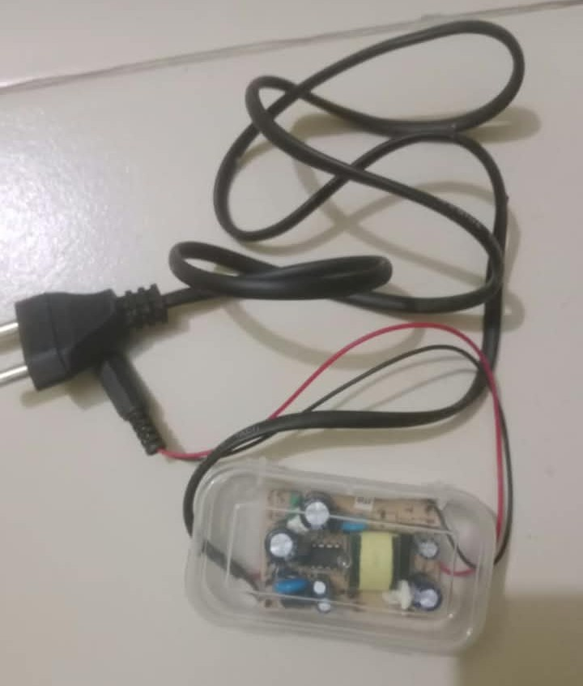
A DIGITAL ELECTRONICS
Water Alarm: A Digital Electroproject
Design a simple sensing-and-alert circuit that warns when a tank reaches a critical water level
CONTROL CIRCUIT PCB
POWER SUPPLY
PROJECT HARDWARE BUILD

Slide 3



WHY IT MATTERS
Why a water alarm matters
Prevent overflow
Warn before overflow
One complete circuit
Water overflow wastes water and can damage surrounding spaces.
The project demonstrates sensing, switching, indication, and sound output in one circuit.
An alarm gives an immediate indication before the tank overflows.

Slide 4
Introduction to Water Alarm System
A Water Alarm System is an electronic safety device designed to detect the presence or rising level of water and alert users through an audible alarm.
Water leakage and overflowing tanks can cause water wastage, property damage, and other problems.
Our project uses an electronic control circuit and a power supply to detect water and activate an alarm when water reaches the sensing point.
Key Features:
Detects the presence of water.
Generates an audible warning.
Uses an electronic control circuit.
Provides a simple and economical solution.
Helps prevent water wastage and overflow.

Slide 5
Main Objectives
The primary objective of this project is to develop a simple and effective electronic water detection and warning system.
Our objectives are:
To detect the presence of water using a sensing mechanism.
To generate an alarm when water is detected.
To understand the practical application of electronic components.
To design and implement a control circuit using a PCB.
To understand the role of a power supply in electronic systems.
To develop a low-cost solution for water leakage and overflow warnings.

Slide 6
COMPONENTS USED
Hardware Components
The project consists of the following major components:
1. Control Circuit PCB:
Acts as the main processing and control unit of the water alarm system.
2. Integrated Circuits (ICs):
Perform electronic control and signal-processing functions.
3. Relay:
An electrically operated switching device used to control an external circuit.
4. Capacitors:
Used for filtering, smoothing, and stabilizing electrical signals and voltage.
5. Resistors:
Help control current and establish appropriate operating conditions in the circuit.
6. LED Indicator:
Provides a visual indication of the circuit's operating or alarm status.
7. Buzzer:
Produces an audible warning when the alarm is activated.
8. Power Supply Unit:
Provides the required electrical power to operate the control circuit.
9. Water Sensor:
Detects the presence of water and provides a signal to the control circuit.

Slide 7
BLOCK DIAGRAM AND WORKING PRINCIPLE
Working Principle
The Water Alarm System operates on the principle of water detection followed by electronic signal processing.
Basic Block Diagram:
Water Sensor → Control Circuit → Alarm Activation → Buzzer
Working Steps:
The water sensor is placed at the desired detection point.
When water reaches the sensor, it detects the presence of water.
The sensor generates an electrical signal.
This signal is received by the control circuit.
The control circuit activates the alarm mechanism.
The buzzer produces sound to alert the user.
The relay can also be used to switch an external electrical load, depending on the circuit connections.

Slide 8
CONTROL CIRCUIT PCB
Control Circuit Description
The control circuit PCB is the main part of our project. It contains different electronic components connected together to perform water detection and alarm control.
Main Parts Visible in Our PCB:
Integrated circuit chips for electronic control.
Relay for switching operations.
Capacitors and resistors for circuit operation.
LED indicator for visual indication.
Buzzer connection for audible alerts.
External sensor connections.
Function:
The PCB receives the signal from the water sensor and controls the alarm response. It coordinates the operation of the electronic components to provide an effective warning system.
CONTROL CIRCUIT PCB

Slide 9
POWER SUPPLY UNIT
Power Supply Description
The power supply unit provides the electrical energy required for the operation of the water alarm system.
Our project uses a separate power supply circuit connected to the control circuit.
Main Functions:
Receives electrical input from the AC supply.
Converts electrical power into a suitable form for the electronic circuit.
Provides the required DC output.
Helps the control PCB operate properly.
Importance of Power Supply:
A stable and appropriate power supply is essential for the reliable operation of electronic components and the overall functioning of the project.
POWER SUPPLY

Slide 10
APPLICATIONS & ADVANTAGES
Applications
Water tank overflow detection.
Leakage detection in homes and buildings.
Monitoring water accumulation in basements.
Water detection in storage areas.
Industrial water monitoring systems.
Advantages
Simple electronic design.
Provides an audible warning.
Helps reduce water wastage.
Economical and practical solution.
Easy to understand and demonstrate.

Slide 11
Conclusion
The Water Alarm System demonstrates the practical application of electronic components in water detection and warning systems.
Through this project, our team gained practical knowledge about PCB circuits, integrated circuits, relays, power supply units, and sensor-based electronic systems.
This project provides a basic and useful approach to detecting water and alerting users, helping prevent water-related problems.
THANK YOU!

