Slide 1
TRAFFIC ANALYTICS & TRAVEL TIME PREDICTION
Internship Project
Submitted By
BCA – Data Science Jaypee University Internship Duration: 2 Months
Rishabh Gaur Ankit Yadav Himanshi Yadav

Slide 2
01
Introduction
What the project is about
THE IDEA
OUR APPROACH
Traffic changes during the day, so the time needed to travel the same distance can also change.
We analysed traffic data in Python and then used machine learning to estimate travel time.
WHY IT MATTERS
A simple prediction system can help understand congestion and support better travel planning.

Slide 3
02
Problem Statement
The practical problem
• Traffic volume is not constant throughout the day.
• Average vehicle speed changes when roads become busy.
• Weather and other conditions can influence travel time.
• Because of these changes, estimating journey time manually is difficult.
• The project aims to learn these patterns from data and predict travel time.

Slide 4
03
Objectives
What we planned to achieve
1. Understand the traffic dataset
4. Create useful visualisations
2. Find hourly traffic patterns
5. Train a regression model
3. Study factors related to travel time
6. Check how well the model predicts

Slide 5
04
Dataset
The data used in the project
32
8
Main fields
observations
columns
Date • Hour • Day • Traffic Volume Average Speed • Weather Distance • Travel Time
Target variable: Travel_Time_min
The current dataset is a small sample, so the model results are mainly for academic demonstration.

Slide 6
05
Tools & Technologies
Software used
PYTHON
PANDAS
MATPLOTLIB / SEABORN
Main programming language
Loading and working with the CSV data
Charts and visualisation
SCIKIT-LEARN
VS CODE / JUPYTER
GITHUB
Machine learning model
Writing and testing the project
Final project submission and documentation

Slide 7
06
Data Preparation
Before training the model
• Loaded the traffic CSV using Pandas.
• Checked the available columns and values.
• Converted the Weather field into a numerical form for modelling.
• Selected Hour, Traffic Volume, Average Speed, Weather and Distance as model inputs.
• Used Travel Time as the target variable.
• Split the data into training and testing sets.

Slide 8
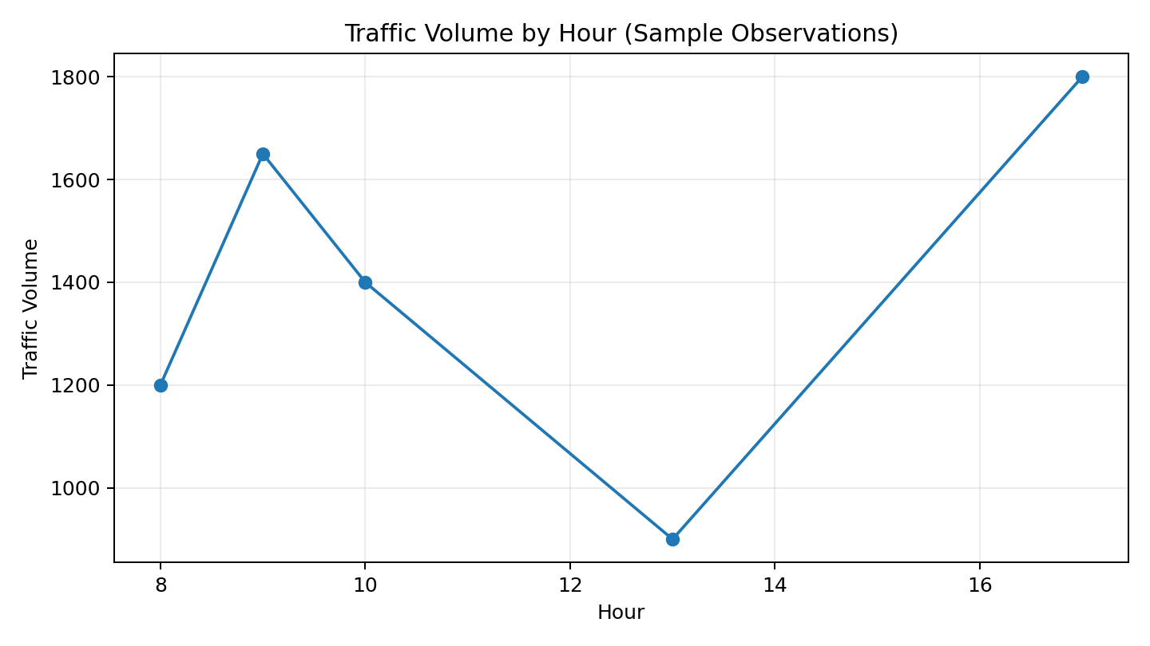
07
Traffic Volume by Hour
One of the main exploratory plots
This view makes the busier hours easier to spot.

Slide 9
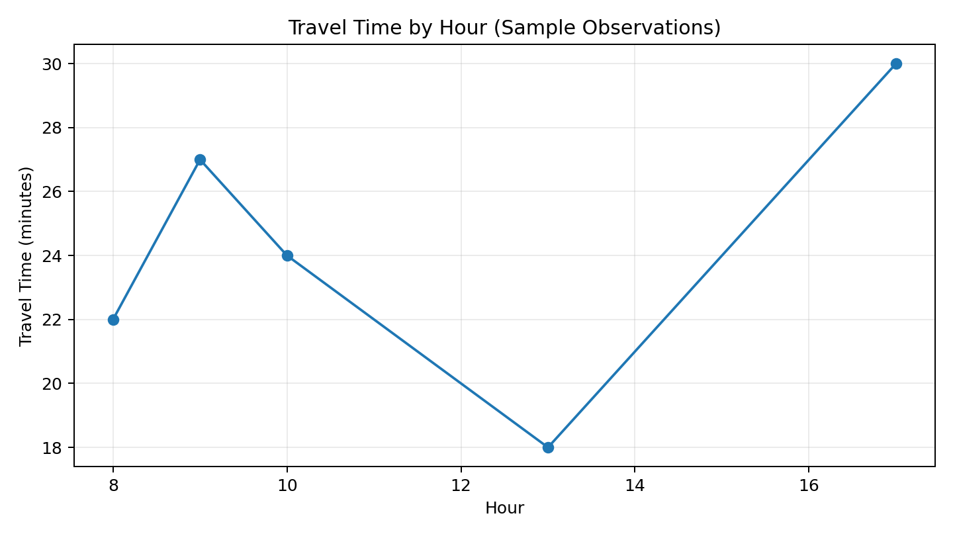
08
Travel Time by Hour
Another view of the same traffic data
Comparing hours helps us see when journeys take longer.

Slide 10
09
What We Observed
A short summary of the analysis
Average traffic volume
Average speed
Average travel time
1754.69
27.69 km/h
31.09 min
In simple terms:
Higher traffic and lower speed are important signals when estimating how long a trip may take.

Slide 11
10
Travel Time Prediction
Machine learning part
Random Forest Regression
INPUTS
Hour Traffic Volume Average Speed Weather Distance
The model learns from existing traffic observations and uses several input features to estimate travel time.
TARGET
Travel Time (minutes)

Slide 12
11
Model Results
Performance on the current test split
MAE
MSE
R²
1.08 min
1.56
0.98
These are good results for the current sample, but the dataset is small (32 rows). A larger real-world dataset would be needed before using the model in practice.

Slide 13
12
Example Prediction
One sample input and output
Example input
Predicted travel time
Hour: 18 Traffic Volume: 2500 Average Speed: 18 km/h Weather: Rain Distance: 10 km
44.46 minutes
This is an example prediction produced by the project model.

Slide 14
13
Limitations & Future Scope
What can be improved
LIMITATIONS
FUTURE SCOPE
• Small sample dataset • Unexpected incidents are difficult to predict • Real-time data is not connected
• Larger real-world datasets • GPS / live traffic data • More weather and road features • Web dashboard or mobile app

Slide 15
14
Conclusion
Final takeaway
The project shows a complete student-level workflow: data → analysis → visualisation → machine learning → prediction.
• Traffic patterns can be explored using simple visualisations.
• Traffic volume and speed are useful features for travel-time prediction.
• Random Forest Regression produced an R² score of 0.98 on the current sample test split.
• The next step is to test the approach on a larger and more realistic dataset.

Slide 16
Thank You
Traffic Analytics & Travel Time Prediction
Rishabh Gaur • Ankit Yadav • Himanshi Yadav

