Slide 1

Flask PDF to Excel Converter
This presentation outlines a Flask-based solution for automated data extraction from PDFs into Excel format. The converter focuses on structured tabular data, offering an efficient and user-friendly experience.

Slide 2
Overview
Automates extraction of structured data from PDFs.
Flask-based web application.
Key-value pair extraction. Saves data in Excel.
Designed for simple usage and efficiency.

Slide 3

Core Features
Upload PDF files.
Extracts key-value pairs using regex.
Converts data to Excel.
Downloadable Excel output.
User-friendly web interface.

Slide 4
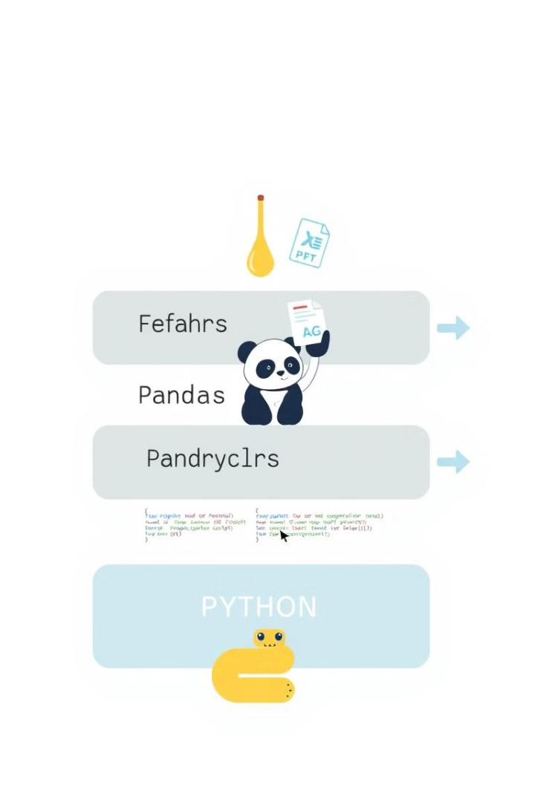
Technology Stack
Backend: Flask (Python)
Libraries: pdfplumber, pandas, re
Frontend: HTML, CSS, Flask templates
Output: Excel (.xlsx) using OpenPyXL

Slide 5

Installation and Setup
Prerequisites: Python 3 installed.
Install dependencies: pip install flask pdfplumber pandas openpyxl
Run application: python app.py. Open http://127.0.0.1:5001 in a browser.

Slide 6
Code Execution Flow
User uploads PDF.
Flask saves file in uploads/ directory.
Extraction function processes the file.
Reads PDF text using pdfplumber.
Uses regex to identify key-value pairs.
Stores data in dictionary.
Data converted to Excel.
User downloads Excel.

Slide 7
Flask Code Example
Flask Web Server Setup: app = Flask(__name__) UPLOAD_FOLDER = "uploads"
PDF Processing Function: def extract_table_from_pdf(...): with pdfplumber.open(pdf_path) as pdf:

Slide 8
Conclusion and Contact
Efficient data extraction from PDFs.
Automated workflows.
Future improvements for accuracy.

