Slide 1
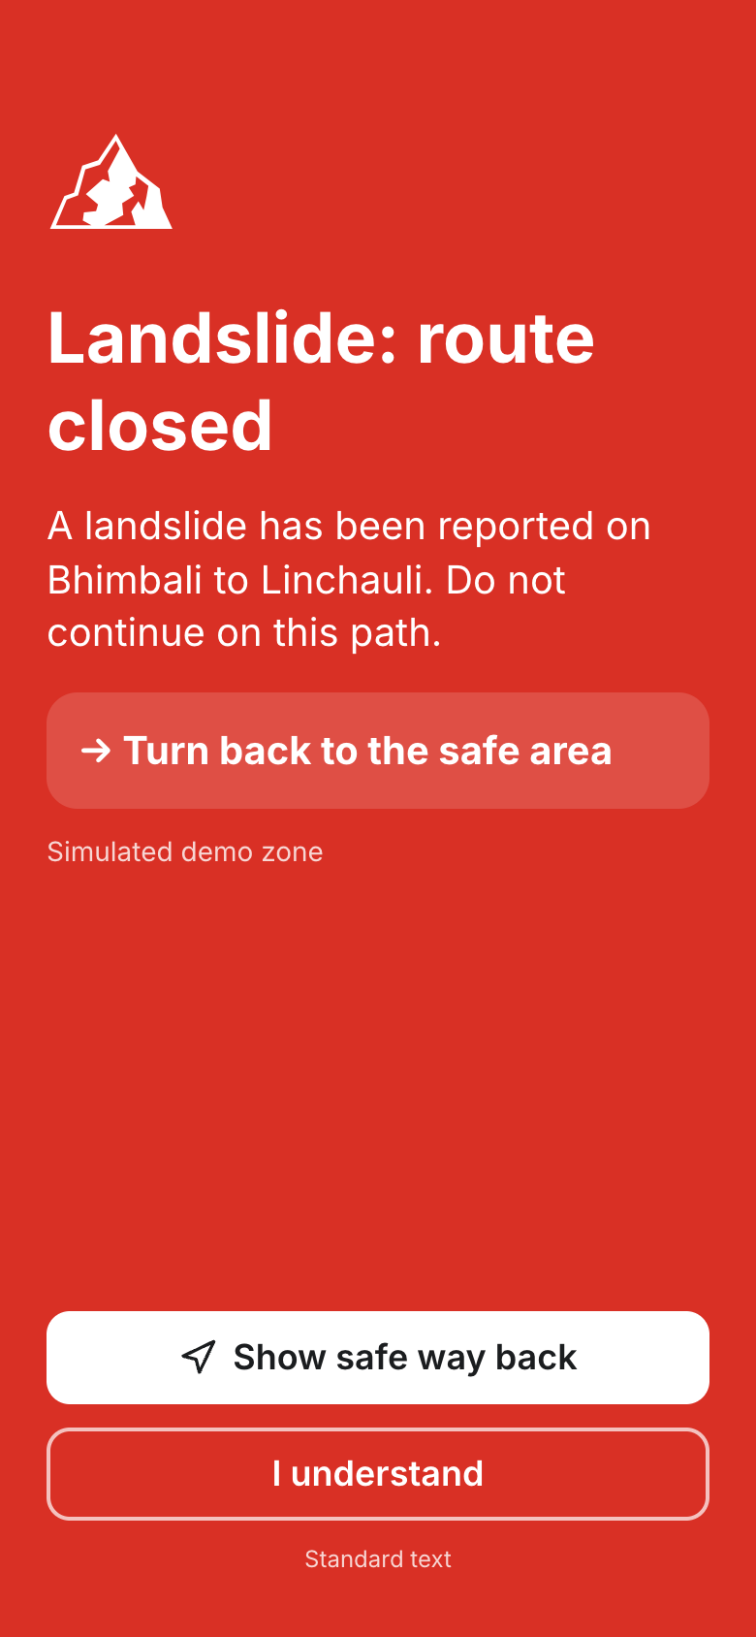
SafeTrail
Warn early. Never lose an SOS. Prove every response.
BIOS V2, Thapar Institute, Patiala
Prune challenge: Ship It Lean, AI Apps on a Budget
[TO FILL: team name and members]
Notes:
SafeTrail is a safety companion for treks, pilgrimages and national parks. Warn early, never lose an SOS, prove every response.

Slide 2
Three things fail at the same moment
In October 2023, a glacial lake burst in North Sikkim. Floods cut off the roads to Lachen and Lachung, and thousands of tourists were stranded. Every season, pilgrims on the Kedarnath route face landslides and crushing crowds.
1
2
3
Nobody warns you
There is no signal
No shared language
The route is closed or the crowd ahead is dangerous, and you find out too late.
Long stretches of these routes have no mobile data when you need it most.
You can't explain what happened to the people who can help.
Responders get late, vague, duplicate calls.
Notes:
Three things fail together: nobody warns you, there is no signal, and you do not share a language with the people who can help.

Slide 3
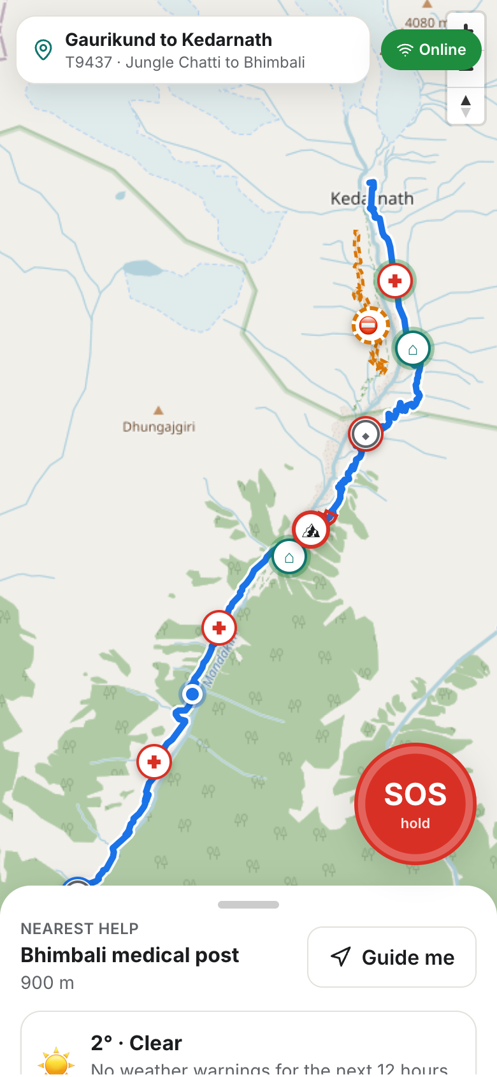
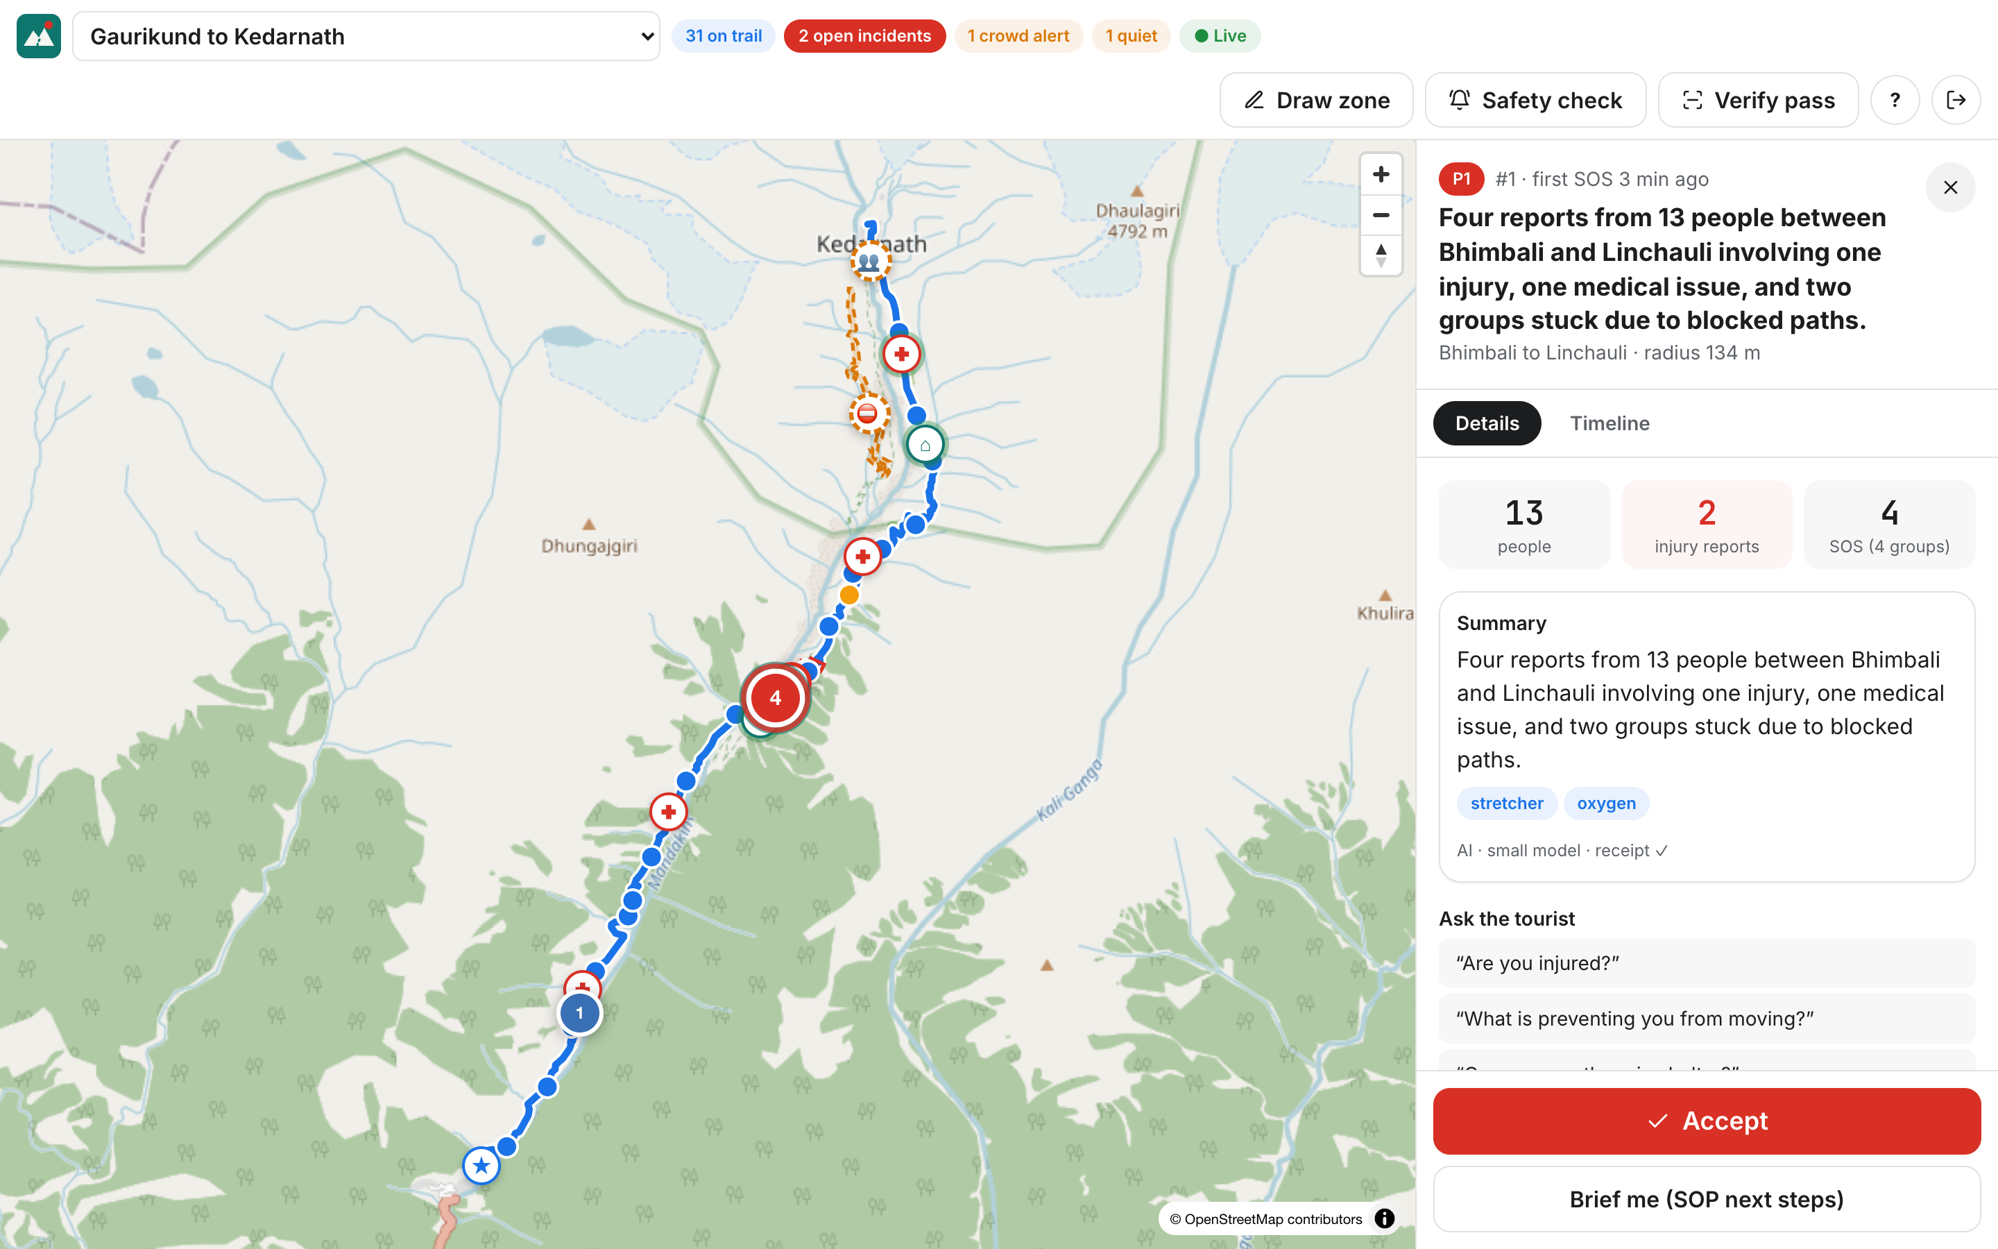
One app for the tourist and the responder
Tourist
Danger zone and crowd warnings
Offline safety pack
One-hold SOS
"Are you safe?" check-in
Family link, status only
Signed pass
Responder
Live map and drawn danger zones
One grouped incident, exact counts
Reports in their language
Next steps, then Accept
Notes:
One installable app, with no app store needed. The tourist gets warnings and an SOS. The responder gets one clear picture.

Slide 4
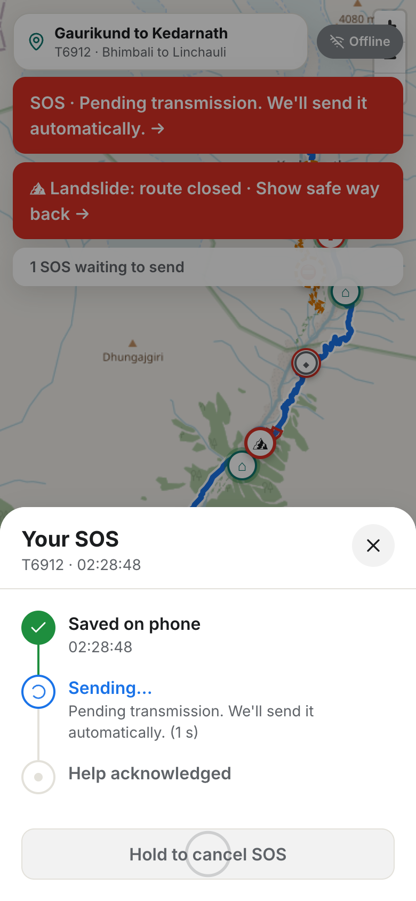
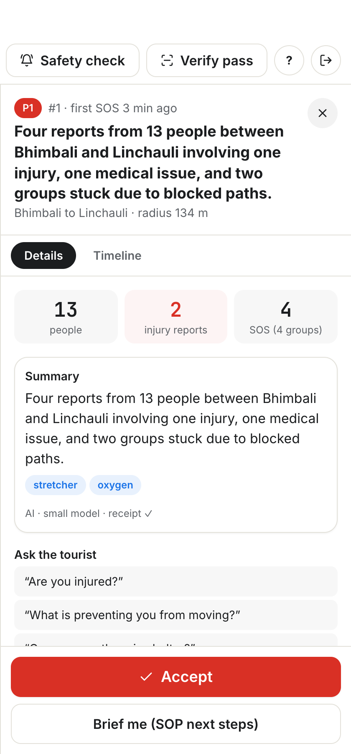
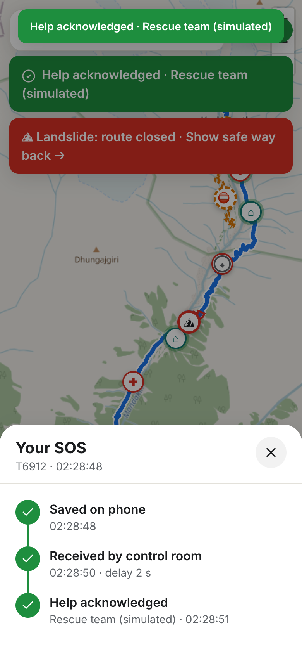
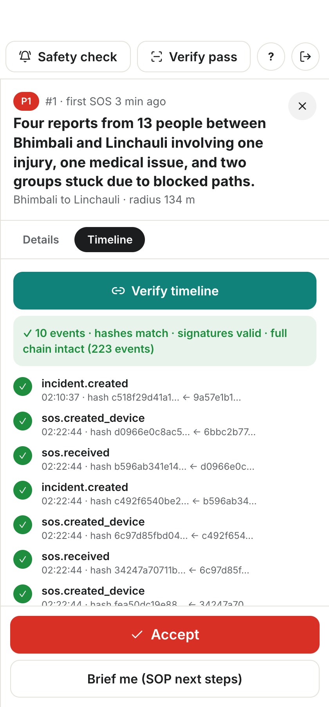
From danger to proof in five steps
1
Warn
2
Save
3
Group
4
Accept
5
Prove
Alerts come from the phone, even offline
SOS is saved at once, sent on first signal
150 m, 30 minutes: one incident, exact counts
The tourist sees "Help acknowledged"
A signed log: change one line and it breaks
Notes:
Warn, save, group, accept, prove. Plain code does every one of these steps. You will see them all live in a moment.

Slide 5
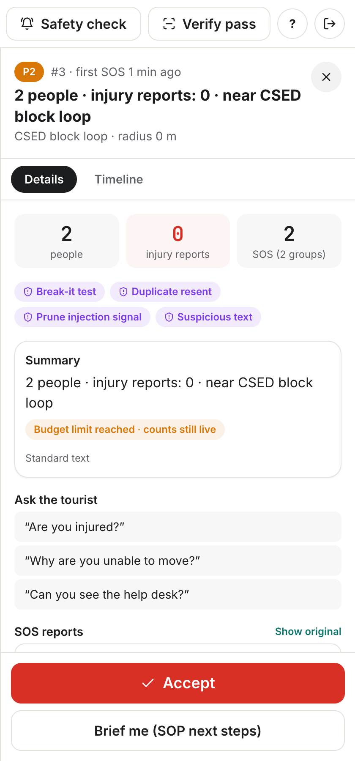
The AI is never in the emergency path
Plain code, works with the AI off
AI writes and translates only
Zone alerts and crowd detection
SOS saving and sending
Grouping and counts
Check-ins and pass checks
Signed log and family link
Safety packs
Zone warnings
Incident reports and summaries
Responder next steps
SMS details and permit cards
Rules decide. If the AI is slow, down or over budget, standard text shows, and it appears first anyway.
Notes:
This is the most important idea here. Rules decide, and plain code counts people. The AI only writes and translates. This screen shows Prune stopping the AI on budget: the counts stay live and the card says Standard text.

Slide 6
Every AI call goes through one gate
Tourist phone
Zones, SOS queue, pass. Works offline
SafeTrail server
Rules, grouping, signed log
Responder app
Live map, incidents, Accept
One module makes every AI call
A checker fails the build on any direct provider call
Keys never reach the browser
Prune gateway
Budgets, injection check, exact cache, signed receipts
Gemini models
Small first, stronger for harder jobs
Dotted lines are the AI. Everything on the solid lines works without it.
Notes:
Every AI call goes through Prune with one base URL. The dotted lines are the AI. Cut them and warnings, SOS and grouping all keep working.

Slide 7
We spend AI only where words are needed
Tokens per monitored trip
3 paise
10 paise
Naive (a low estimate)
1,997
AI cost per monitored trip
AI cost per emergency
SafeTrail design
369
SafeTrail + Prune, first day
403
82%
72%
SafeTrail + Prune, repeat day
0
fewer tokens per trip than the naive way
of repeat-day calls served from cache
100 simulated trips on the small model. Cost is Google's token counts times Google's list price. The live demo runs on a free key.
Notes:
Plain code does everything safety-critical, so those parts use no AI. One safety pack is shared by everyone on the same route, language and traveller type. That uses 82 percent fewer tokens per trip than writing one pack per person. It works out to about 3 paise a trip and 10 paise an emergency. On a repeat day the exact cache serves 72 percent of calls and the trip cost drops to zero. If asked: these are our own sums from Google's token counts at $0.25 input and $1.50 output per million tokens, at 88 rupees to the dollar. Prune's own figures for this run are 2.4 paise a trip and 15 paise an emergency, because it prices input at a flat rate and leaves out output. Its total comes out close to ours. Every run used the small model, because the free key ran out of large model quota, so real group summaries on the large model would cost a little more.

Slide 8
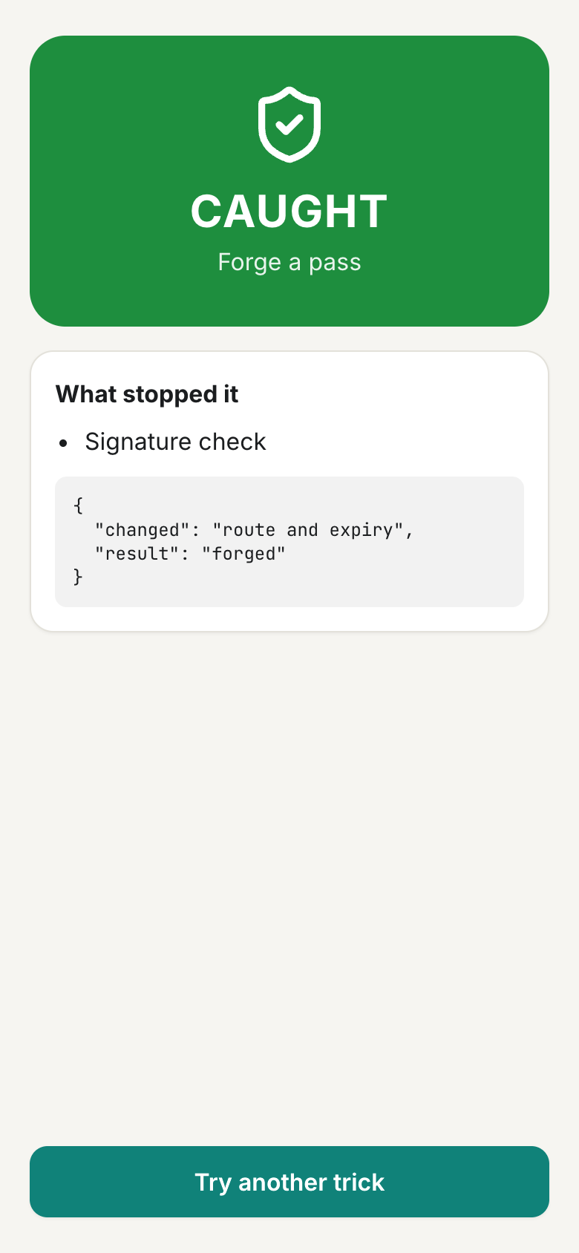
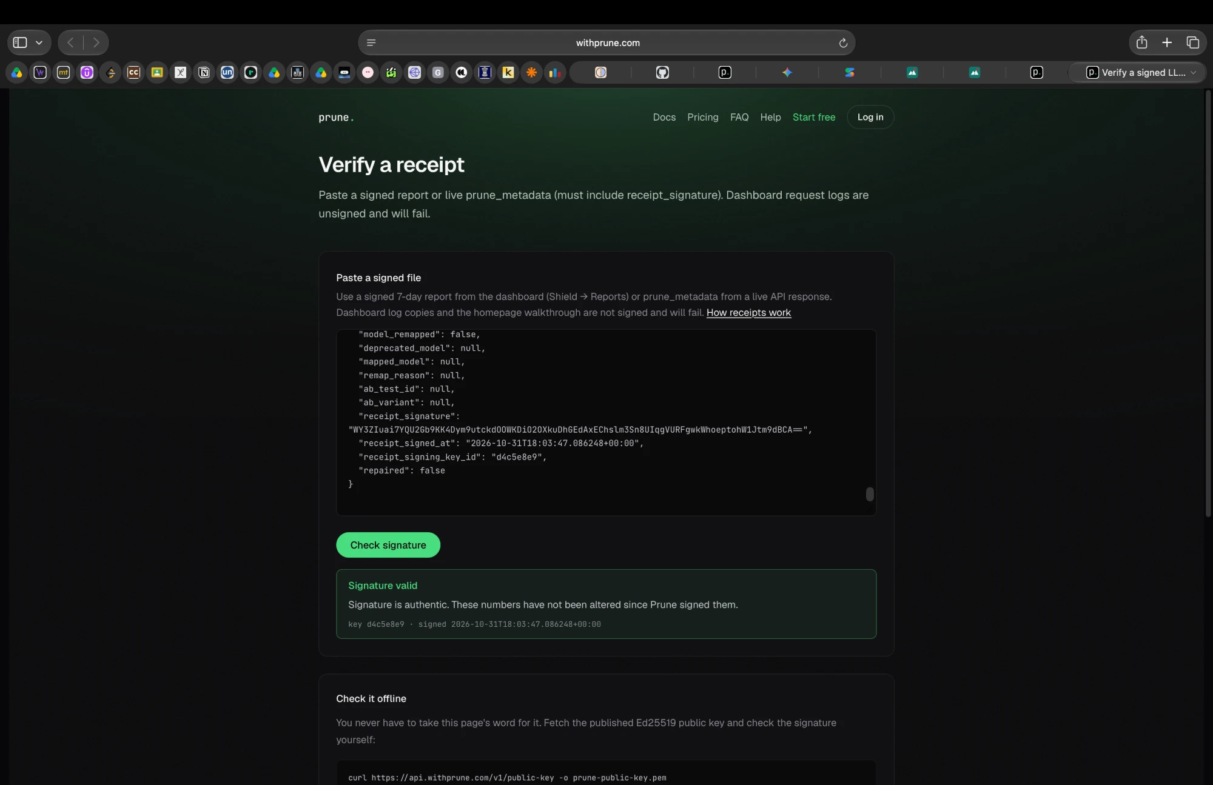
Built to fail safely, and tested on real prompts
✓
Validators
Invented numbers or places fall back to standard text
✓
Privacy
No names, phone numbers or ID numbers go into a prompt
✓
Budgets
Prune's verify page: "Signature valid"
Prune stops a job over budget, and the app carries on
✓
Injection
Judges attack it live: 8 tricks in the Break it round
English tricks in an SOS note get flagged, and no SOS is blocked
✓
Receipts
Signed by Prune and verified on its own site
✓
Our best catch
A cache could return another incident's summary. Now only identical requests match
Notes:
We tested with real prompts, not just unit tests. The strongest moment: a cached answer could return another incident's summary. We found it, fixed it, and added a live check that fails if it ever comes back. If asked about injection: 2 of our 4 test notes were flagged, the English ones. An SOS is never blocked either way.

Slide 9
You're on the trail now
[TO FILL: Join QR code]
1
2
3
Join
Zone alert
Crowd warning
4
5
6
Offline SOS
One incident
Are you safe?
7
8
9
Accept
Family link
Signed receipt
Demo zones and dispatches are simulated.
Notes:
Scan the QR. Say early: demo zones and dispatches are simulated. Running order: 1, everyone joins. 2, draw a zone and phones get the alert. 3, crowd warning. 4, one offline SOS, then signal returns. 5, reports group into one incident. 6, send "Are you safe?" and watch the tally. 7, Accept, and the tourist sees Help acknowledged. 8, open the family link. 9, show the signed receipt. Full script: docs/DEMO_SCRIPT.md. The QR link changes each time run_phones.sh starts, so paste a fresh QR here on the day or show it from the projector screen.

Slide 10
SafeTrail doesn't replace 112. It's the safety layer before it.
Digital Tourist ID
Where it starts
How it could pay
The pass links to the permit a traveller already holds. Built today with a simulated registry.
Routes that already need registration or permits: Kedarnath and the Char Dham yatra, the North East, national parks.
A state or park licenses it, with a small fee per tourist.
github.com/gaurvit06/Safetrail
Notes:
SafeTrail doesn't replace 112. It's the safety layer before it. Thank you.

Slide 11
Questions judges will ask
Question | Answer
Why not just call 112? | We warn before it happens, work across languages, keep the SOS with no signal, and give one grouped picture. We work alongside 112.
Does it work with no network? | Warnings, the pack and saving the SOS work offline. Sending needs some signal: data, SMS or a checkpoint.
Is the AI deciding emergencies? | No. Rules set priority and plain code counts people.
Isn't this surveillance? | It's opt-in per trip with a Stop button, location history is deleted after 7 days, and family see status only.
Can GPS be faked? | We flag impossible travel, replays and forged passes. We don't claim to stop all spoofing.
Notes:
Backup slide. Use only if asked.

Slide 12
What's real, simulated and not built
Real
Simulated, labelled
Not built, on purpose
Working app, 76 + 6 automated tests
Kedarnath trail from OpenStreetMap, 15.1 km
Live weather from Open-Meteo
Live AI through Prune with Gemini
Signed, verified receipts
Demo zones and dispatches
Permit registry, with fake numbers
CSED block route: help points are placeholders
Sikkim and Corbett routes, approximate
Real 112 integration
Real permit APIs
Face recognition
Satellite SOS
A chatbot
Notes:
Backup slide. English and Hindi are built and tested. Assamese notes are translated for responders. Nepali is partial.

Slide 13
Benchmark: 100 simulated trips, four ways
Run | Tokens per trip | Paise per trip | Paise per emergency | Calls to Google | From cache | Standard text
Naive (a low estimate) | 1,997 | 15.9 | n/a | 124 | 0% | 41 of 161
SafeTrail design | 369 | 2.9 | 9.6 | 56 | 0% | 0 of 56
SafeTrail + Prune, first day | 403 | 3.1 | 10.0 | 57 | 1.7% | 0 of 56
SafeTrail + Prune, repeat day | 0 | 0 | 6.3 | 16 | 72.4% | 0 of 56
Cost is Google's token counts times its list price: $0.25 in, $1.50 out per million tokens, ₹88 to the dollar
Every run used the small model, because the free key ran out of large model quota
Google limits stopped 41 of the naive run's jobs, so its true use is higher and its emergency cost isn't comparable
Prune rerouted no calls, so using the small model first is our own design
Counts were 100% correct in all four runs, because plain code computes them
Injection: 2 of 4 test notes were flagged, the English ones
Notes:
Backup slide. Token counts come from Google. Paise figures are our own sums at Google's list price, not a bill: the demo runs on a free key.

