Slide 1
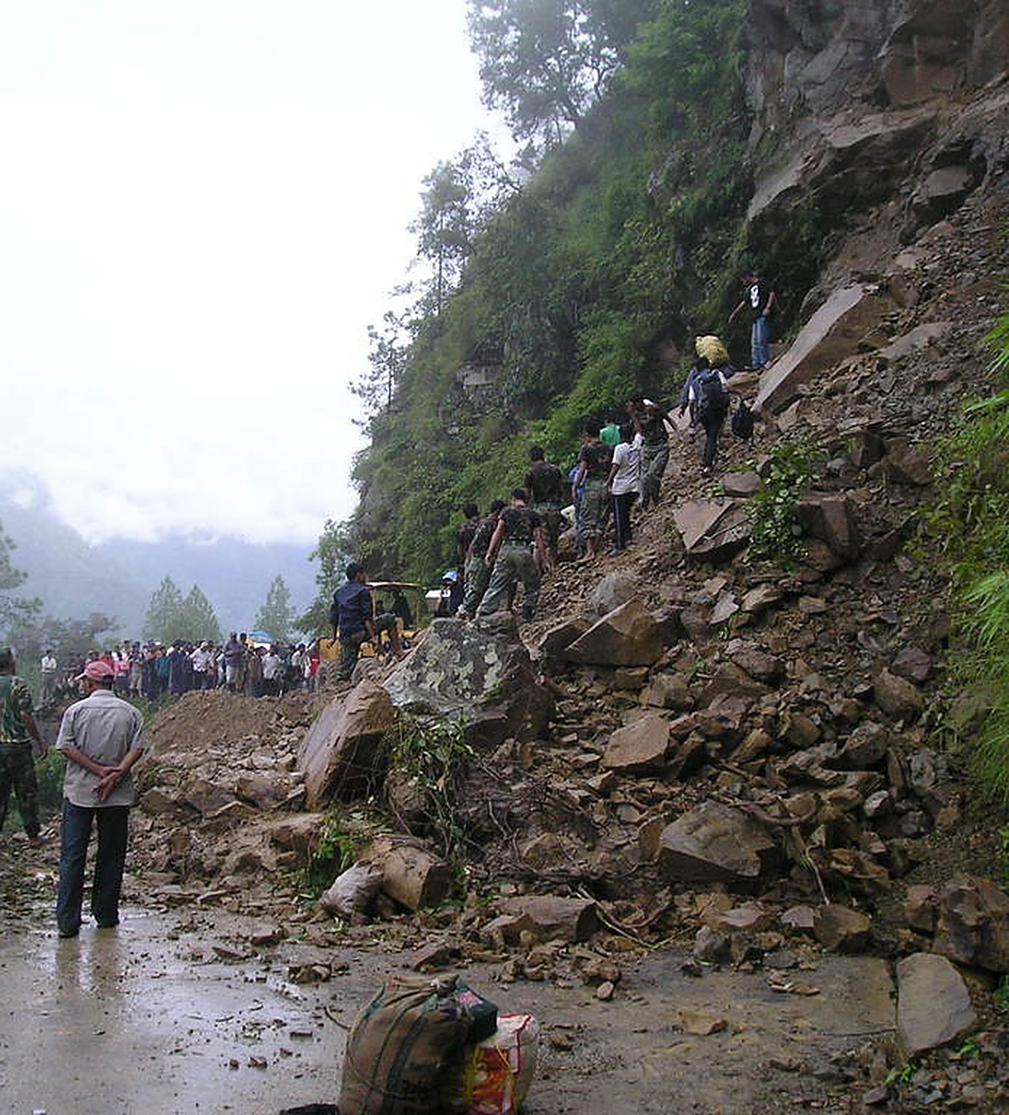



SafeTrail
BIOS V2 · Thapar Institute · Prune track: Ship It Lean
Warn early. Never lose an SOS.
Prove every response.
A landslide on the trail. No signal, no common language, and a crowd building behind you. In the mountains, everything fails at once.
Where it breaks
No warning
No signal
No common language
Walking into closed or unsafe stretches.
Calls fail exactly where help is needed.
A pilgrim can't say where, or what.
Why it matters
16.5 lakh+
15,000+
Up to 3,000
pilgrims visited Kedarnath in 2025, counted by early October
evacuated from the Kedarnath trek after the July 2024 cloudburst
people stranded at Lachen and Lachung, North Sikkim, Oct 2023
ETV Bharat, Oct 2025
Deccan Herald, Aug 2024
Telangana Today (ANI), Oct 2023
A landslide blocks the only road. Far-western Nepal.
Photo: Possible (Flickr), CC BY 2.0
Pilots: Kedarnath · Lachung to Yumthang, Sikkim · Corbett Tiger Reserve
Notes:
SAY: "Imagine trekking to Kedarnath when a landslide blocks the path. No signal, no common language, and a crowd building behind you. Today's safety depends on tourists spotting danger, having signal, and explaining where they are. In the mountains all three fail at the same time. We built SafeTrail for exactly that moment."
Point at the facts: more than 16.5 lakh pilgrims visited Kedarnath in 2025 (official count by early October; the season closed higher); in July 2024 a cloudburst washed out the trek at Lincholi and Bhimbali (the same stretch our demo landslide zone sits on) and more than 15,000 people had to be evacuated; in October 2023 a glacial lake burst cut off North Sikkim and up to 3,000 people were stranded at Lachen and Lachung.
Sources: ETV Bharat, Oct 2025 (Kedarnath season count); Deccan Herald, "Over 15000 evacuated as rescue ops on Kedarnath trek route concludes", Aug 2024; Telangana Today / ANI, "Sikkim lake burst: 3,000 stranded in Lachen-Lachung", Oct 2023.
Before presenting: add the team names.
Photo: "Landslide on the only road to Far-Western Nepal" by Possible, Flickr, CC BY 2.0 (via Google Open Images). The photo is from Nepal, not Kedarnath, and the caption says so.

Slide 2
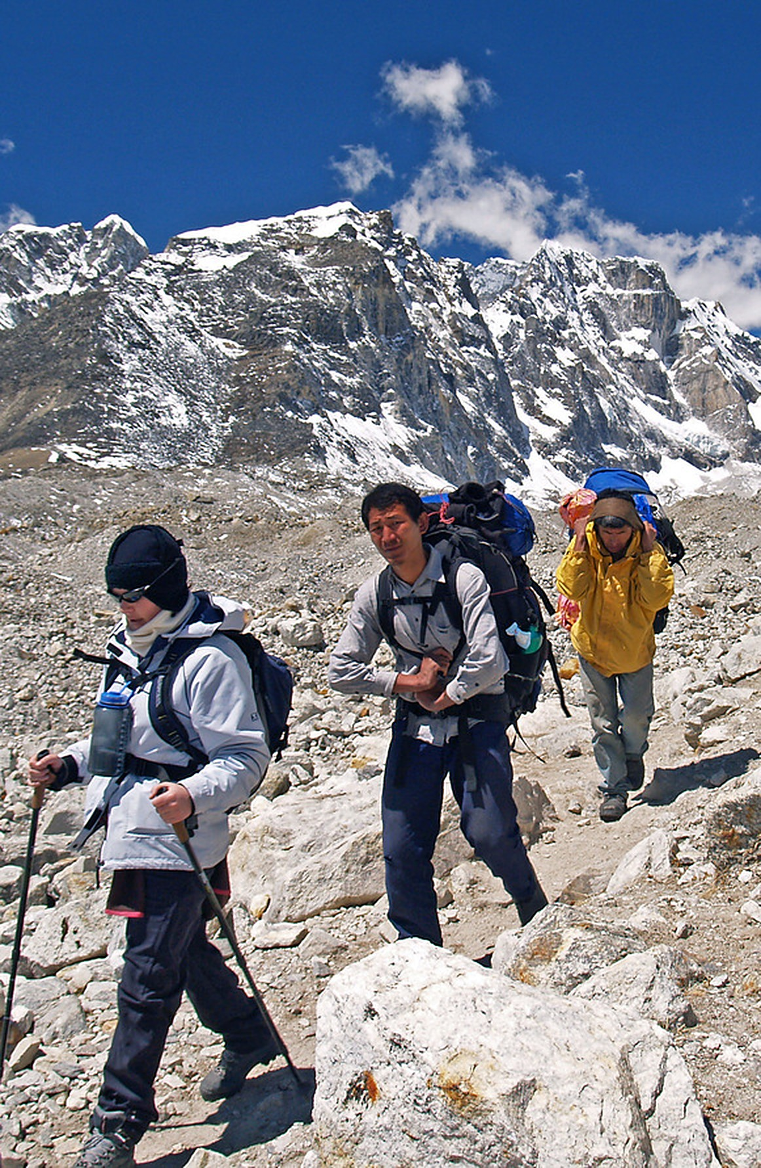
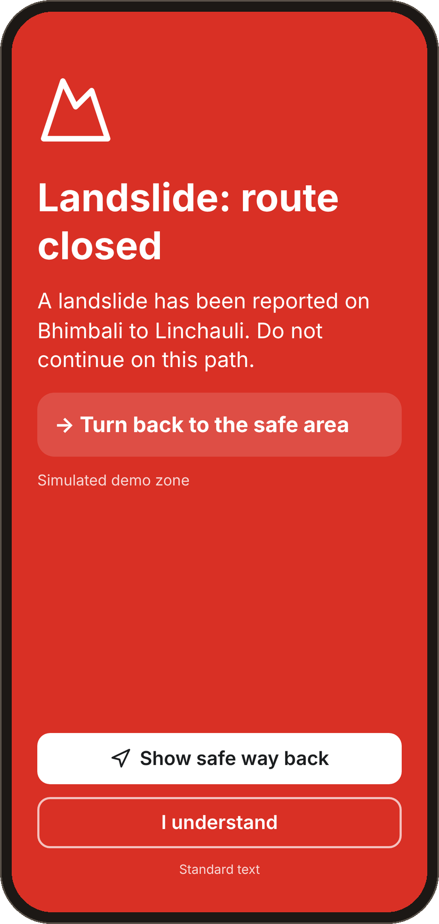
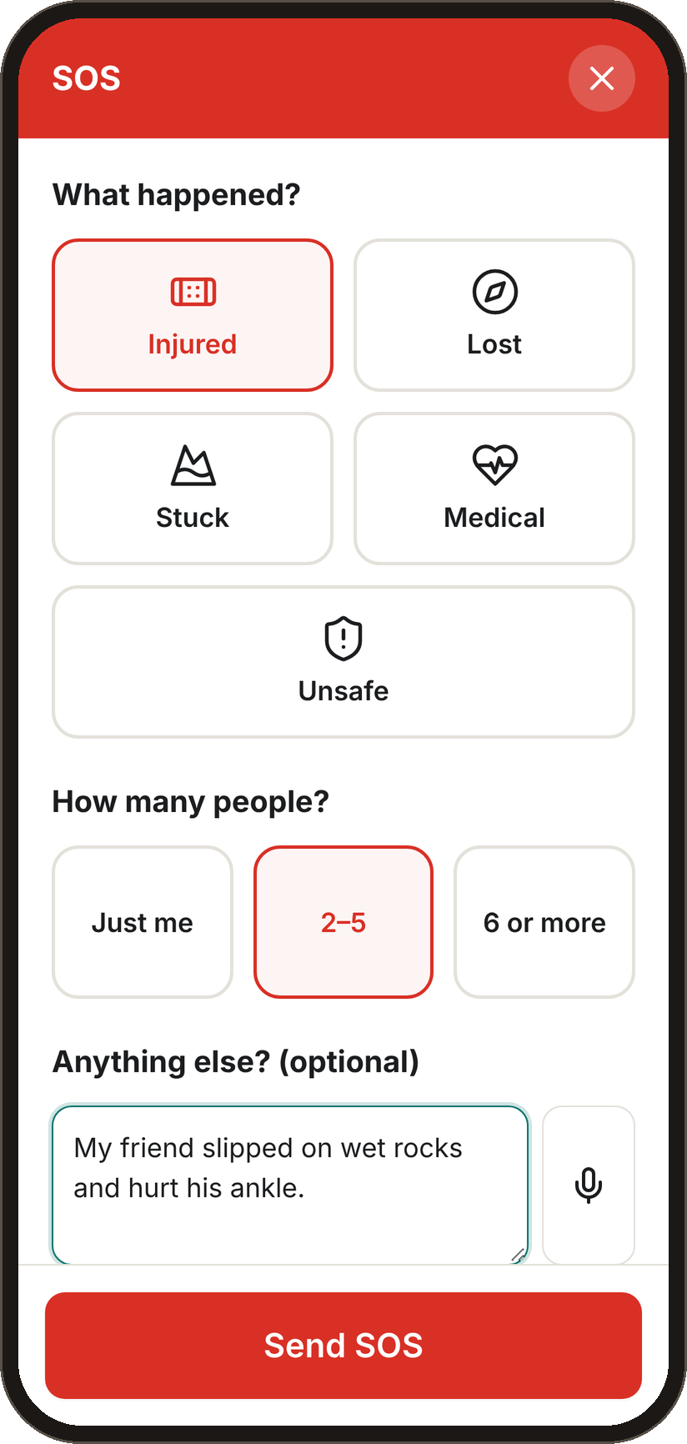
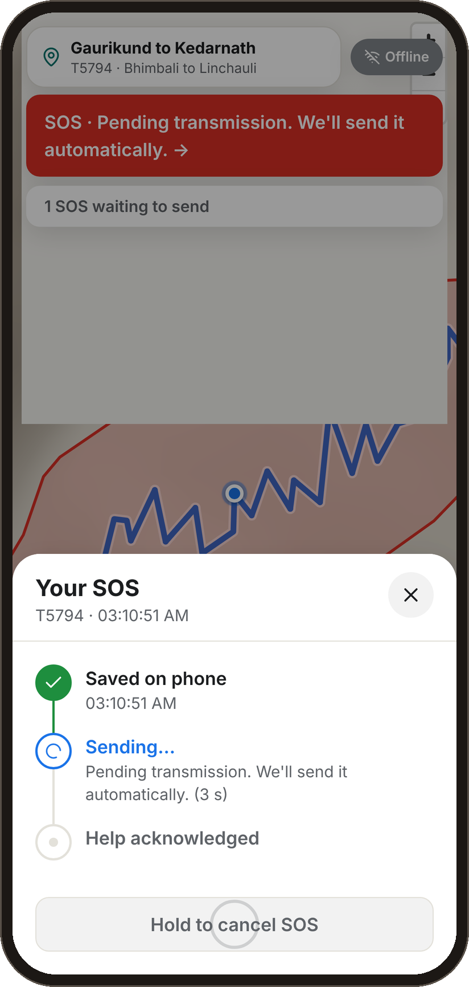




For the tourist: warned early, never alone
Real screens from the app: one installable web app that works offline once opened.
Before you go
Join by QR code, no app store
Safety pack in your language
Signed trip pass that works offline
On the trail
Danger-zone alerts with no internet
Crowd warnings before you walk in
Weather by section, safe way back
In trouble
Hold SOS: three taps, no typing
Saved on the phone, sent on first signal
Whistle, flash and a read-to-112 card
Help is coming
“Help acknowledged” on every phone
“Are you safe?” after a disaster
Family link: status, never location
Danger-zone alert
SOS in three taps
Offline, still safe
Full screen, from the phone's own check. No signal needed.
What happened and how many. No typing, in any language.
Saved with time and place. Sends itself on the first signal.
Photo: Steve Hicks, trekking in the upper Khumbu, Nepal (CC BY 2.0)
Notes:
SAY: "It's one app with two sides. The tourist side works offline. Before the trip you join by QR, get a safety pack in your language and a signed pass. On the trail, the phone checks your position against danger zones by itself, with no internet, and warns you about crowds and weather. If you're in trouble, hold SOS: three taps, no typing. It's saved on the phone and sent automatically the moment any signal returns, by SMS if data is down. When the control room accepts, every phone in the group shows Help acknowledged, and your family sees your status, never your location."
All three phone screens are real screenshots of the app (Kedarnath route, simulated demo zone). The map relief is from open elevation data.
Photo: "Trekking in the upper Khumbu" by Steve Hicks, Flickr, CC BY 2.0 (via Google Open Images).

Slide 3





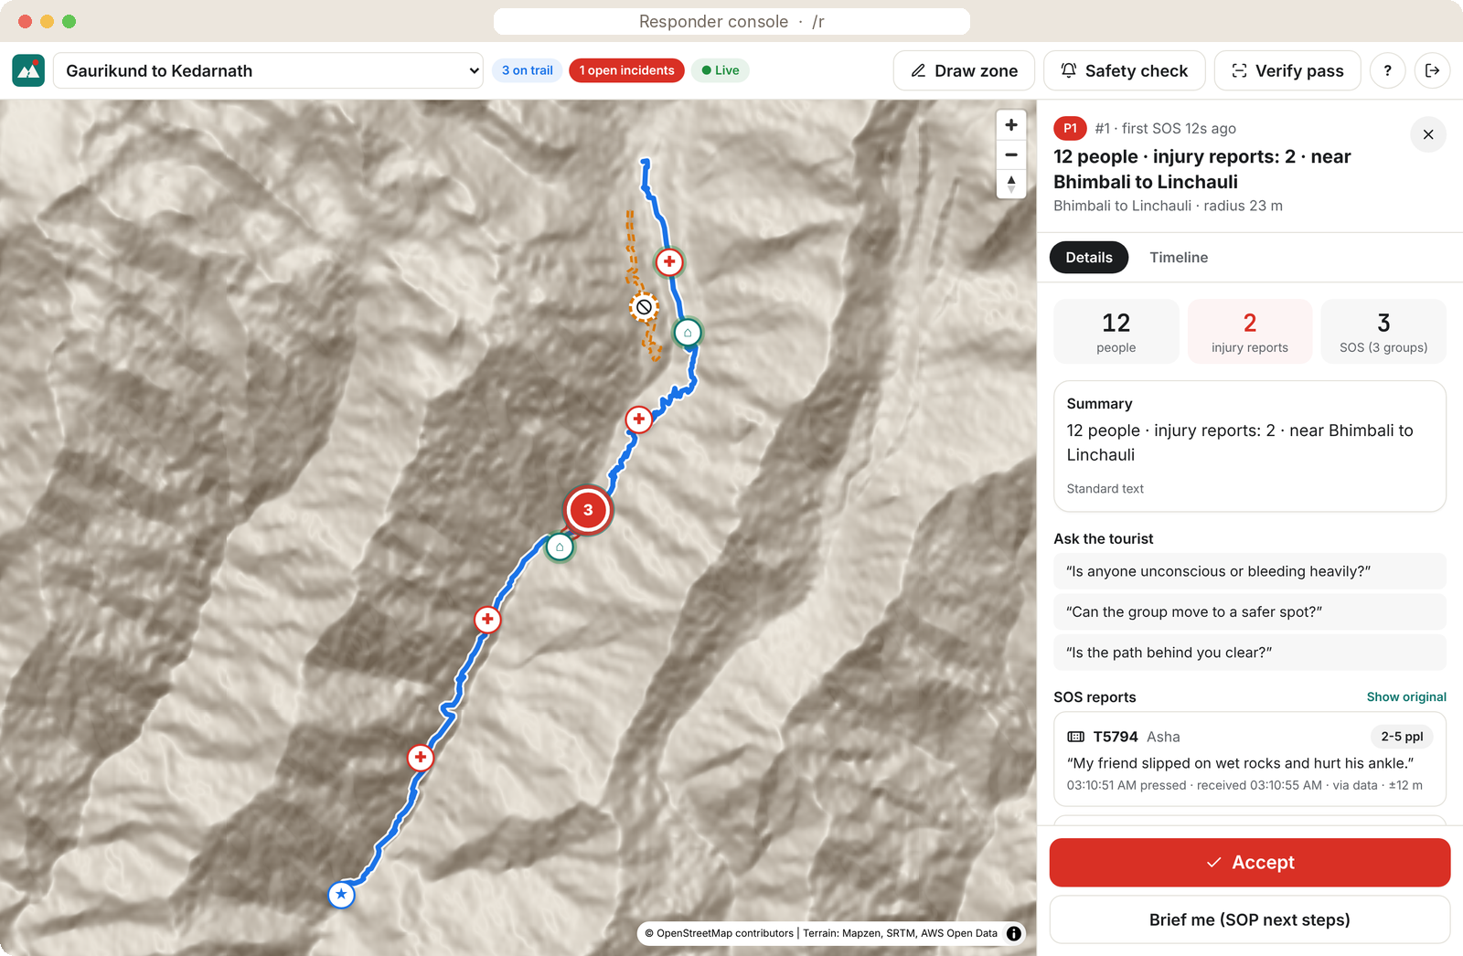
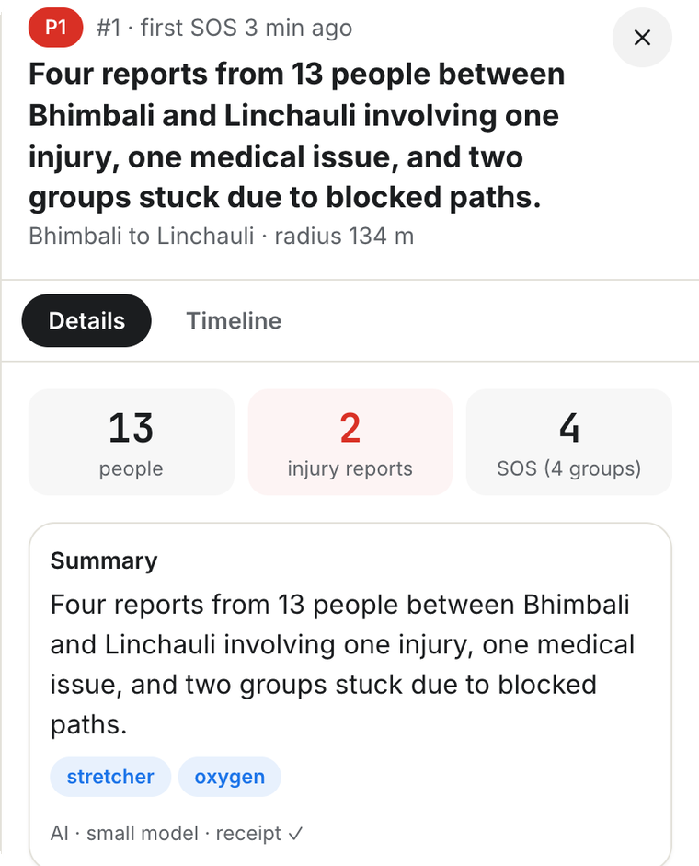
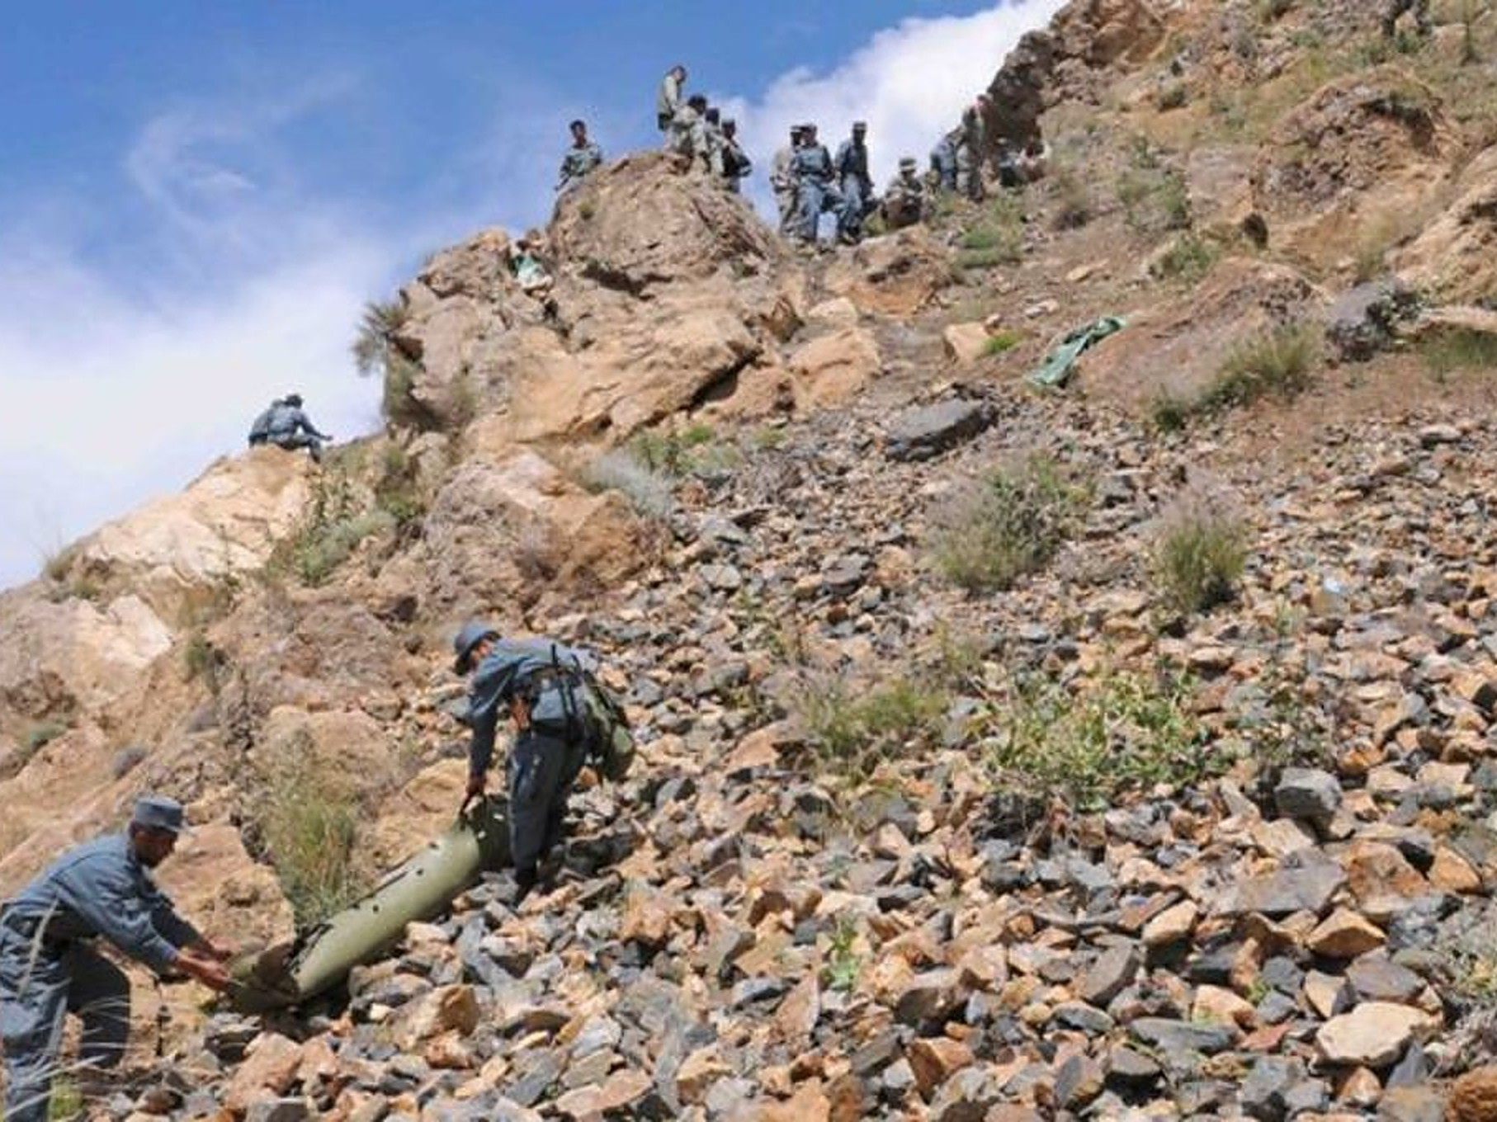
For responders: 40 calls become one clear incident
The same app with an officer login. Counts come from code; the AI only writes.
SOS arrives
Grouped by place
AI report via Prune
Accept
Signed timeline
By data, coded SMS or at a checkpoint. Duplicates dropped.
SOS within 150 m and 30 min: one incident, exact counts.
Summary and notes in the officer's language.
Every phone in the group shows “Help acknowledged”.
Every step hash-chained and signed. Edits show.
Live AI summary via Prune, with its signed receipt (Hardik's laptop).
One clear picture for the rescue team, not 40 calls.
Photo: ResoluteSupportMedia, mountain rescue training (CC BY 2.0)
Crowd heat + weather
“Are you safe?” tally
Draw a zone
Verify passes
Notes:
SAY: "When a landslide hits, responders don't get 40 separate calls. They get one incident: how many people, how many injury reports, where, and what they wrote, translated. SOS within 150 metres and 30 minutes are grouped, like DBSCAN. Counts come from code, not AI, so they're always exact; the AI only writes the summary, through Prune, and if it's down the panel shows standard text. One tap on Accept and every phone in that group shows help is coming. Every step is hash-chained and signed, so nobody can quietly rewrite what happened."
The window is the real responder console (this build, standard text because no AI key was set on this machine). The card next to it is a live AI summary from Hardik's laptop on 31 Oct, labelled "AI · small model · receipt ✓".
Photo: "Mountain Rescue Training" by ResoluteSupportMedia, Flickr, CC BY 2.0 (via Google Open Images).

Slide 4
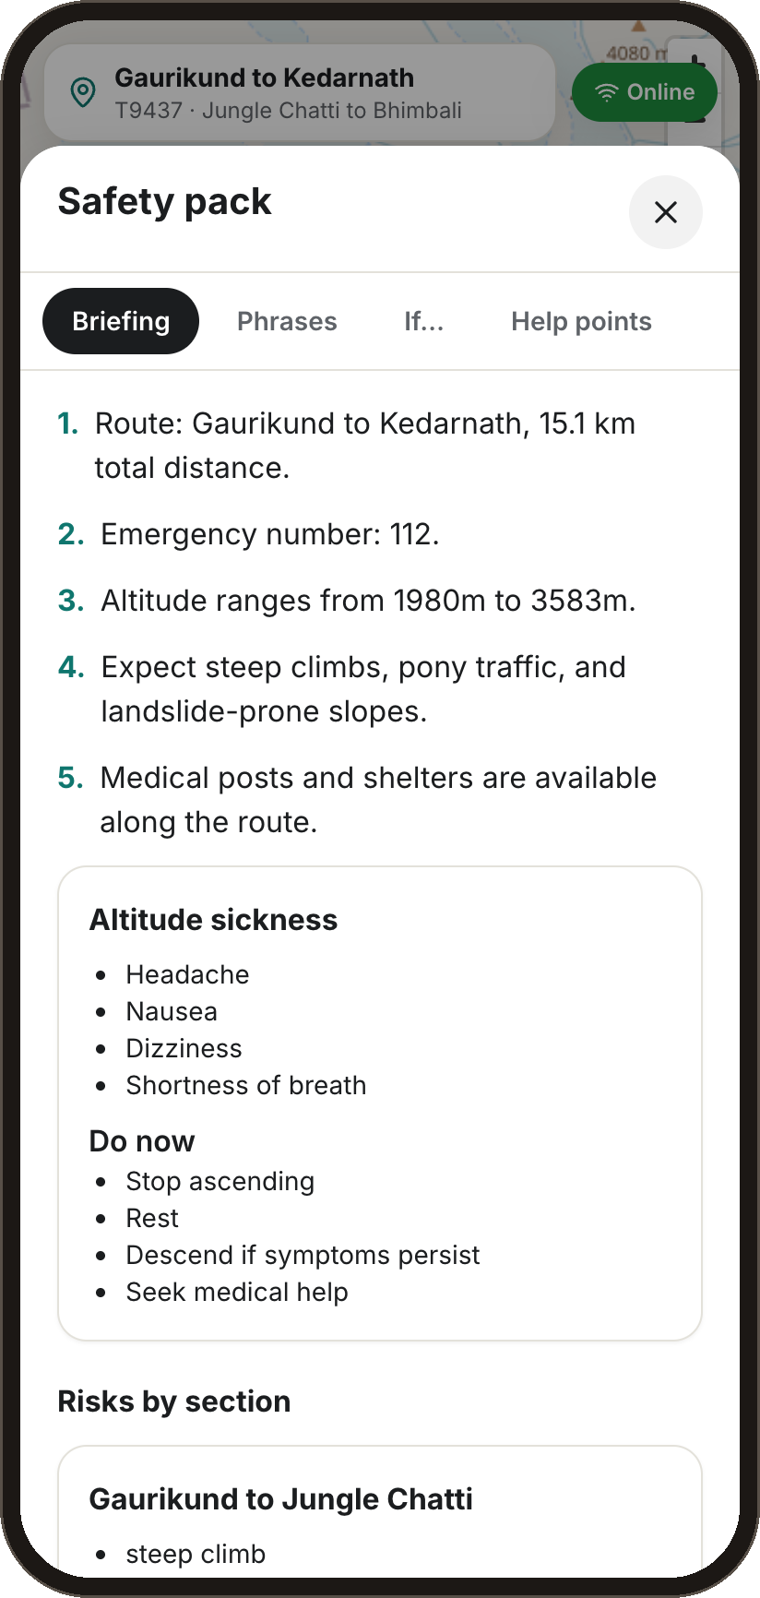
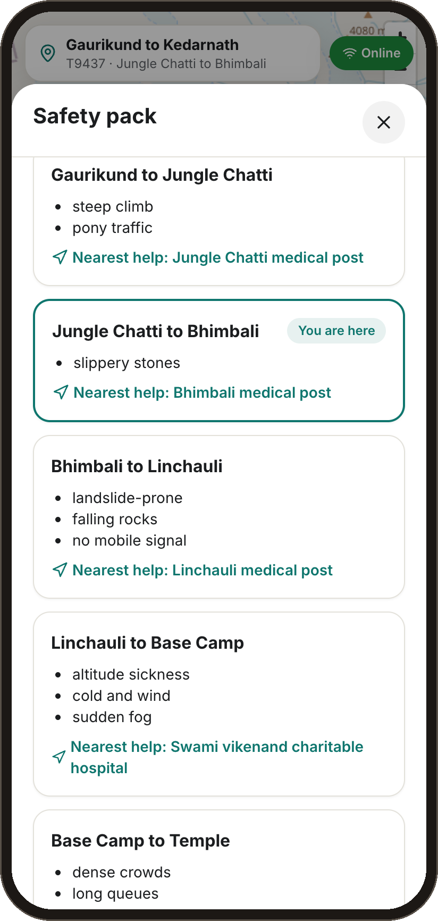
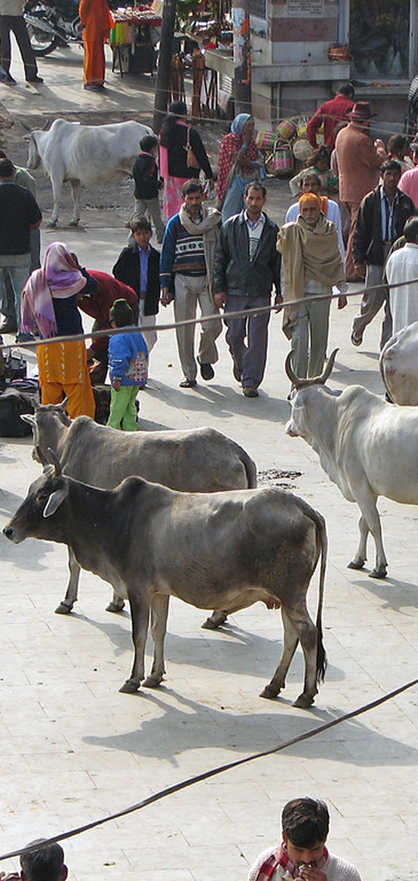



The AI safety pack: made once per route, read offline
Written through Prune before the trip, checked by validators, shared by every tourist on that route and language.
What's inside
Route briefing
Distance, altitude, the emergency number and control room.
Risks by section
What each stretch is like, and the nearest help point.
Altitude sickness
The warning signs, and what to do right now.
Phrases and “Show to a local”
Hindi or Nepali, read aloud or shown full screen.
Help points
A compass guide to the nearest shelter, offline.
How it's made
Verified route facts and SOPs
Prune: small model first
Validators: no invented facts
Cached per route and language
Route briefing
Risks by section
For every pilgrim
Pack #2 onward costs nothing: it is shared, not regenerated. If the AI is down, the phone shows “Standard text” written by us.
Real AI output through Prune (Hardik's laptop).
Marks the stretch you are on.
Photo: McKay Savage, Haridwar (CC BY 2.0)
Also written by AI through Prune:
SOS notes translated
Group summaries
SOP next steps
Zone warnings per language
Free-text SMS
Permit explainer
Notes:
SAY: "The AI's main job is the safety pack. Before the trip, Prune's small model writes a briefing for the route in the tourist's language: distance and altitude, the risks on each section with the nearest help point, altitude sickness signs, phrases you can read aloud or show to a local, and a compass guide to shelters. It's built only from verified route facts and the official SOP, and validators reject anything that invents a number, place or step. It's cached per route and language, so the second pilgrim's pack costs nothing, and it all works offline. If the AI is down, the phone shows our own standard text."
The two pack screens are real AI output from Hardik's laptop (Prune with Gemini, 31 Oct).
Other AI features, all through Prune: SOS note translation, group summaries, responder next steps citing the SOP, zone warnings in each language, reading free-text SMS, and the permit explainer card. The AI never decides anything safety-critical.
Photo: "India - Haridwar - 002" by McKay Savage, Flickr, CC BY 2.0 (via Google Open Images).

Slide 5
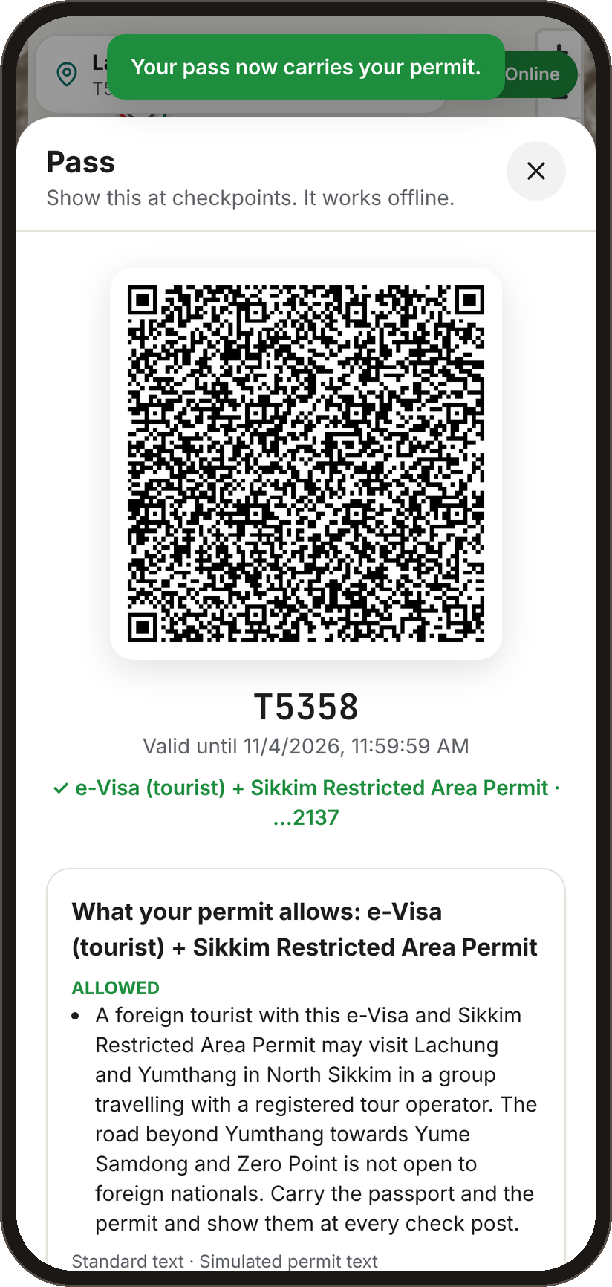
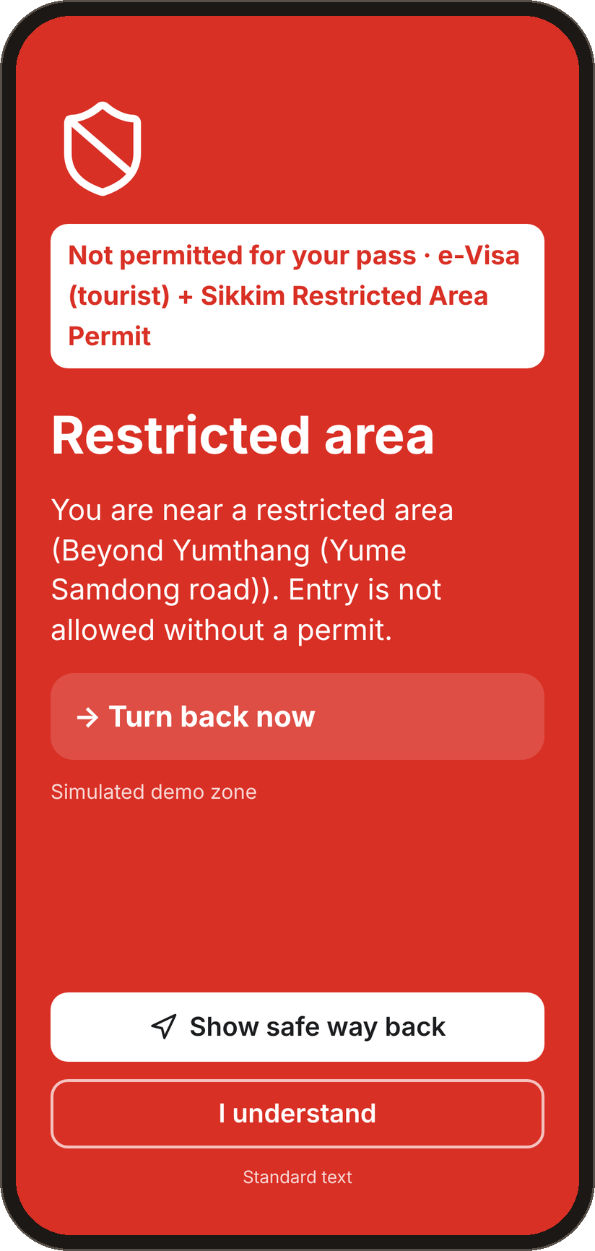
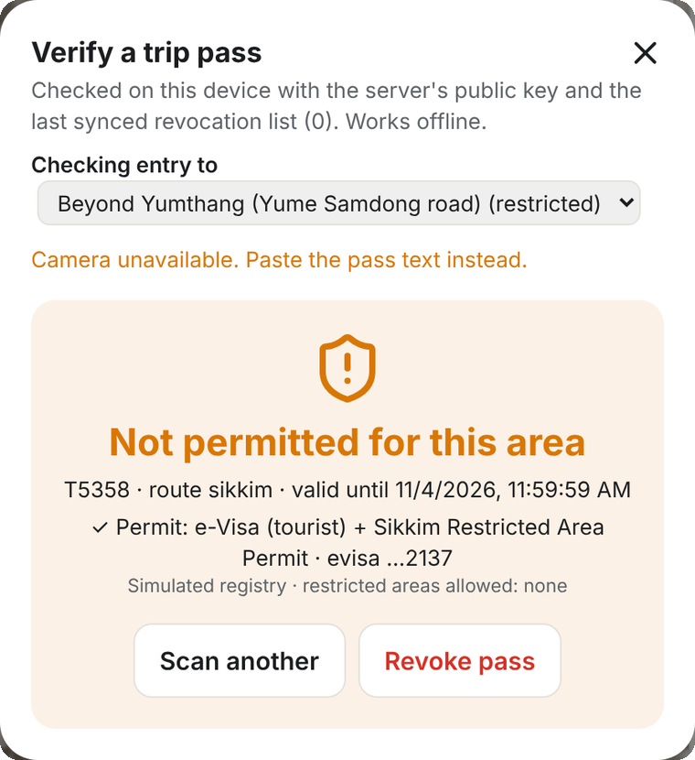
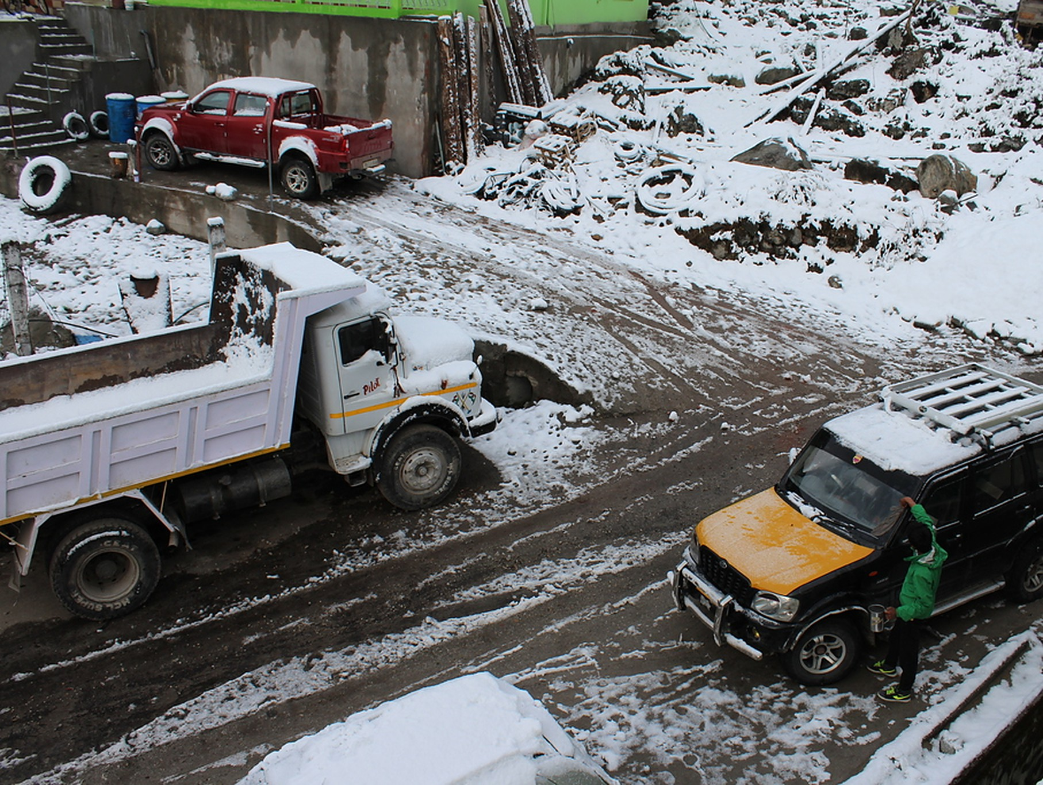





Your pass comes from the permit you already have
Phase 2, built with a simulated registry: link the e-Visa, e-ILP or yatra registration you already hold.
Foreign visitor
e-Visa or visa number, plus PAP or RAP where the state requires one
Indian visitor
e-ILP, yatra registration, DigiLocker, passport or voter ID
Aadhaar
Optional: the last 4 digits only, never required
How linking works
1 Enter the visa or permit number
2 Checked against the registry
3 Hashed at once; only the last 4 kept
4 Pass re-signed with permit and allowed zones
Checkpoint scan, offline: “Not permitted for this area”.
Checked offline at any checkpoint
Valid
Expired
Forged
Revoked
Not permitted here
The full number is never stored, logged or sent to the AI: only a salted hash and the last 4 characters. Upgrades and revocations are signed into the event log, and checkpoints keep the revocation list offline.
Permit linked
Past the permit's limit
e-Visa + Sikkim permit, last 4 only.
Walking toward the road beyond Yumthang.
North Sikkim: where you may go depends on your permit.
Photo: genobz, Sikkim (CC BY 2.0)
Hackathon build: a simulated registry with fake numbers. A real rollout plugs into the official e-Visa, e-ILP and yatra checks.
Notes:
SAY: "In permit states like Sikkim, the tourist already holds an e-Visa or an inner-line permit. SafeTrail links it instead of inventing a new ID. The number is checked against the registry, hashed at once, and only the last four characters are kept; it never reaches the AI. The pass is re-signed with the permit and the zones it allows, so any checkpoint can check it offline: valid, expired, forged, revoked, or not permitted for this zone. And if a visitor walks toward a road their permit doesn't cover, the phone warns them before they get there."
Be clear that the registry is simulated with fake numbers. Aadhaar is optional and only the last 4 digits are kept.
Photo: "Sikkim Feb 2015" by genobz, Flickr, CC BY 2.0 (via Google Open Images).

Slide 6
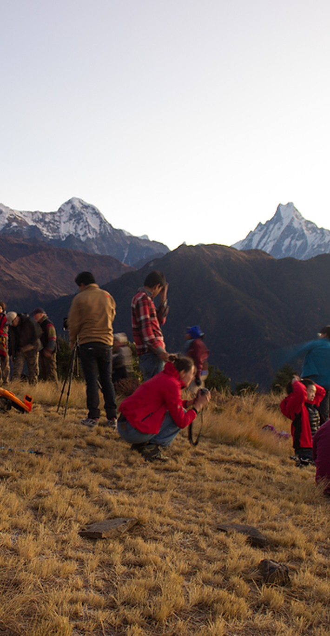




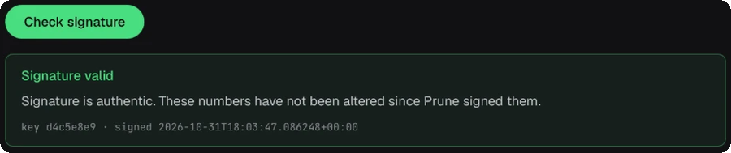

How it's built, and what it costs
Safety runs as plain code on the phone and the server. Every AI call goes through Prune.
Phone, works offline
Server: FastAPI + SQLite
Prune gateway
Gemini models
Zone alerts, SOS queue, pass check, phrases
Grouping, counts, signed log, live updates
Budgets, cache, injection check, receipts
3.1 Flash-Lite (small), 3.5 Flash (large)
The AI is never in the emergency path: if it's down, every alert and SOS still works.
React + TypeScript PWA (service worker, IndexedDB queues) · MapLibre + OpenStreetMap · FastAPI · SQLite · Server-Sent Events · Ed25519-signed passes · hash-chained event log · Open-Meteo weather
What Prune does for us
Measured on 100 simulated trips
One base URL. A checker fails the build on any direct AI call.
82% fewer
≈ 3 paise
Small model by default, the large one only when needed.
tokens per trip than the naive way
per monitored trip, at Google's list price
SafeTrail doesn't replace 112. It's the safety layer before it.
Budgets: ours, then Prune's run budget and step limit, then a daily key cap.
100%
72%
Exact cache, made safe with a request fingerprint after we caught it mixing up incidents.
of counts correct: code, never AI
of repeat-day calls served from Prune's cache
Injection checks on SOS notes. No personal data in prompts.
Same 100-trip scenario run four ways; costs from Google's own token counts at list price (docs/BENCHMARK.md).
Who pays: state tourism departments, pilgrimage boards and park authorities, with a licence and a small fee per tourist.
A signed receipt on every call.
github.com/gaurvit06/Safetrail
withprune.com/verify · 77 backend + 6 app tests · 10 of 11 Prune checks
Photo: Matt Zimmerman (CC BY 2.0)
Notes:
SAY: "Everything that keeps you safe runs on the phone or as plain code on the server: zone alerts, the SOS queue, grouping and counts, the signed log. The AI only writes and translates, and every AI call goes through one module to Prune. Prune gives us the small model by default, budgets it enforces, an exact cache, injection checks, and a signed receipt on every call. We tested its cache on real incident prompts and caught it returning one incident's summary for another, so every call now carries a request fingerprint and a strict setting; a live check fails if that ever changes."
"We measured it: on the same 100-trip scenario, our design uses 82% fewer tokens per trip than the naive way, about 3 paise per monitored trip at Google's list price, and on a repeat day Prune's cache served 72% of calls. Counts are 100% correct because code computes them, never the AI."
"SafeTrail doesn't replace 112. It's the safety layer before it."
Numbers: docs/BENCHMARK.md. 2.9 paise (our design) and 3.1 paise (with Prune) per monitored trip; about 10 paise per emergency. Do not quote Prune's own dollar figures (they leave out output tokens). Prune rerouted no calls in our tests, so don't claim routing savings.
Photo: "Sunrise on Poon Hill, Annapurna Base Camp Trek, Nepal" by Matt Zimmerman, Flickr, CC BY 2.0 (via Google Open Images).

