Slide 1

Amazon Sales Analysis
Data Science Project using Python
Presented by: Gaurvi Thakur
PYTHON
PANDAS
NUMPY
MATPLOTLIB
SEABORN
STREAMLIT
JUPYTER NOTEBOOK
GitHub

Slide 2
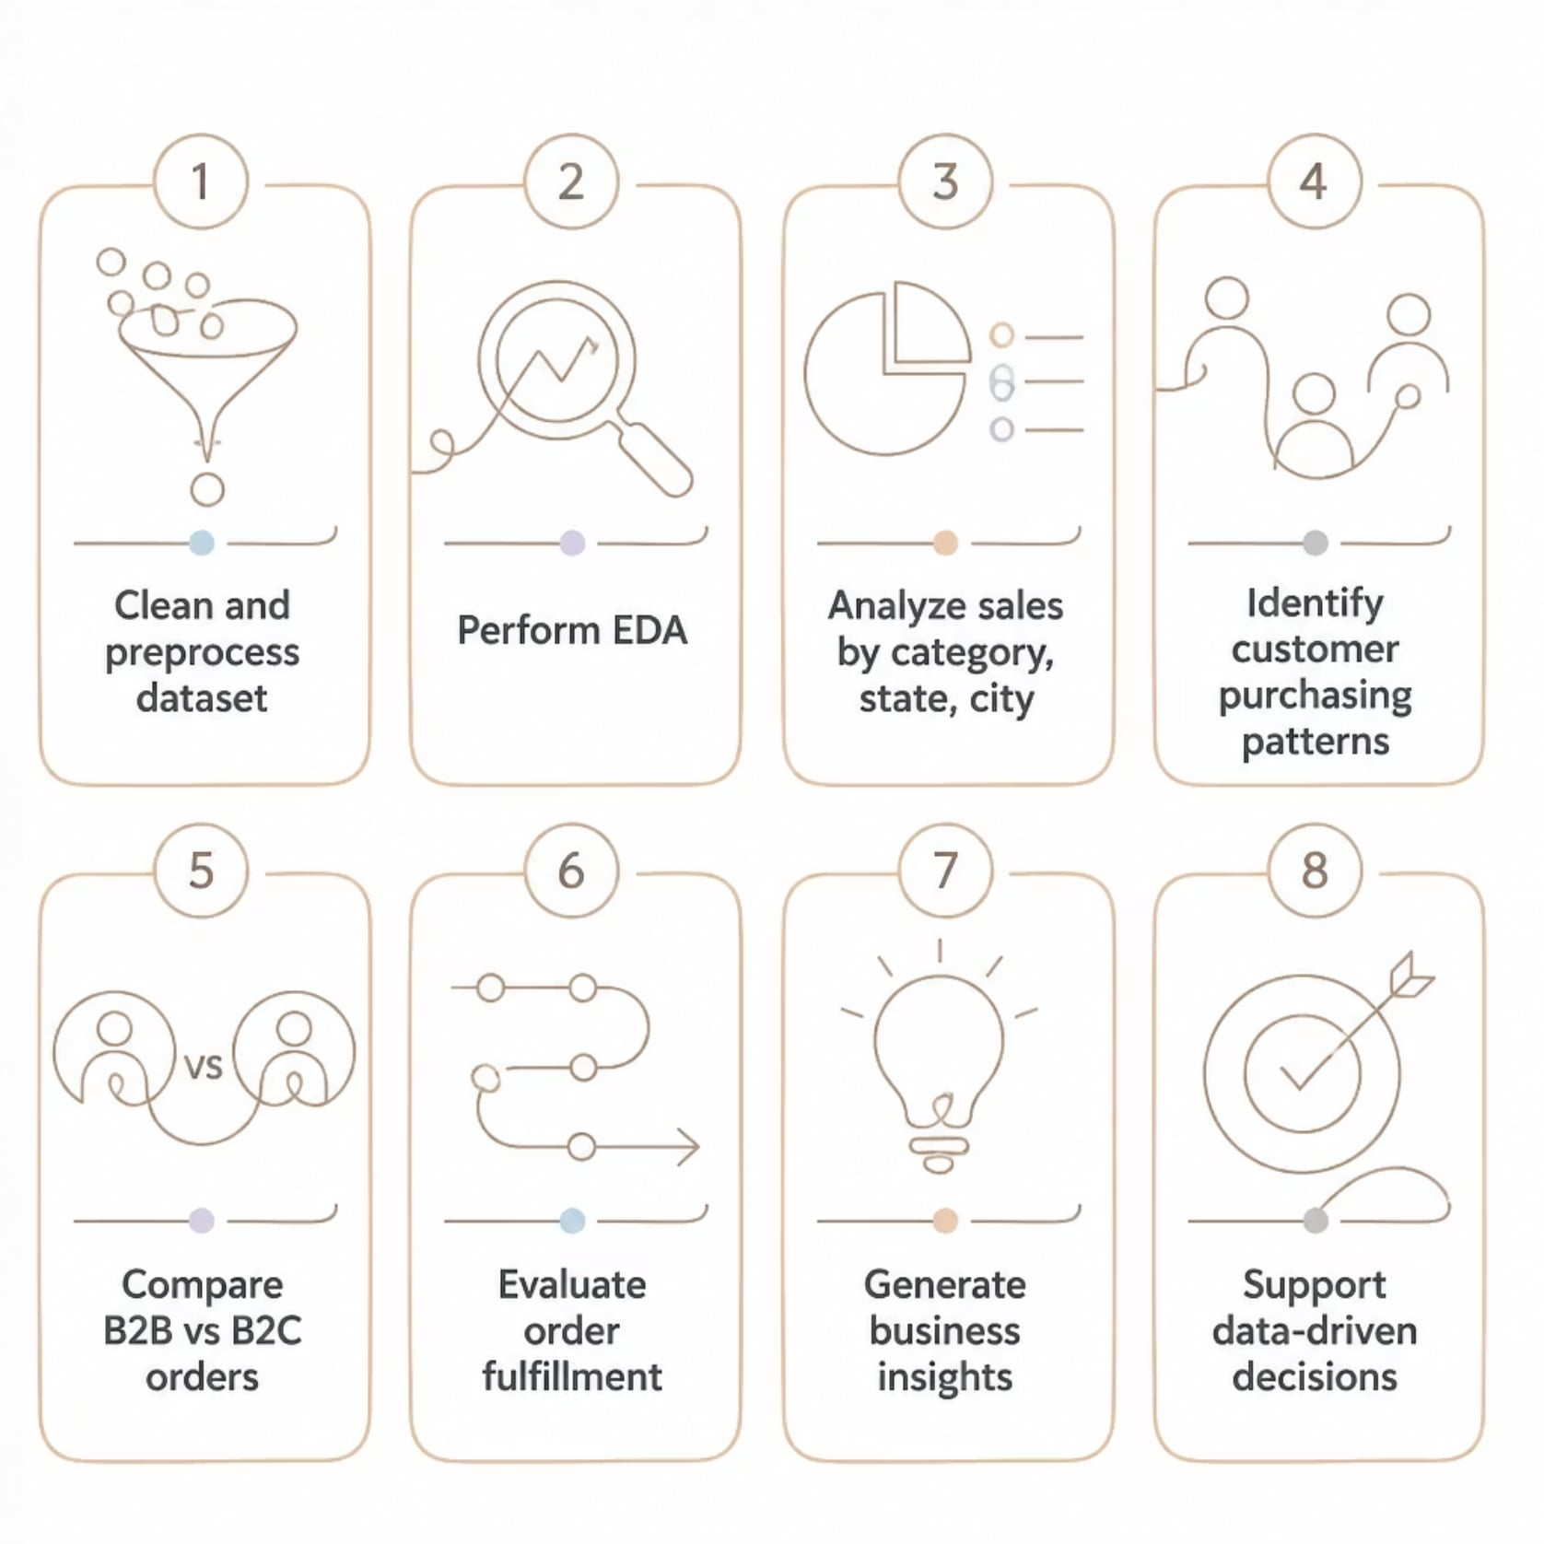

Problem Statement & Objectives
Amazon generates massive sales data across categories, cities, and states. Manual analysis is slow and error-prone — this project uses Python-based EDA to transform raw data into actionable insights.

Slide 3
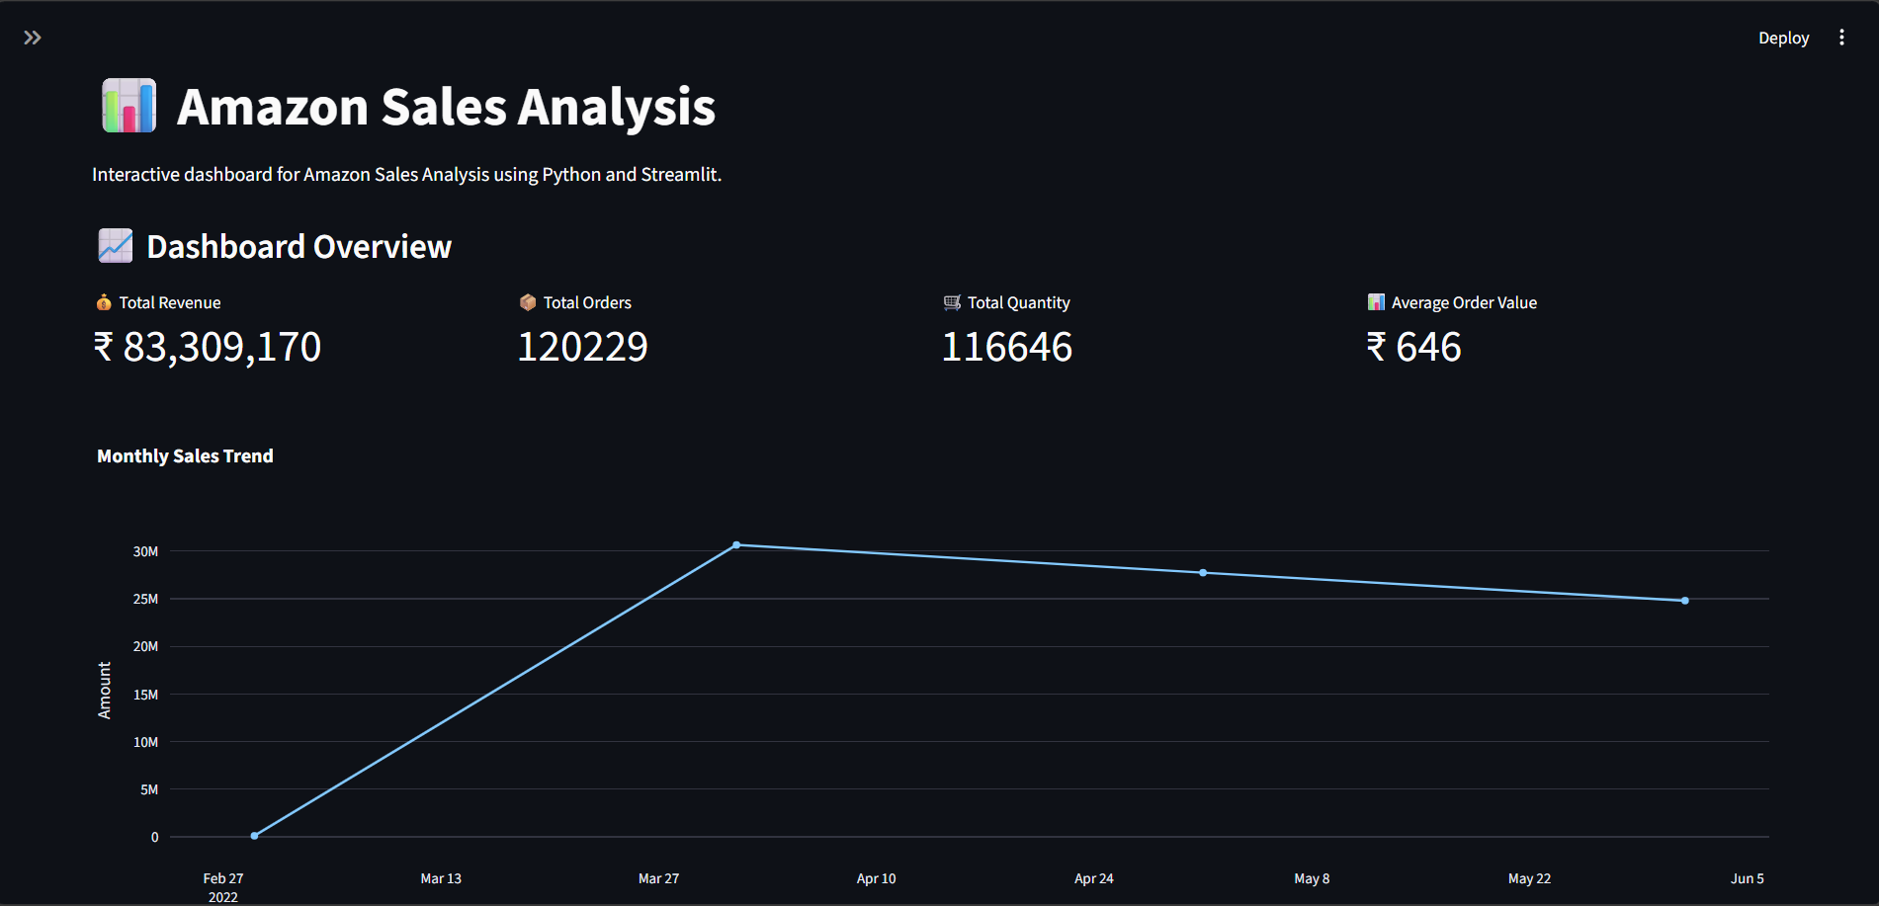




Project Overview
Analyze Amazon sales data to uncover patterns, trends, and actionable business insights.
Sales Performance
Revenue trends over time
Customer Patterns
Purchasing behavior analysis
Category Performance
Top-selling product segments
Regional Distribution
State & city-level sales

Slide 4
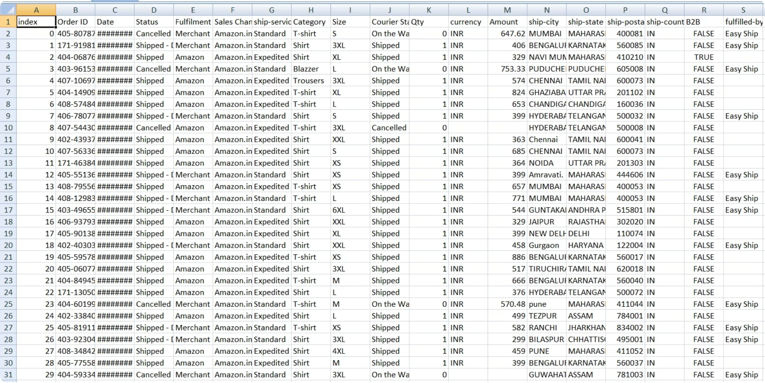

Dataset Overview
Key Features: Order ID, Date, Category, Status, Amount, Quantity, Size, State, City, Fulfilment, Sales Channel, B2B
Clean dataset ready for analysis after preprocessing
128,976
21
Total Records
Features

Slide 5







Project Workflow
Data Collection
Data Cleaning
Preprocessing
EDA
Visualization
Business Insights
Conclusion
End-to-end pipeline from raw data to actionable insights using Python.

Slide 6
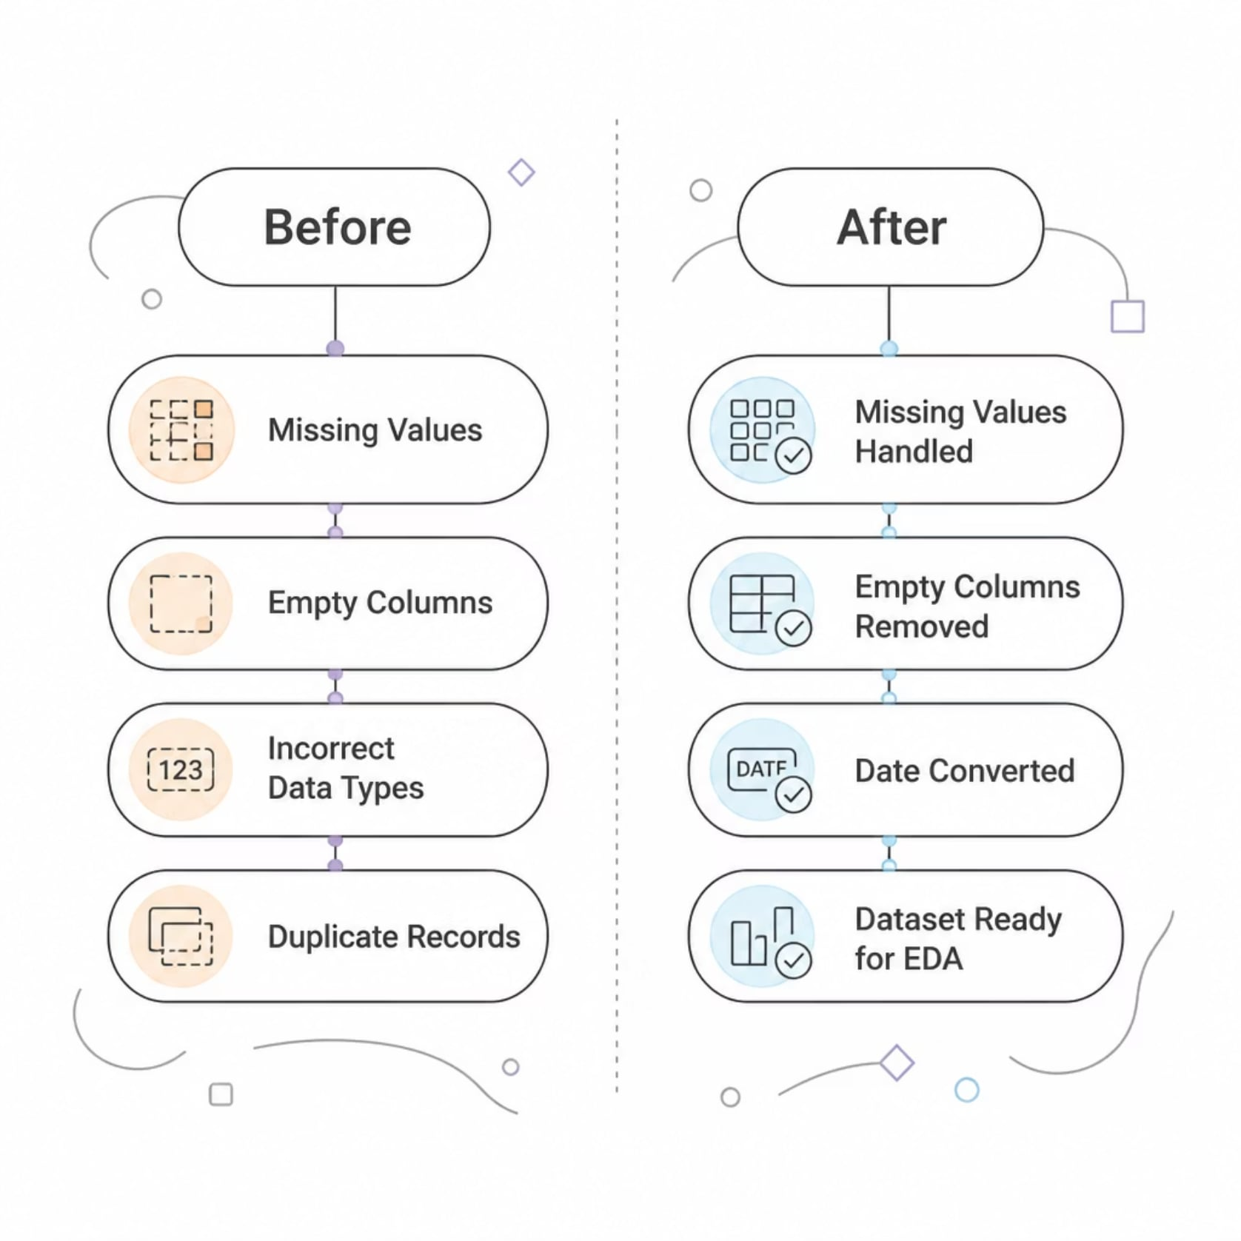

Data Preparation
Cleaning Steps Applied
Removed null & duplicate entries
Dropped irrelevant columns
Converted date formats
Standardized data types
Dataset validated & ready for EDA

Slide 7
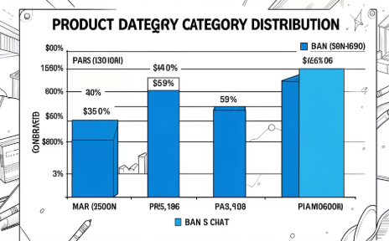
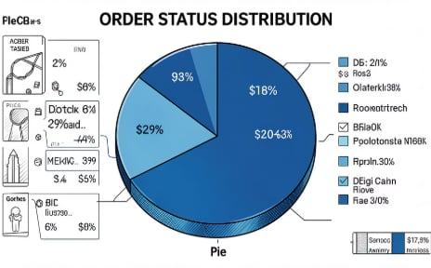
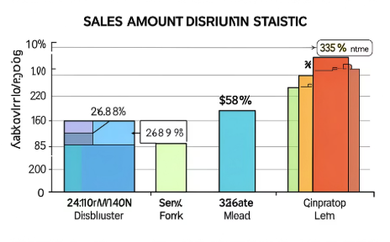
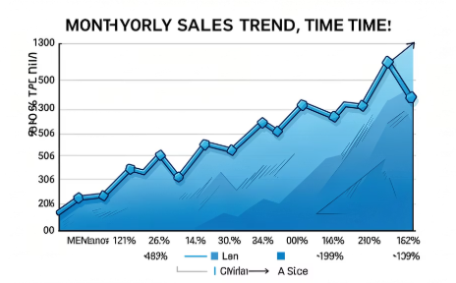
Exploratory Data Analysis
Python-generated visualizations reveal key patterns in the Amazon sales dataset.
📊 Category Distribution
🥧 Order Status
📦 Sales Amount
📈 Monthly Sales Trend
Pie chart — completed, pending & cancelled orders
Box plot — spread, outliers & median sales values
Bar chart — top product categories by sales volume
Line chart — revenue progression across months

Slide 8
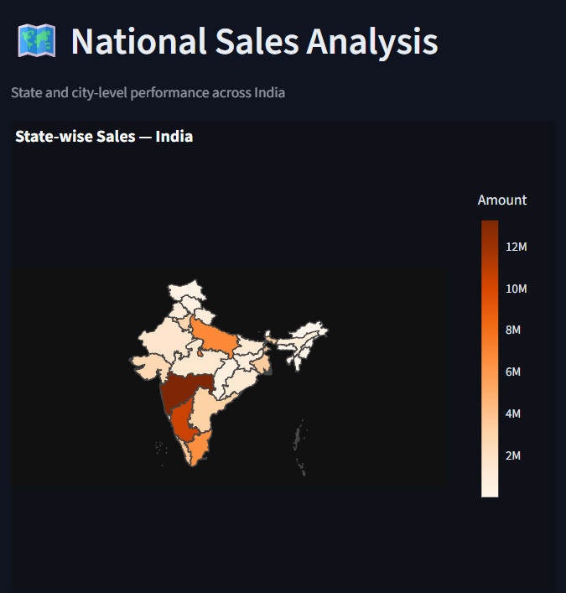

Location-wise Sales Analysis (India)
📍 Top 10 States by Sales
Bar chart placeholder — highest-revenue states
🏙 Top 10 Cities by Orders
Bar chart placeholder — most active cities
🗺 Regional Distribution
Map visualization — geographic sales spread
Key insight: Concentrated sales in specific regions reveals expansion opportunities

Slide 9






Key Business Insights
Top Category
Best State
Highest-selling product segment identified
Leading state by total sales revenue
Top Size
Order Status
Most ordered product size across categories
Majority of orders successfully completed
Sales Trend
Customer Behavior
Monthly revenue pattern & seasonality
B2B vs B2C purchasing patterns

Slide 10


Pros, Cons & Future Scope
✅ Advantages
Clear sales performance view
Supports data-driven decisions
Identifies customer trends
⚠️ Limitations
Limited time period
No profit/cost data
Missing demographics
🚀 Future Scope
Sales forecasting models
Power BI dashboard
ML recommendation system

Slide 11
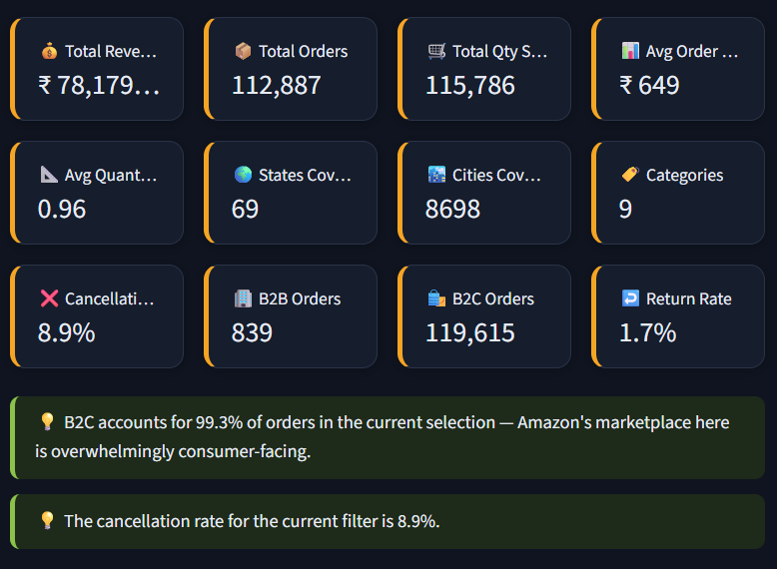
Conclusion
01
Data Cleaning
Dataset validated & preprocessed
02
EDA & Visualization
Key sales patterns uncovered
03
Location-wise Analysis
Regional insights mapped
04
Business Insights
Actionable recommendations delivered

Slide 12
Thank You

