Slide 1
Green Basket Health Services: one trusted view of patient flow, resource use and disease surveillance
End-to-end BI solution: PostgreSQL data warehouse, ELT with validated data quality, Power BI with row-level security, and four analytics techniques
Notes:
Member 1 (0:00-0:30). Good morning. We are the consulting team engaged by Green Basket Health Services, five hospitals and five clinics in nine Namibian regions. In ten minutes we show how we turned nine disconnected data sources into one trusted view of patient flow, beds and staff, and disease surveillance, and what that view tells management. All patient data are synthetic; the census figures are real NSA values.

Slide 2
ED patients seen on time fell from 79 % to 67 %
Nine sources, no single truth
2,966
duplicate attendance rows from overlapping yearly extracts
16,223
superseded spell images in the change-data-capture export
30
spellings of 9 notifiable conditions in the IDSR returns
Attendances rose 14 % in 2025 with the malaria upsurge, and patients leaving without being seen almost doubled (3.3 % to 6.2 %).
Notes:
Member 1 (0:30-1:15). Between 2022 and 2024 about 77 percent of ED patients were seen within their South African Triage Scale target. In 2025 that fell to 67.5 percent and it has not recovered. Management could not tell whether demand, beds or staff were to blame, because the data sat in nine places: the patient administration system, paper ward returns, the e-roster, weekly IDSR returns, a master-data workbook and two external sources. Profiling found 2,966 duplicate attendance rows, 16,223 superseded spell images and 30 spellings of nine notifiable conditions.

Slide 3
Five business questions, each tied to a KPI and a 2027 target
Target 2027 and 2025 baseline
1
Patient flow: are ED patients seen within their triage target, and what drives the delays?
Seen within target %, median door-to-doctor, LWBS %, arrivals per doctor-shift
≥ 80 % seen within target
2025: 67.5 %
2
Resource use: are beds and nursing hours matched to demand by facility, ward and season?
Bed occupancy, discharges before noon, length of stay, nursing hours per patient day
≥ 40 % discharged before noon
2025: 26.9 %
3
Surveillance: where are notifiable diseases rising, and is IDSR reporting complete and on time?
Notified cases, incidence per 1,000 person-years, positivity, completeness, timeliness
≥ 80 % complete and on time
2025: 98.7 % and 92.9 %
4
Preparedness: how many malaria cases should the north-east expect in the next 4–13 weeks?
Forecast with 80 % interval, back-test error (WAPE)
≥ 4 weeks' warning before the peak
2025: 3–6 weeks
5
Safe transitions: which discharged patients are most likely to be readmitted within 30 days?
30-day readmission rate, top-20 % risk capture, calibration
≤ 12 % readmitted within 30 days
2025: 13.4 %
Notes:
Member 1 (1:15-1:45). Five business questions, each tied to one of the five strategic objectives, a KPI with an explicit definition, a 2025 baseline from the warehouse and a 2027 target agreed with the executive committee. Every page of the dashboard answers one or two of these questions; nothing on a page exists without a question behind it.

Slide 4
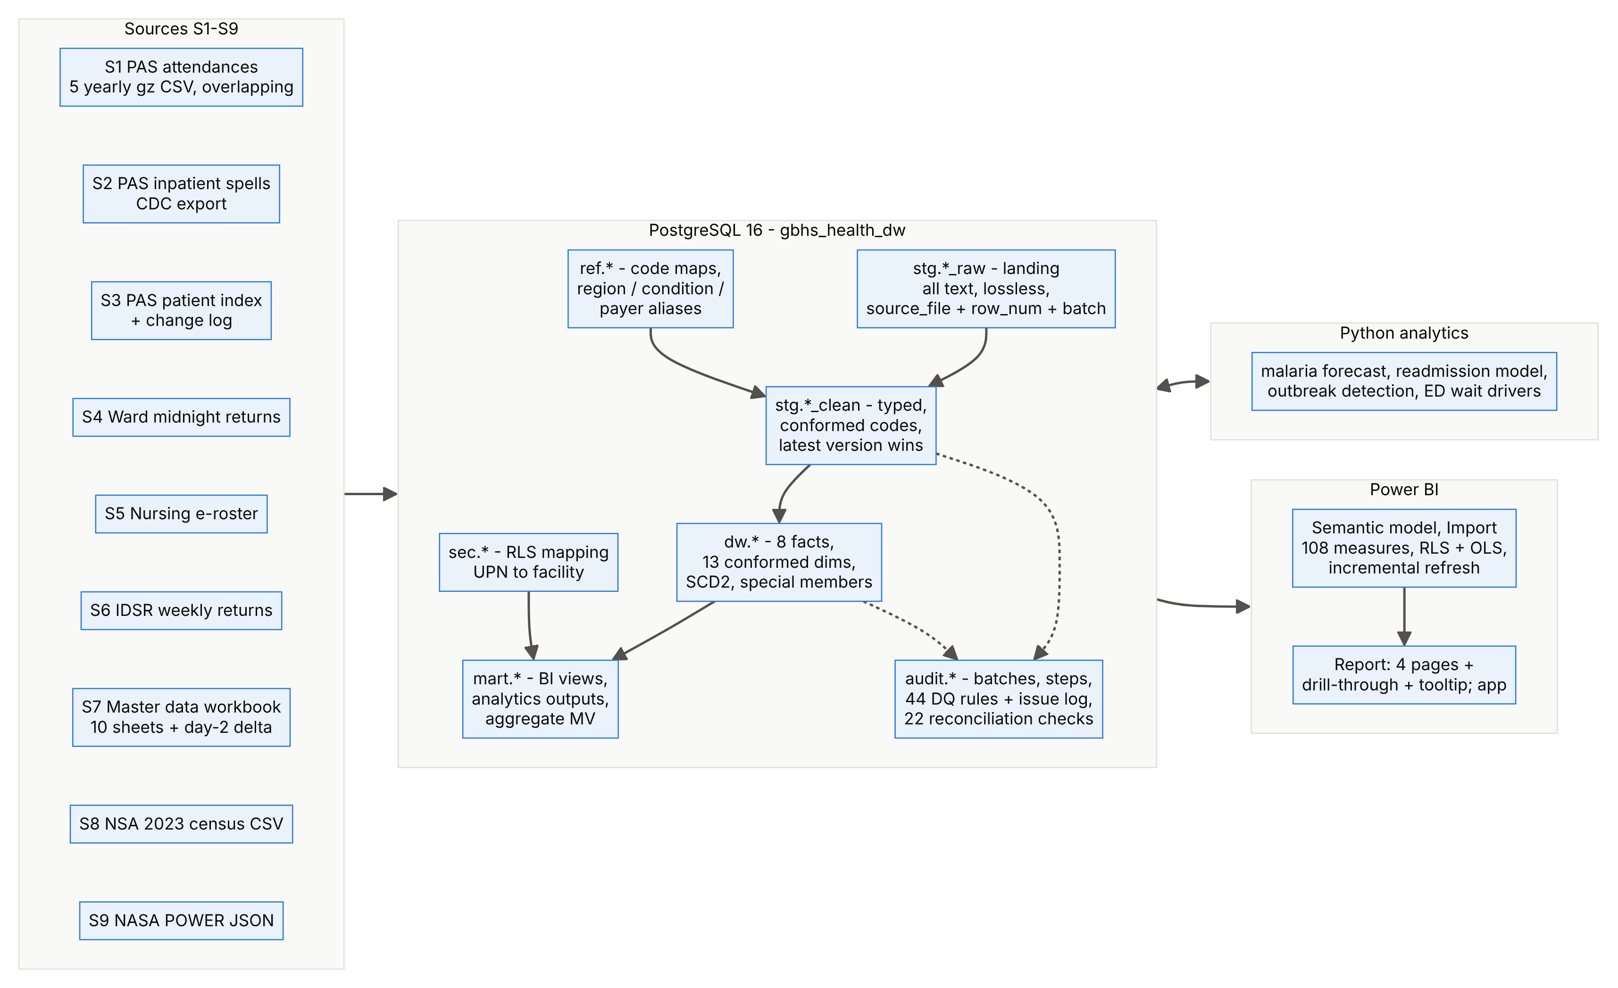
ELT in PostgreSQL 16: from raw extracts to one semantic model
1
Lossless landing
every warehouse figure traces back to its source file and row
2
44 DQ rules, 22 reconciliation checks
run on every load; each issue is logged with an owner
3
One command, about 5 minutes
python run_all.py rebuilds data, warehouse, evidence, model and backup
Notes:
Member 3 (1:45-2:30). Extract, load, then transform inside PostgreSQL. Raw files land unchanged as text with their file name and row number, so any number can be traced back. Cleansed staging applies 44 rules; the dimensional layer holds 8 facts and 13 conformed dimensions; thin mart views feed Power BI, and the Python analytics write forecasts, risk deciles and outbreak alerts back to the same schema. One command rebuilds everything, including a day-2 incremental load, in about five minutes.

Slide 5
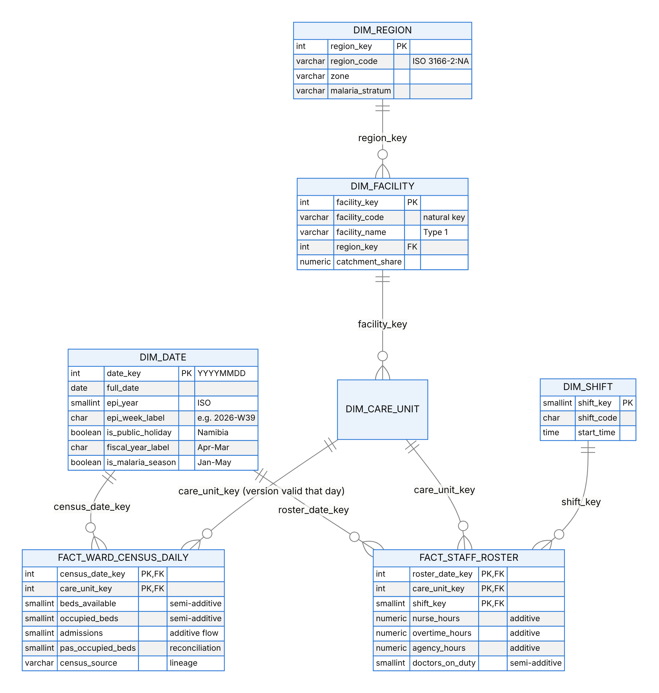
Type 2 history keeps the crowding visible
January 2025: 152 % of the 24 beds the ward had, not 102 % of today's 36. Without Type 2 history, the malaria-season crowding that justified the expansion disappears.
ERD 3 of 5: Care Unit → Facility → Region is snowflaked, because some facts are recorded per ward and others per facility.
Notes:
Member 2 (2:30-3:15). Eight fact tables of four types - transaction, accumulating snapshot, periodic snapshot and factless coverage - share 13 conformed dimensions. We snowflaked Care Unit to Facility to Region because attendances and the census are recorded per ward while IDSR returns and weather are recorded per facility: one conformed Facility table filters both. Wards and patients keep Type 2 history. The chart shows why: Rundu's medical ward grew from 24 to 32 beds in April 2025 and to 36 in October 2026. Measured against the beds it actually had, it ran at 152 percent in January 2025; against today's beds that crowding would vanish. Another example: WHK-MED2 was a COVID-19 isolation ward from January to March 2022, and spells in that period keep that version.

Slide 6
134,964 of 134,992 injected defects caught, 0 false positives
134,964
WC02: ×10 errors hid in small wards
A '3 × the bed complement' test missed 2 → 20 in a 24-bed ward. The PAS midnight count, added as a second witness, now catches all of them.
of 134,992 damaged records flagged by their own rule; the other 28 by another rule
0
false positives: no good record was changed
SV04: deaths are reported late
'Deaths > cases' fired on real deaths reported a week after the case. A margin of 3 removed the false alarms and still catches every injected defect.
44
rules, each with an owner, a DQ dimension and a logged action
Notes:
Member 3 (3:15-4:00). Because the internal data are synthetic, the generator recorded every defect it injected, so we could measure our rules instead of trusting them. 134,964 of 134,992 damaged records were flagged by their own rule and the remaining 28 by another rule; no good record was changed. Validation also improved two rules: a x10 keying error in a small ward slipped under a '3 times the beds' test until we added the PAS midnight count as a second witness, and the deaths-greater-than-cases rule fired on genuine deaths reported a week after the case until we allowed a margin.

Slide 7
Reconciled, owned and secured
20 / 22
Owners
Chief Operating Officer (operational data); Clinical Director and Head of Surveillance (clinical and IDSR data)
Dynamic RLS: each facility manager sees only their own facilities
OLS: the MoHSS surveillance partner sees aggregates only; patient tables are hidden
Pseudonymised patients, no direct identifiers; counts of 1–4 suppressed in external outputs
Namibian law: Constitution Art. 13 (privacy), Public and Environmental Health Act 2015 (notification); the Data Protection Bill is not yet law, so we design to its principles and to GDPR, POPIA and HIPAA
checks pass after the day-2 load; 2 WARN explained, 0 FAIL
R07 WARN: 25 spells never discharged in the PAS add 17,242 bed-days the wards never had; now a steward task.
R22 WARN: 3 ward-days above 200 % occupancy; 6,002 days above 100 % are plausible overflow.
Stewards
Nine rule owners, from the Health Information Manager to the Surveillance Officer, work weekly issue queues
Custodian
The BI team runs the pipeline, backups and change control; IT security reviews access quarterly
Notes:
Member 3 (4:00-4:30). 22 reconciliation checks run after every load: row counts, control totals, cross-source comparisons, integrity and plausibility. 20 pass. The two warnings are findings, not pipeline errors: 25 spells never closed in the PAS, and three implausible ward-days. Every rule has a named steward. Security is layered: least-privilege database roles, dynamic row-level security per facility, object-level security for the Ministry's surveillance partner, sensitivity labels, pseudonymisation and small-cell suppression. Namibia's Data Protection Bill is not yet enacted, so we design to its principles and benchmark against GDPR, POPIA and HIPAA.

Slide 8
Semantic model: 108 governed measures, RLS and OLS
Import
+ incremental refresh (5 years, 10 days)
108
DAX measures in 8 display folders
38
relationships, one-to-many, single direction
4
security roles: dynamic and static RLS, OLS
Malaria Cases Epi-YTD =
VAR _end =
MIN ( MAX ( 'Date'[Date] ), [Last Epi Week Start] + 6 )
VAR _y =
CALCULATE (
MAX ( 'Date'[Epi Year] ),
REMOVEFILTERS ( 'Date' ),
'Date'[Date] = _end
)
RETURN
IF (
MIN ( 'Date'[Date] ) <= _end,
CALCULATE (
[Malaria Cases],
REMOVEFILTERS ( 'Date' ),
'Date'[Epi Year] = _y,
'Date'[Date] <= _end
)
)
Identity | Facilities | ED 2025 | Malaria 2025
Executive (all facilities) | 10 | 81,612 | 14,571
fm.katima (dynamic RLS) | 1 | 13,072 | 4,899
fm.rundu (dynamic RLS) | 2 | 18,467 | 7,875
Unmapped user | (blank) | (blank) | (blank)
North-East Zone (static) | 3 | 31,539 | 12,774
Surveillance Partner (OLS) | 10 | hidden | 14,571
Expected values computed in SQL with the DAX logic; tested with View as role in Power BI Desktop. The five managers sum to the executive total.
Left: IDSR counts by ISO epi week, and 2025-W01 began on 30 December 2024, so TOTALYTD would cut weeks in half. This measure filters the Epi Year attribute instead.
Notes:
Member 4 (4:30-5:15). Import mode: about 0.9 million rows compress to roughly 12.5 megabytes, and incremental refresh re-reads only the last ten days. 108 measures carry descriptions and display folders. One example on the left: IDSR reports by ISO epi week, and epi year 2025 began on 30 December 2024, so a calendar TOTALYTD would cut weeks in half; this measure filters the Epi Year attribute instead. Malaria incidence uses person-time, so one measure works for a week or for five years. Row-level security maps each facility manager to their facilities from a warehouse table; the expected totals per identity come from SQL, and the View-as test in Desktop must match them.

Slide 9
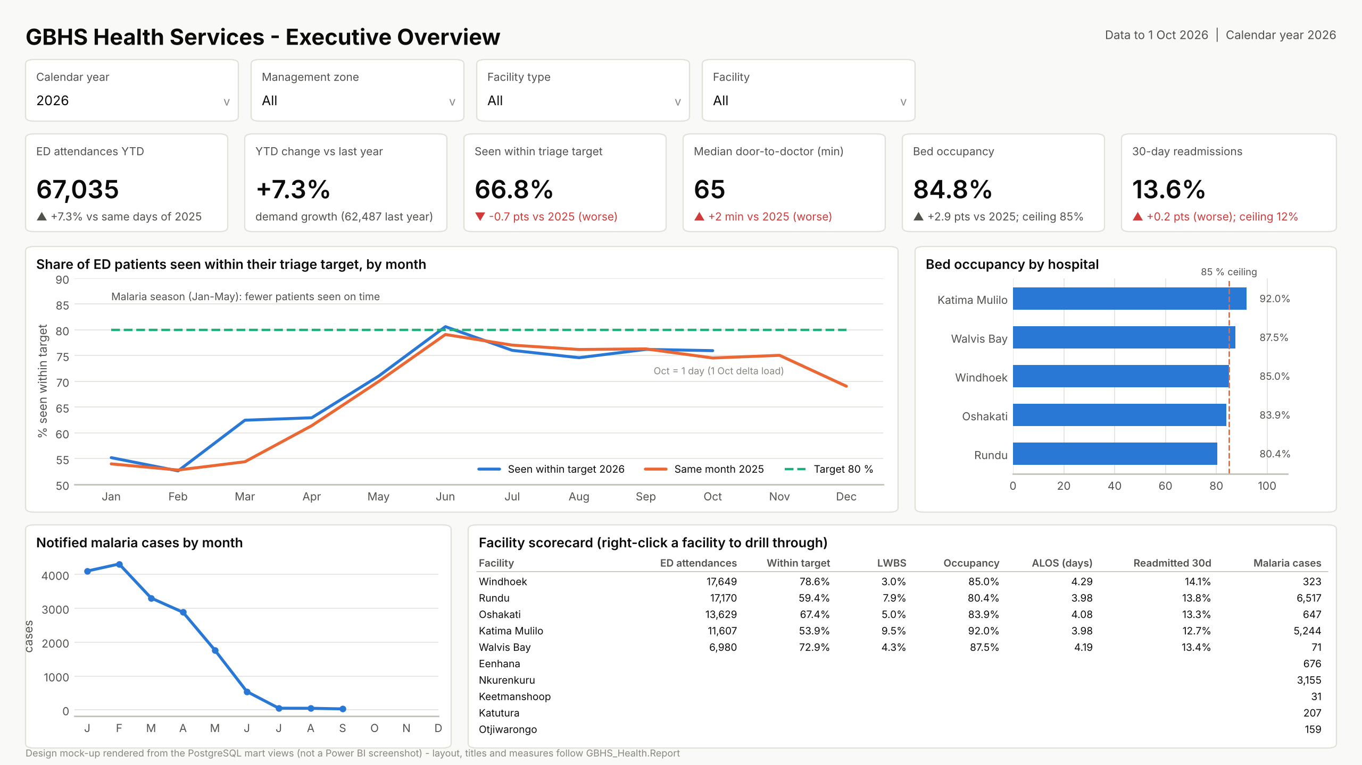
Live demo: from headline to ward in four steps
1
Executive page, 2026: the KPI cards answer 'are we on track?'
2
Drill through from the scorecard to Katima Mulilo
3
Patient Flow page: drill Region › Facility › Ward, then Disease Surveillance
4
View as fm.katima: 1 facility, 13,072 ED attendances in 2025; then as the surveillance partner
Design mock-up rendered from warehouse data; replaced by the Power BI screenshot after the Desktop build.
Notes:
Member 4 (5:15-6:45). Demo path. One: the Executive Overview with Calendar Year 2026 - attendances, seen within target, median wait, occupancy and readmissions, each against target. Two: right-click Katima Mulilo in the scorecard and drill through to Facility Detail. Three: the Patient Flow page, expanding the matrix from Region to Facility to Ward; then the Disease Surveillance page with the epi-week trend and the rainfall lead indicator. Four: Modeling, View as role, fm.katima - one facility, 13,072 attendances in 2025; then the Surveillance Partner role, where the patient tables disappear from the field list. If the live demo fails, use backup slides 15 to 18.

Slide 10
Load per doctor drives the waits: +6.3 % per extra arrival
+6.3 %
longer wait per extra arrival per doctor-shift (OLS, 95 % CI +6.2 to +6.4 %)
+12.7 points
seen within target at Katima Mulilo with a second day-shift doctor (Jan–Jun 2026 against 2025)
+9.6 vs +1.6
Rundu (extra doctor) against Oshakati (none): a difference-in-differences pattern
The YELLOW target is 60 minutes; above 16 arrivals per doctor the median wait reaches 68.
Notes:
Member 5 (6:45-7:30). We joined each attendance to the doctors rostered in its shift and to hospital occupancy that day - a drill-across through conformed dimensions. After adjusting for triage and facility, each extra arrival per doctor in a shift adds +6.3 % to the wait; at more than 16 arrivals per doctor the median urgent patient waits 68 minutes against a 60-minute target. The 2026 natural experiment confirms it: with a second day-shift doctor from January to June, Katima Mulilo improved by 12.7 points and Rundu by 9.6, while Oshakati, without one, moved 1.6. The regression is observational; the experiment is the stronger evidence.

Slide 11
Malaria early warning: 2–6 weeks before the peak
4–8 weeks
rainfall lead indicator: SARIMAX coefficient 0.405 on log rainfall, p < 0.001
2–6 weeks
historical-limits alert before the seasonal peak, in time to extend clinic hours
19.4 %
forecast error (WAPE) one week ahead, Holt-Winters, rolling-origin back-test
Seasonal peaks in epi weeks 2025-W07 and 2026-W05; the 2025 and 2026 seasons were far larger than 2022–2024.
Notes:
Member 5 (7:30-8:15). Malaria in the north-east follows the rains with a lag: rainfall four to eight weeks earlier is a significant driver in our SARIMAX model. The WHO-style historical-limits threshold fired 2 to 6 weeks before the 2025 and 2026 peaks - enough to start the roster uplift, but less than our 4-week objective, so the next step is rainfall-triggered thresholds. For stock planning, Holt-Winters forecasts one week ahead with 19.4 % weighted error in a 52-week rolling-origin back-test.

Slide 12
Target the follow-up calls; catch outbreaks within a week
37 %
of readmissions fall in the top 20 % of predicted risk: 1.9 times random (AUC 0.66)
11 of 12
injected outbreaks found by CUSUM, median delay 1 week, under 1 false alert per 100 facility-condition-weeks
9 of 12
for EARS C2; both missed a 22-case measles cluster in a busy clinic
Well calibrated: predicted and observed rates agree in every decile, so the scores can be read as probabilities.
Notes:
Member 5 (8:15-8:45). Thirty-day readmissions: a gradient-boosting model trained on spells before July 2025 and tested on later ones. An AUC of 0.66 is typical for readmission models, and the model is well calibrated. Its value is prioritisation: calling the top 20 percent of patients by risk - about 3,601 a year - reaches 37 percent of all readmissions. It ranks a call list; it never decides care. For surveillance, the generator injected 12 outbreaks; CUSUM found 11 of 12 with a median delay of one week, EARS C2 found 9 of 12.

Slide 13
Optimised: faster queries, smaller model, lighter refresh
454×
faster patient drill-through: an index on the patient key
-46 %
model size: 23.0 to 12.5 MB (columnar proxy for VertiPaq)
-99.4 %
rows per daily refresh with incremental refresh (560,557 to 3,214)
Notes:
Member 5 (8:45-9:15). We measured before we optimised. Seven techniques: B-tree indexes on fact foreign keys, a BRIN index on the arrival date, an aggregate table, removing unused and high-cardinality columns such as the encounter number, incremental refresh, a set-based idempotent ELT, and a stored durable patient key. Results: the patient drill-through is 454 times faster, the model is 46 percent smaller, and a daily refresh reads 3,214 rows instead of 560,557. Two queries did not improve, because a full scan is already optimal for them; we report that rather than hide it. Power BI timings are recorded with Performance Analyzer and DAX Studio in Desktop.

Slide 14
Recommendations
1
Season-triggered roster uplift
an extra ED day-shift doctor at Rundu and Katima Mulilo from January to May; the 2026 test recovered 10–13 points
2
Discharge before noon, occupancy below 85 %
26.9 % of discharges leave before noon; a 40 % target frees beds for the afternoon ED peak
3
Call the top 20 % risk patients within 72 hours
about 3,600 patients a year, reaching 37 % of all 30-day readmissions
4
Run the DQ process weekly and publish the app
44 rules with named stewards; facility RLS for managers, aggregates only for the MoHSS
Thank you – questions?
Notes:
Member 1 (9:15-10:00). Four recommendations, each traced to evidence in the warehouse. First, trigger a roster uplift with the malaria season: the extra doctor was the only intervention with a measured effect. Second, discharge before noon and keep occupancy below 85 percent, so that morning beds are free for the afternoon ED peak. Third, a 72-hour follow-up call for the highest-risk fifth of discharges. Fourth, run the data-quality process weekly with named stewards and publish the Power BI app with row-level security. Thank you - each of us will answer questions on the part we built.

Slide 15
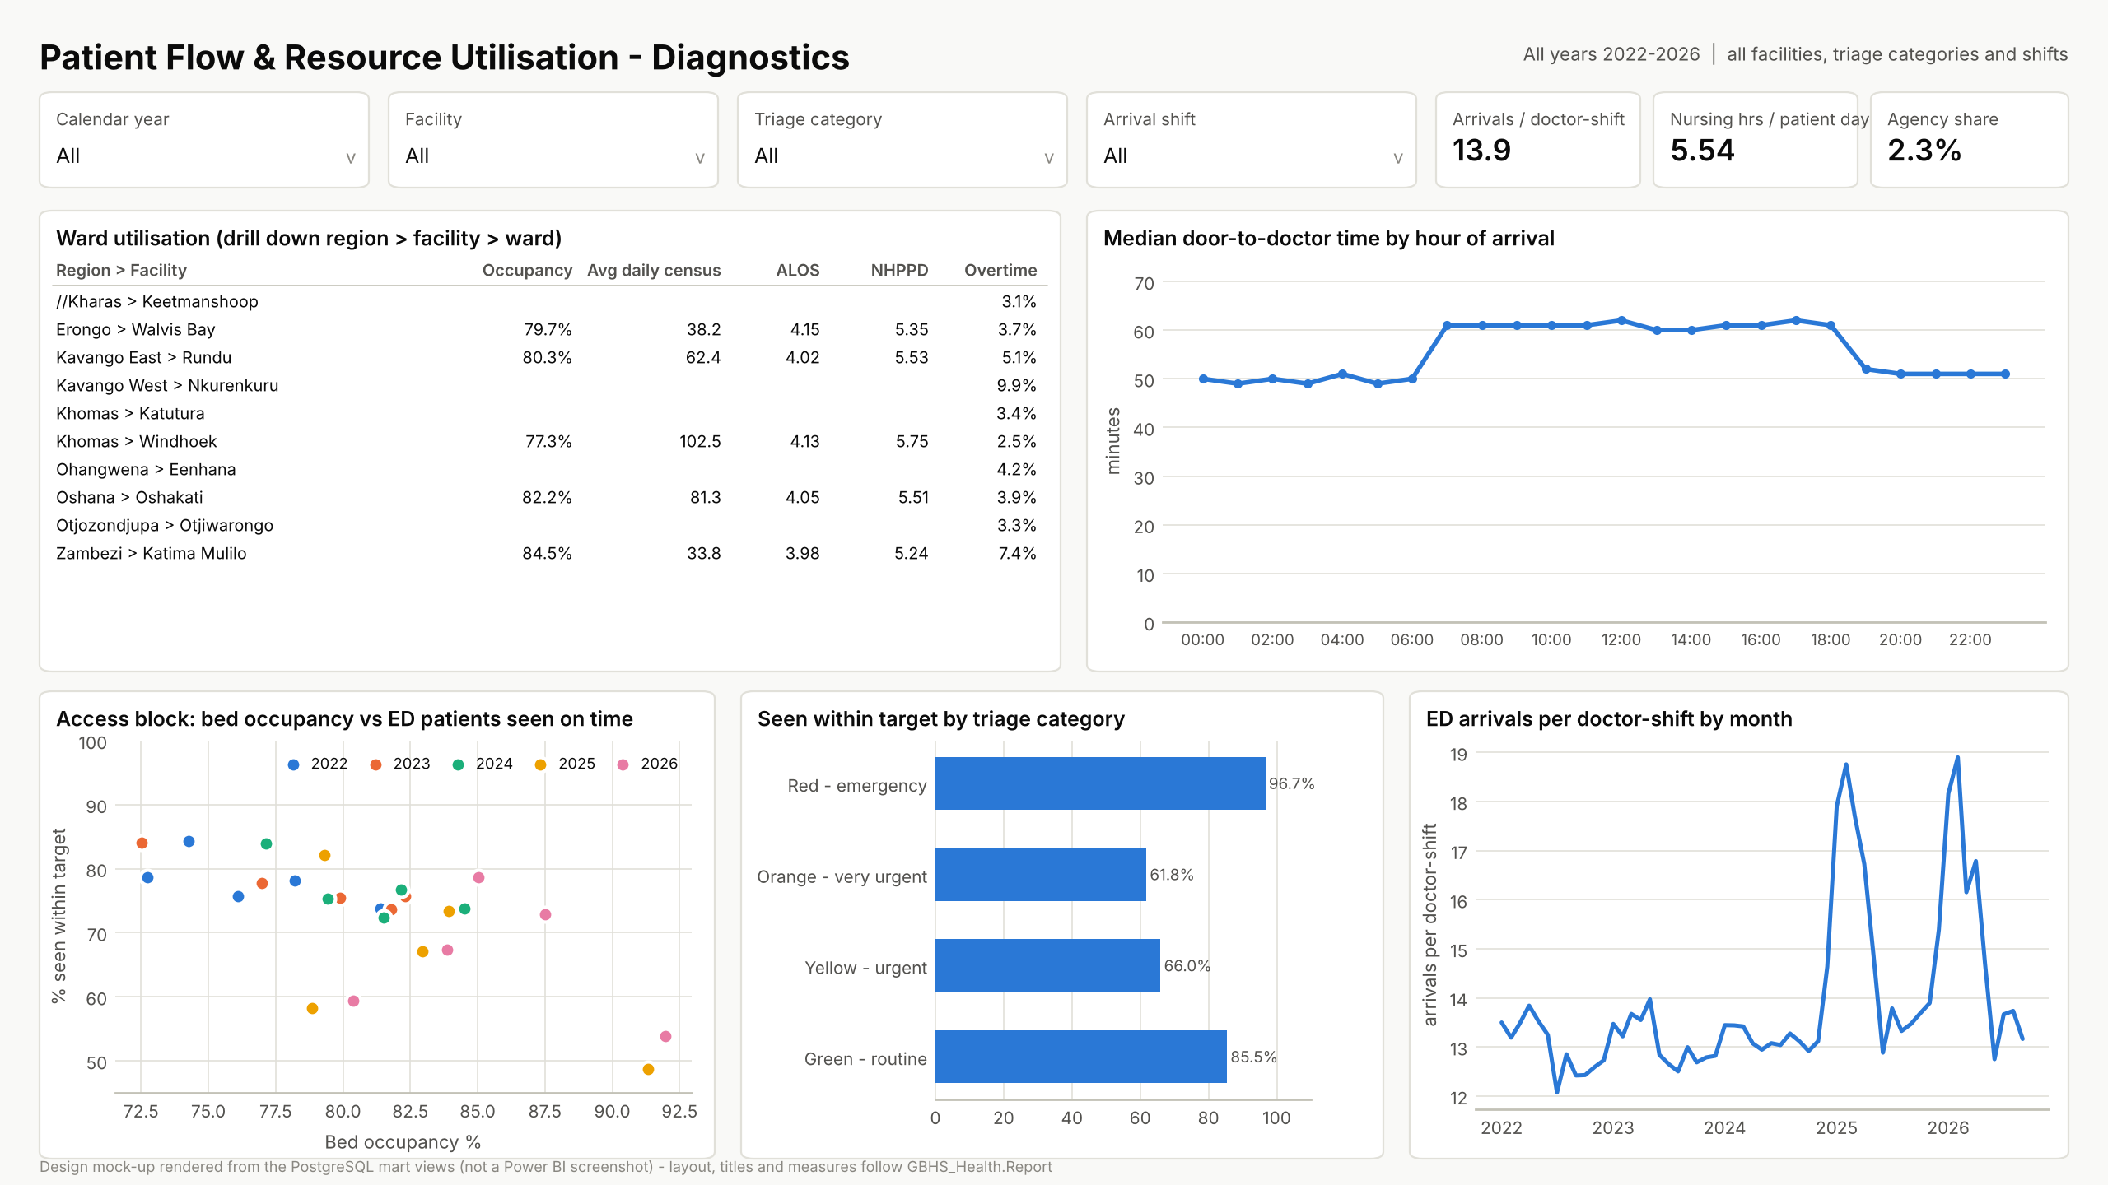
Backup: Patient Flow & Resources page
Notes:
Backup slide for the demo: design mock-up rendered from warehouse data (replace with the Power BI Desktop screenshot).

Slide 16
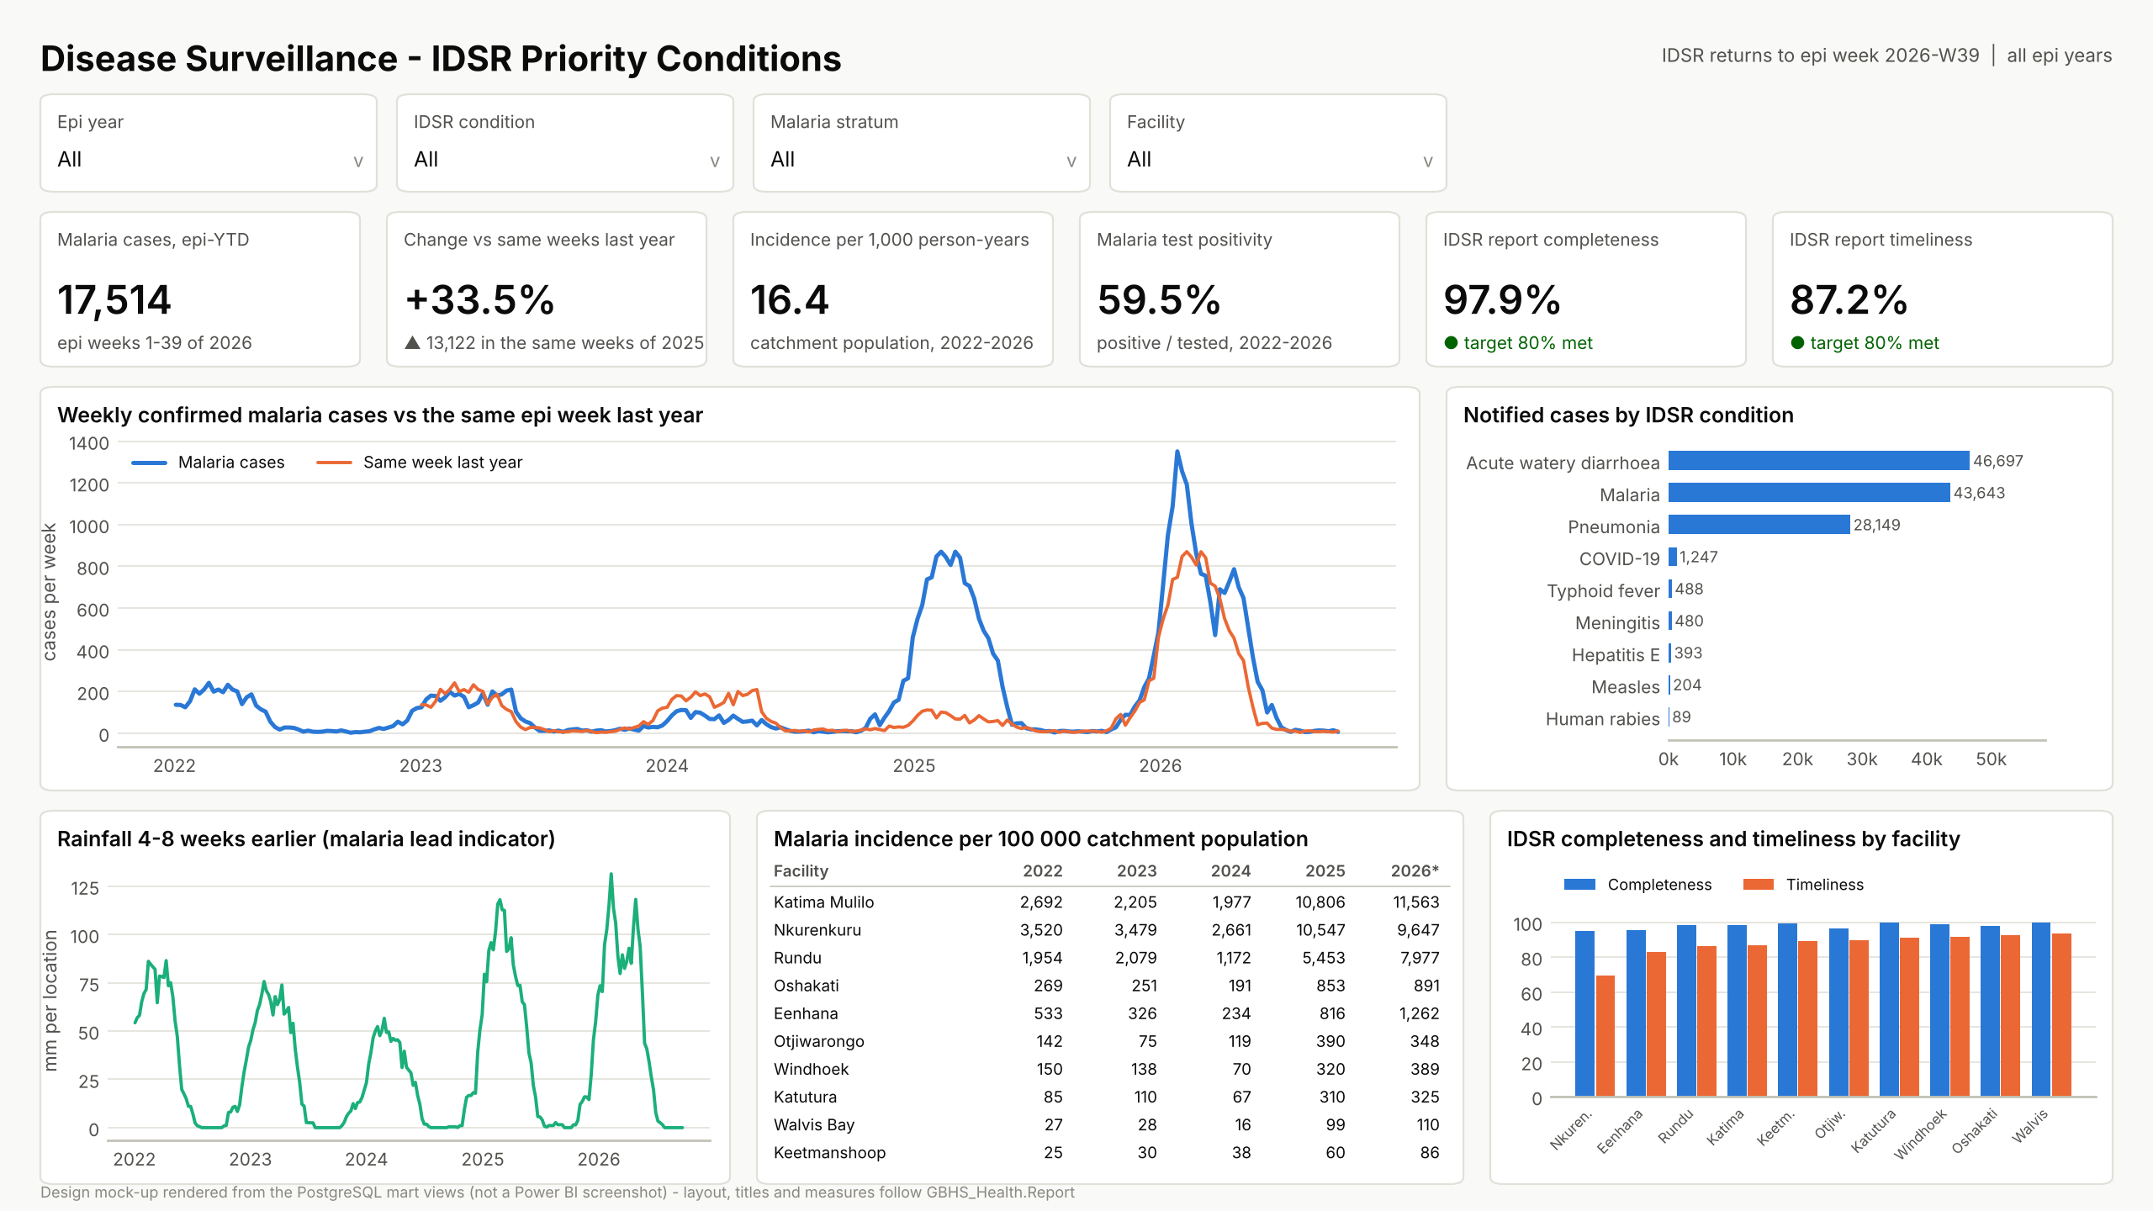
Backup: Disease Surveillance page
Notes:
Backup slide for the demo: design mock-up rendered from warehouse data (replace with the Power BI Desktop screenshot).

Slide 17
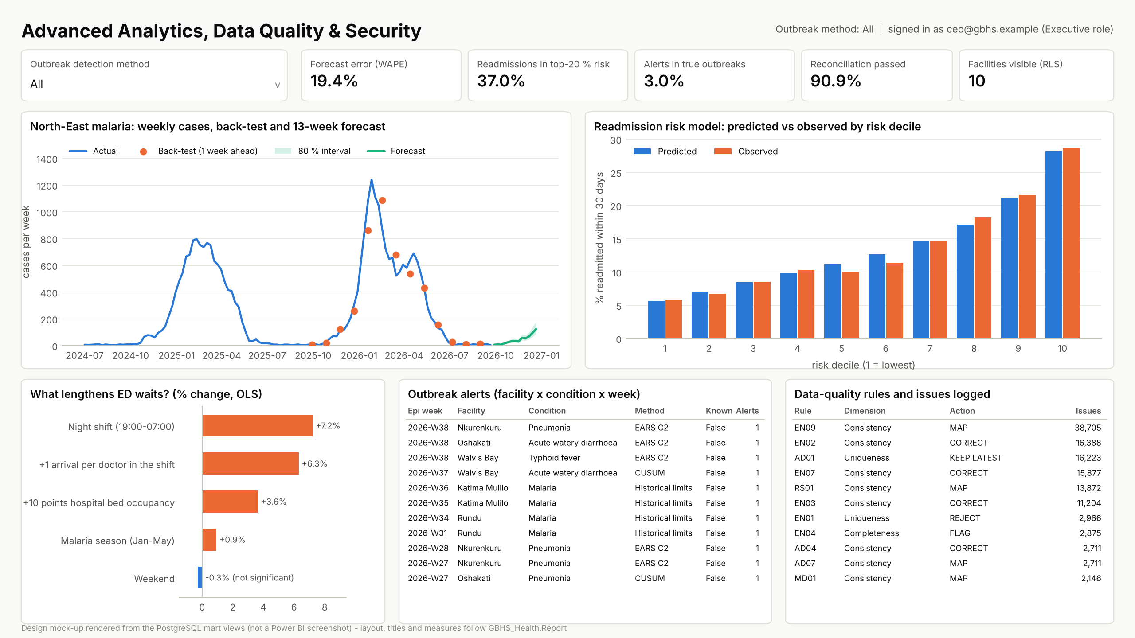
Backup: Advanced Analytics & Data Quality page
Notes:
Backup slide for the demo: design mock-up rendered from warehouse data (replace with the Power BI Desktop screenshot).

Slide 18
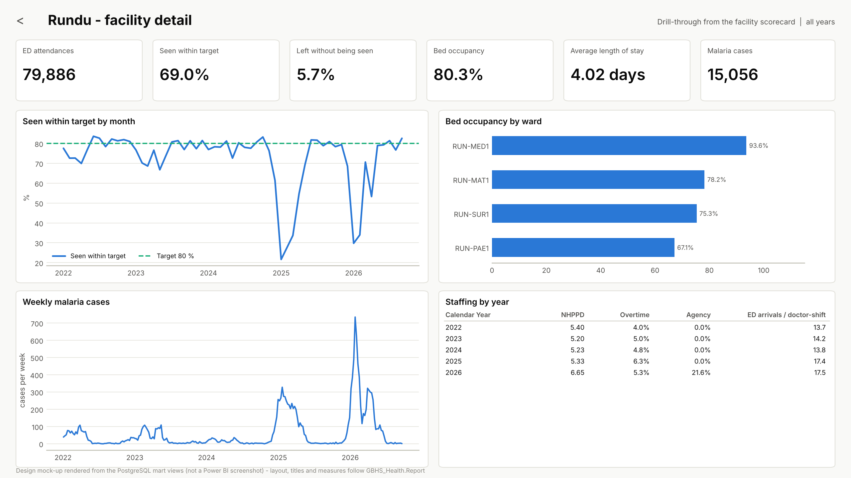
Backup: Facility Detail drill-through (Rundu)
Notes:
Backup slide for the demo: design mock-up rendered from warehouse data (replace with the Power BI Desktop screenshot).

