Slide 1
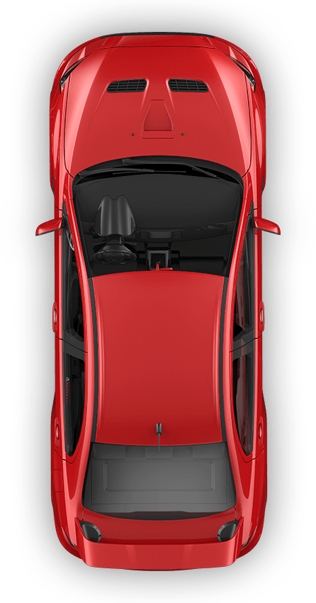
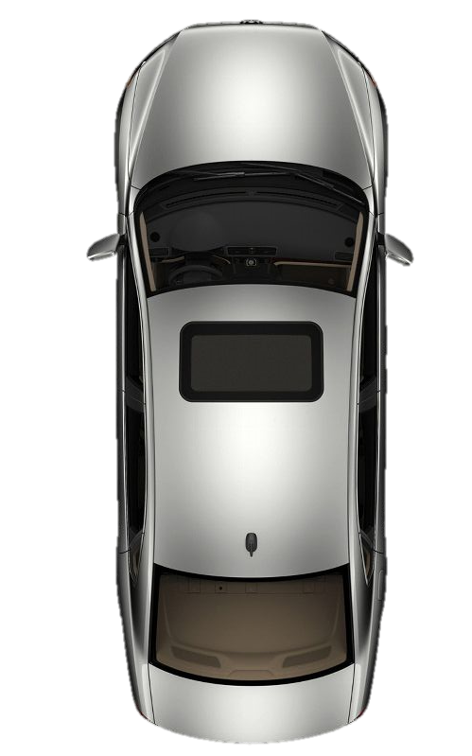



$$p_{2}=(−1, 3)$$
헤딩 각
$$θ$$
(0, 0)
$$p_{1}=(1, 0)$$

Slide 2









헤딩 각
$$v_{1}× v_{2}$$
$$θ$$
헤딩 각
$${|v}_{1}× v_{2}|=\left|v_{1}\right|\left|v_{2}\right|\sin{θ}$$
$$θ$$
$$θ$$
$$v_{1}$$
$$v_{2}$$
헤딩 각
$$θ$$
헤딩 각
$$θ$$

