Slide 1










=
+
-
A
B
Intersection
Union
$${max⁡_y}_{2}$$
<
$${max⁡_y}_{1}$$
y$length$
$$x length$$
$${min⁡_y}_{2}$$
<
<
<
$${min⁡_y}_{1}$$
$${min⁡_x}_{1}$$
$${min⁡_x}_{2}$$
$${max⁡_x}_{1}$$
$${max⁡_x}_{2}$$

Slide 2
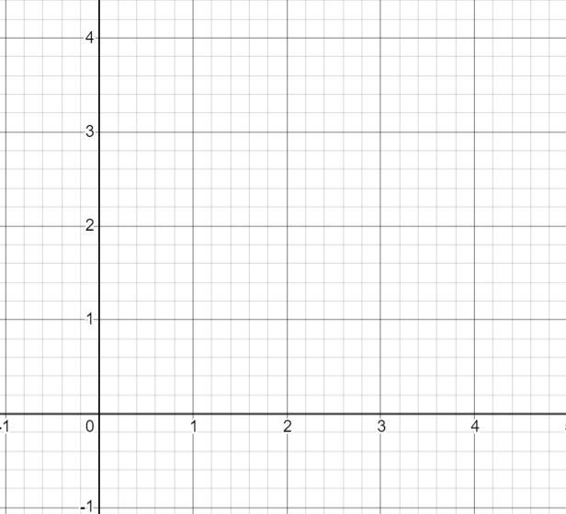

$${min⁡_x}_{1}$$
$${max⁡_x}_{1}$$
$${min⁡_x}_{2}$$
$${max⁡_x}_{2}$$
$x length$ < 0

Slide 3
1
3
5
4
2

Slide 4
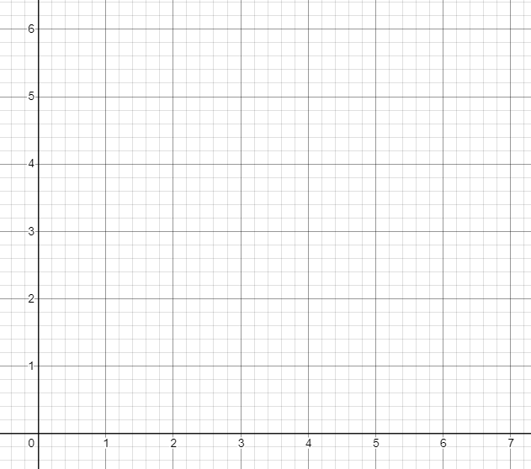

Slide 5
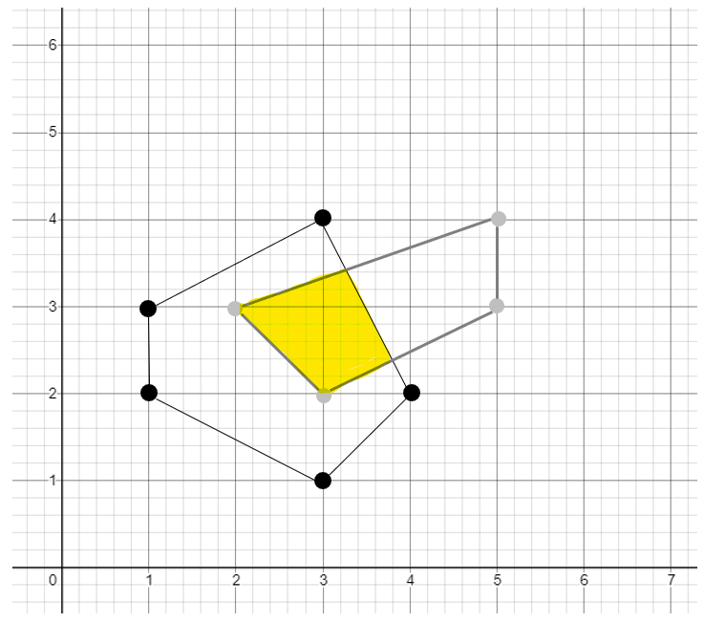

Slide 6
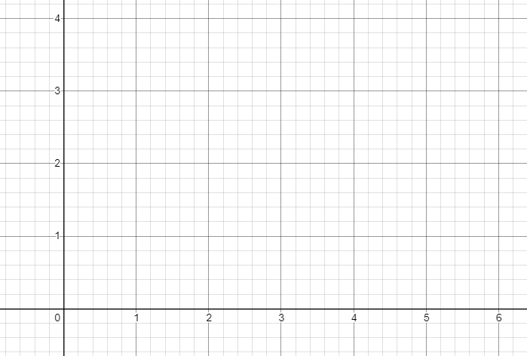
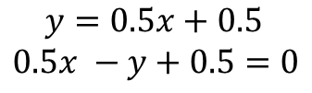
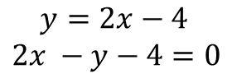
$$y=2x−4$$
$2x −y−4=0$
$$y=0.5x+0.5$$
$0.5x −y+0.5=0$

