Slide 1
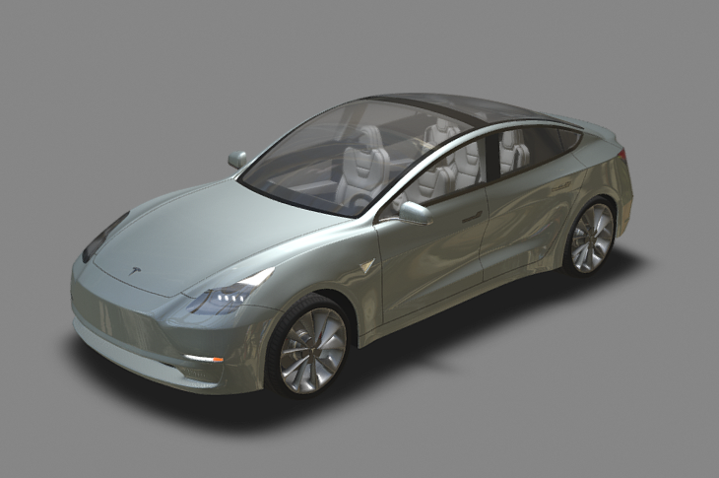
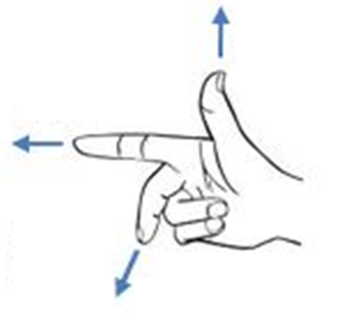
Z / Vertical / Yaw
z축
x축
y축
Y / Lateral / Pitch
X / Longitudinal / Roll

Slide 2
