Slide 1
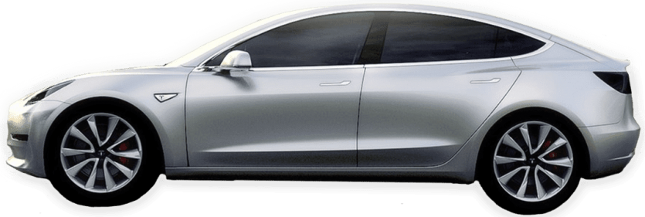

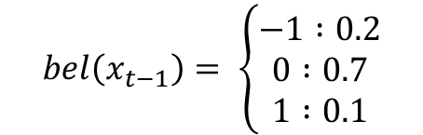
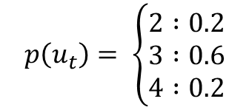


t 시간에서 차의 위치 확률 분포
$$bel\left(x_{t−1}\right)= \left\{\begin{aligned}−1 :0.2 \\ 0 :0.7 \\ 1 :0.1\end{aligned}\right.$$
$$p\left(u_{t}\right)= \left\{\begin{aligned}2 :0.2 \\ 3 :0.6 \\ 4 :0.2\end{aligned}\right.$$
-1 | 0 | 1 | 2 | 3 | 4 | 5
$$bel\left(x_{t−1}=−1\right)$$
$$=0.2$$
$$bel\left(x_{t−1}=0\right)$$
$$=0.7$$
$$bel\left(x_{t−1}=1\right)$$
$$=0.1$$

Slide 2


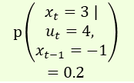
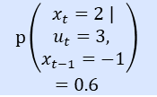
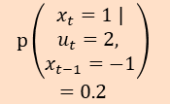


$p\left(x_{t}\right)$ 상태에서 제어값 $u_{t}=+3$이 입력되었을 때, 노이즈의 확률 분포는 다음과 같습니다.
$bel\left(x_{t−1}=−1\right)p\left(x_{t}=1 |u_{t}=2, x_{t−1}=−1 \right)=0.2×0.2=0.04 ⋯ (1)$
$$bel\left(x_{t−1}=−1\right)p\left(x_{t}=2 |u_{t}, =3, x_{t−1}=−1 \right)=0.2×0.6=0.12 ⋯ (2)$$
$$bel\left(x_{t−1}=−1\right)p\left(x_{t}=3 |u_{t}=4, x_{t−1}=−1 \right)=0.2×0.2=0.04 ⋯ (3)$$
$이$ 때, bel(x_t)의 각 상태에서 이동할 수 있는 +3 만큼 이동할 수 있는 경우는 다음과 같으며 각 위치에서의 확률 분포는 아래와 같이 계산될 수 있습니다.
-1 | 0 | 1 | 2 | 3 | 4 | 5
$$bel\left(x_{t−1}=−1\right)$$
$$=0.2$$
$$\left(1\right)$$
$$0.2 ×0.2=0.04$$
$$\left(2\right)$$
$$0.2 ×0.6=0.12$$
$$\left(3\right)$$
$$0.2 ×0.2=0.04$$
$$p\left(\begin{aligned}\begin{aligned}x_{t}=1 | \\ u_{t}=2, \end{aligned} \\ x_{t−1}=−1\end{aligned}\right)$$
$$=0.2$$
$$p\left(\begin{aligned}\begin{aligned}x_{t}=2 | \\ u_{t}=3, \end{aligned} \\ x_{t−1}=−1\end{aligned}\right)$$
$$=0.6$$
$$p\left(\begin{aligned}\begin{aligned}x_{t}=3 | \\ u_{t}=4, \end{aligned} \\ x_{t−1}=−1\end{aligned}\right)$$
$$=0.2$$

Slide 3
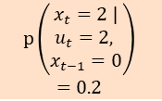




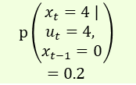
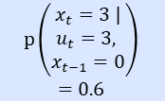
$bel\left(x_{t−1}=0\right)p\left(x_{t}=2 |u_{t}=2, x_{t−1}=0 \right)=0.7×0.2=0.14 ⋯ (4)$
$$bel\left(x_{t−1}=0\right)p\left(x_{t}=3 |u_{t}, =3, x_{t−1}=0 \right)=0.7×0.6=0.42 ⋯ (5)$$
$$bel\left(x_{t−1}=0\right)p\left(x_{t}=4 |u_{t}=4, x_{t−1}=0 \right)=0.7×0.2=0.14 ⋯ (6)$$
-1 | 0 | 1 | 2 | 3 | 4 | 5
$$bel\left(x_{t−1}=−1\right)$$
$$=0.7$$
$$\left(4\right)$$
$$0.7 ×0.2=0.14$$
$$\left(5\right)$$
$$0.7 ×0.6=0.42$$
$$\left(6\right)$$
$$0.7 ×0.2=0.14$$
$$p\left(\begin{aligned}\begin{aligned}x_{t}=2 | \\ u_{t}=2, \end{aligned} \\ x_{t−1}=0\end{aligned}\right)$$
$$=0.2$$
$$p\left(\begin{aligned}\begin{aligned}x_{t}=3 | \\ u_{t}=3, \end{aligned} \\ x_{t−1}=0\end{aligned}\right)$$
$$=0.6$$
$$p\left(\begin{aligned}\begin{aligned}x_{t}=4 | \\ u_{t}=4, \end{aligned} \\ x_{t−1}=0\end{aligned}\right)$$
$$=0.2$$

Slide 4
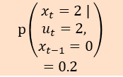




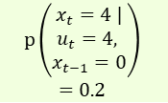
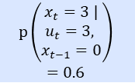
$bel\left(x_{t−1}=1\right)p\left(x_{t}=3 |u_{t}=2, x_{t−1}=1 \right)=0.1×0.2=0.02 ⋯ (7)$
$$bel\left(x_{t−1}=1\right)p\left(x_{t}=4 |u_{t}, =3, x_{t−1}=1 \right)=0.1×0.6=0.06 ⋯ (8)$$
$$bel\left(x_{t−1}=1\right)p\left(x_{t}=5 |u_{t}=4, x_{t−1}=1 \right)=0.1×0.2=0.02 ⋯ (9)$$
-1 | 0 | 1 | 2 | 3 | 4 | 5
$$bel\left(x_{t−1}=−1\right)$$
$$=0.1$$
$$\left(7\right)$$
$$0.1 ×0.2=0.02$$
$$\left(8\right)$$
$$0.1 ×0.6=0.06$$
$$\left(9\right)$$
$$0.1 ×0.2=0.02$$
$$p\left(\begin{aligned}\begin{aligned}x_{t}=2 | \\ u_{t}=2, \end{aligned} \\ x_{t−1}=0\end{aligned}\right)$$
$$=0.2$$
$$p\left(\begin{aligned}\begin{aligned}x_{t}=3 | \\ u_{t}=3, \end{aligned} \\ x_{t−1}=0\end{aligned}\right)$$
$$=0.6$$
$$p\left(\begin{aligned}\begin{aligned}x_{t}=4 | \\ u_{t}=4, \end{aligned} \\ x_{t−1}=0\end{aligned}\right)$$
$$=0.2$$

Slide 5








-1 | 0 | 1 | 2 | 3 | 4 | 5
$$p\left(x_{t+1}=4\right)=0.7×0.2=0.14$$
$$\overline{bel}\left(x_{t}=1\right)$$
$$=0.04$$
$$\overline{bel}\left(x_{t}=2\right)$$
$$=0.26$$
$$\overline{bel}\left(x_{t}=3\right)$$
$$=0.48$$
$$\overline{bel}\left(x_{t}=4\right)$$
$$=0.20$$
$$\overline{bel}\left(x_{t}=5\right)$$
$$=0.02$$
$$\overline{bel}\left(x_{t}=1\right)=0.04$$
$$\overline{bel}\left(x_{t}=2\right)=0.12+0.14=0.26$$
$$\overline{bel}\left(x_{t}=3\right)=0.04+0.42+0.02=0.48$$
$$\overline{bel}\left(x_{t}=4\right)=0.14+0.06=0.20$$
$$\overline{bel}\left(x_{t}=5\right)=0.02$$
확$률의 합 : 0.04+0.26+0.48+0.20+0.02=1$

Slide 6
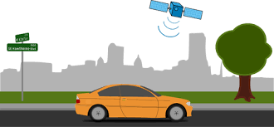
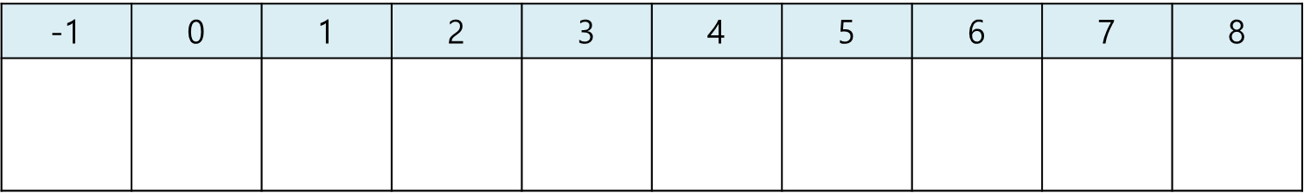




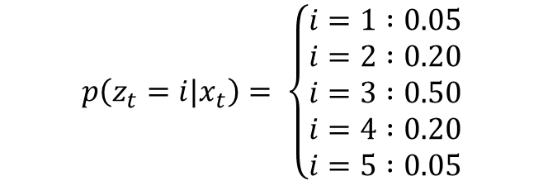

$$p\left(z_{t}=i|x_{t}\right)= \left\{\begin{aligned}i=1 :0.05 \\ i=2 :0.20 \\ i=3 :0.50 \\ i=4 :0.20 \\ i=5 :0.05\end{aligned}\right.$$
$$p\left(z_{t}=1\right| x_{t}) \overline{bel}\left(x_{t}=1\right)=0.05×0.04=0.002$$
$$p\left(z_{t}=2| x_{t}\right)\overline{ bel}\left(x_{t}=2\right)=0.20×0.26=0.052$$
$$p\left(z_{t}=3| x_{t}\right) \overline{bel}\left(x_{t}=3\right)=050×0.48=0.24$$
$$p\left(z_{t}=4| x_{t}\right)\overline{ bel}\left(x_{t}=4\right)=0.20×0.20=0.04$$
$$p\left(z_{t}=5| x_{t}\right) \overline{bel}\left(x_{t}=5\right)=0.05×0.02=0.001$$
$$p\left(x_{t+1}=1\right)$$
$$=0.04$$
$$p\left(x_{t+1}=2\right)$$
$$=0.26$$
$$p\left(x_{t+1}=3\right)$$
$$=0.48$$
$$p\left(x_{t+1}=4\right)$$
$$=0.20$$
$$p\left(x_{t+1}=5\right)$$
$$=0.02$$

Slide 7






-1 | 0 | 1 | 2 | 3 | 4 | 5
$$p\left(x_{t+1}=4\right)=0.7×0.2=0.14$$
$$bel\left(x_{t}=1\right)$$
$$=0.0059$$
$$bel\left(x_{t}=2\right)$$
$$=0.1552$$
$$bel\left(x_{t}=3\right)$$
$$=0.7164$$
$$bel\left(x_{t}=4\right)$$
$$=0.1194$$
$$bel\left(x_{t}=5\right)$$
$$=0.0029$$

Slide 8
