Slide 1
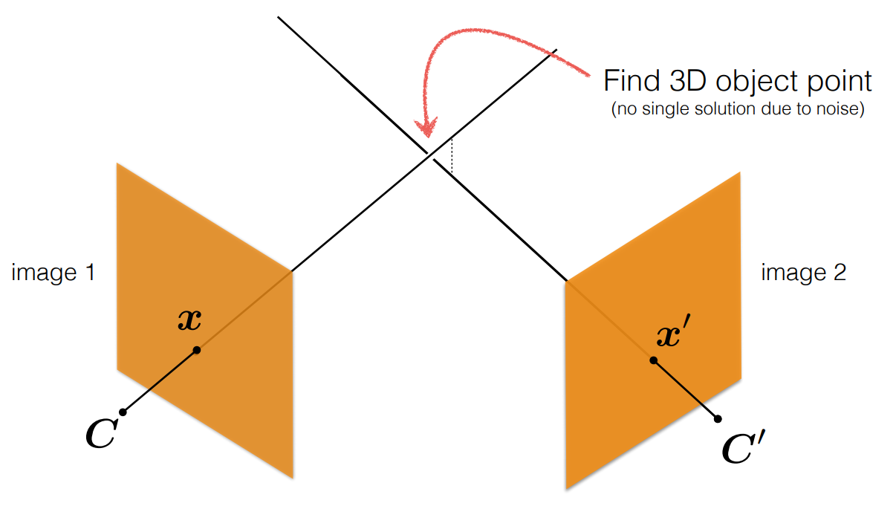
Estimate Unknown 3D Points
Known 2D Points
Known 2D Points
Known Camera Parameters
Known Camera Parameters

Slide 2
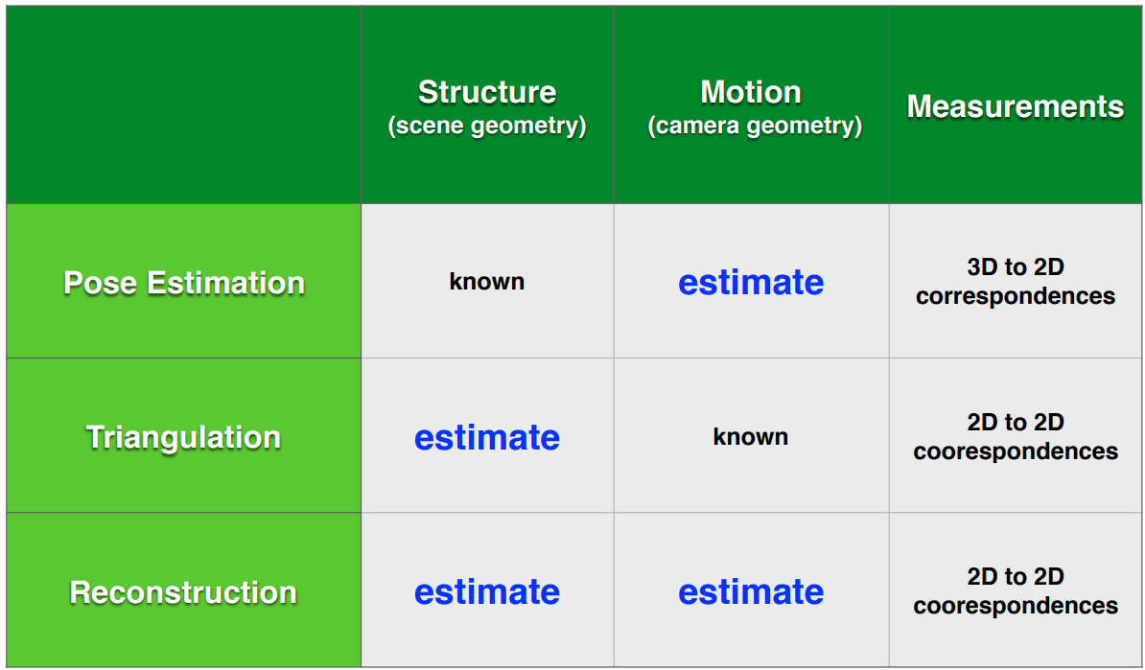

Slide 3
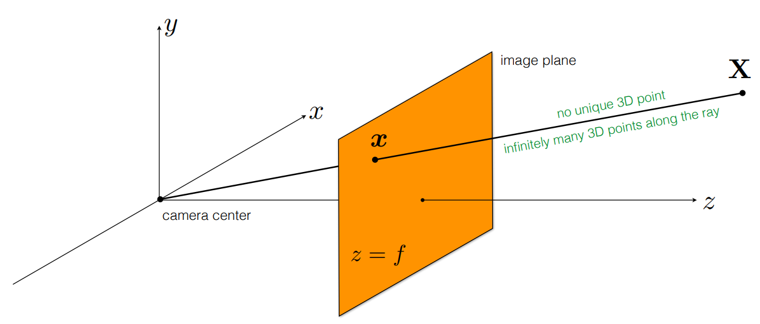

$$\text{scale}\text{: }α$$

