Slide 1
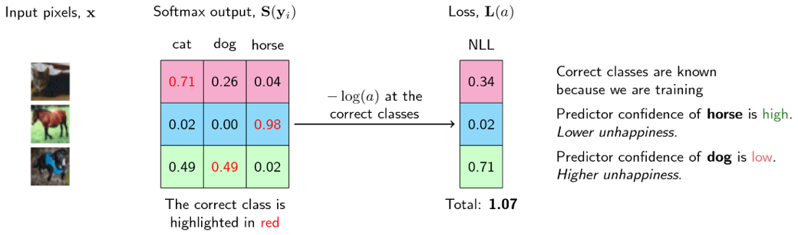
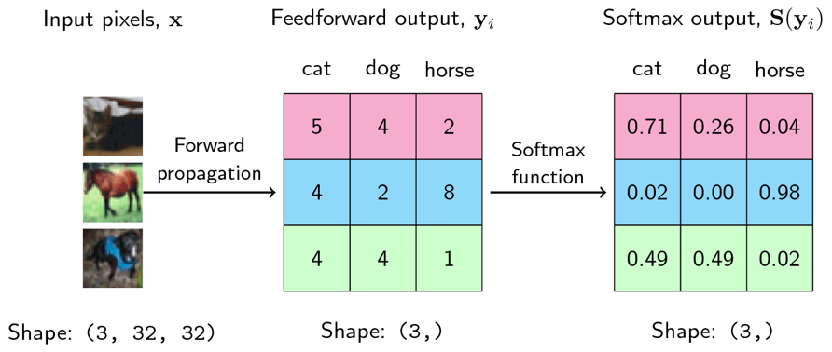
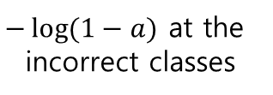
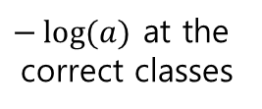
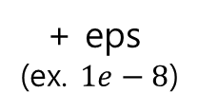
0.34 | 0.30 | 0.04
0.02 | 0.00 | 0.02
0.67 | 0.71 | 0.02
+ eps
+ eps
+ eps
$−\log{(a)}$ at the
correct classes
+ eps
(ex. $1e−8$)
+ eps
+ eps
+ eps
$−\log{(1−a)}$ at the
incorrect classes
+ eps
+ eps
+ eps
Mean : 0.24
Sum : 2.13

