Slide 1
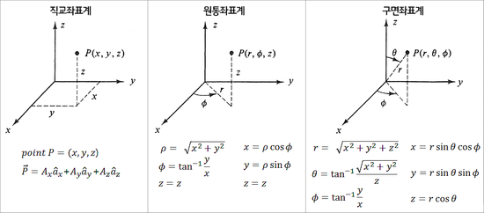
$$r$$
$$r$$
$$r$$
$$r$$
$$r$$
$$r$$
$$r$$
$$r$$
$$r$$

Slide 2
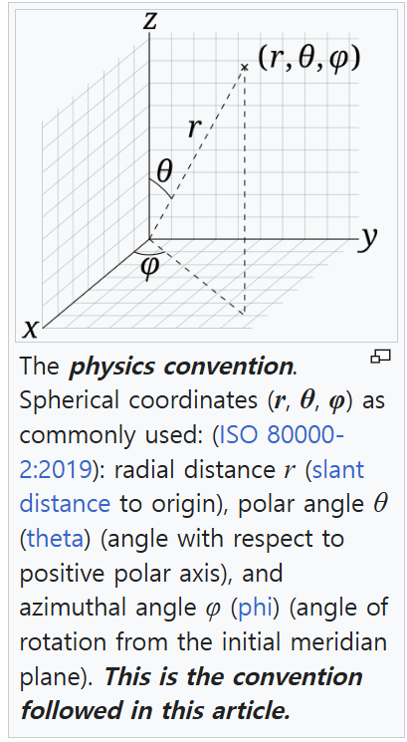
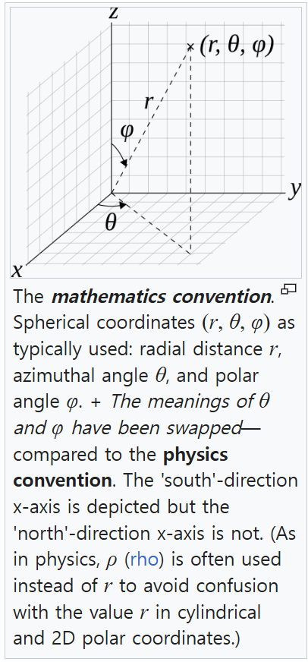

Slide 3
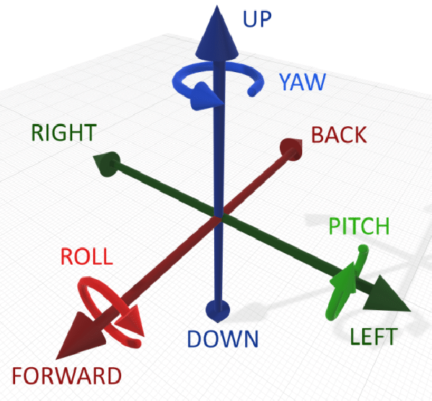
Z
Y
X

