Slide 1
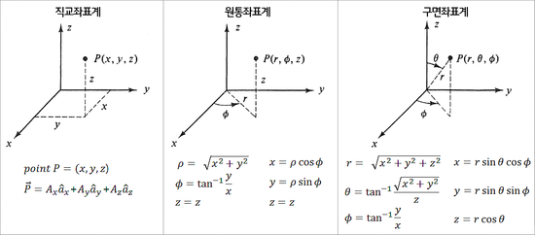
$$r$$
$$r$$
$$r$$
$$r$$
$$r$$
$$r$$
$$r$$
$$r$$
$$r$$

Slide 2
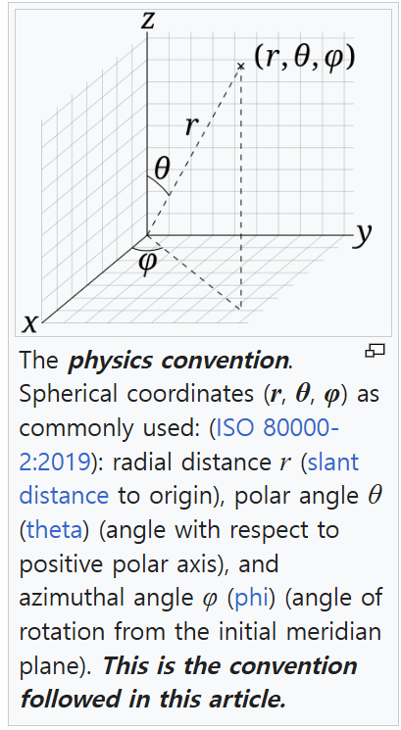
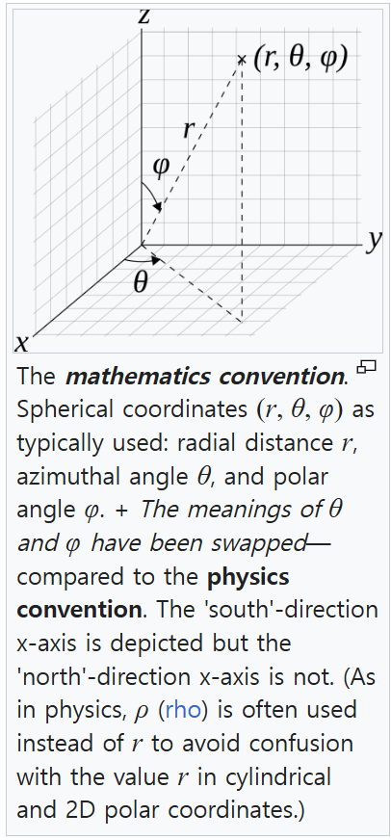

Slide 3




Yaw
Z
Y
Pitch
X
Roll
직교 좌표계
원통 좌표계
Yaw
Z
Yaw
Z
$$P(x, y, z)$$
$$P(r, φ, z)$$
z
Y
z
Y
Pitch
$$r$$
Pitch
x
X
X
$$ϕ$$
Roll
y
Roll

Slide 4





직교 좌표계
구면 좌표계
Yaw
Z
Yaw
Z
$$P(x, y, z)$$
$$P(r, θ, φ)$$
$$θ$$
$$r$$
z
Y
Y
Pitch
Pitch
x
X
X
$$ϕ$$
Roll
y
Roll
원통 좌표계
구면 좌표계
Yaw
Z
Yaw
Z
$$P(r, φ, z)$$
$$P(r, θ, φ)$$
$$θ$$
$$r$$
z
Y
Y
$$r$$
Pitch
Pitch
X
$$ϕ$$
X
$$ϕ$$
Roll
Roll

Slide 5


















직교 좌표계
원통 좌표계
Z
Z
Roll
Roll
$$r$$
X
$$ϕ$$
X
Pitch
Pitch
구면 좌표계
$$P(x, y, z)$$
$$P(r, φ, y)$$
Yaw
Z
$$P(r, θ, φ)$$
Y
Yaw
Y
Yaw
$$r$$
직교 좌표계
구면 좌표계
Y
Pitch
Z
Z
X
$$ϕ$$
Roll
Roll
Roll
X
$$ϕ$$
X
직교 좌표계
원통 좌표계
Pitch
$$θ$$
Pitch
$$P(x, y, z)$$
$$r$$
Yaw
Z
Yaw
Z
$$P(r, θ, φ)$$
$$P(x, y, z)$$
$$P(r, φ, z)$$
Y
Yaw
Y
Yaw
z
Y
z
Y
Pitch
$$r$$
Pitch
원통 좌표계
구면 좌표계
x
X
X
$$ϕ$$
Roll
y
Roll
Z
Z
Roll
Roll
$$r$$
$$ϕ$$
X
$$ϕ$$
X
Pitch
$$θ$$
Pitch
$$r$$
$$P(r, φ, y)$$
$$P(r, θ, φ)$$
Y
Yaw
Y
Yaw

