Slide 1










Principal Axis
$$Ray_{1}$$
$$Ray_{2}$$
$$θ_{2}$$
$$θ_{1}$$
Pinhole
$$f= focal length$$
$$θ_{1}$$
$$θ_{2}$$
$$p_{1}$$
$$p_{2}$$
$$r_{1}$$
$$r_{2}$$
Image Coordinate
$$r= f⋅tan{(θ)}$$

Slide 2
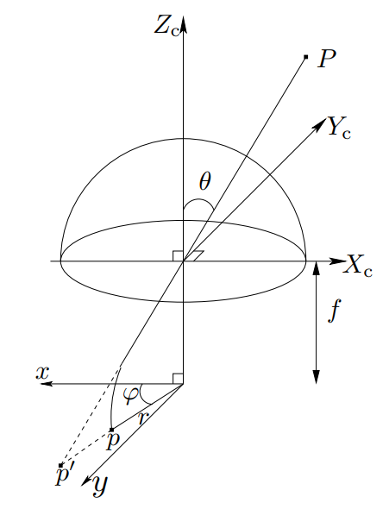













Principal Axis
$$Ray_{1}$$
$$Ray_{2}$$
$$θ_{2}$$
$$θ_{1}$$
Pinhole
$$f= focal length$$
$$p_{1}$$
$$p_{1}′$$
$$p_{2}$$
$$p_{2}′$$
$$r_{1}$$
$$r_{2}$$
(Distorted) Image Coordinate
$$\frac{θ_{1}}{r_{1}}=\frac{θ_{2}}{r_{2}}$$
$$r= f⋅{θ}$$

Slide 3
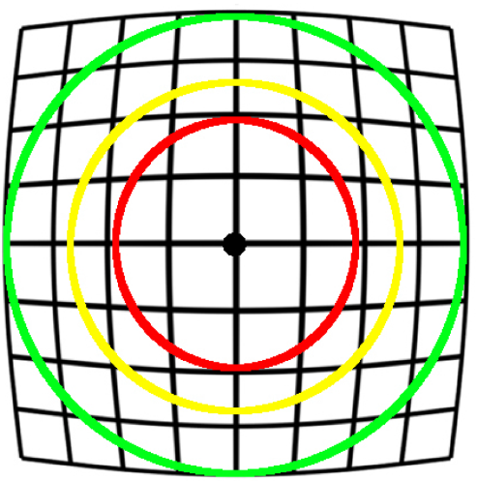



$$θ_{1}→r_{1}$$
$$θ_{2}→r_{2}$$
$$θ_{3}→r_{3}$$

Slide 4
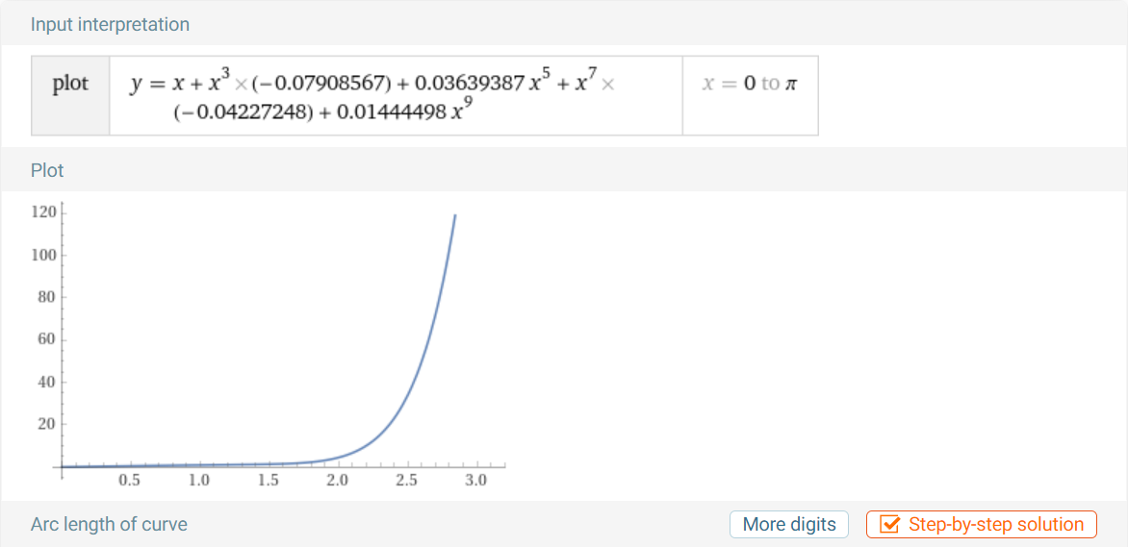

Slide 5
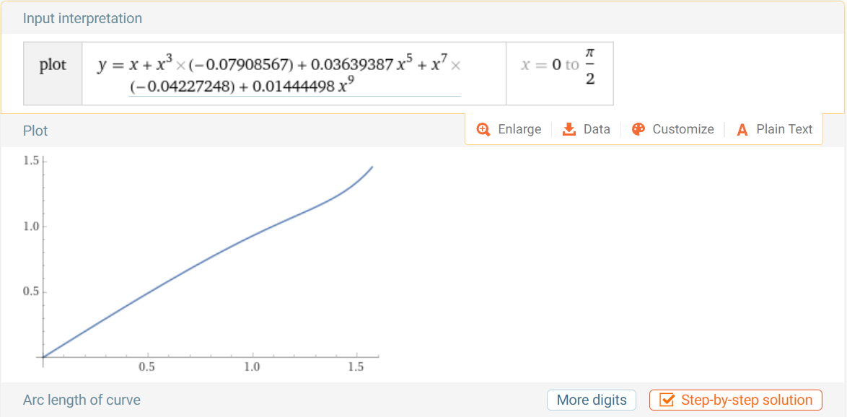

Slide 6





$$0°$$
$$30°$$
$$30°$$
$$45°$$
$$45°$$
$$90°$$
$$90°$$
$$100°$$
$$100°$$

Slide 7
