Slide 1
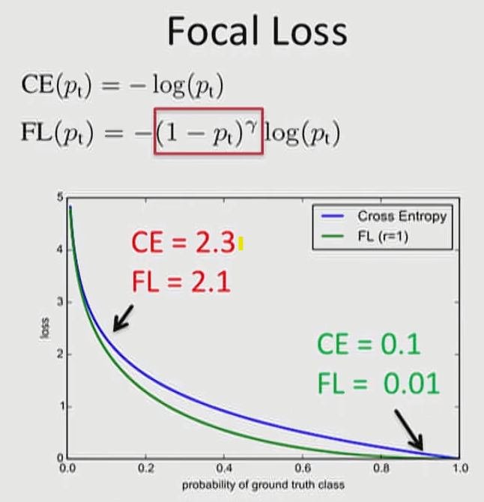
0.1
0.9

Slide 2
Element-Wise
Multiplication
X
=
(5)
(C, H, W) = (5, 3, 3)
(C, H, W) = (5, 3, 3)

Slide 3
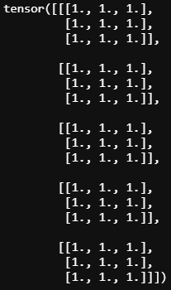
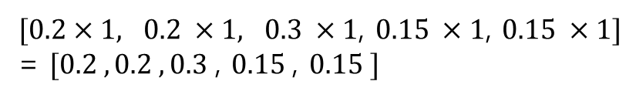
$[0.2×1, 0.2 ×1, 0.3 ×1$, $0.15 ×1$, $0.15 ×1]$
= $[0.2 , 0.2 , 0.3$, $0.15$, $0.15 ]$

Slide 4


