Slide 1
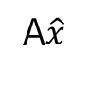
M
A
b
b – Ax = e
N
A$\hat{x}$
①
Ax
②
③
col(A) = M

