Slide 1












$$v$$
$$u$$
image plane
$$p_{image}$$
normalized
image plane
$$p_{norm_image}$$
$$y$$
$$x$$
$$Z_{c}$$
Camera
Coordinate
$$p_{c}$$
$$Y_{c}$$
$$X_{c}$$
$$u=f_{x} ∗x+c_{x}$$
$$v=f_{y} ∗y+c_{y}$$

Slide 2














$$crop_{cx}$$
$$crop_{cy}$$
image plane
$$v$$
$$u$$
$$p_{image}$$
normalized
image plane
$$p_{norm_image}$$
$$y$$
$$x$$
$$Z_{c}$$
Camera
Coordinate
$$p_{c}$$
$$Y_{c}$$
$$X_{c}$$
$$u=f_{x} ∗x+(c_{x} −crop_{cx})$$
$$v=f_{y} ∗y+{(c}_{y} −crop_{cy})$$

Slide 3












$$v$$
$$u$$
image plane
$$p_{image}$$
normalized
image plane
$$p_{norm_image}$$
이미지 끝 crop은
좌표계 이동과 무관함
$$y$$
$$x$$
$$Z_{c}$$
Camera
Coordinate
$$p_{c}$$
$$Y_{c}$$
$$X_{c}$$
$$u=f_{x} ∗x+c_{x}$$
$$v=f_{y} ∗y+c_{y}$$

Slide 4














$${resize}_{x}$$
$$resize_{y}$$
image plane
$$v$$
$$u$$
$$p_{image}$$
$${resize}_{x}$$
normalized
image plane
$$p_{norm_image}$$
$$resize_{y}$$
$$y$$
$$x$$
$$Z_{c}$$
Camera
Coordinate
$$p_{c}$$
$$Y_{c}$$
$$X_{c}$$
$$u={resize}_{x} ∗\left(f_{x} ∗x+c_{x}\right)={{resize}_{x}f}_{x} ∗x+{{resize}_{x}c}_{x}$$
$$v={resize}_{y}∗\left(f_{y} ∗y+c_{y}\right)={resize}_{y}f_{y} ∗y+{{resize}_{y}c}_{y}$$

Slide 5





$$u$$
$$v$$
$$u$$
$$p_{image}$$
$$p_{image}$$
Crop 미적용
Crop 적용

Slide 6


$$θ_{f}$$
$$θ_{2f}$$
f
2 * f
Image plane
Image plane

Slide 7









image plane
$$v$$
$$u$$
$$p_{\text{image}}$$
$$f$$
normalized
image plane
$$p_{\text{norm}\text{_}\text{image}}$$
$$f=1$$
$$y$$
$$x$$
$$Z_{c}$$
Camera
Coordinate
$$p_{c}=(X_{c}, Y_{c}, Z_{c})$$
$$Y_{c}$$
$$X_{c}$$
$$x=\frac{X_{c}}{Z_{c}}$$
$$y=\frac{Y_{c}}{Z_{c}}$$
$$u=α ∗x+x_{0}$$
$$v=β ∗y+y_{0}$$

Slide 8
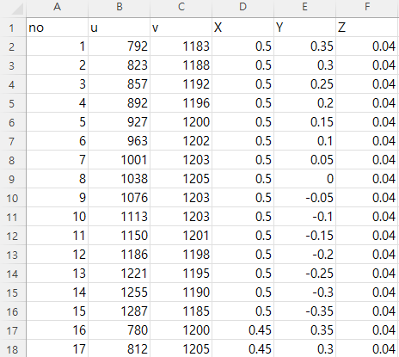
X, Y, Z 는 원점을 기준으로 체커보드 패턴을 이용하여 계산함
manual_checkboard_points_extractor.py 로 추출함

