Slide 1

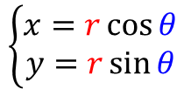




$$\left\{\begin{aligned}x=r\cos{θ} \\ y=r\sin{θ}\end{aligned}\right.$$
$$(x,y)$$
$$r$$
$$r\sin{θ}$$
$$θ$$
$$r\cos{θ}$$

