Slide 1
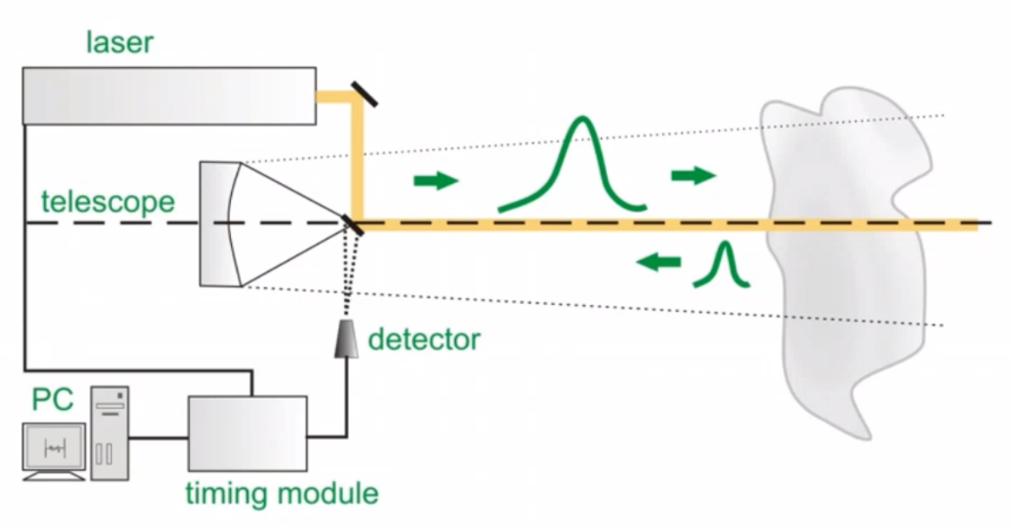
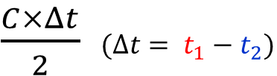


③
④
⑥
⑤
⑧
⑦
⑨
①
$$t_{1}$$
$$t_{2}$$
$\frac{C×Δt}{2}$ $(Δt= t_{1}−t_{2})$
②
⑩

Slide 2
