Slide 1
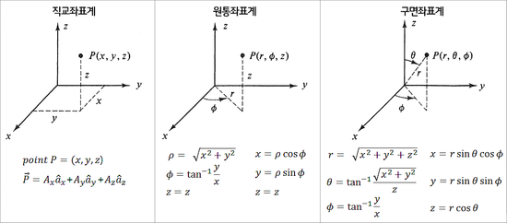
$$r$$
$$r$$
$$r$$
$$r$$
$$r$$
$$r$$
$$r$$
$$r$$
$$r$$

Slide 2
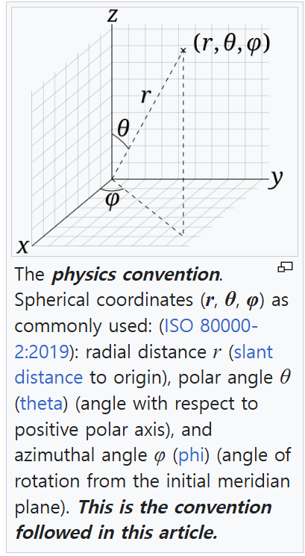
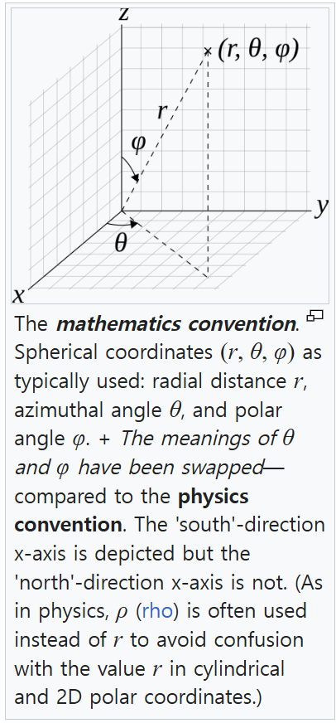

Slide 3




Yaw
Z
Y
Pitch
X
Roll
직교 좌표계
원통 좌표계
Yaw
Z
Yaw
Z
$$P(x, y, z)$$
$$P(r, φ, z)$$
z
Y
z
Y
Pitch
$$r$$
Pitch
x
X
X
$$ϕ$$
Roll
y
Roll

Slide 4


$$r$$
$$r$$
$$r$$
직교 좌표계
구면 좌표계
Yaw
Z
Yaw
Z
$$P(x, y, z)$$
$$P(r, θ, φ)$$
$$r$$
z
Y
Y
Pitch
Pitch
x
X
X
$$ϕ$$
Roll
y
Roll

Slide 5




직교 좌표계
구면 좌표계
Yaw
Z
Yaw
Z
$$P(x, y, z)$$
$$P(r, θ, φ)$$
$$r$$
z
Y
Y
Pitch
Pitch
x
X
X
$$ϕ$$
Roll
y
Roll
원통 좌표계
구면 좌표계
Yaw
Z
Yaw
Z
$$P(r, φ, z)$$
$$P(r, θ, φ)$$
$$r$$
z
Y
Y
$$r$$
Pitch
Pitch
X
$$ϕ$$
X
$$ϕ$$
Roll
Roll

Slide 6
Z
Roll
X
Pitch
Y
Yaw

