Slide 1
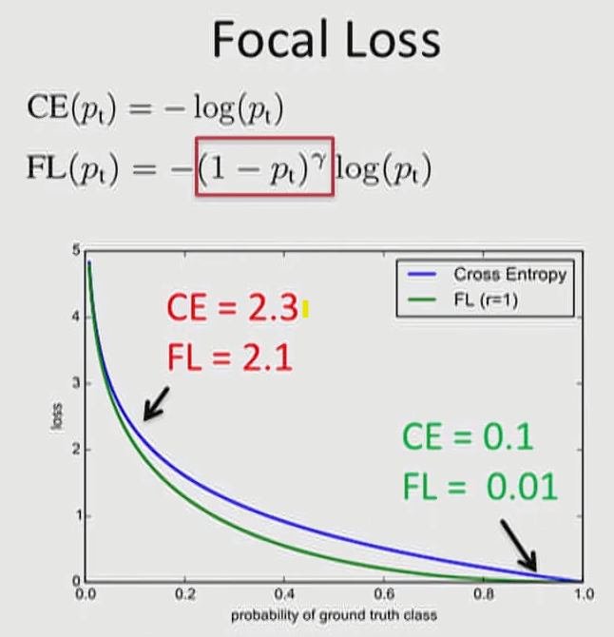
0.1
0.9

Slide 2
Element-Wise
Multiplication
X
=
(C, H, W) = (5, 1, 1)
(C, H, W) = (5, 3, 3)
(C, H, W) = (5, 3, 3)

Slide 3
