Slide 1



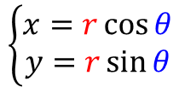






$$\left\{\begin{aligned}x=r\cos{θ} \\ y=r\sin{θ}\end{aligned}\right.$$
$$(x,y)$$
$$(x,y)$$
$$r$$
$$r\sin{θ}$$
$$θ$$
$$r\cos{θ}$$
$$ds= dr⋅(r⋅dθ)$$
$$dr$$
$$dθ$$
$$r⋅dθ$$
$$r$$
$$r= \int_{0}^{r}{dr}$$

