Slide 1
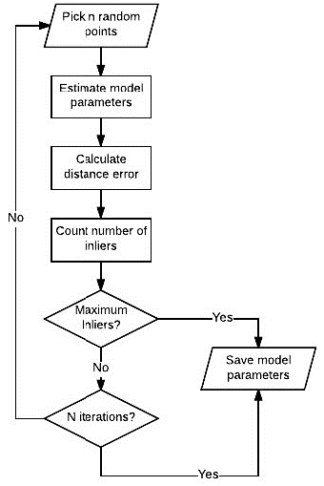

Slide 2
n Random sampling
Estimate model
parameters
Count number of
inliers
No
Maximum
Inliers ?
Yes
n Random sampling
within inliers
Pick inliers
Fit model
within inliers
M recursive iterations
After M recursive iterations
Count number of inliers
No
Maximum
Inliers ?
Yes
Save model
parameters
Local optimization with inliers
No
Maximum
Inliers ?
Yes
Save model
parameters
No
N iterations ?
Yes
Save model parameters

Slide 3


$$\text{inlier} \text{data}$$
$$\text{o}\text{utlier} \text{data}$$

Slide 4


$$\text{threshold}\text{ = }| y −y_{pred} |$$
$$\text{Assume} \text{threshold}\text{ = 1}$$

Slide 5


$$\text{\#}\text{inlier}\text{ : 7, }\text{ratio}\text{ : 29.2 \%}$$
$$\text{Assume} \text{threshold}\text{ = 1}$$

Slide 6

$$\text{\#}\text{inlier}\text{ : 6, }\text{ratio}\text{ : 25 \%}$$

Slide 7

$$\text{\#}\text{inlier}\text{ : 10, }\text{ratio}\text{ : 41.7 \%}$$

Slide 8

$$\text{\#}\text{inlier}\text{ : 16, }\text{ratio}\text{ : 66.7 \%}$$

