Slide 1
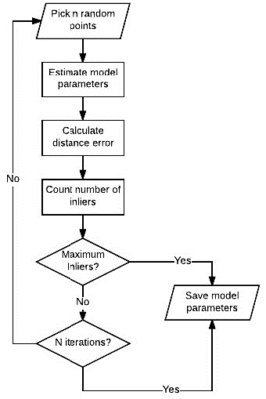

Slide 2
① n Random sampling
② Estimate model
parameters
③ Count number of
inliers
Pick inliers
No
④ Maximum
Inliers ?
M recursive iterations
Yes
After M recursive iterations
⑤ n Random sampling
within inliers
⑥ Fit model
within inliers
⑦ Count number of inliers
No
⑧ Maximum
Inliers ?
Yes
⑨ Save model
parameters
⑩ Local optimization with inliers
No
⑪ Maximum
Inliers ?
Yes
⑫ Save model
parameters
No
⑬ N iterations ?
Yes
⑭ Save model parameters

Slide 3


$$\text{inlier} \text{data}$$
$$\text{o}\text{utlier} \text{data}$$

Slide 4


$$\text{threshold}\text{ = }| y −y_{pred} |$$
$$\text{Assume} \text{threshold}\text{ = 1}$$

Slide 5


$$\text{\#}\text{inlier}\text{ : 7, }\text{ratio}\text{ : 29.2 \%}$$
$$\text{Assume} \text{threshold}\text{ = 1}$$

Slide 6

$$\text{\#}\text{inlier}\text{ : 6, }\text{ratio}\text{ : 25 \%}$$

Slide 7

$$\text{\#}\text{inlier}\text{ : 10, }\text{ratio}\text{ : 41.7 \%}$$

Slide 8

$$\text{\#}\text{inlier}\text{ : 16, }\text{ratio}\text{ : 66.7 \%}$$

Slide 9
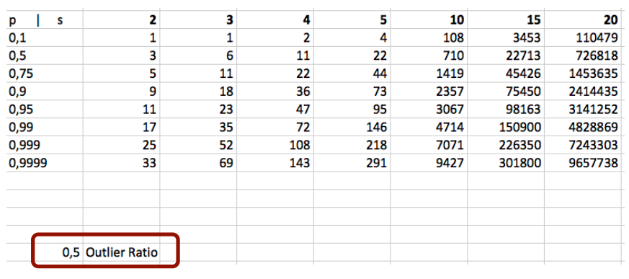
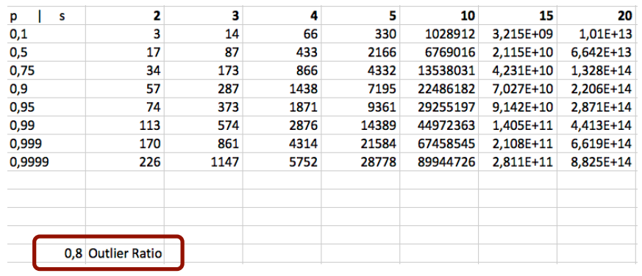

Slide 10
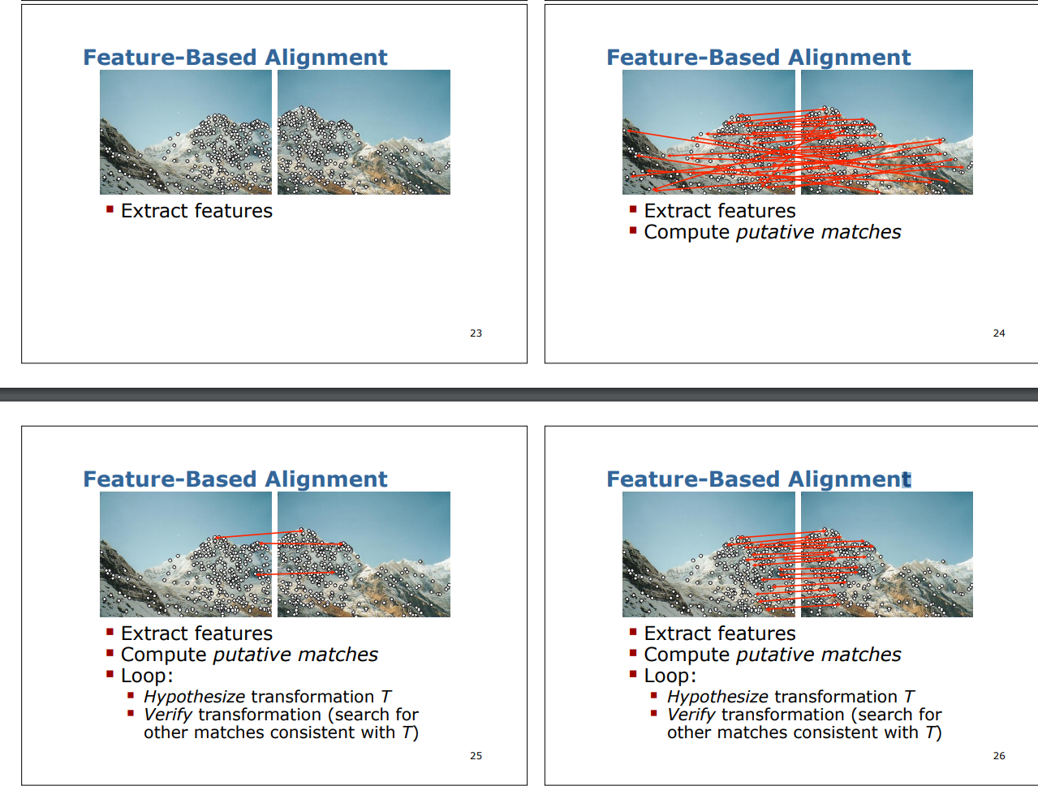
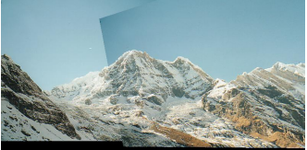

Slide 11
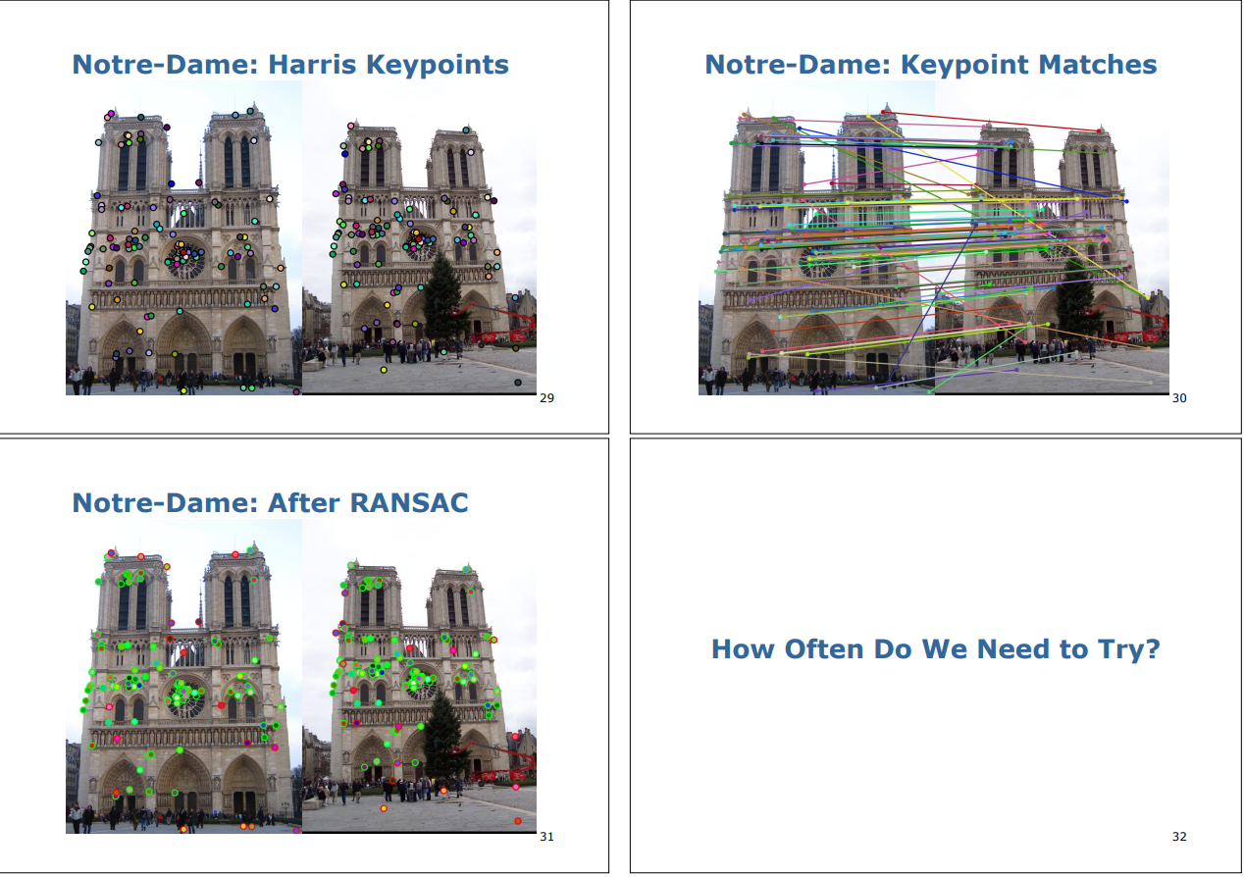
Feature Point 추출
Feature Matching
Inlier(초록색) / Outlier (빨간색) 분리

