Slide 1
NO | 대분류 | 소분류 | 내용 | 수식 | 비고
1 | Gradient Descent | Gradient Descent
2 |  | SGD
3 |  | Momentum
4 |  | RMSProp
5 |  | Adam
6 | Newton Method | Newton Method
7 |  | Gauss-Newton Method
8 |  | Levenberg-Marquardt Method
9 |  | Quasi Newton Method
10 | Constrained Optimization | Lagrange Multiplier

Slide 2
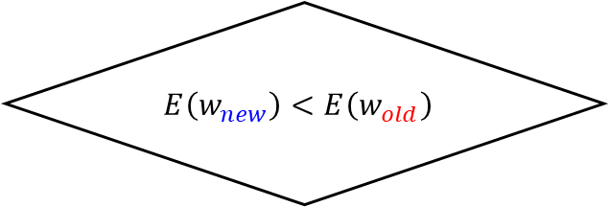
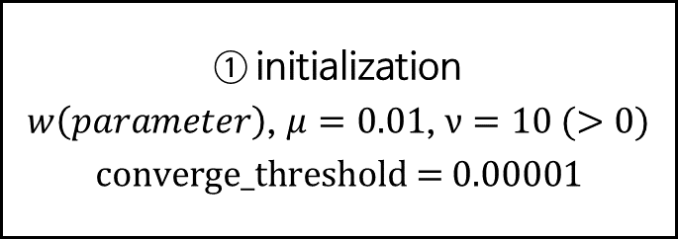
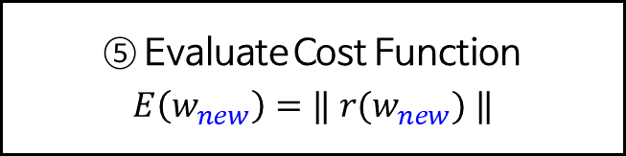
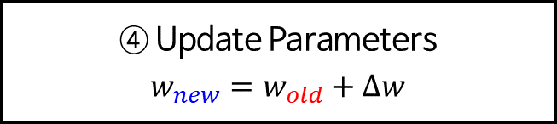
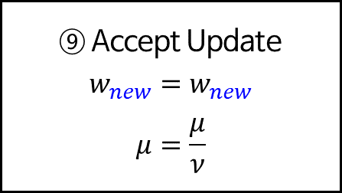
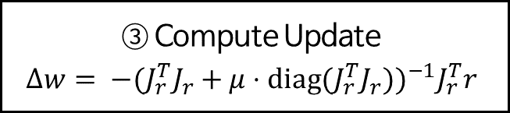
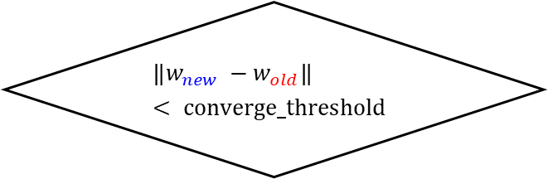
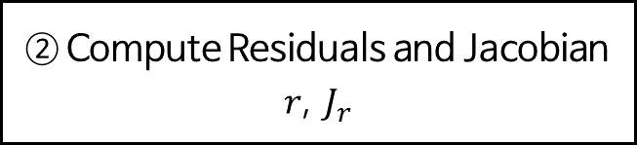
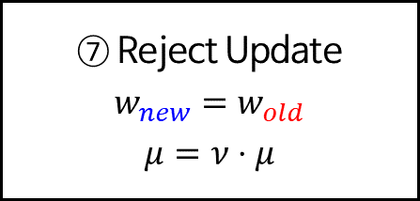
Levenberg-Marquardt Method
Start
① initialization
$w\left(parameter\right)$, $μ=0.01$, $ν=10 (>0)$
$$\text{converge}\text{_}\text{threshold}\text{ = 0.00001}$$
② Compute Residuals and Jacobian
$r$, $J_{r}$
③ Compute Update
$$Δw= {−(J_{r}^{T}J_{r}+μ⋅\text{diag}\text{(}J_{r}^{T}J_{r}))}^{−1}J_{r}^{T}r$$
④ Update Parameters
$$w_{new}=w_{old}+Δw$$
⑤ Evaluate Cost Function
$$E\left(w_{new}\right)=‖ r(w_{new}) ‖$$
⑦ Reject Update
$$w_{new}=w_{old}$$
$$μ=ν⋅μ$$
$$E\left(w_{new}\right)<E\left(w_{old}\right)$$
No
⑥
Yes
⑨ Accept Update
$$w_{new}=w_{new}$$
$$μ=\frac{μ}{ν}$$
$${‖w}_{new} −w_{old}‖< \text{converge}\text{_}\text{threshold}$$
No
⑧
Yes
Stop

Slide 3
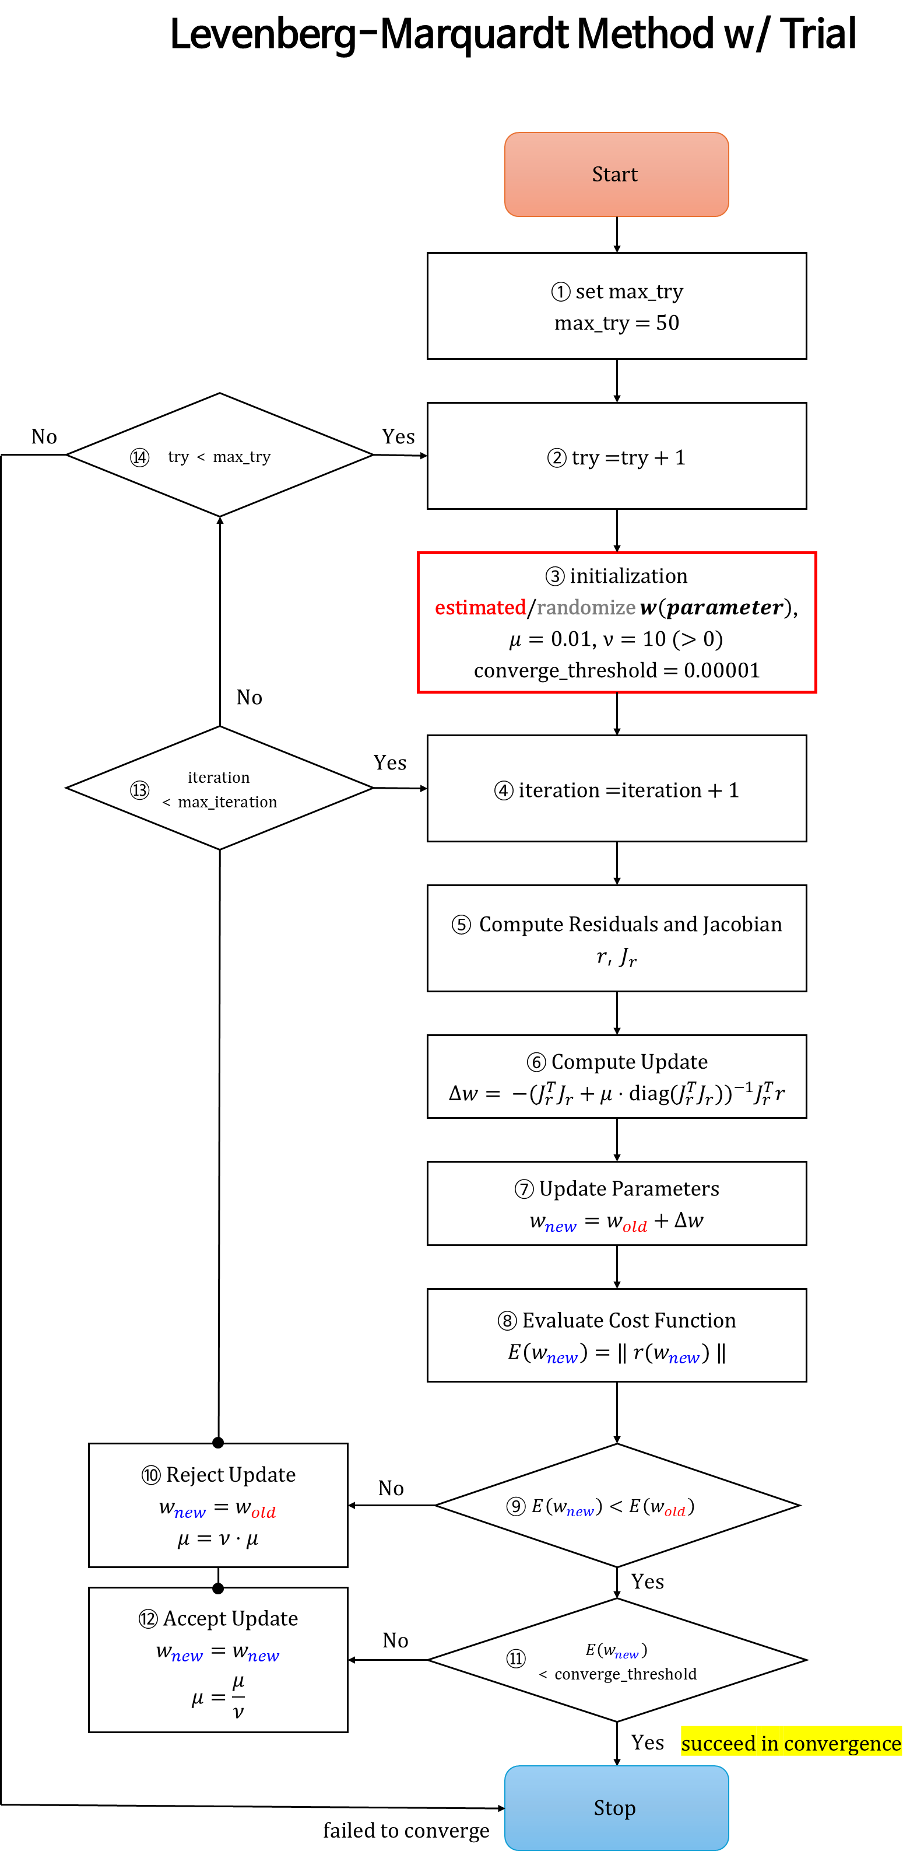
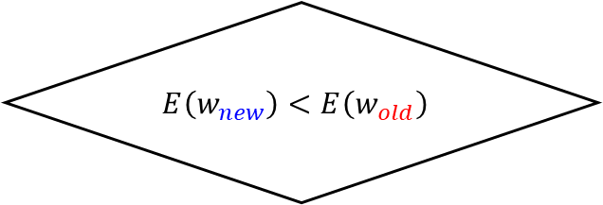

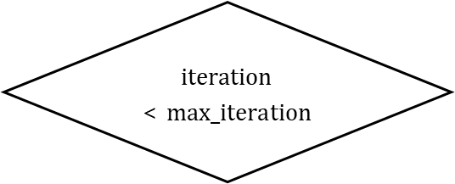

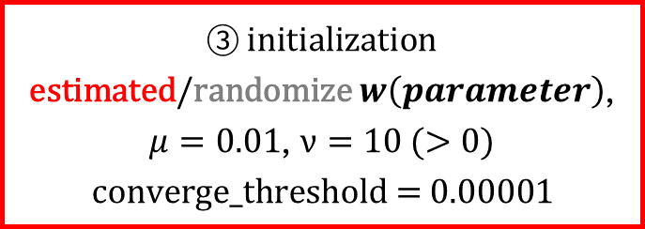
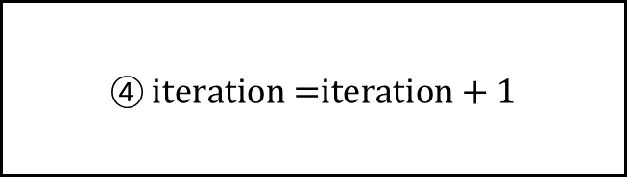
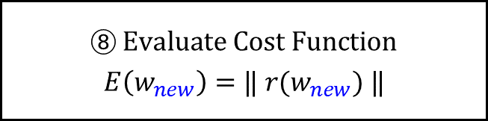






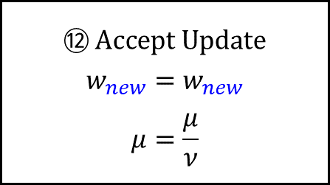

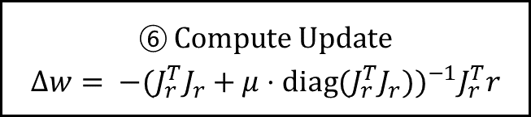



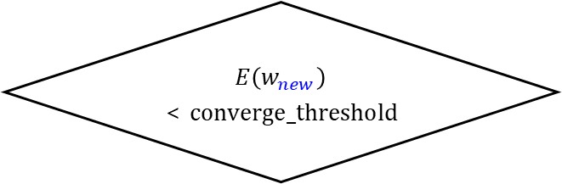
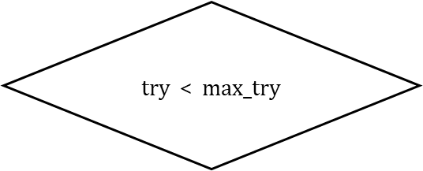
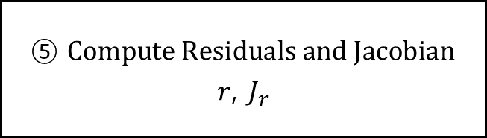
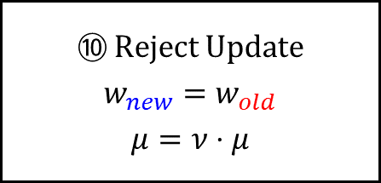



Levenberg-Marquardt Method w/ Trial
$$\text{Start}$$
① $\text{set} \text{max}\text{_}\text{try}$
$$\text{max}\text{_}\text{try}\text{ = 50}$$
$\text{try}$ < $\text{max}\text{_}\text{try}$
② $\text{t}\text{ry}\text{ =}\text{try}\text{ + 1}$
$$\text{No}$$
$$\text{Yes}$$
⑭
③ $\text{initialization}$
$\text{estimated}\text{/}\text{randomize} w\left(parameter\right)$, $μ=0.01$, $ν=10 (>0)$
$$\text{converge}\text{_}\text{threshold}\text{ = 0.00001}$$
$$\text{No}$$
$\text{iteration}$ < $\text{max}\text{_}\text{iteration}$
④ $\text{iteration}\text{ =}\text{iteration}\text{ + 1}$
$$\text{Yes}$$
⑬
⑤ $\text{Compute} \text{Residuals} \text{and} \text{Jacobian}$
$r$, $J_{r}$
⑥ $\text{Compute} \text{Update}$
$$Δw= {−(J_{r}^{T}J_{r}+μ⋅\text{diag}\text{(}J_{r}^{T}J_{r}))}^{−1}J_{r}^{T}r$$
⑦ $\text{Update} \text{Parameters}$
$$w_{new}=w_{old}+Δw$$
⑧ $\text{Evaluate} \text{Cost} \text{Function}$
$$E\left(w_{new}\right)=‖ r(w_{new}) ‖$$
⑩ $\text{Reject} \text{Update}$
$$w_{new}=w_{old}$$
$$μ=ν⋅μ$$
$$E\left(w_{new}\right)<E\left(w_{old}\right)$$
$$\text{No}$$
⑨
$$\text{Yes}$$
⑫ $\text{Accept} \text{Update}$
$$w_{new}=w_{new}$$
$$μ=\frac{μ}{ν}$$
$E\left(w_{new}\right)$ < $\text{converge}\text{_}\text{threshold}$
$$\text{No}$$
⑪
$$\text{Yes}$$
$$\text{succeed} \text{in} \text{convergence}$$
$$\text{Stop}$$
$$\text{failed} \text{to} \text{converge}$$

